Slide 1
Dynamic Soil-Structure-Interaction
By: M. Iman Khodakarami (Associate Prof. of Earthquake Eng.)
Email: Khodakarami@semnan.ac.ir ; I.Khodakarami@gmail.com
Phone: (+98) 23- 3153 5243
Civil Eng. Faculty,
Semnan University

Slide 2
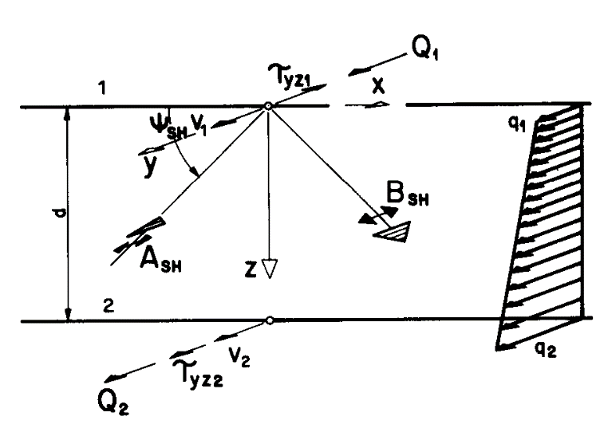
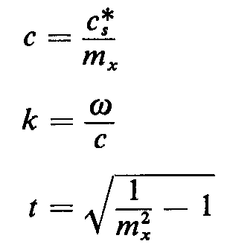
Free-Field Motion
Equation of motion;
Out-of-plane motion in a soil layer;
Out-of-plane motion in a half-space;

Slide 3
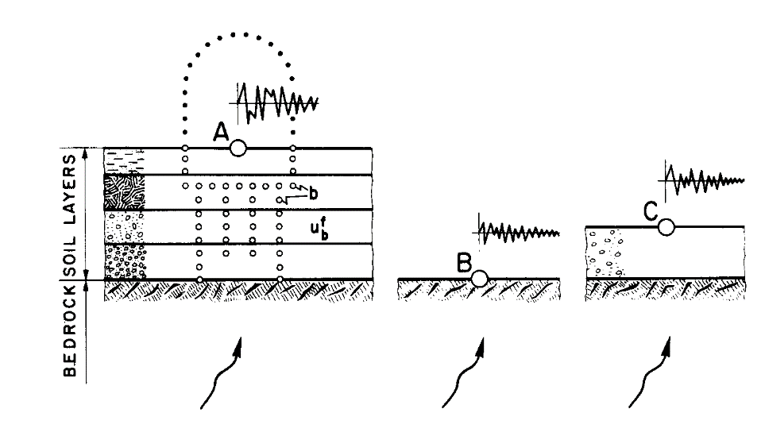
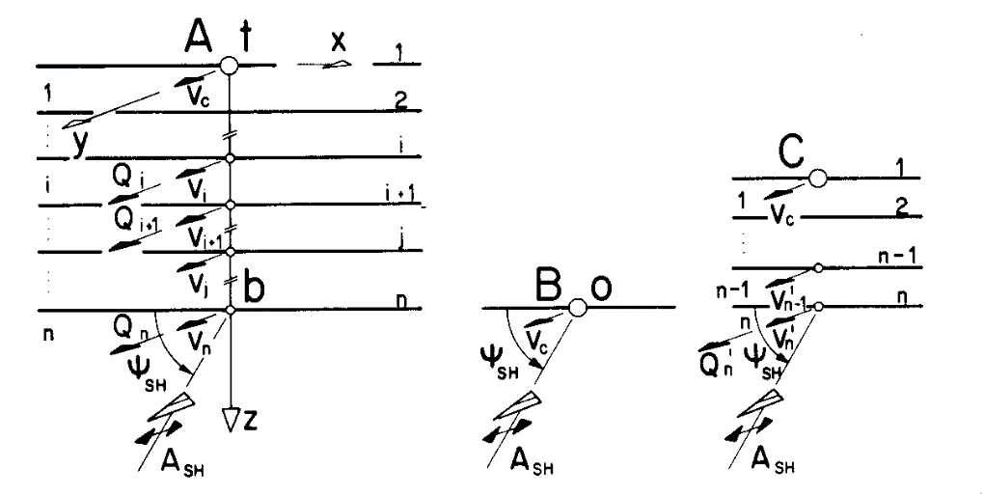
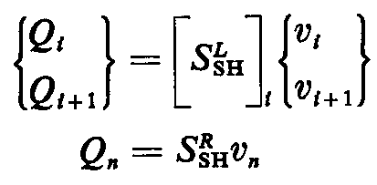
Free-Field Motion
Out-of-Plane- motion;

Slide 4
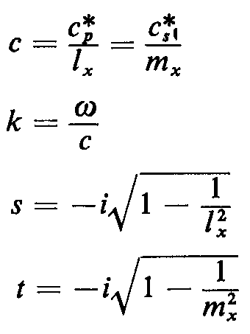
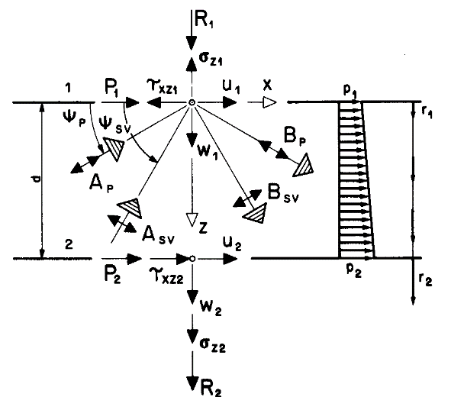
Free-Field Motion
In-plane motion in a soil layer;
In-plane motion in a soil layer;
On Which term of equation of motion does the location of the control point influence ?

Slide 5
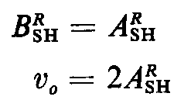
Half-Space
Incident SH-Waves;
=0

Slide 6
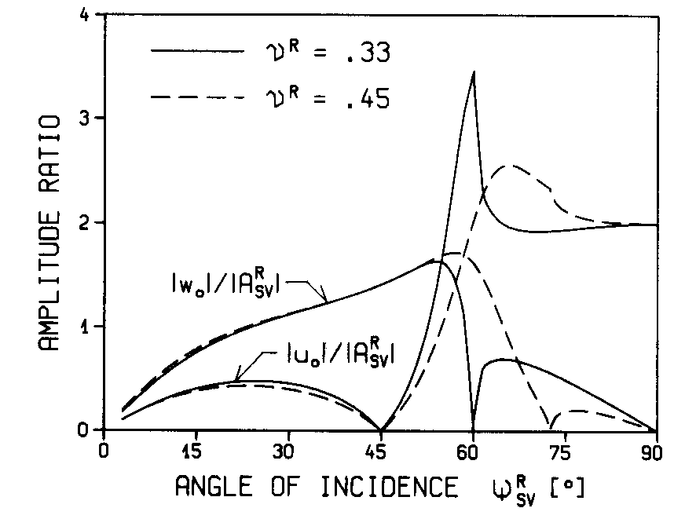
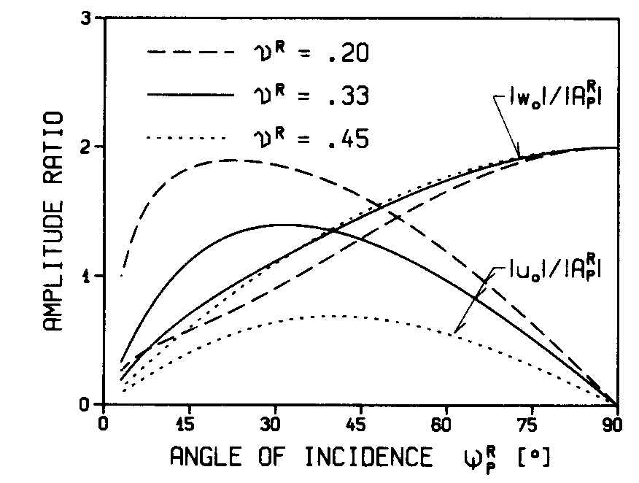
Half-Space
Incident P and SV-Waves;
0=

Slide 7
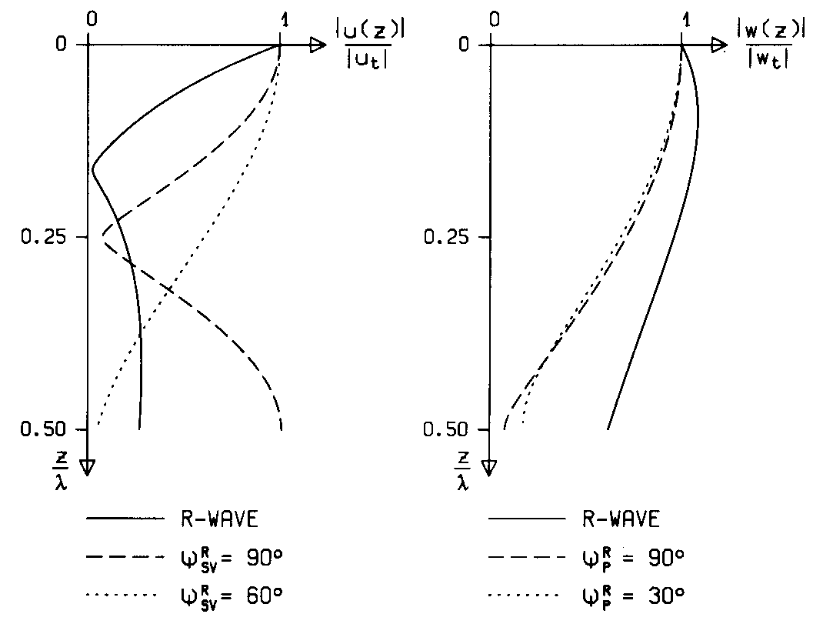
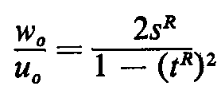
Half-Space
Rayleigh Waves;
No incident waves are present;

Slide 8
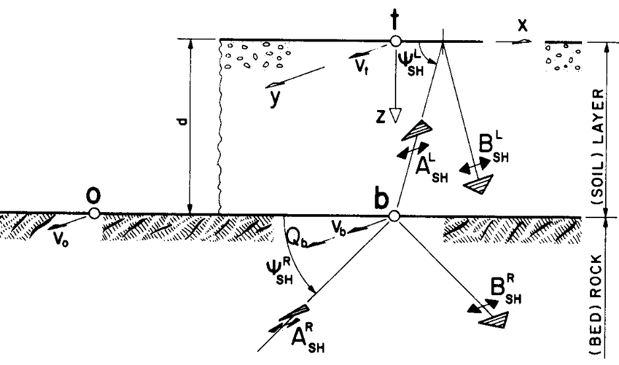
Single Layer on Half-Space
SH-Waves;
For an undamped layer;
For a damped layer;

Slide 9
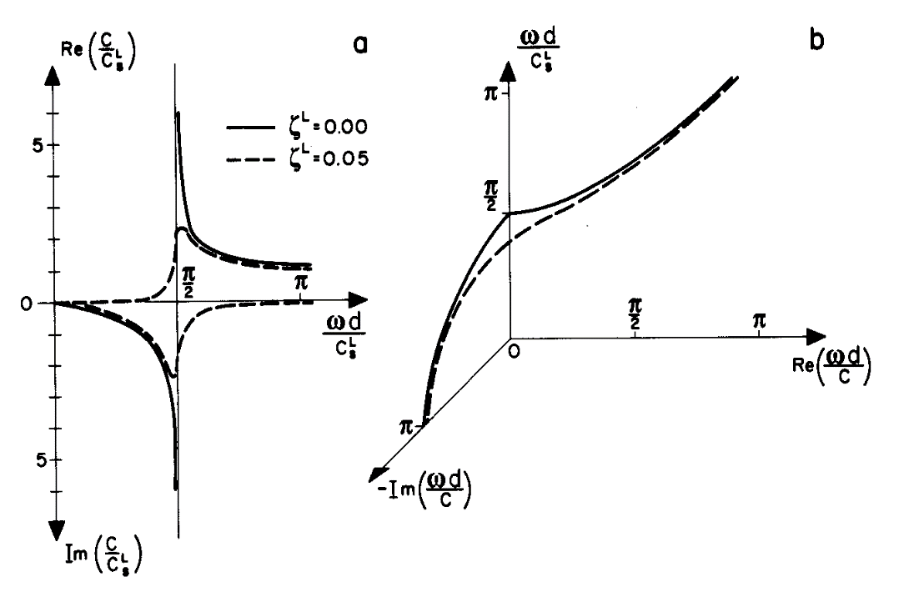
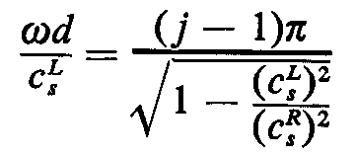
Single Layer on Half-Space
Love-Waves;
Cut-off frequency

Slide 10
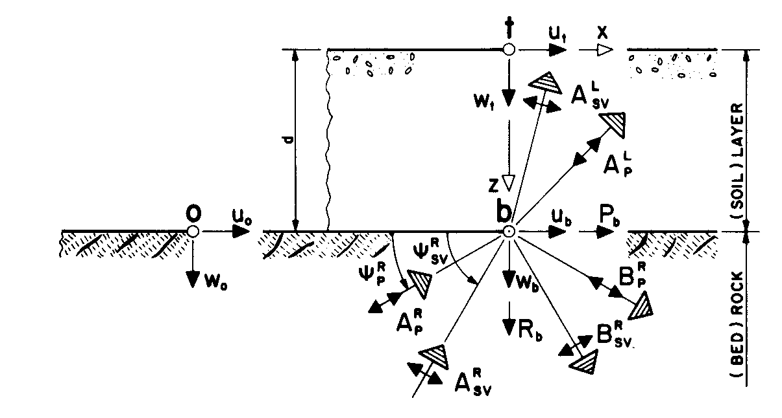
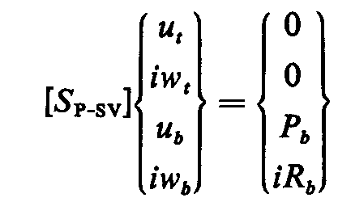
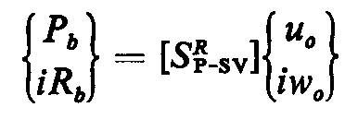
Single Layer on Half-Space
P and SV-Waves;

Slide 11
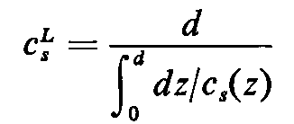
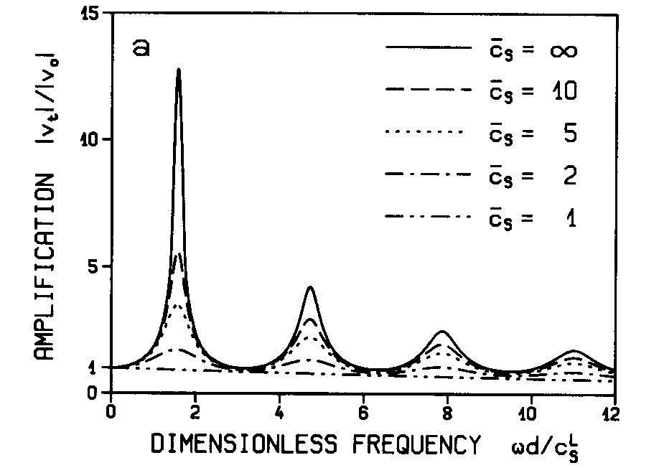
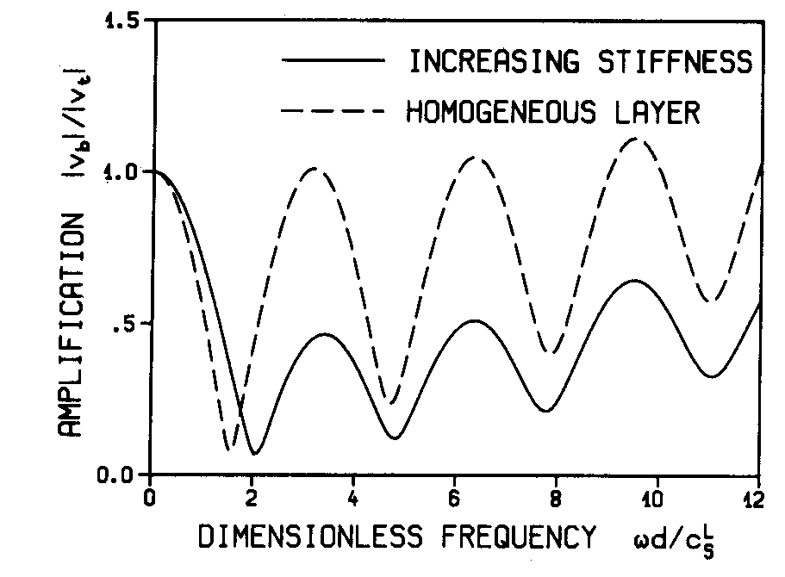
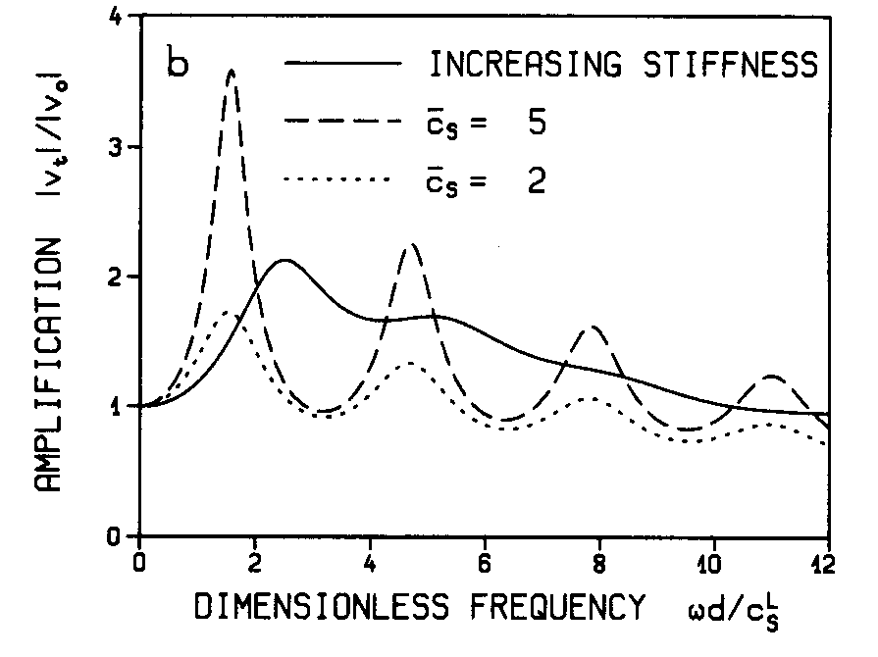
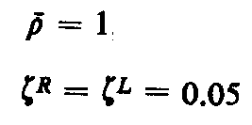
Out-of-Plane Motion
Vertically propagated waves;

Slide 12
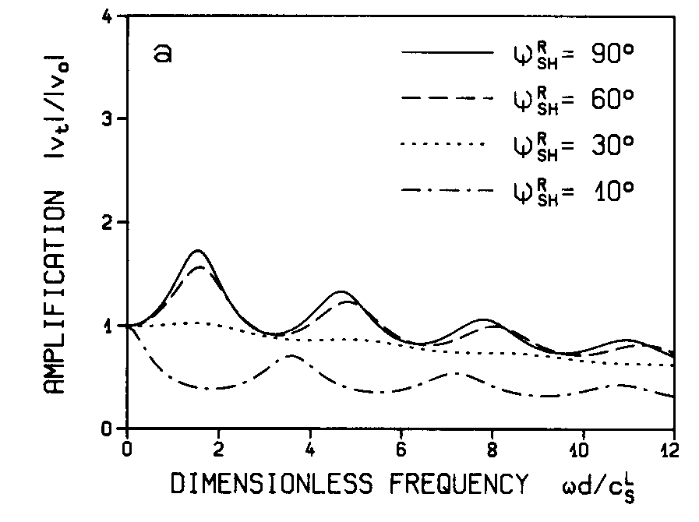
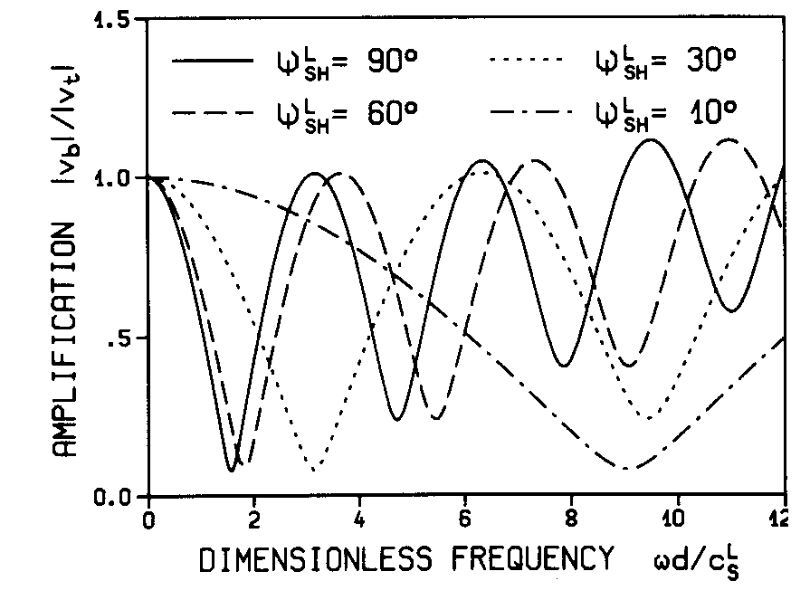
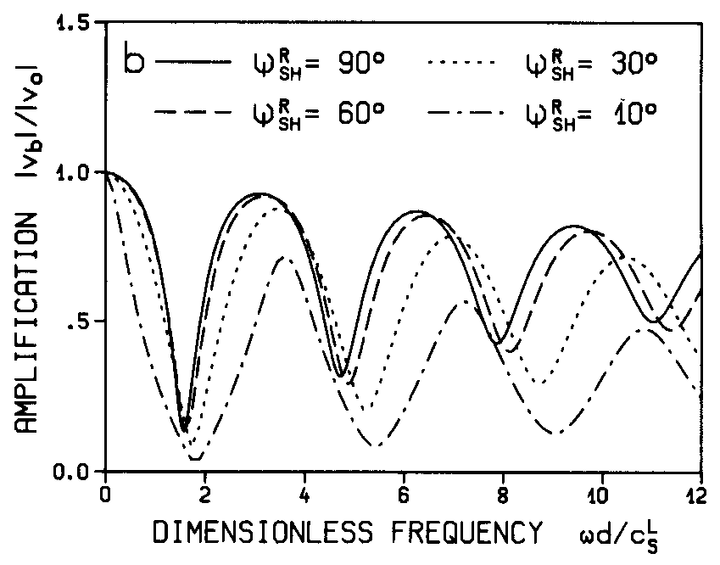
Out-of-Plane Motion
Inclined propagated waves;

Slide 13
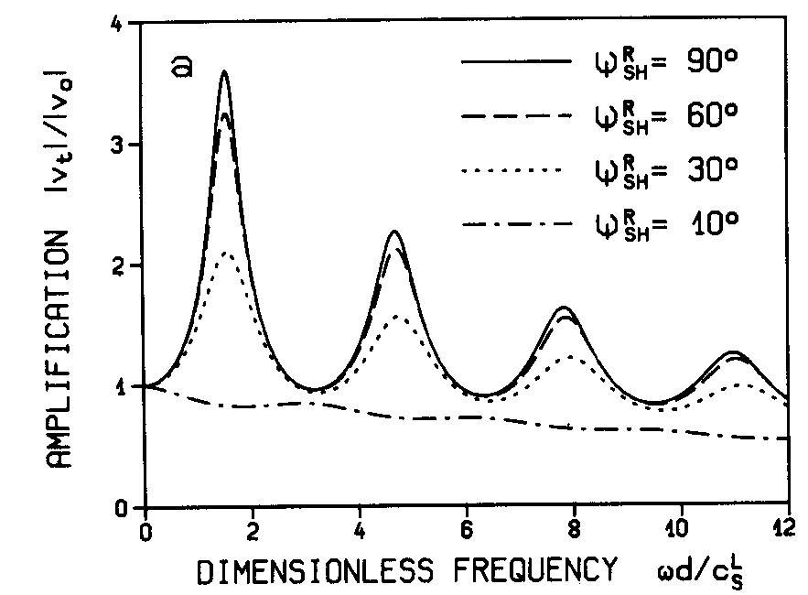
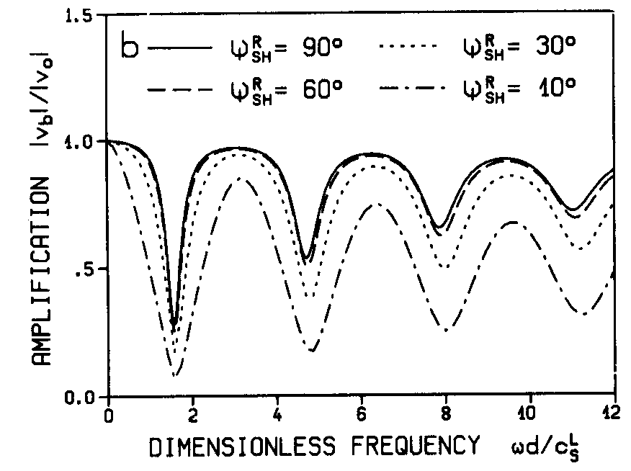
Out-of-Plane Motion
Inclined propagated waves;

Slide 14
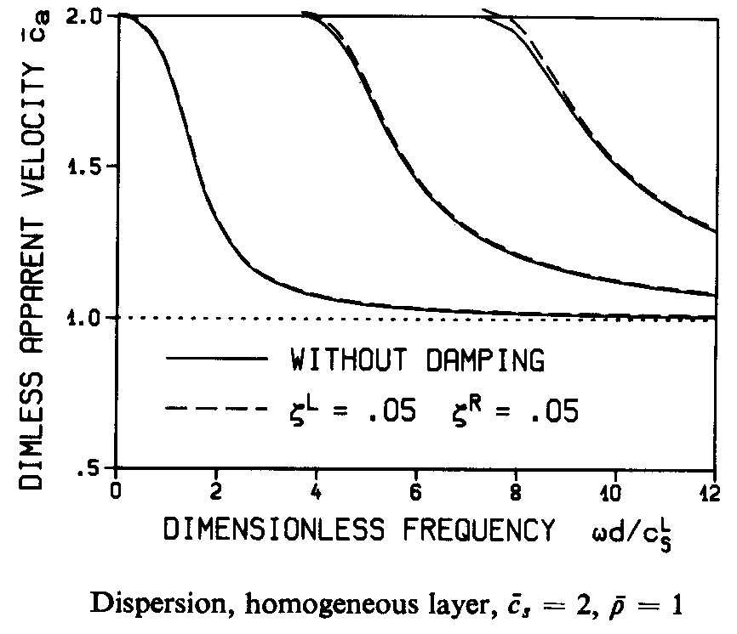
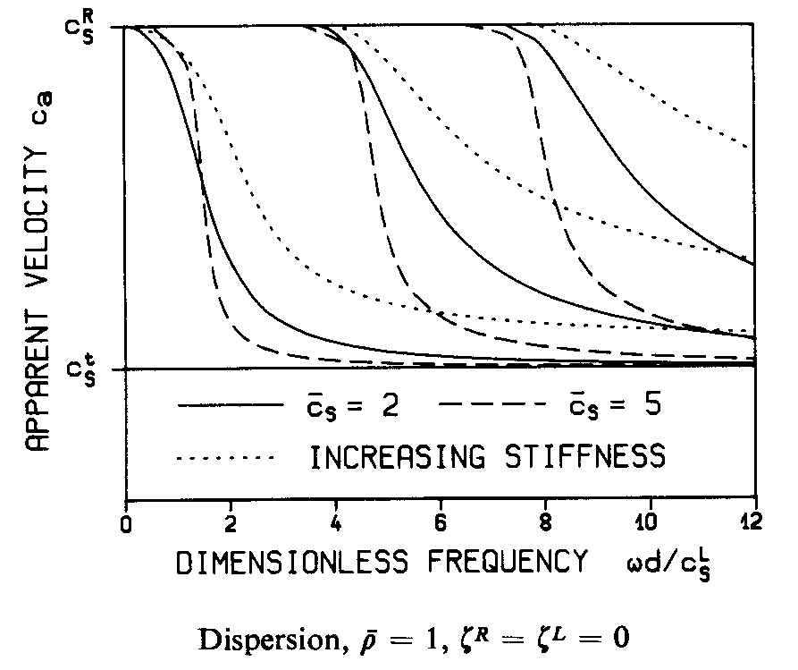
Out-of-Plane Motion
Love-waves;

Slide 15
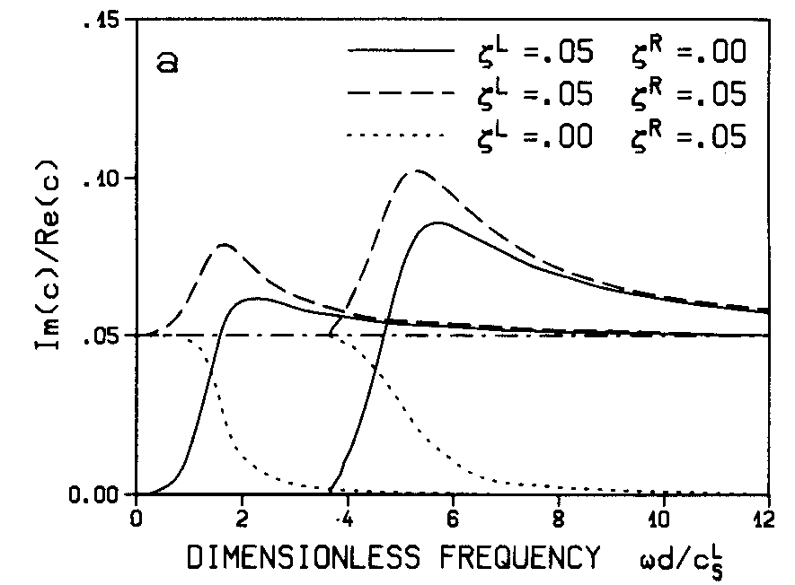
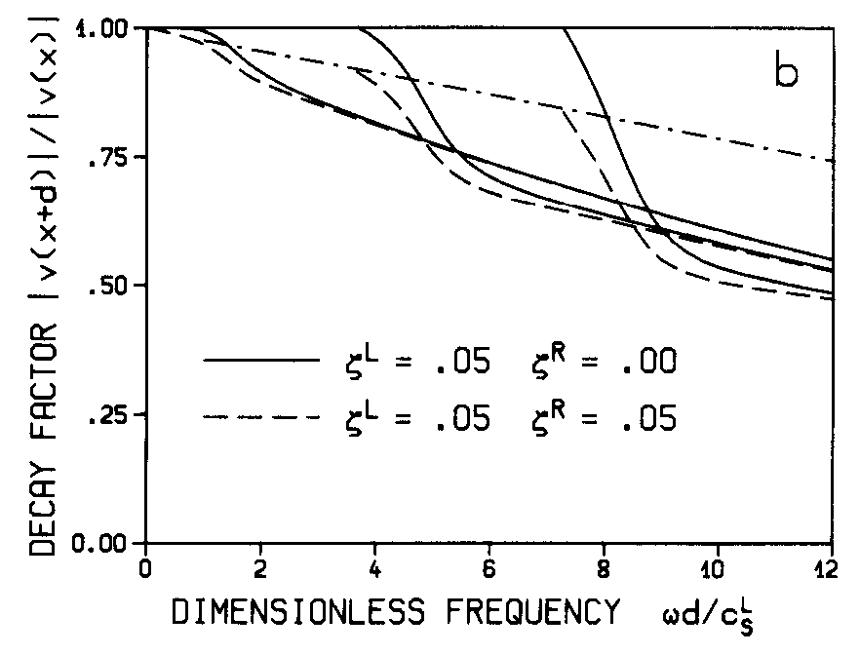
Out-of-Plane Motion
Love-waves;

Slide 16
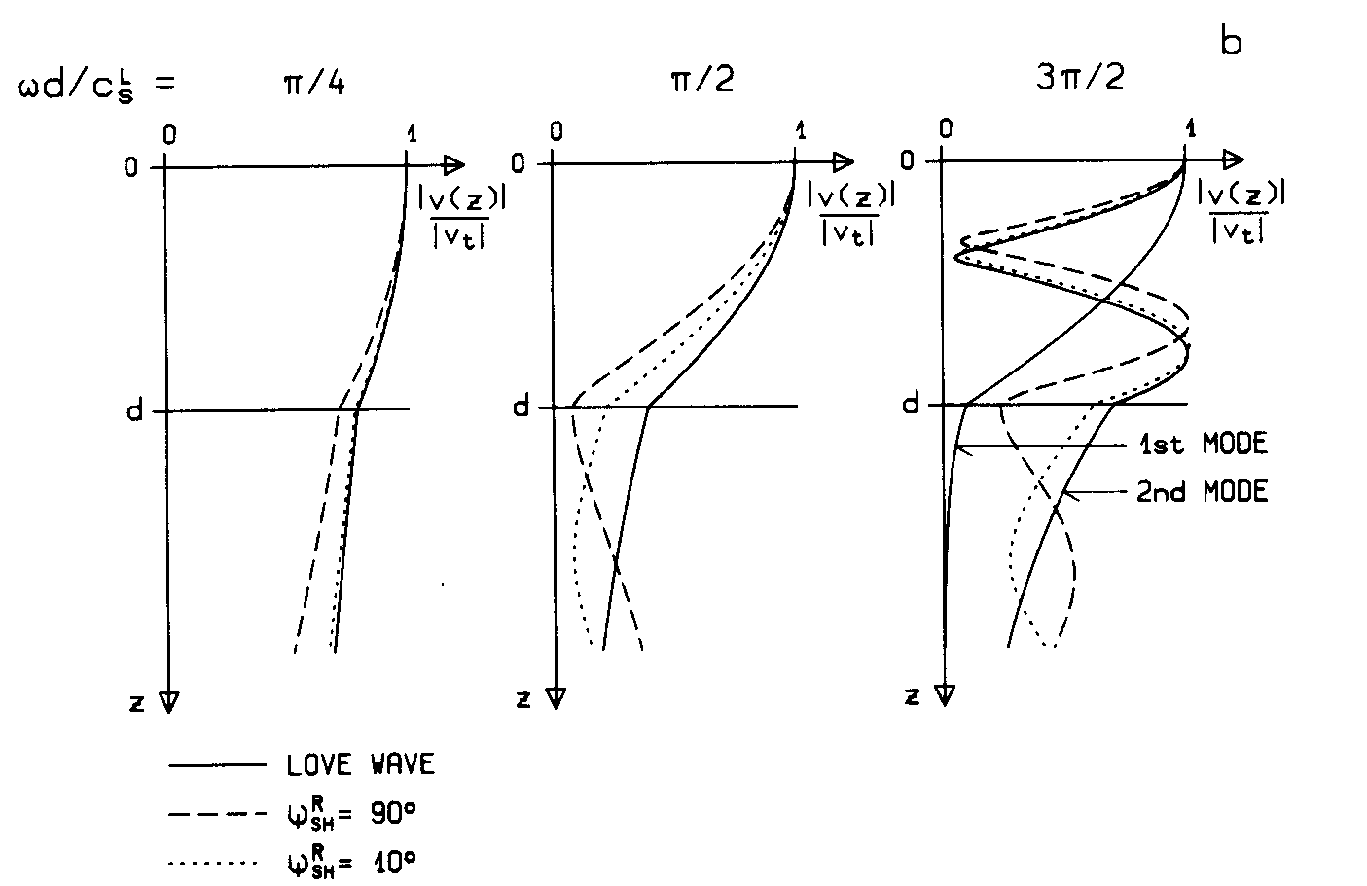
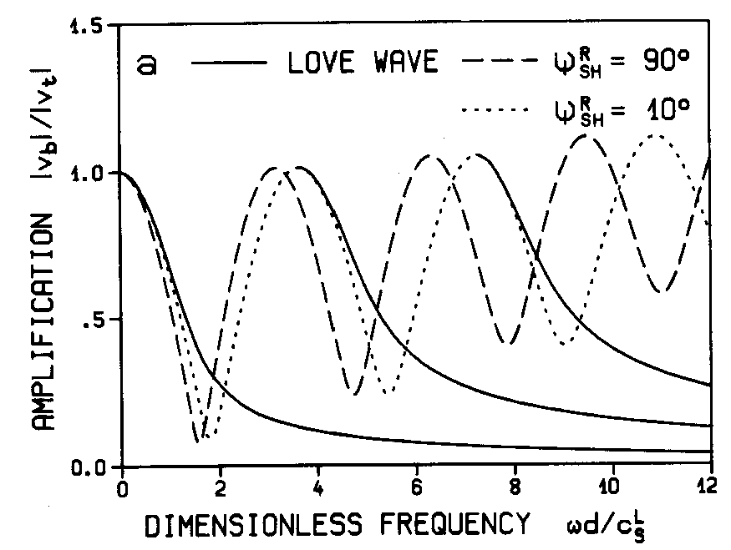
Out-of-Plane Motion
Love-waves;

Slide 17
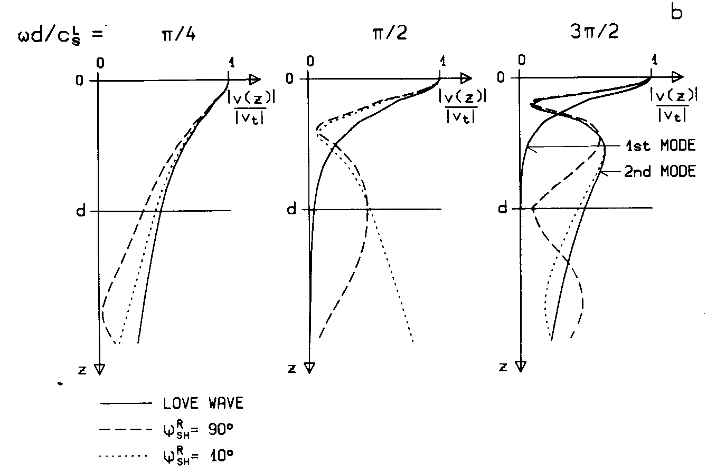
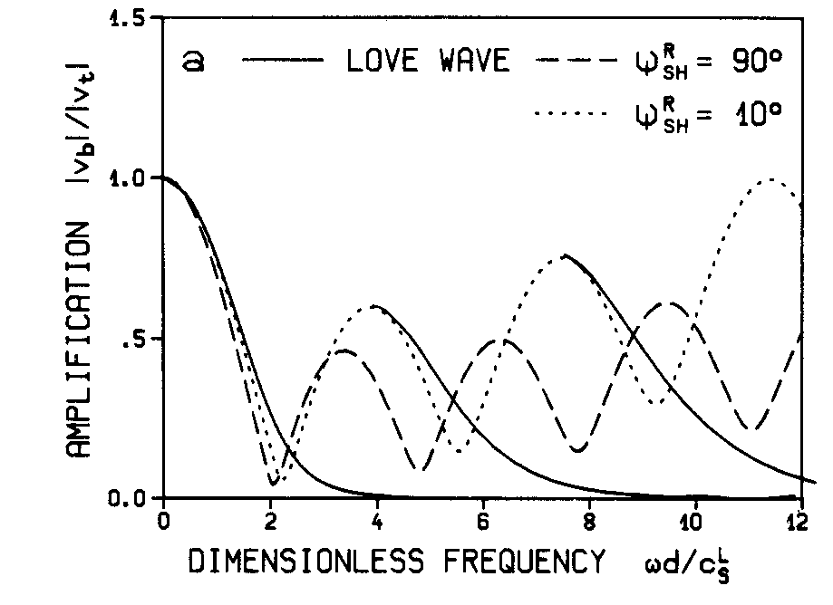
Out-of-Plane Motion
Love-waves;

Slide 18
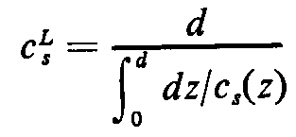
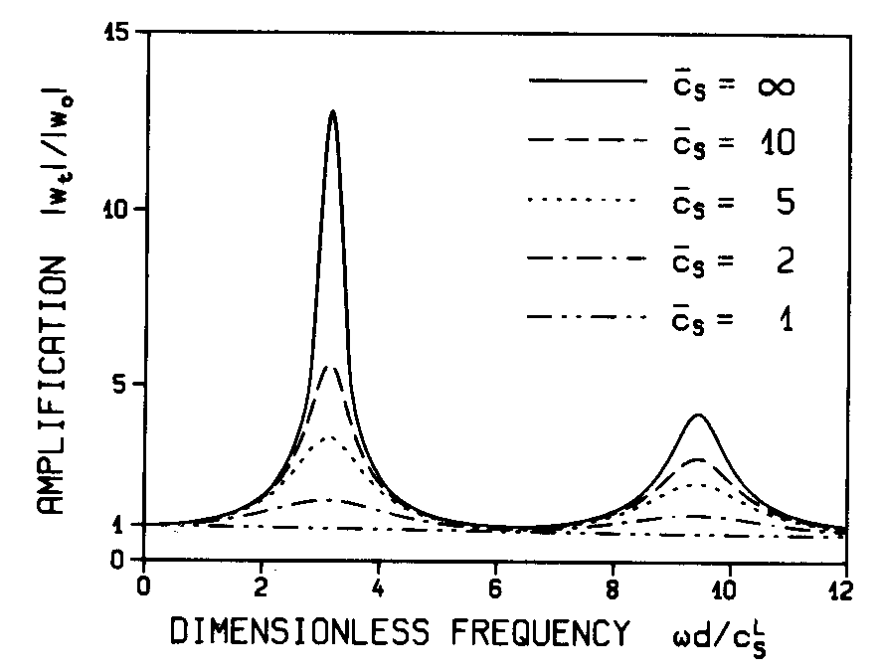
Out-of-Plane Motion
Vertically propagated waves;

Slide 19
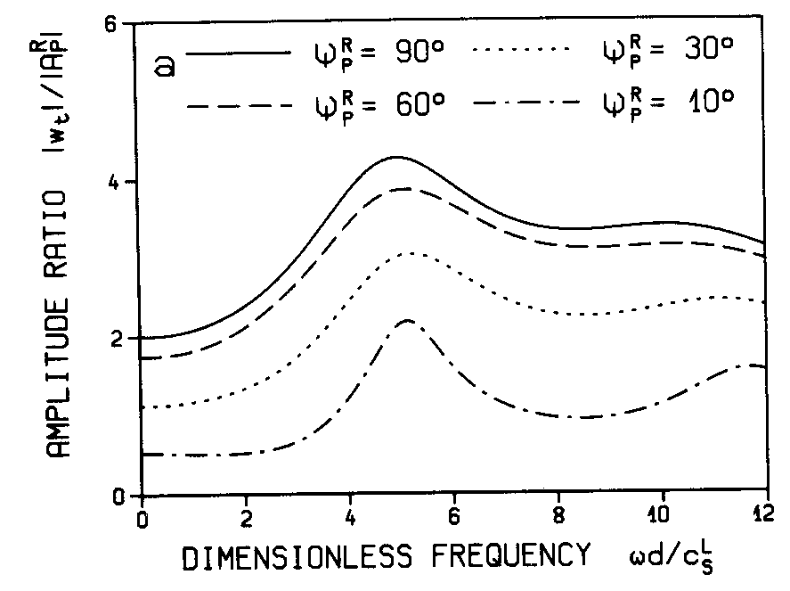
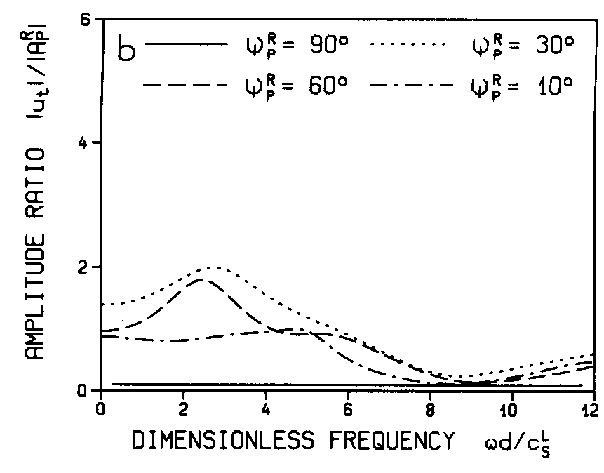
In-Plane Motion
Inclined P-waves;

Slide 20
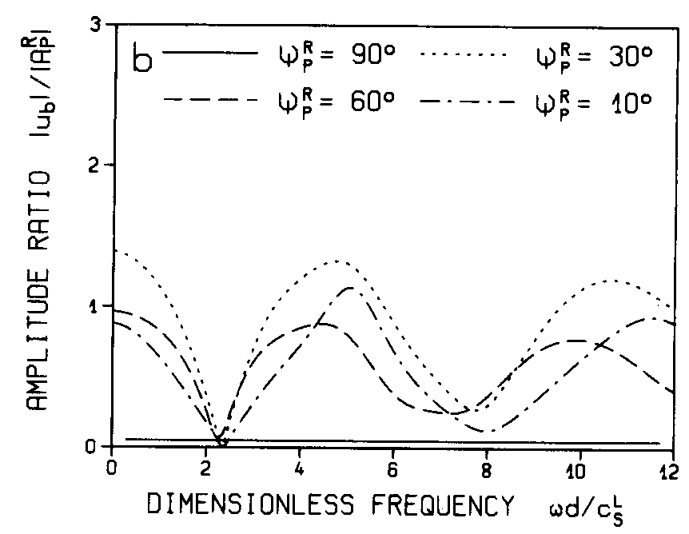
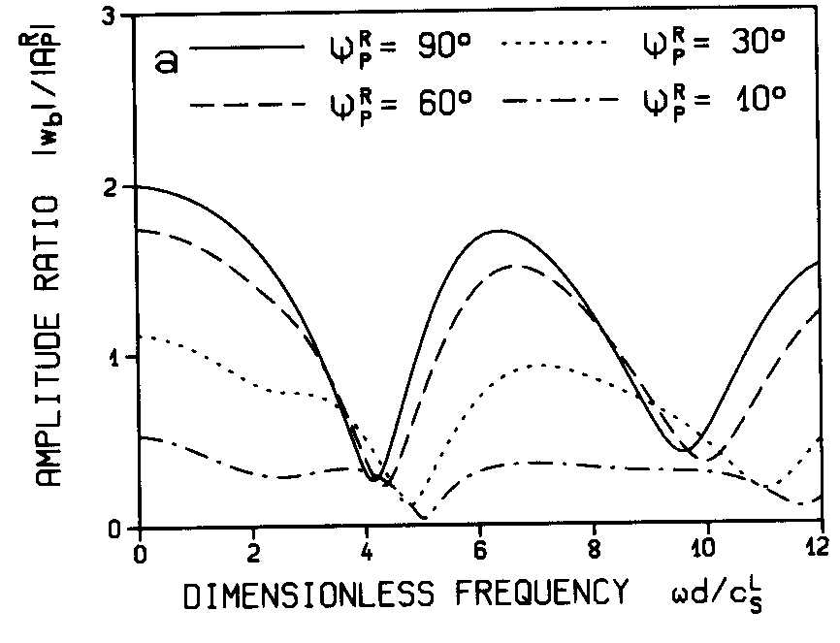
In-Plane Motion
Inclined P-waves;

Slide 21
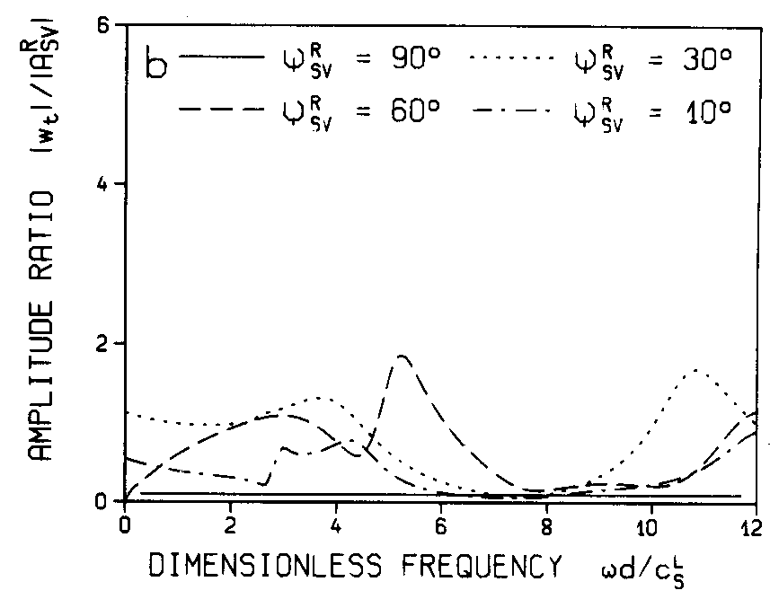
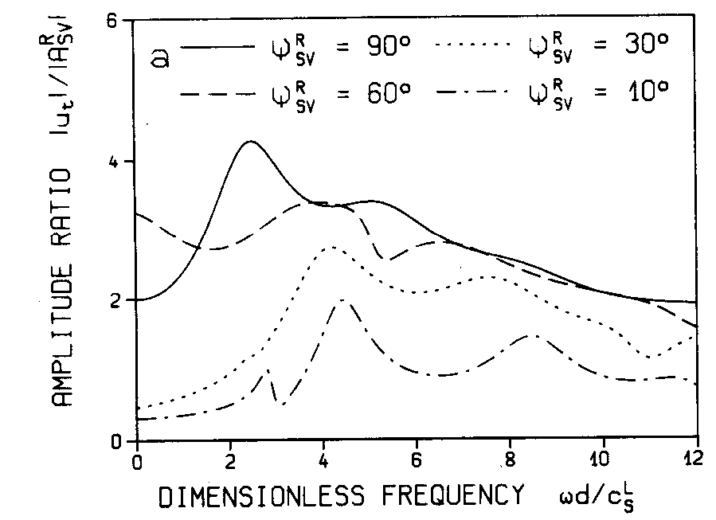
In-Plane Motion
Inclined SV-waves;

Slide 22
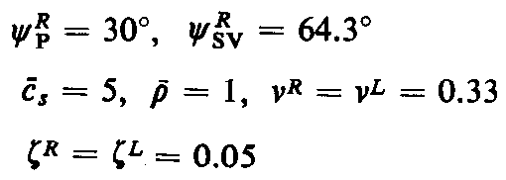
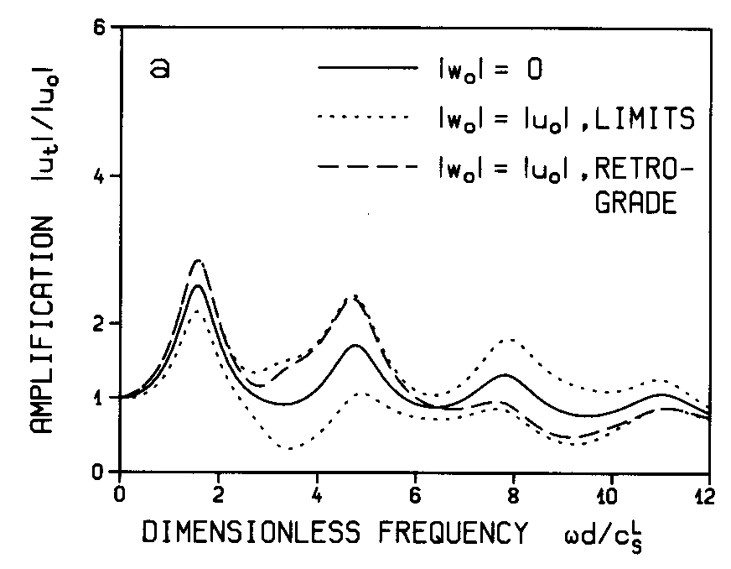
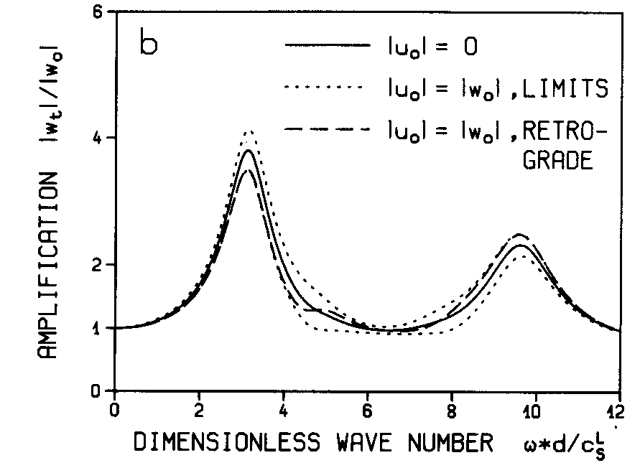
In-Plane Motion
Inclined P and SV-waves;

Slide 23
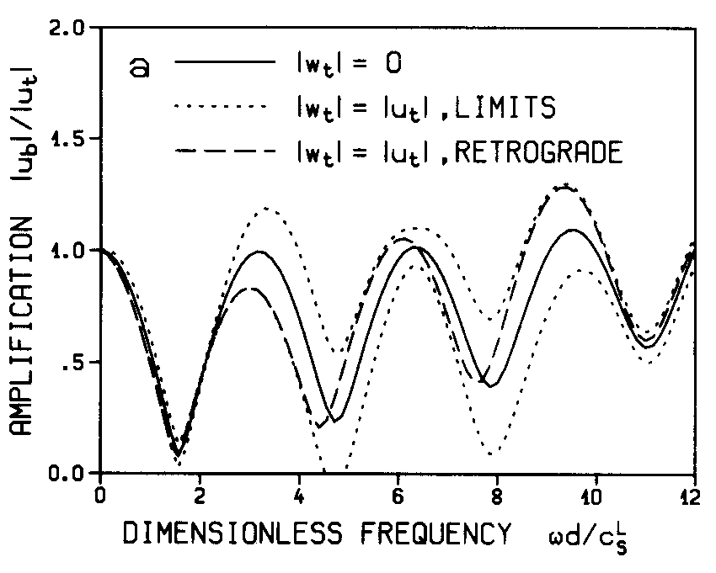
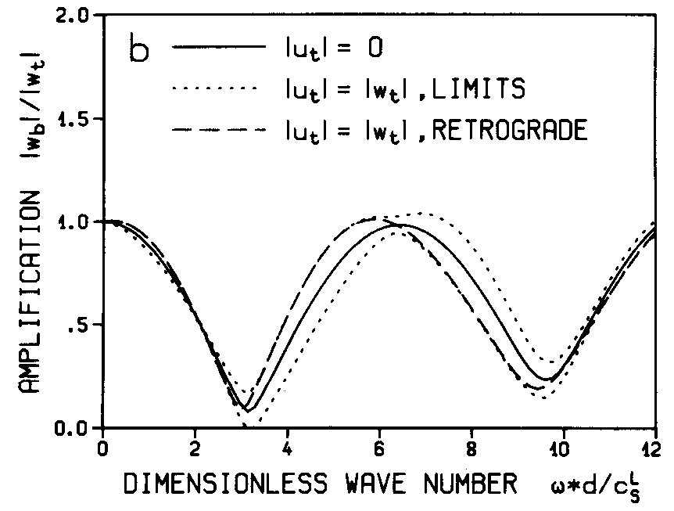
In-Plane Motion
Inclined P and SV-waves;

