Slide 1
Soil Dynamics
By: M. Iman Khodakarami (Associate Prof. of Earthquake Eng.)
Email: Khodakarami@semnan.ac.ir ; I.Khodakarami@gmail.com
Phone: (+98) 23- 31535243
Civil Eng. Faculty,
Semnan University

Slide 2
Course Outline
Introduction: Basic Concepts; Review of Application of Soil Dynamics in Civil Engineering; Nature of Dynamics loads.
Brief Review on Earthquake Engineering: The earthquake and its complications; Causes of Earthquake; Seismic Waves; Ground Motions; Characteristics of Earthquakes; Attenuation of Acceleration and Velocity.
A Review on Vibration: Vibration of SDOF & MDOF; Natural & Resonance Frequency; Forced & Free Vibration; Damped & Un-damped Systems.
Wave Propagation in Elastic Medium: Wave Equation; Properties of Waves; Various types of Waves; Reflection & Refraction of Waves; Effects of Topographic Irregularities of Waves.
The Dynamic Characteristics of the Soil : Laboratory Tests and Results; Field Test Measurements; Correlations for Shear Modulus and Damping Ratio.

Slide 3
Course Outline - Cont’d
The Dynamic Characteristics of the Soil : Laboratory Tests and Results; Field Test Measurements; Correlations for Shear Modulus and Damping Ratio.
Vibration of the Foundations : Vertical Vibration; Rocking Vibration; Sliding Vibration; Vibration of Embedded Foundations; Dynamic bearing capacity of shallow foundations; Dynamic bearing of foundations
Effects of Earthquake on retaining walls: Active Earth Pressure Theory; Dynamic Passive Force on Retaining Wall.
Liquefaction of Soil: Concept of Liquefaction; Dynamic Triaxial Test; Cyclic Simple Shear Test; Determination of Liquefaction.
Seismic stability of earth embankments.

Slide 4
Prerequisites for the course
Theory of Vibration, Wave propagation, Earthquake Engineering;
Nature of earthquakes; effects of earthquake of various kind of structures; seismic waves; Vibration of SDOF & MDOF systems.
Theory of elasticity, Mechanics of solids, structures and soil, Continuum mechanics;
Mechanical behavior of materials and analysis of stress and deformation in engineering structures and continuous media. Topics include concepts of stress and strain; the elastic, plastic, and time-dependent response of materials; general three-dimensional states of stress; Mohr's circle; stress concentrations.
Applied Mathematics and Numerical methods;
Mathematical techniques involving differential equations used in the analysis of physical aspects of problems . Emphasis on the use of established methods, rather than rigorous foundations. I: First and second order differential equations. II: Applications of linear algebra to systems of equations; numerical methods; nonlinear problems and stability; introduction to partial differential equations.

Slide 5
Grading & Collaboration Policies
Grading Policy;
Homework: 15%
Oral Quiz: 15%
Quiz: 30%
Final Oral Exam: 20%
Final exam: 20%
Collaboration policy;
We encourage discussions on homework and computer assignments: you can learn a lot from working
with a group. This means that you are permitted to discuss homework problems and computer assignments
with classmates, and are permitted to seek help from other students if you run into difficulties. However, material submitted for grading should represent independent work of its author. Any work done in collaboration should be clearly marked as such. It is not acceptable to copy the work of other students, and it is not acceptable for two students to submit identical copies of any part of an assignment.

Slide 6
References
Soil Dynamics (1981), By: Sh. Prakash; Mcgraw-Hill, Inc.
Geotechnical Earthquake Engineering (1996), By: S. L Kramer; Prentice Hall, Inc.
Principles of Soil Dynamics (2010), By: B. Das, G.V. Ramana; Cengage Learning.
Fundamentals of soil dynamics and earthquake engineering (2009), By: B. B. PRASAD; PHI Learning Private.
Advanced Soil Dynamics and Earthquake Engineering (2008), By: B. B. PRASAD; PHI Learning Private.
Geotechnical Earthquake Engineering (2008), By: I. Towhata; Springer Science & Business Media.

Slide 7
Journals
Soil Dynamics and Earthquake Engineering; Published by Elsevier.
Géotechnique; Published by Thomas Telford Ltd.
Soils and Foundations; Published by Elsevier.
Earthquake Spectra ; Published by Allen Press.
Earthquake Engineering & Structural Dynamics; Published by John Wiley & Sons.
Earthquake Engineering and Engineering Vibration; Published by Springer.
Acta Geotechnica; Published by Springer.
Bulletin of Earthquake Engineering; Published by Springer.
Computers and Geotechnics; Published by Elsevier.
Bulletin of the Seismological Society of America; Published by SSA.

Slide 8
Conferences
International conference on earthquake geotechnical engineering; Past: (6ICEGE), New Zealand, 1-4 November 2015.
International Conference of Seismology and Earthquake Engineering; Past: (SEE7), Iran, 18-21 May 2015.
World Conference on Earthquake Engineering; Past: (16WCEE), Chile, 2017.
European conference on earthquake engineering; Past: (15ECEE), Turkey, 2014.
Canadian Conference on Earthquake Engineering; Past: (11CCEE), Canada, 21-24 July 2015.

Slide 9
The Project
To provide experience with applying the principles covered in this course to practical engineering problems, and also to demonstrate your proficiency with Soil Dynamics. The project will involve;
Choose a problem to solve. One possibility is to apply Soil Dynamics to help you with another design or independent study course, or a research project. Alternatively, you could consult the instructor for suggestions.
Write a short proposal that defines the problem to be solved, describes what will be calculated, outlines briefly how the calculation will be done.
Submit the proposal via email and obtain approval from the instructor.
Gathering the related scientific articles for your project.
Write a formal report no more than 15 pages that summarizes the results in a template of a scientific paper.
Give a short oral presentation to the rest of the class (up to15 min).

Slide 10
Introduction
Soil mechanics is the branch of civil engineering that deals with the engineering properties and behavior of soil under stress.
Most of the studies in the field of Soil Mechanics have been devoted to the determination of soil behavior under static load conditions.
Soil dynamics is the branch of soil mechanics that deals with the behavior of soil under dynamic load, including the analysis of the stability of earth-supported and earth-retaining structures.
Dynamic loads are imposed on soils and geotechnical structures by several sources, such as earthquakes, bomb blasts, operation of machinery, construction operations, mining, traffic, wind, and wave actions.
It is well known that the stress-strain properties of a soil and its behavior depend upon several factors and can be different in many ways under dynamic loading conditions as compared to the case of static loading.
During the last 50 years, several factors, such as damage due to liquefaction of soil during earthquakes, stringent safety requirements for nuclear power plants, industrial advancements (for example, design of foundations for power generation equipment and other machinery), design and construction of offshore structures, and defense requirements, have resulted in a rapid growth in the area of soil dynamics.

Slide 11
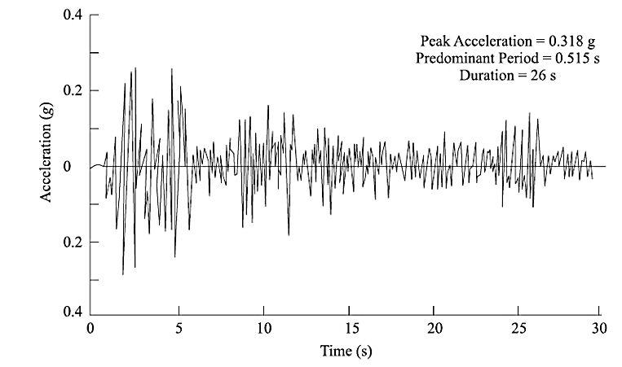
Introduction
Nature and Type of Dynamic Loading on Soils
Dynamic loads vary in their magnitude, direction, or position with time.

Slide 12
Introduction
Importance of Soil Dynamics
Earthquake, ground vibration, and wave propagation through soils
Dynamic stress, deformation, and strength properties of soils
Dynamic earth pressure problem
Dynamic bearing capacity problems and design of shallow foundations
Problems related to soil liquefaction
Design of foundations for machinery and vibrating equipment
Design of embedded foundations and piles under dynamic loads
Stability of embankments under earthquake loading

Slide 13
Introduction
Designing for dynamic conditions requires answers to:
How should failure be defined and what should be the failure criteria?
What is the relationship between applied loads and the significant parameters used in defining the failure criteria?
How can the significant parameters be identified and evaluated?
What will be an acceptable factor of safety, and will the factor of safety as used for static design condition be enough to ensure satisfactory performance or will some additional conditions need to be satisfied?
The importance of soil dynamics lies in providing safe, acceptable, and time-tested solutions to the problem of dynamic loading in soil, in spite of the fact that the information in some areas may be lacking and the actual loading condition may not be predictable, as in the case of the earthquake phenomenon.

Slide 14
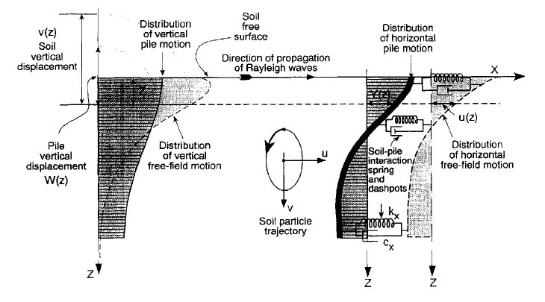
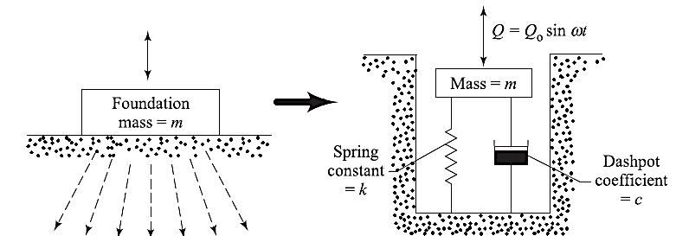
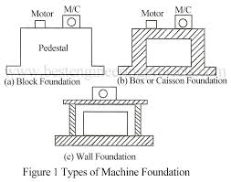
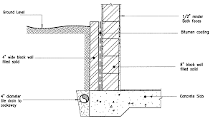
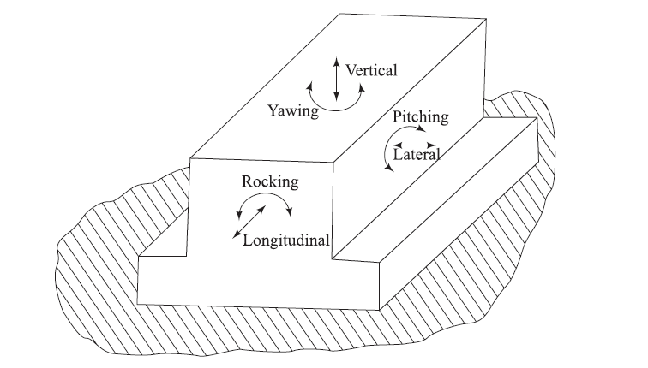
A Review on Vibration
Fundamentals of Vibration
Free Vibration
Forced Vibration
Dynamical Degree of Freedom
Damped System
Undamped System

Slide 15
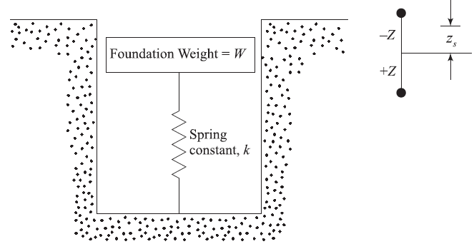
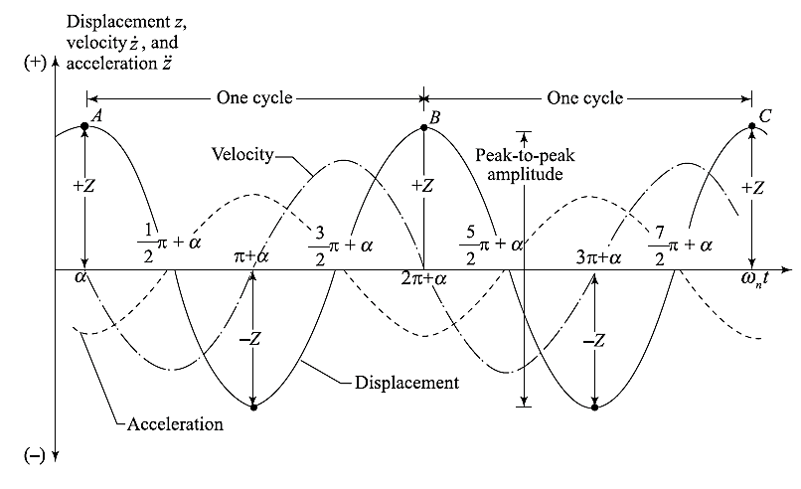
A Review on Vibration
Free Vibration of a SDOF system

Slide 16
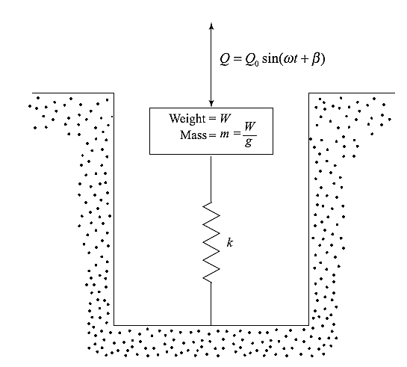
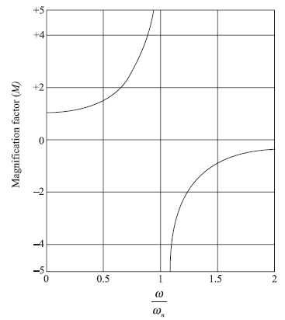
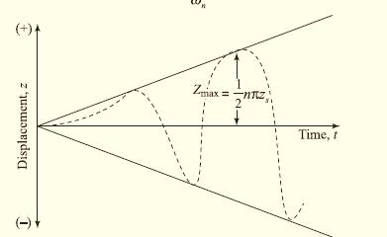
A Review on Vibration
Forced Vibration of a SDOF system

Slide 17
A Review on Vibration
Maximum Force on Foundation Subgrade

Slide 18
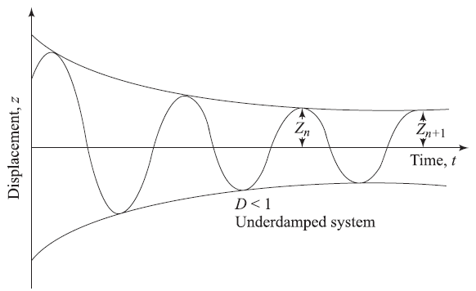
A Review on Vibration
Free Vibration of Damped system

Slide 19
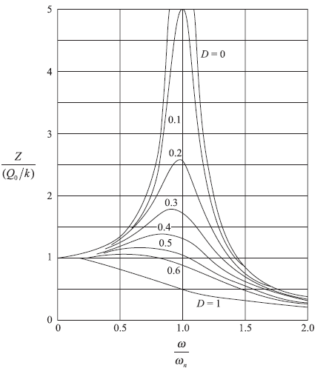
A Review on Vibration
Forced Vibration of Damped system
How one can determine the damping ratio of a system?

Slide 20
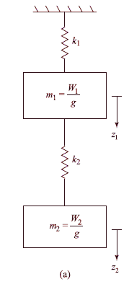
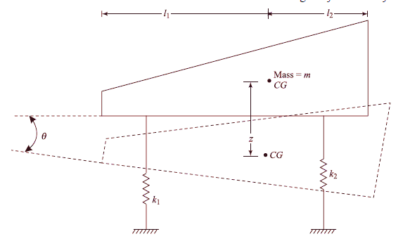
A Review on Vibration
Vibration of MDOF system

