Slide 1
Soil Dynamics
By: M. Iman Khodakarami (Associate Prof. of Earthquake Eng.)
Email: Khodakarami@semnan.ac.ir ; I.Khodakarami@gmail.com
Phone: (+98) 23- 31535243
Civil Eng. Faculty,
Semnan University

Slide 2
Wave propagation
Nature on waves: If a stress is suddenly applied to a body, the part of the body closest to the source of disturbance will be affected first. The deformation of the body due to the load will gradually spread throughout the body via stress waves.
Importance of wave propagation:
Determination of soil properties such as modulus of elasticity, shear wave velocity, shear modulus;
Interpretation of test results of geophysical investigation,
Numerical formulation of ground response analysis and also helps in the development of the design parameters for earthquake resistant structures.

Slide 3
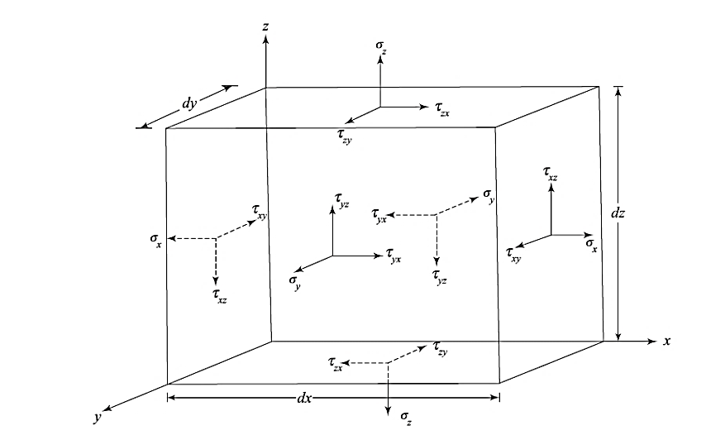
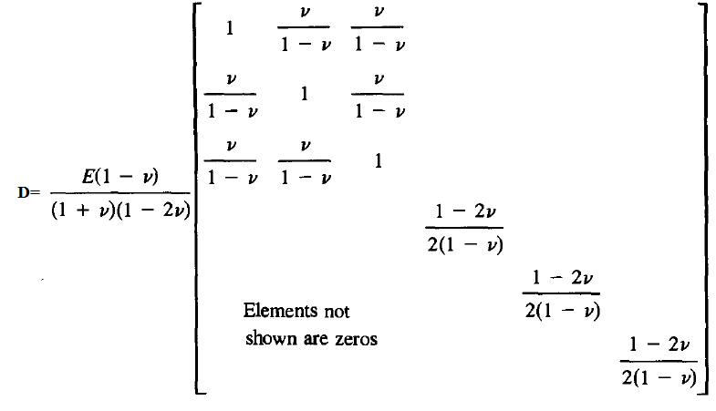
Review of the Basic Theory
In general, the stresses and strains in a structure consist of six components:
$$G=\frac{E}{2\left(1+ν\right)}$$
$$λ=\frac{ν.E}{\left(1+ν\right)\left(1−2ν\right)}$$

Slide 4
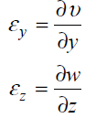
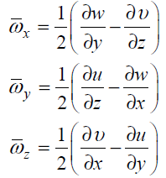
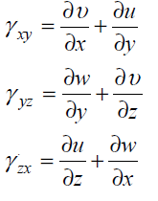
Review of the Basic Theory

Slide 5
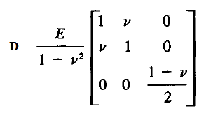
Plane (2-D) Problems
Plane stress

Slide 6
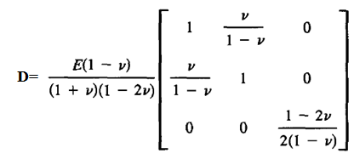
Plane (2-D) Problems
Plane strain

Slide 7
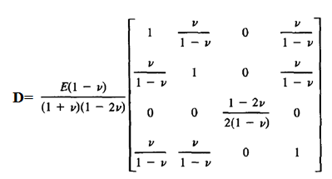
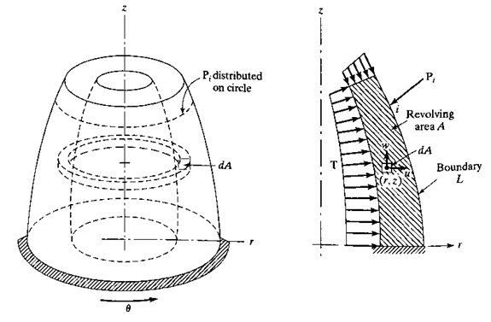
Plane (2-D) Problems
Axisymmetric;
$$u_{θ}=0$$

Slide 8
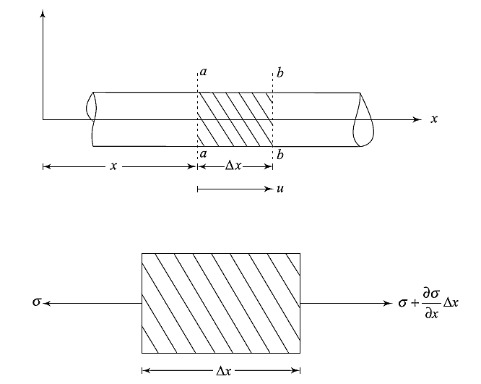
Elastic waves in a bar
Longitudinal Elastic Waves
$\sum{F}$= m.a

Slide 9
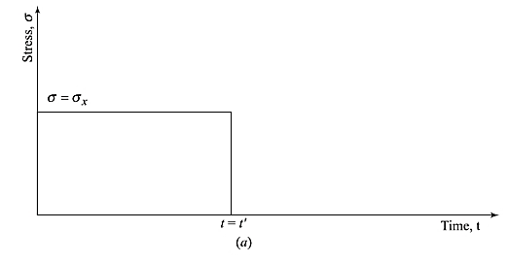
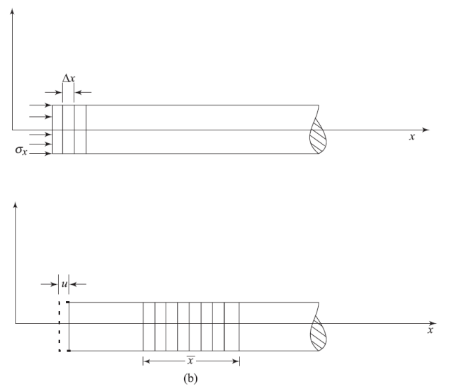
Elastic Longitudinal waves in a bar
Velocity of Particles in the Stressed Zone:
For any t>t’:
elastic shortening:
particle velocity:
The vibration measuring instruments pick the particle vibration velocity and not the wave propagation velocity. Usually, the peaks in particle vibration velocities are detected and the wave propagation velocities are interpreted.

Slide 10
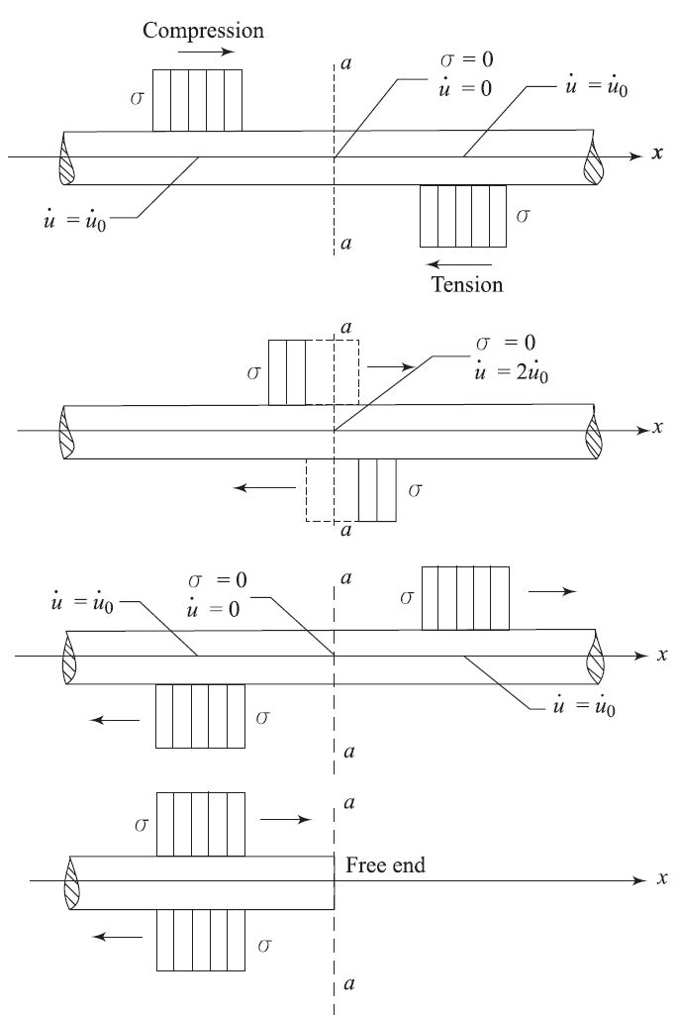
Elastic Longitudinal waves in a bar
Reflections of 1D Waves at free end of the bar:

Slide 11
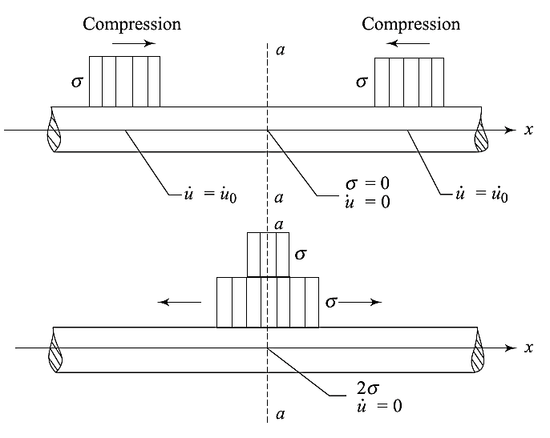
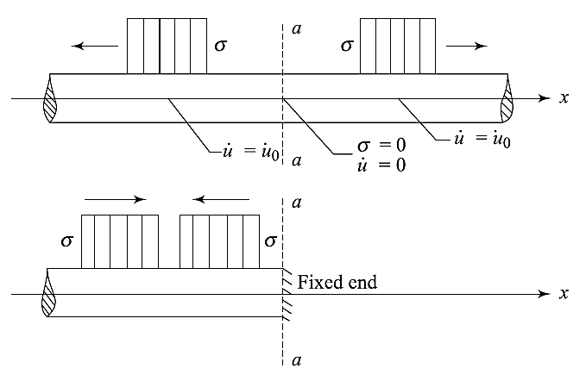
Elastic Longitudinal waves in a bar
Reflections of 1D Waves at fixed end of the bar:

Slide 12
Elastic Longitudinal waves in a bar
Solution for infinite bar:

Slide 13
Elastic Longitudinal waves in a bar
Solution for short bar:

Slide 14
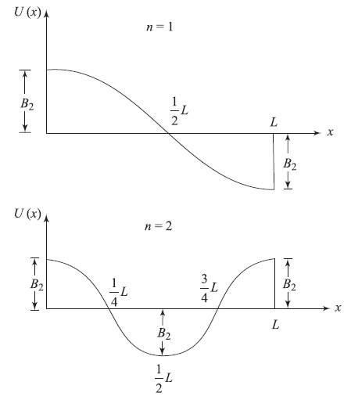
Elastic Longitudinal waves in a bar
Solution for short bar ; free-free end:

Slide 15
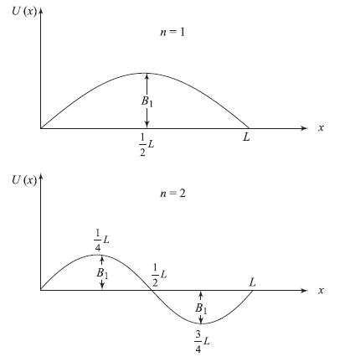
Elastic Longitudinal waves in a bar
Solution for short bar ; fixed-fixed end:
B2=0

Slide 16
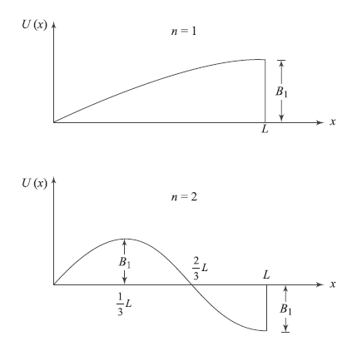
Elastic Longitudinal waves in a bar
Solution for short bar ; fixed-free end:
B2=0

Slide 17
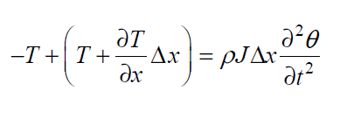
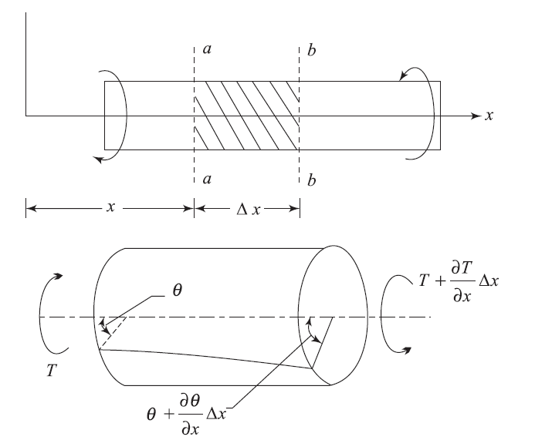
Elastic Torsional waves in a bar

Slide 18
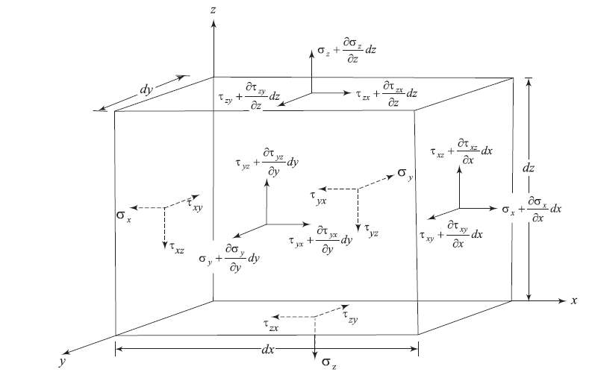
General equation of stress waves

Slide 19
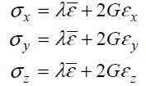
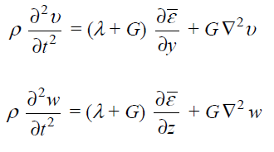
General equation of stress waves
Compression Waves

Slide 20
General equation of stress waves
Compression Waves

Slide 21
General equation of stress waves
Shear Waves

Slide 22
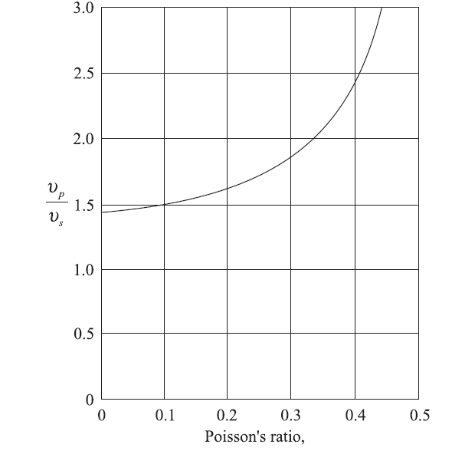
General equation of stress waves

Slide 23
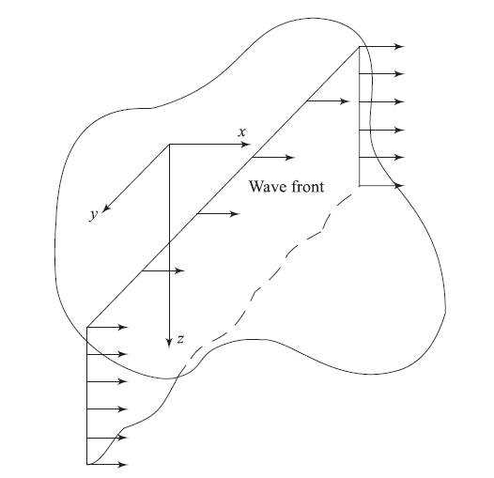
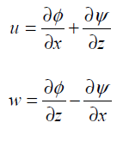
Stress Waves in Elastic Half-Space
Rayleigh Waves

Slide 24
Stress Waves in Elastic Half-Space
Rayleigh Waves

Slide 25
Stress Waves in Elastic Half-Space
Rayleigh Waves

Slide 26
Stress Waves in Elastic Half-Space
Rayleigh Waves

Slide 27
Stress Waves in Elastic Half-Space
Rayleigh Waves

Slide 28
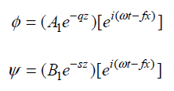
Stress Waves in Elastic Half-Space
Rayleigh Waves

Slide 29
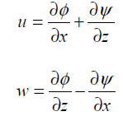
Stress Waves in Elastic Half-Space
Rayleigh Waves

Slide 30
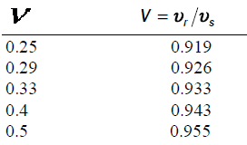
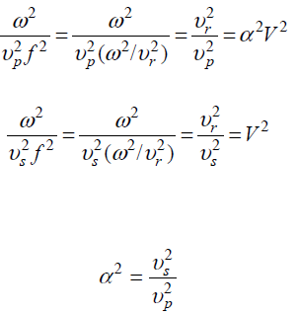
Stress Waves in Elastic Half-Space
Rayleigh Waves

Slide 31
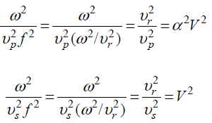
Stress Waves in Elastic Half-Space
Rayleigh Waves

Slide 32
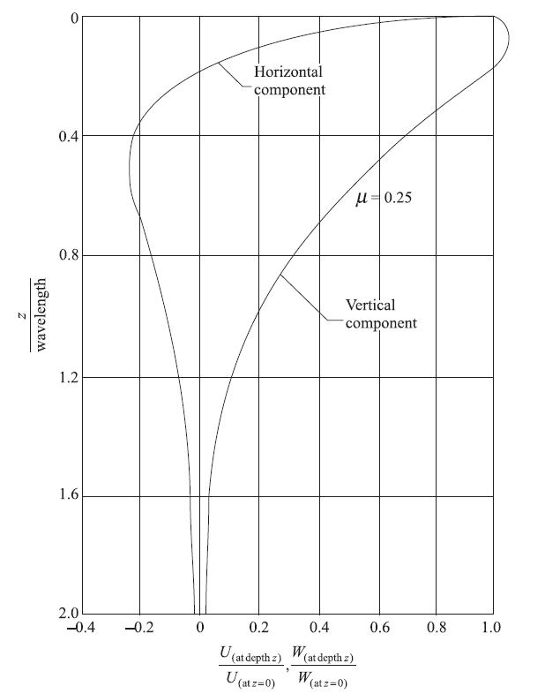
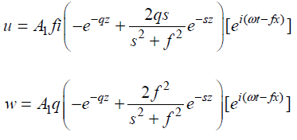
Stress Waves in Elastic Half-Space
Displacement of Rayleigh Waves

Slide 33
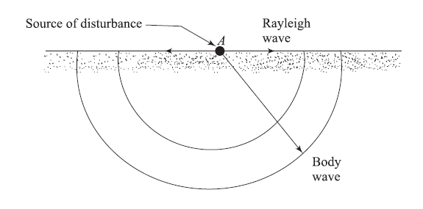
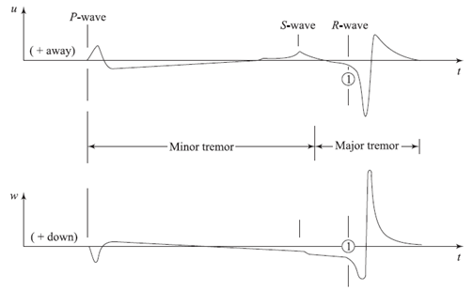
Attenuation of the Amplitude of Elastic Waves with Distance

Slide 34
Attenuation of the Amplitude of Elastic Waves with Distance
Body Waves:
Rayleigh Waves:
The loss of the amplitude of waves due to spreading out is called geometrical damping.
In addition to the above damping, there is another type of loss — that from absorption in real earth material. This is called material damping. The magnitude of absorbing coefficient depends on the type of soil.

