Slide 1
Soil Dynamics
By: M. Iman Khodakarami (Associate Prof. of Earthquake Eng.)
Email: Khodakarami@semnan.ac.ir ; I.Khodakarami@gmail.com
Phone: (+98) 23- 31535243
Civil Eng. Faculty,
Semnan University

Slide 2
Properties of dynamically loaded soils
A variety of laboratory tests as well as field techniques are available, each having its own limitations as well as advantages.
Some of these tests are specifically developed for measuring properties of dynamically loaded soils whereas some are modified versions of tests used in the domain of traditional soil mechanics.
Some of these methods are suitable for small strain range whereas some are suitable for large strain range. The range of strain of interest usually dictates the type of equipment/method to be used which in turn depends on the problem to be analyzed at hand.
Some of these equipment are very specialized, expensive and require special training to use and interpret the results.
It is worth noting that soil behavior over a wide range of strains is nonlinear and on unloading follows a different stress-strain path forming a hysteresis loop.

Slide 3
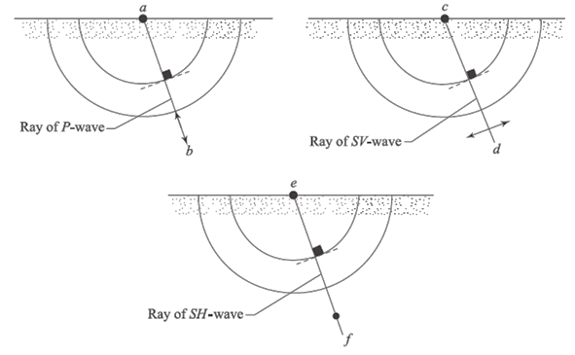
Field Test Measurements

Slide 4
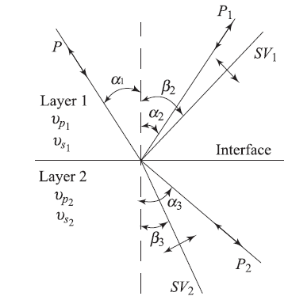
Reflection and Refraction of Elastic Body Waves

Slide 5
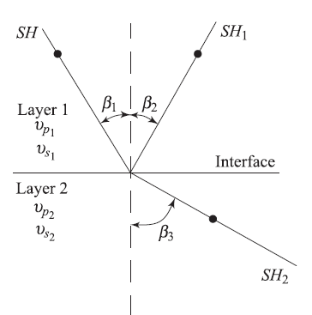
Reflection and Refraction of Elastic Body Waves

Slide 6
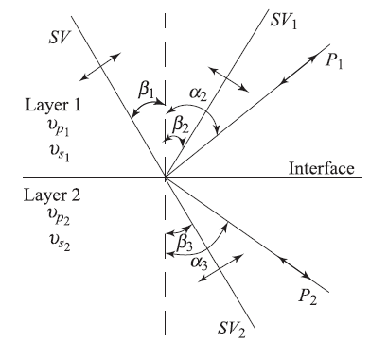
Reflection and Refraction of Elastic Body Waves

Slide 7
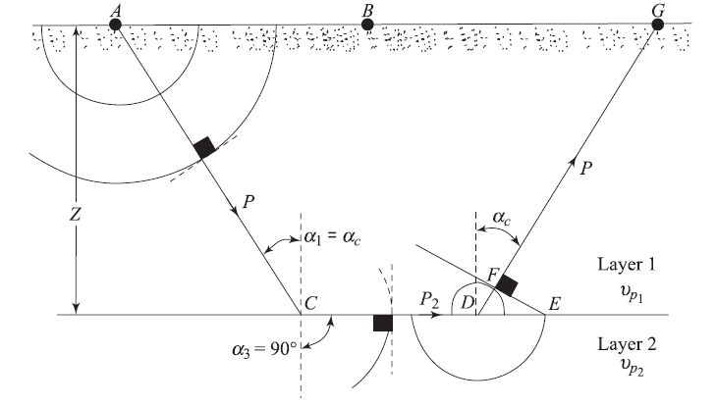
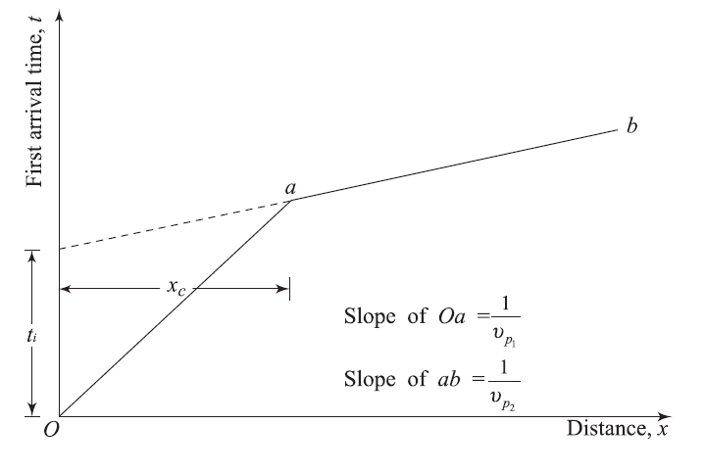
Seismic Refraction Survey (Horizontal Layering)
Seismic refraction surveys are sometimes used to determine the wave propagation velocities through various soil layers in the field and to obtain thicknesses of each layer.

Slide 8
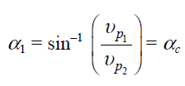
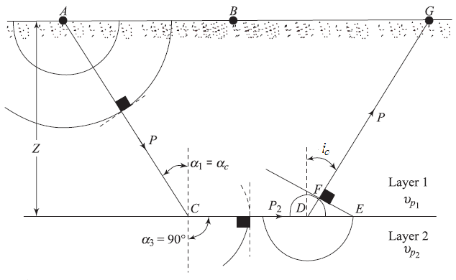
Seismic Refraction Survey (Horizontal Layering)

Slide 9
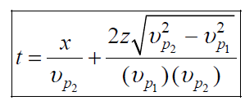
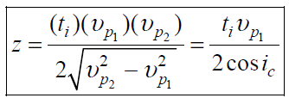
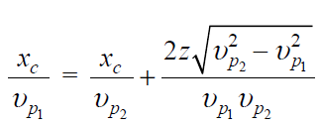
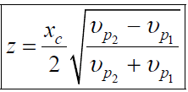
Seismic Refraction Survey (Horizontal Layering)

Slide 10
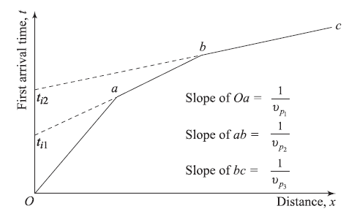
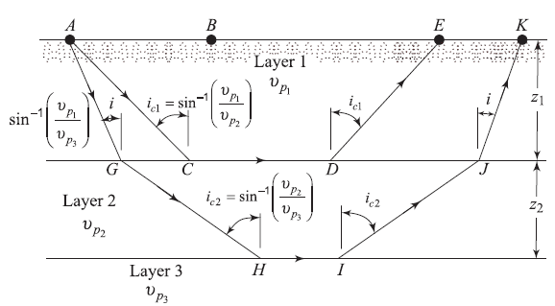
Refraction Survey in a Three-Layered Soil Medium

Slide 11
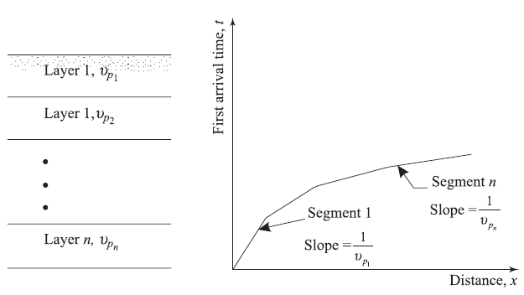
Refraction Survey for Multilayer Soil

Slide 12
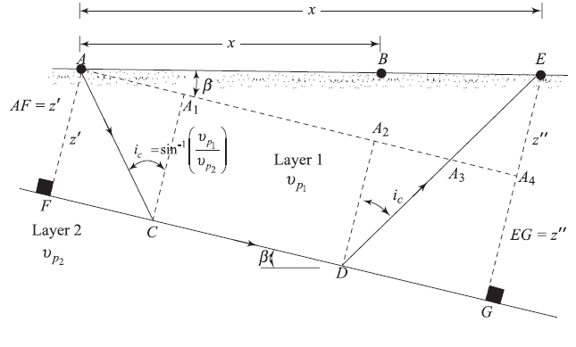
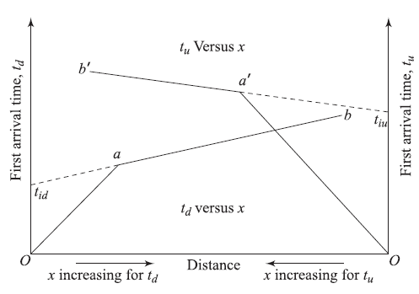
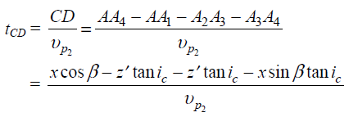
Refraction Survey in Soils with Inclined Layering

Slide 13
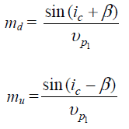
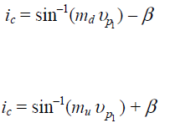
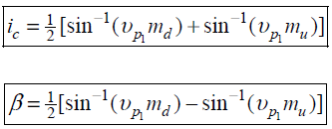
Refraction Survey in Soils with Inclined Layering

Slide 14
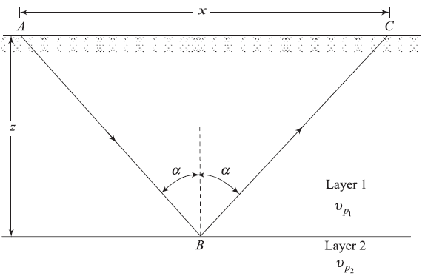
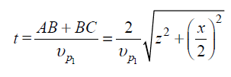
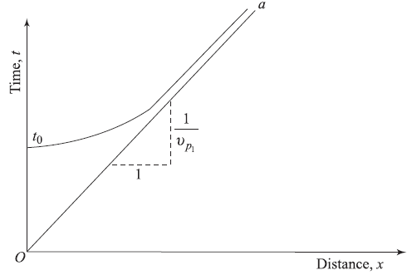
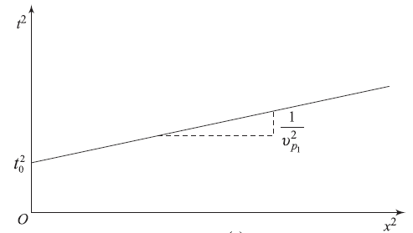
Reflection Survey in Soil (Horizontal Layering)

Slide 15
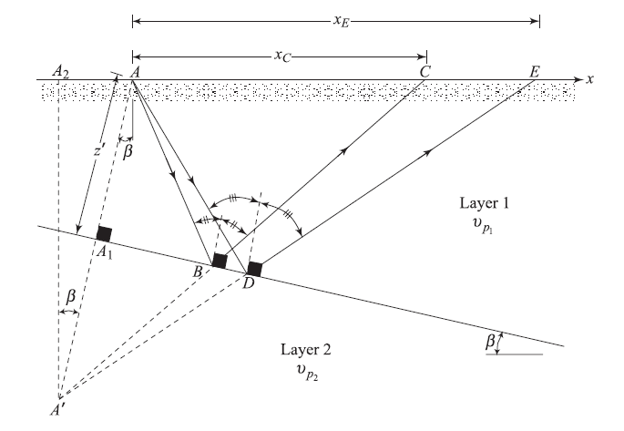
Reflection Survey in Soil (Inclined Layering)

Slide 16
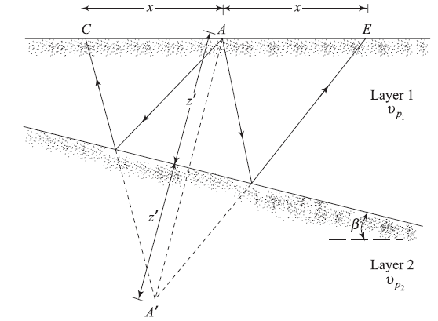
Reflection Survey in Soil (Inclined Layering)

Slide 17
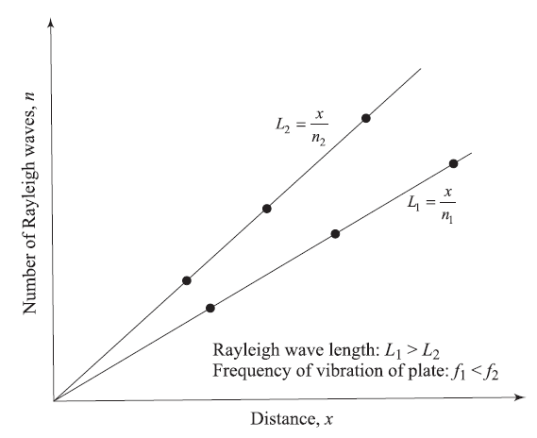
Subsoil Exploration by Steady-State Vibration
Rayleigh waves velocity :

Slide 18
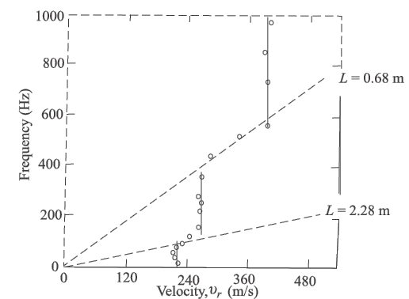
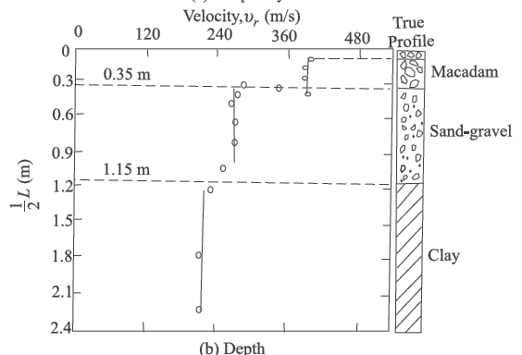
Subsoil Exploration by Steady-State Vibration

Slide 19
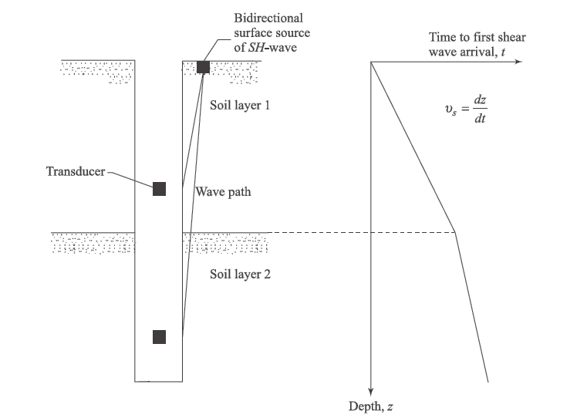
Soil Exploration - Shooting Down the Hole
SH-Waves

Slide 20
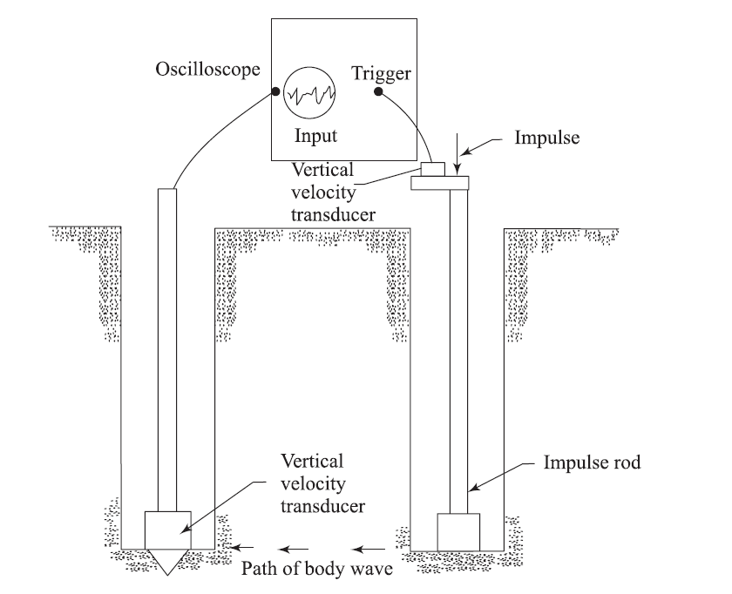
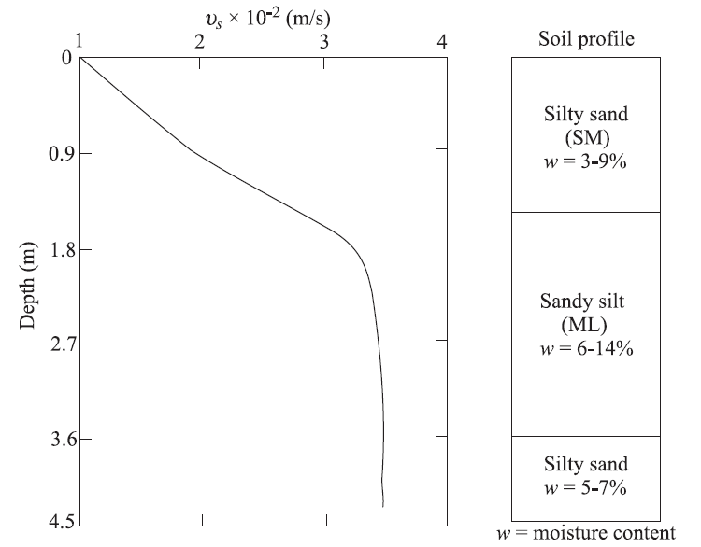
Soil Exploration - Cross-Hole Shooting
SV-Waves

Slide 21
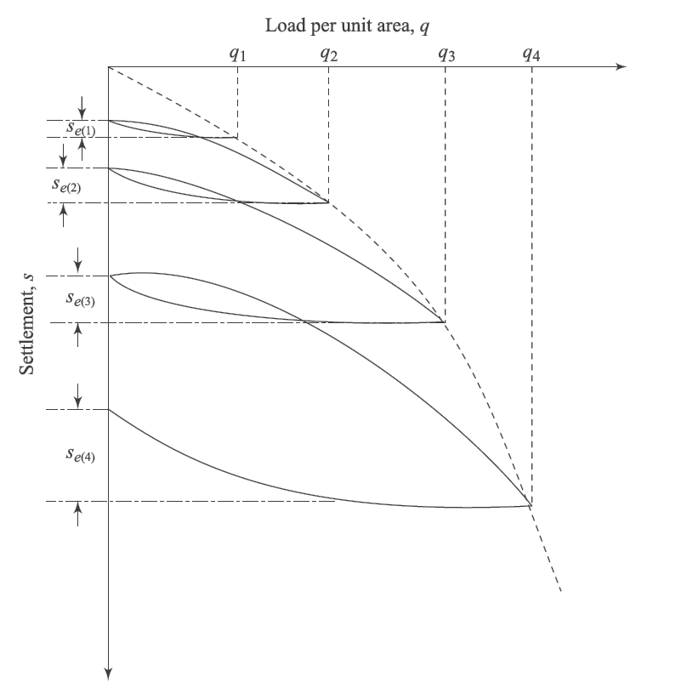
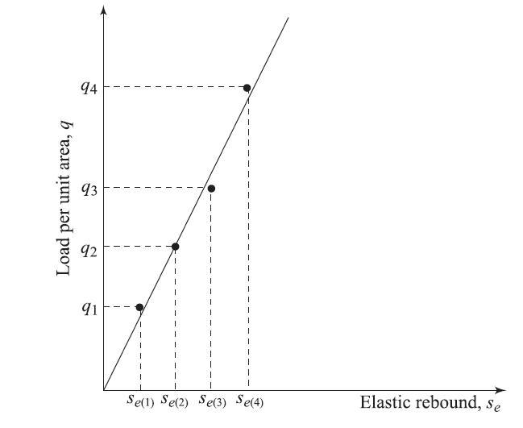
Cyclic Plate Load Test
The cyclic field plate load test is similar to the plate bearing test conducted in the field for evaluation of the allowable bearing capacity of soil for foundation design purposes. The plates used for tests in the field are usually made of steel and are 25 mm thick and 150 mm to 762 mm in diameter.

Slide 22
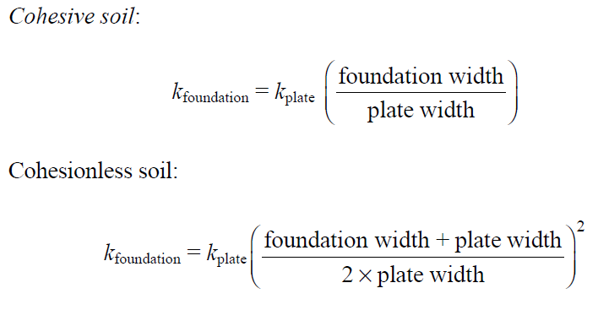
Cyclic Plate Load Test
Spring Constant k:

Slide 23
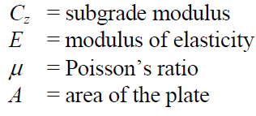
Cyclic Plate Load Test
Shear Modulus (G):

Slide 24
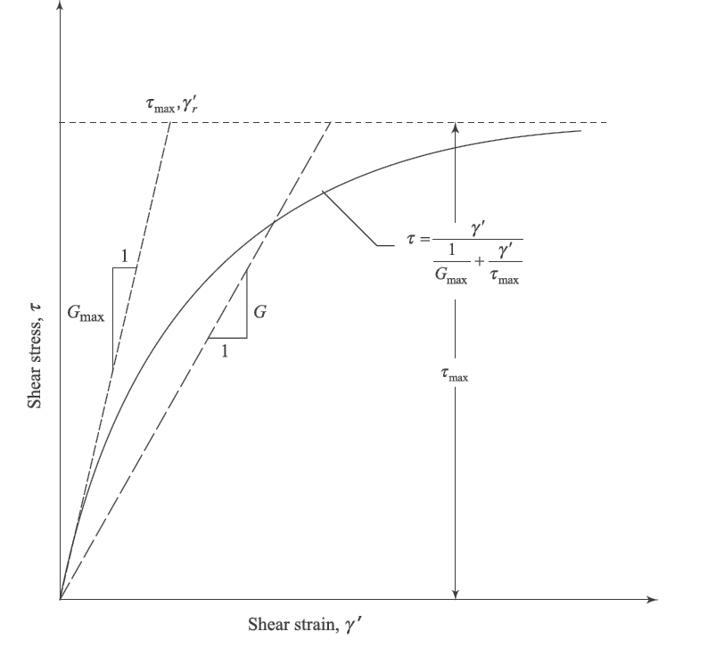
Correlations for Shear Modulus and Damping Ratio
Number of cycles of dynamic load application,
Magnitude of dynamic stress
Level of dynamic strain
Degree of saturation
Confining pressure
Dynamic pre-strain
Type of soil
Frequency

Slide 25
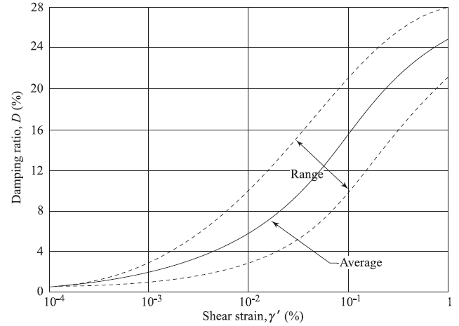
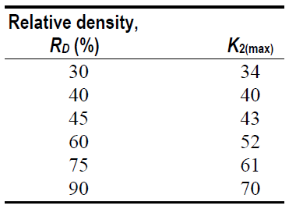
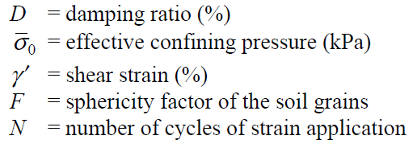
Correlations for Shear Modulus and Damping Ratio
Shear Modulus and Damping Ratio in Sand,

Slide 26
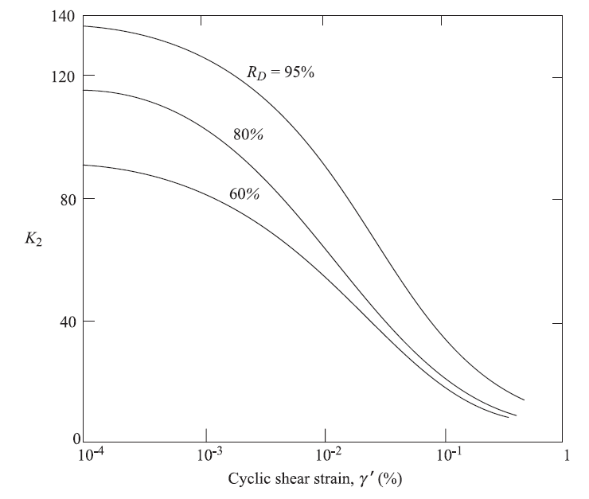
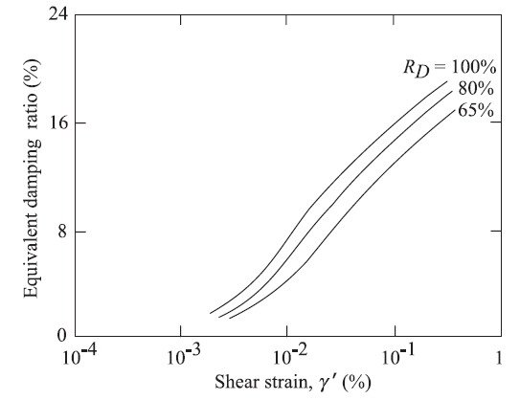
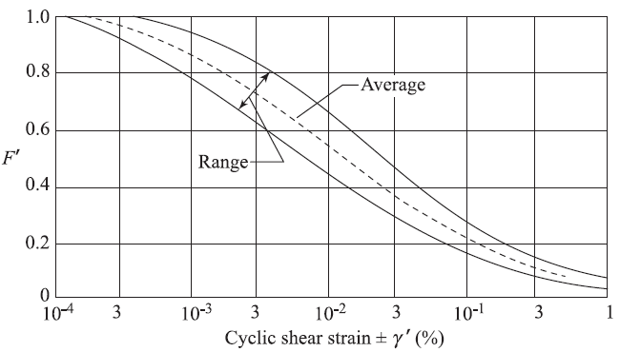
Correlations for Shear Modulus and Damping Ratio
Shear Modulus and Damping Ratio for Gravels

Slide 27
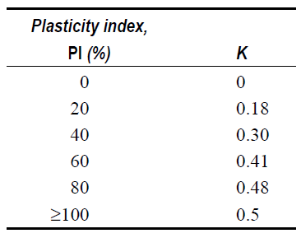
Correlations for Shear Modulus and Damping Ratio
Shear Modulus and Damping Ratio for Clays

Slide 28
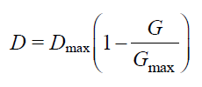
Correlations for Shear Modulus and Damping Ratio
Shear Modulus and Damping Ratio for Clays

Slide 29
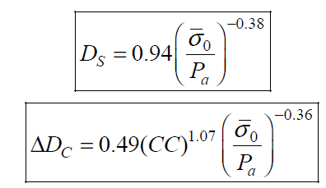
Correlations for Shear Modulus and Damping Ratio
Shear Modulus and Damping Ratio for Lightly Cemented Sand

