Slide 1
Soil Dynamics
By: M. Iman Khodakarami (Associate Prof. of Earthquake Eng.)
Email: Khodakarami@semnan.ac.ir ; I.Khodakarami@gmail.com
Phone: (+98) 23- 31535243
Civil Eng. Faculty,
Semnan University

Slide 2
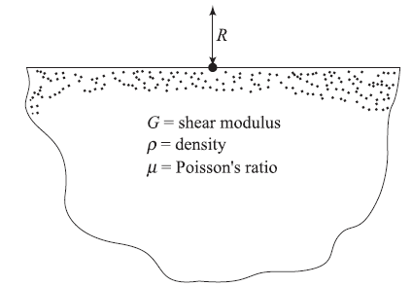
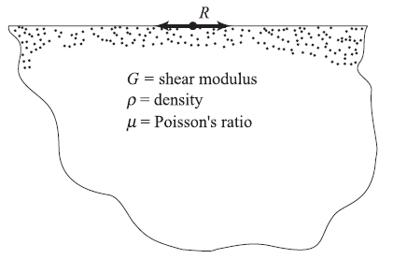
Vertical Vibration of Foundations
Lamb’s problem (dynamic Boussinesq problem)

Slide 3
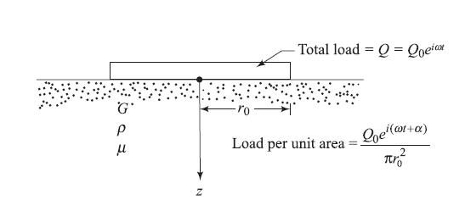
Vertical Vibration of Foundations
Uniformly loaded flexible circular area

Slide 4
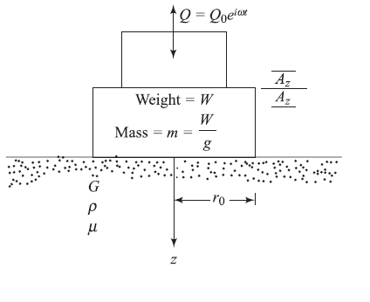
Vertical Vibration of Foundations
Uniformly loaded flexible circular area

Slide 5
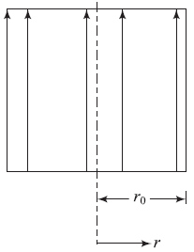
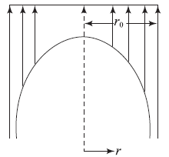
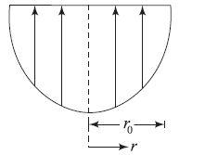
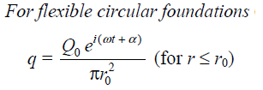
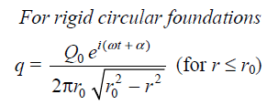
Vertical Vibration of Foundations
contact pressure at a distance r measured from the center of the foundation

Slide 6
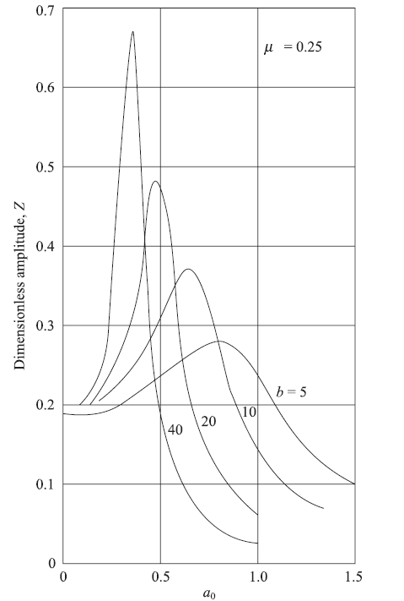
Vertical Vibration of Foundations

Slide 7
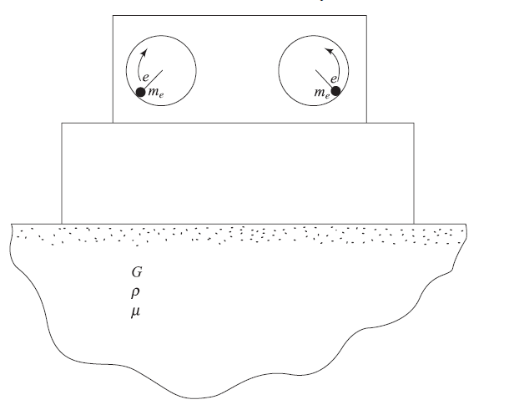
Vertical Vibration of Foundations
Foundations, on some occasions, may be subjected to a frequency-dependent excitation

Slide 8
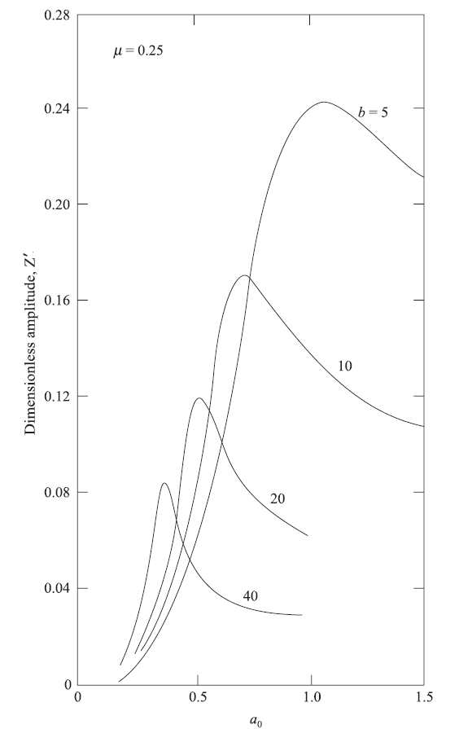
Vertical Vibration of Foundations

Slide 9
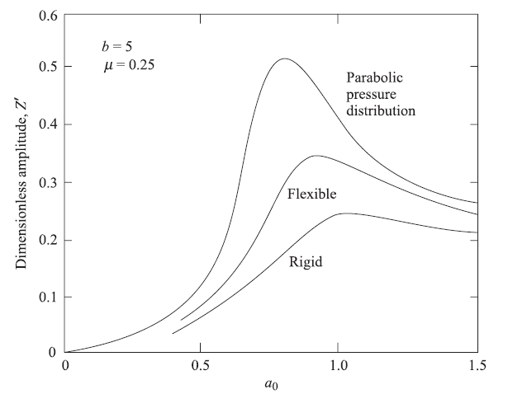
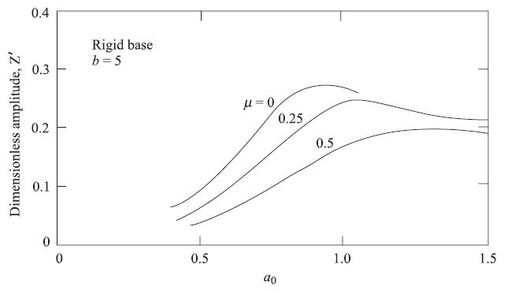
Vertical Vibration of Foundations

Slide 10
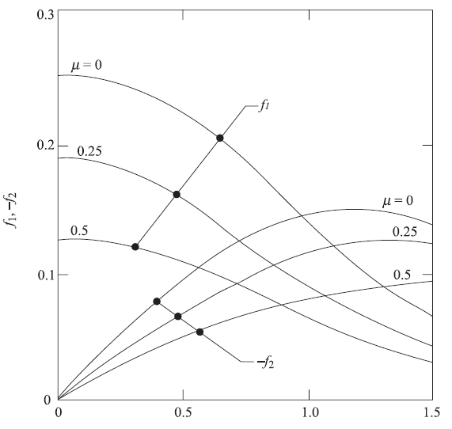
Vertical Vibration of Foundations

Slide 11
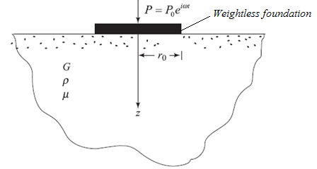
Lysmer’s Analog Solutions for Vertical Vibration of Foundations

Slide 12
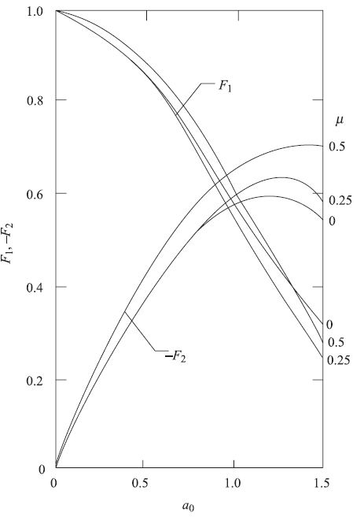
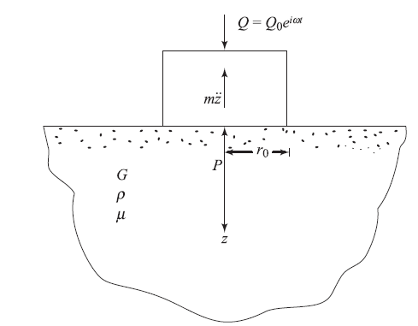
Lysmer’s Analog Solutions for Vertical Vibration of Foundations
Dynamic Equilibrium for a foundation with mass m:
The displacement function:

Slide 13
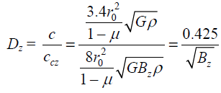
Calculation Procedure for Foundation Response (Vertical Vibration)
Resonant Frequency:
Calculation of natural frequency:
Calculation of damping ratio Dz:

Slide 14
Calculation Procedure for Foundation Response (Vertical Vibration)
Calculation of the resonance frequency:

Slide 15
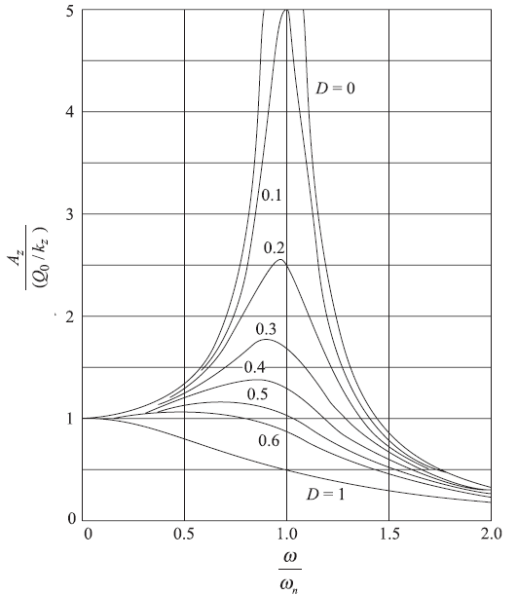
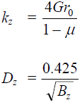
Calculation Procedure for Foundation Response (Vertical Vibration)
Amplitude of Vibration at Resonance:
Amplitude of Vibration at Frequencies Other Than Resonance:
For rectangular foundation (BxL):

Slide 16
Calculation Procedure for Foundation Response (Vertical Vibration)
In the design of machine foundations, the following general rules may be kept in mind to avoid possible resonance conditions:

Slide 17
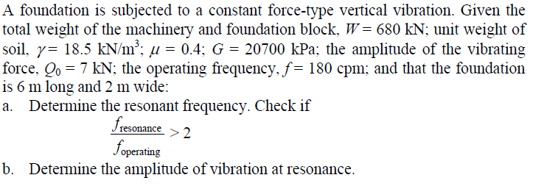
Foundation Response (Vertical Vibration); Example-1

Slide 18
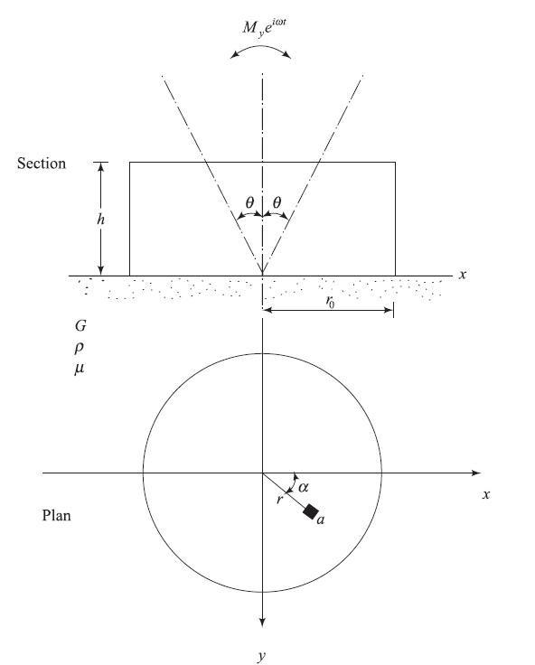
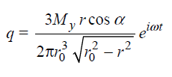
Rocking Vibration of Foundations
Contact pressure at any point defined by point “a” on the plan:
Equation of motion for a rocking vibration:

Slide 19
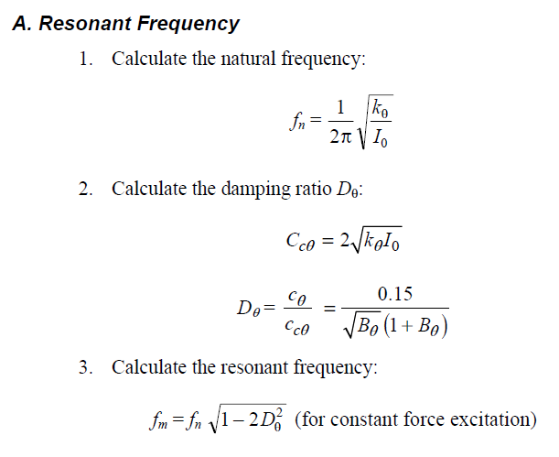
Solution procedure for foundation response (Rocking Vibration )

Slide 20
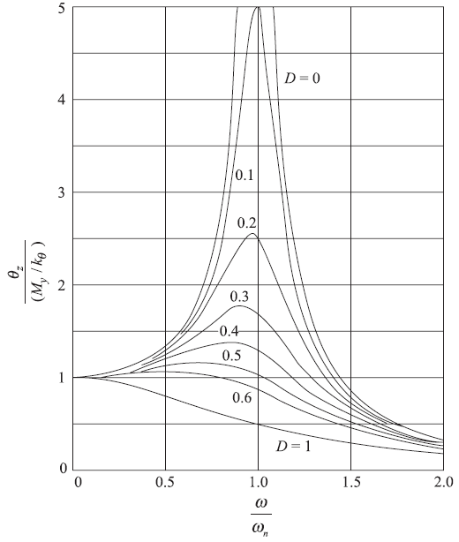
Solution procedure for foundation response (Rocking Vibration )

Slide 21
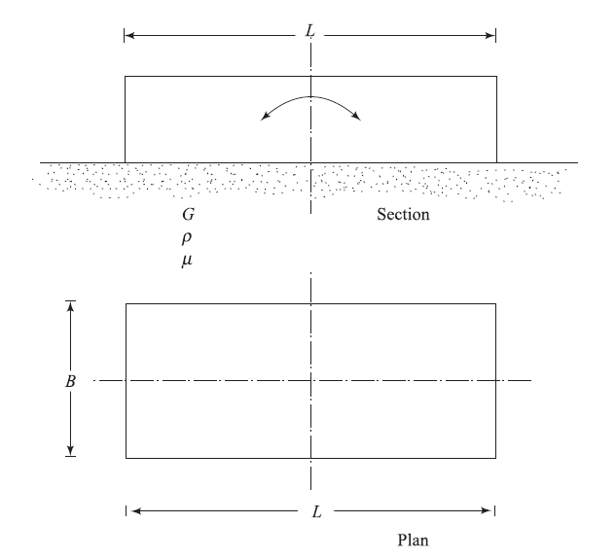
Rocking Vibration of Rectangular Foundations

Slide 22
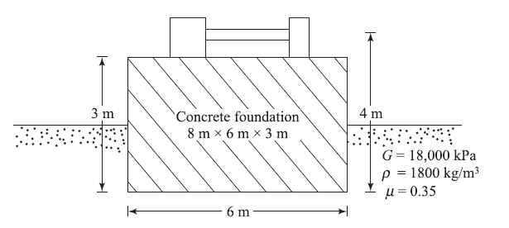
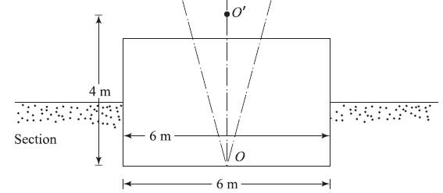
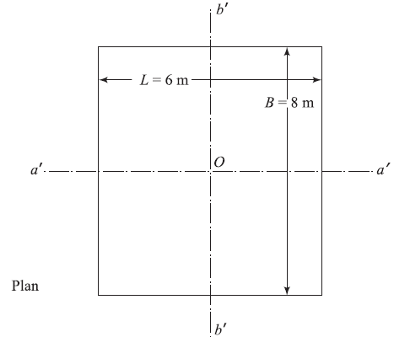
Foundation Response (Rocking Vibration); Example-1c

Slide 23
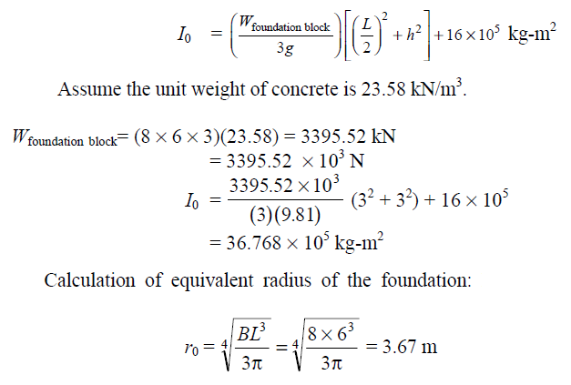
Foundation Response (Rocking Vibration); Example-1c

Slide 24
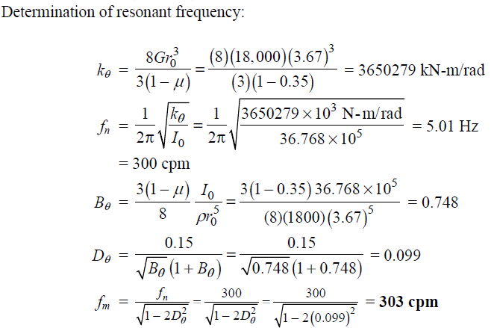
Foundation Response (Rocking Vibration); Example-1c

Slide 25
Foundation Response (Rocking Vibration); Example-1c
Exercise-1: Derive equation of motion for sliding and torsional vibration of a foundation and calculate the foundation response.
Exercise-2: Derive equation of motion for Coupled Rocking and Sliding Vibration of a foundation and calculate its response.

Slide 26
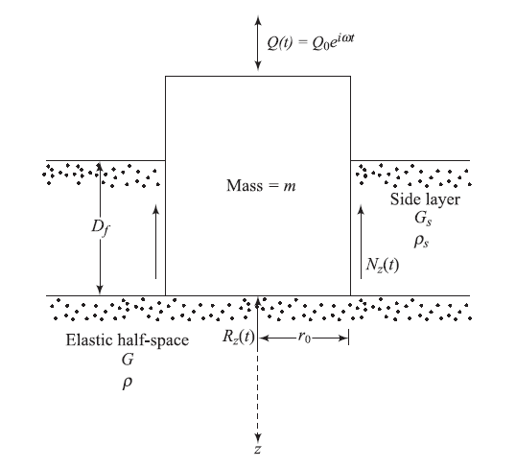
Vibration of Embedded Foundations
Vertical Vibration of Rigid Cylindrical Foundations

Slide 27
Vertical Vibration of Embedded Foundations

Slide 28
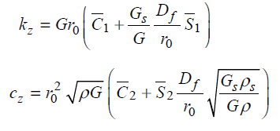
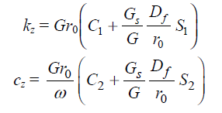
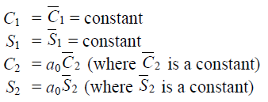
Vertical Vibration of Embedded Foundations

Slide 29
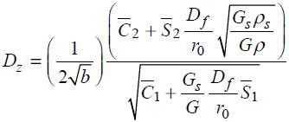
Vertical Vibration of Embedded Foundations
Damping ratio:

Slide 30
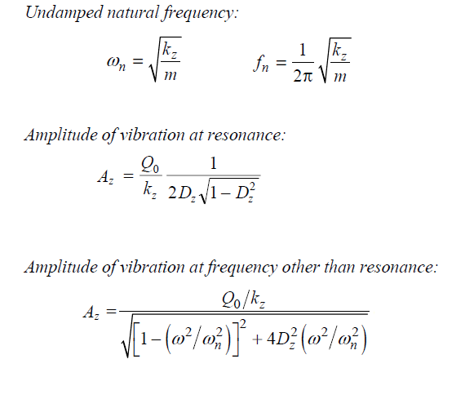
Vertical Vibration of Embedded Foundations
Exercise-3: Derive equation of motion for sliding, torsional and rocking vibration of a embedded foundation and calculate the foundation response.

Slide 31
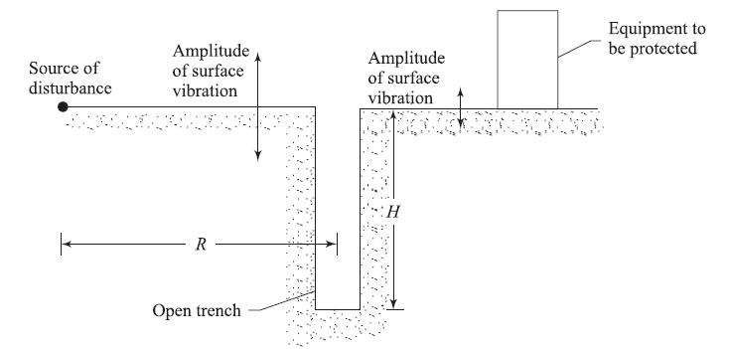
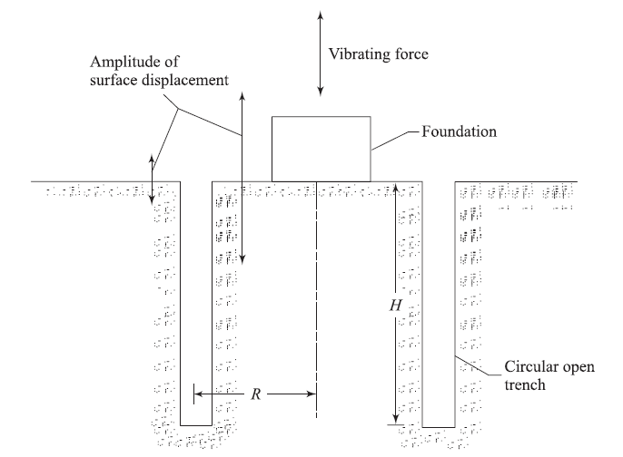
Active/ Passive Isolation by Use of Open Trenches

Slide 32
Dynamic bearing capacity of shallow foundations
Most important factors:
Nature of variation of the magnitude of the loading pulse,
Duration of the pulse,
Strain-rate response of the soil during deformation

Slide 33
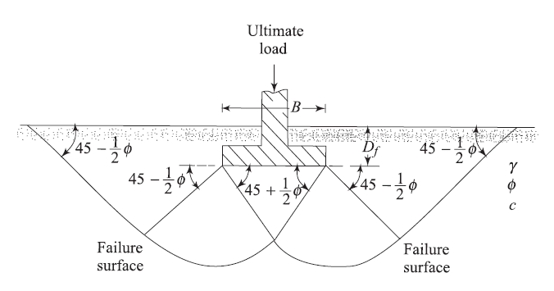
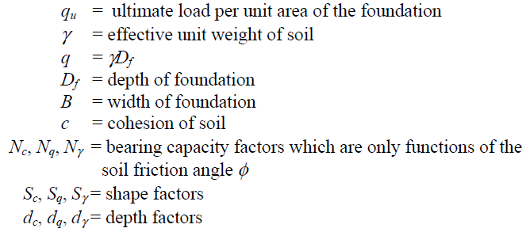
Bearing Capacity of foundation in Sand
static ultimate bearing capacity:

Slide 34
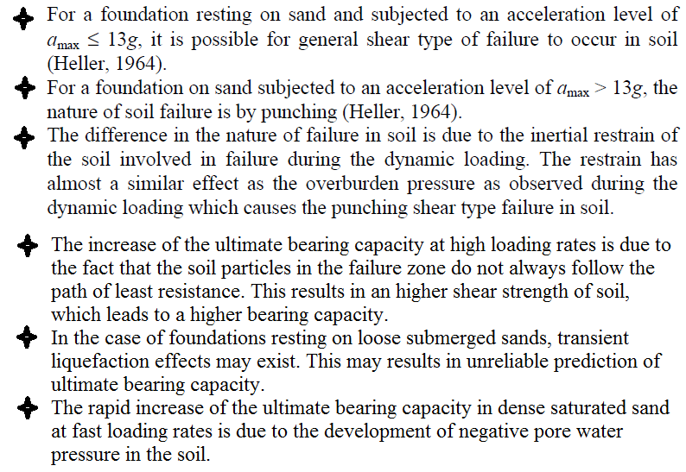
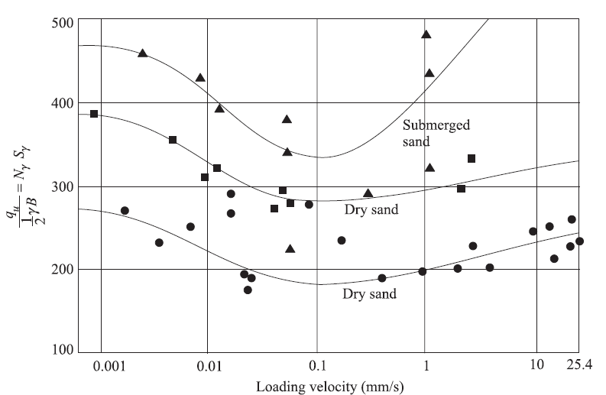
Bearing Capacity of foundation in Sand
Effects loading velocity on bearing capacity factor
This, in effect, corresponds to a decrease in the angle of friction of soil by about 2º when the loading velocity reached a value of about 50.8 × 10−3 mm/s.

Slide 35
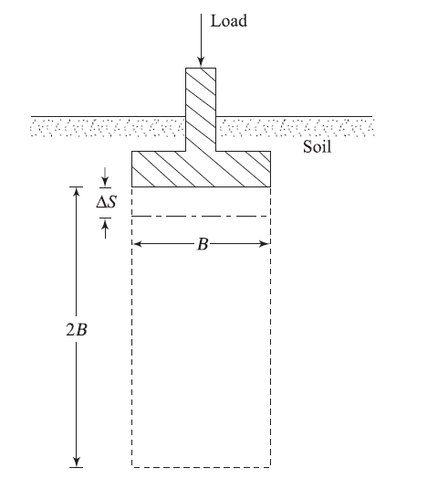
Bearing Capacity of foundation in Clay
For foundations resting on saturated clays (φ = 0 and c = cu;), so;
The ultimate bearing capacity of foundations resting on saturated clay soils, provided the strain-rate effect due to dynamic loading is taken into consideration in determination of the undrained cohesion. Unlike the case in sand, the undrained cohesion of saturated clays increases with the increase of the strain rate. Based on those results, Carroll (1963) suggested that cu(dyn)/cu(stat) may be approximated to be about 1.5.

Slide 36
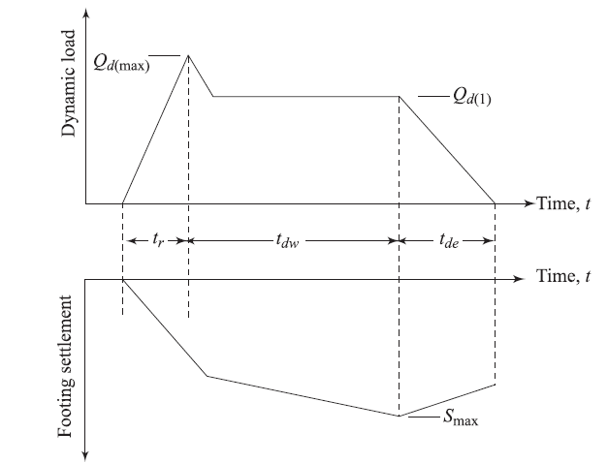
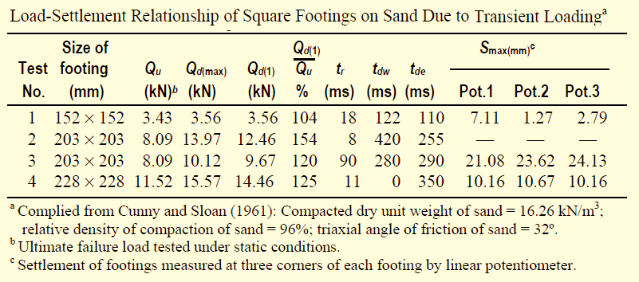
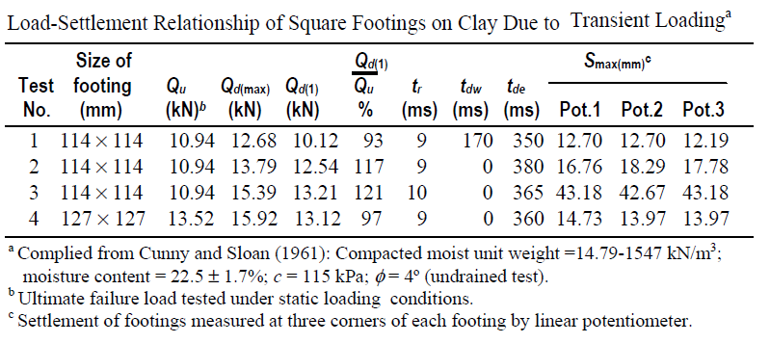
Experimental Observation of Load-Settlement Relationship for Vertical Transient Loading

Slide 37
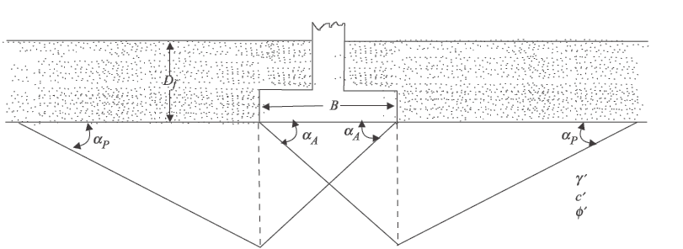
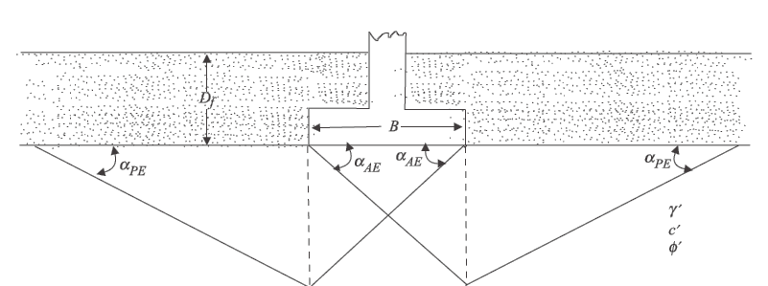
Seismic Bearing Capacity and Settlement in Granular Soil
Failure surface in soil for static bearing capacity analysis:
Failure surface in soil for seismic bearing capacity analysis:

Slide 38
Seismic Bearing Capacity and Settlement in Granular Soil

Slide 39
Seismic Bearing Capacity and Settlement in Granular Soil

Slide 40
Seismic Bearing Capacity- Example

Slide 41
Seismic Bearing Capacity- Example

Slide 42
Seismic Bearing Capacity- Example

