Slide 1
Soil Dynamics
By: M. Iman Khodakarami (Associate Prof. of Earthquake Eng.)
Email: Khodakarami@semnan.ac.ir ; I.Khodakarami@gmail.com
Phone: (+98) 23- 31535243
Civil Eng. Faculty,
Semnan University

Slide 2
Pile Foundations
In general, use of piles will increase the natural frequency of the soil–pile system and may also increase the amplitude of vibration at resonance.
The soil–structure interaction of the deep foundations is not well understood and though rigorous theoretical solutions exist, they are mostly confined to researchers than designers. The practice in design offices is usually based on ignoring the stiffness of the soil and only the stiffness of the pile is taken into account.
In general, piles can be grouped into two broad categories: End-bearing piles: These piles penetrate through soft soil layers up to a hard stratum or rock. The hard stratum or rock can be considered as rigid. Friction piles or floating plies: The tips of these piles do not rest on hard stratum. The piles resist the applied load by means of frictional resistance developed at the soil-pile interface.

Slide 3
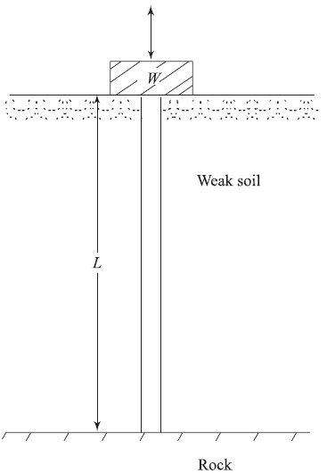
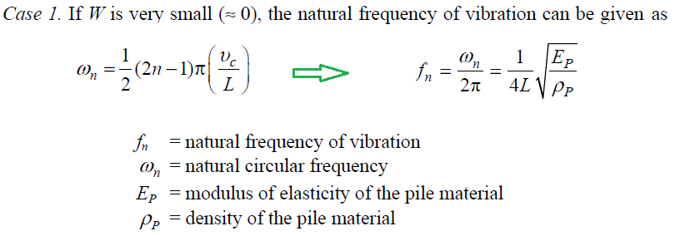
End-Bearing Piles Subjected to Vertical Vibration
This problem can be approximately treated as a vertical rod fixed at the base and free on top. For determining the natural frequency of the piles, three possible cases may arise.

Slide 4
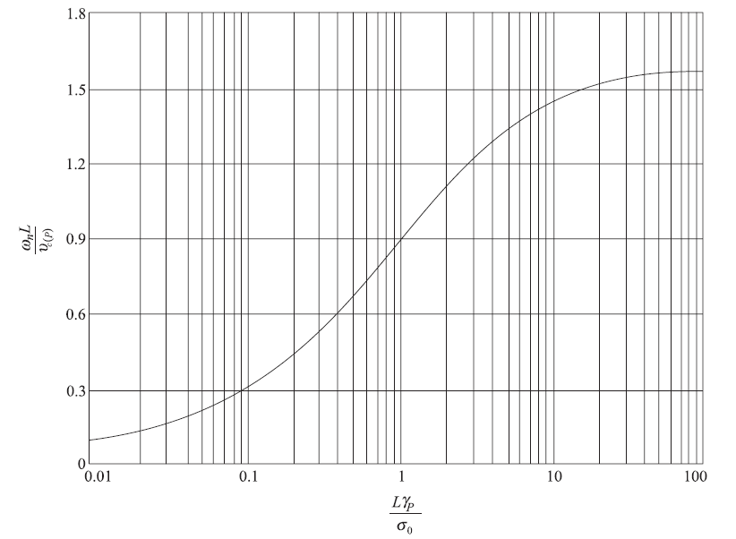
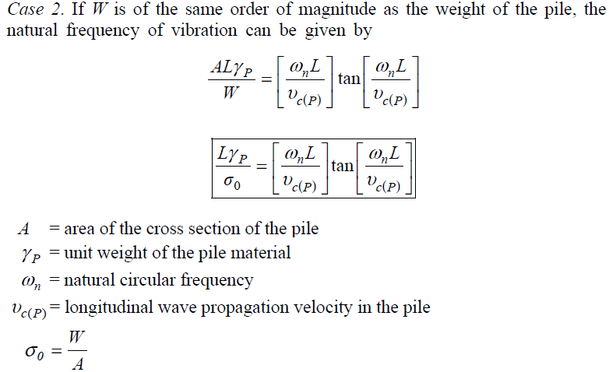
End-Bearing Piles Subjected to Vertical Vibration

Slide 5
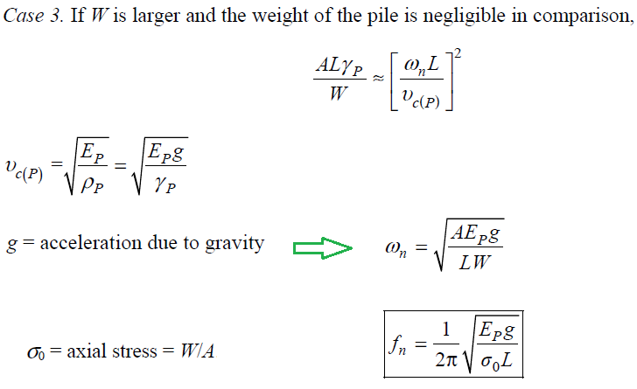
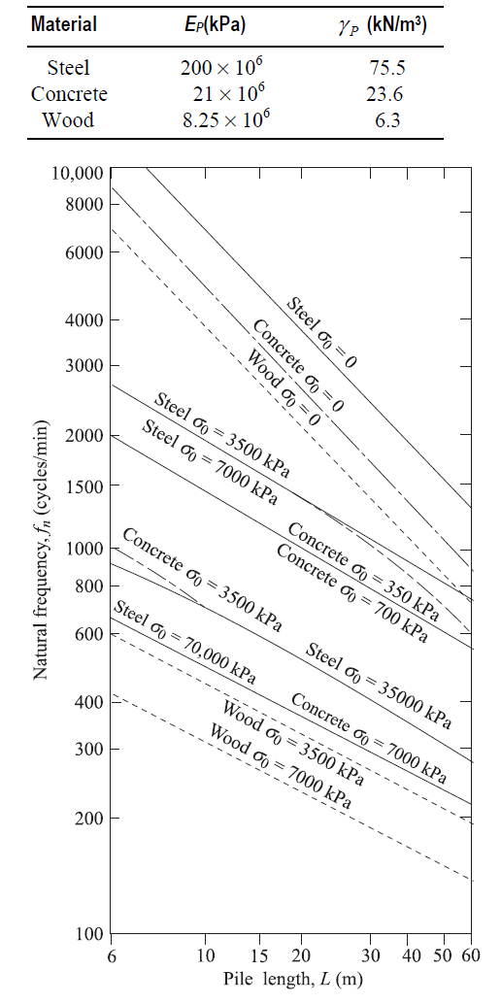
End-Bearing Piles Subjected to Vertical Vibration

Slide 6
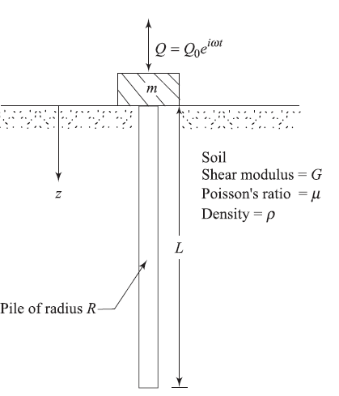
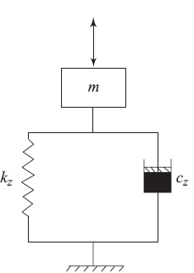
Friction Piles Subjected to Vertical Vibration
In developing the theory for obtaining the stiffness (kz) and the damping (cz) parameters, the following assumptions were made:
The pile is vertical, elastic, and circular in cross section.
The pile is floating.
The pile is perfectly connected to the soil.
The soil above the pile tip behaves as infinitesimal, thin, independent linearly elastic layers.
Assumption of plane strain condition

Slide 7
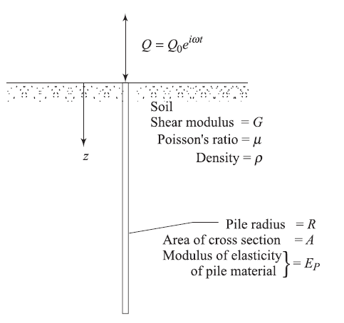
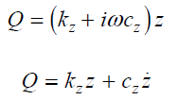
Friction Piles Subjected to Vertical Vibration
The dynamic stiffness and damping of the pile can then be described in terms of complex stiffness

Slide 8
Friction Piles Subjected to Vertical Vibration
The relationships for kz and cz have been given by Novak and El- Sharnouby (1983) as

Slide 9
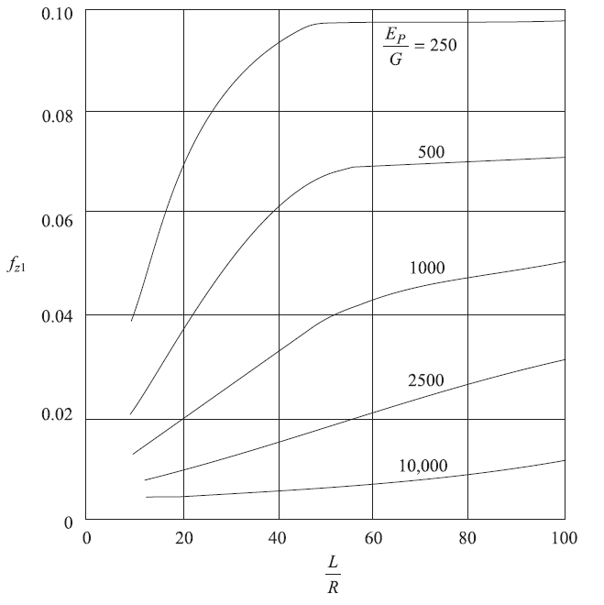
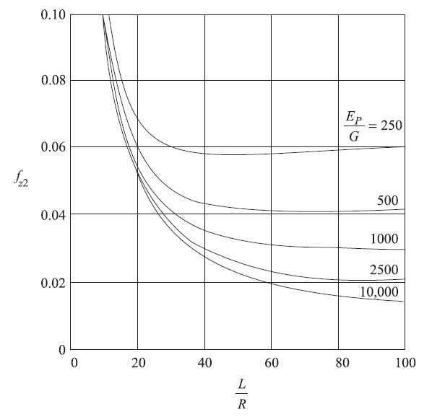
Friction Piles Subjected to Vertical Vibration
for end-bearing piles

Slide 10
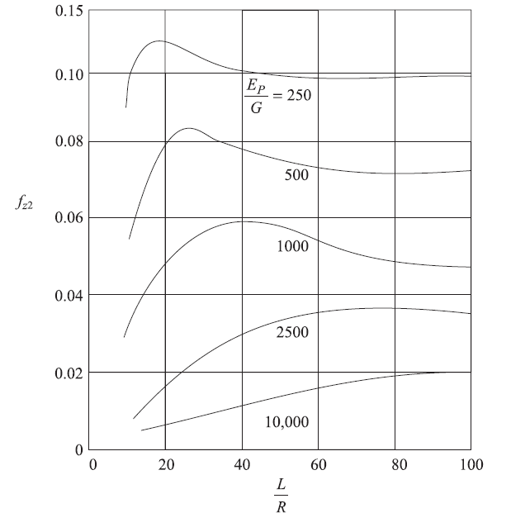
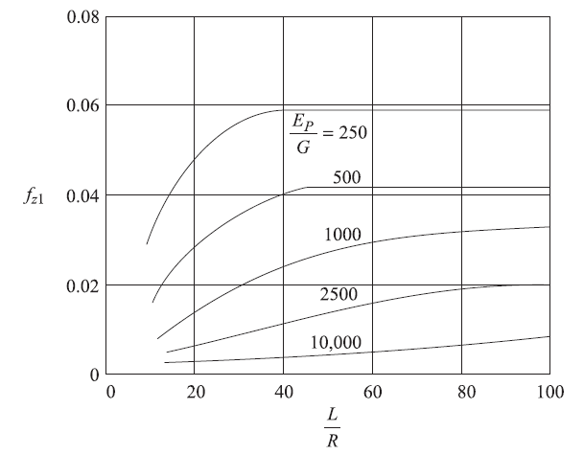
Friction Piles Subjected to Vertical Vibration
For floating piles

Slide 11
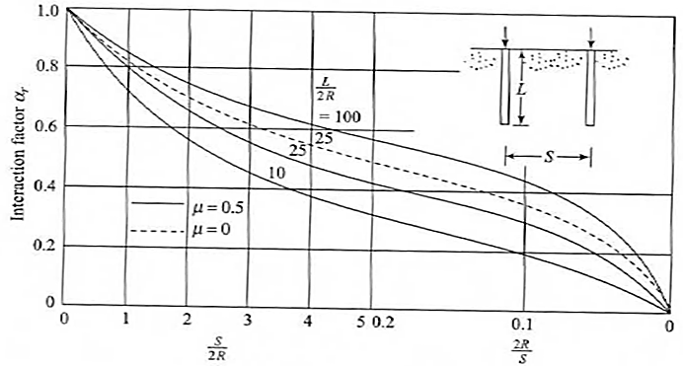
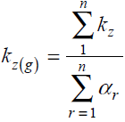
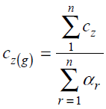
Friction Piles Subjected to Vertical Vibration- Group Piles
Pile foundations are generally constructed in groups. The stiffness and damping constants of a pile group are not simple summations of the stiffness and damping constant of individual piles. Novak (1977) suggested that when piles are closely spaced, the displacement of one pile is increased due to the displacement of all other piles and conversely, the stiffness and damping of the group are reduced. Hence, the stiffness of the pile group can be obtained as:

Slide 12
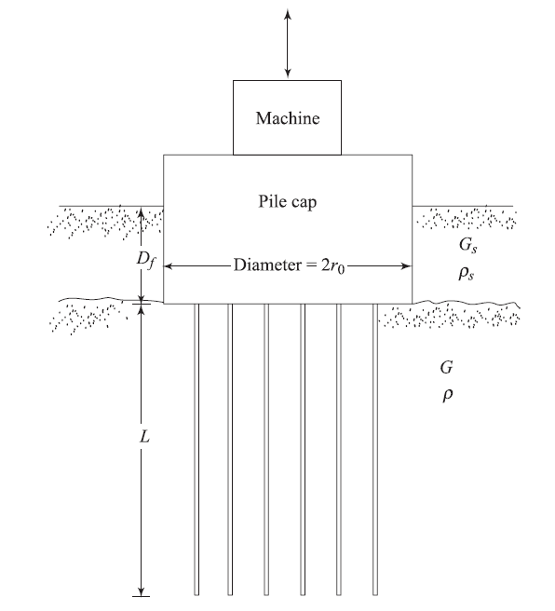
Friction Piles Subjected to Vertical Vibration- Group Piles with Cap

Slide 13
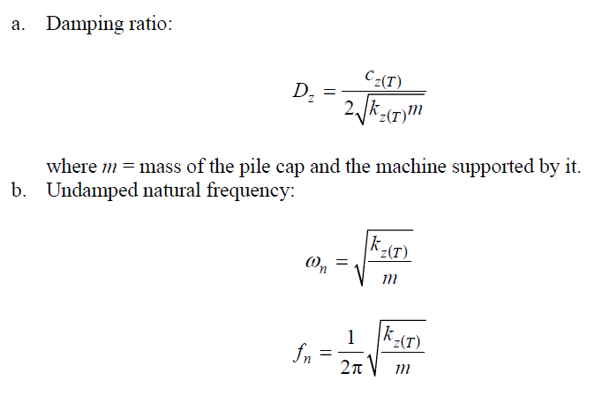
Piles Response- Vertical Vibration

Slide 14
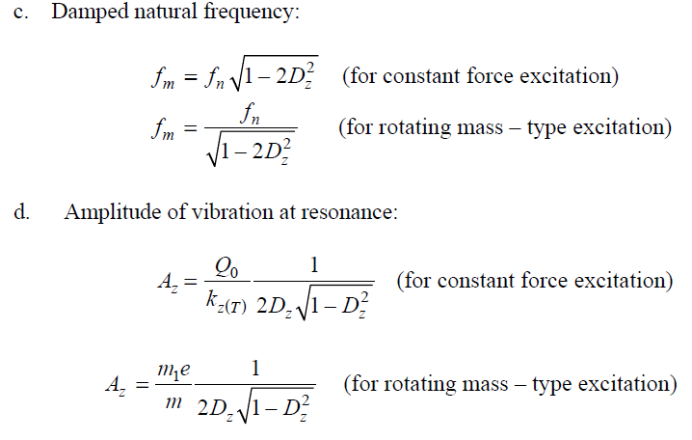
Piles Response- Vertical Vibration

Slide 15
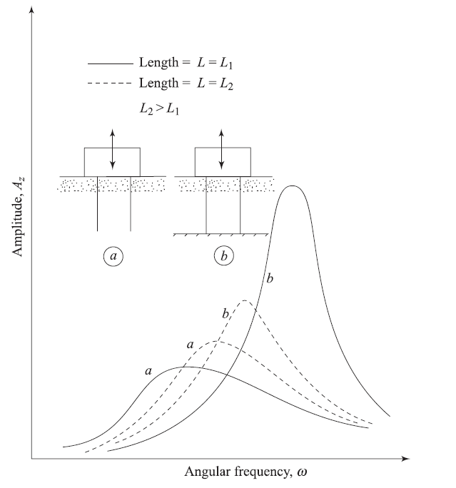
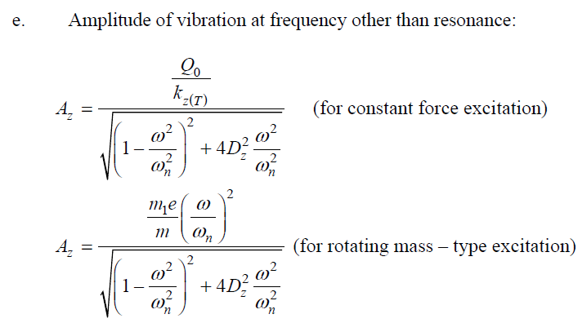
Piles Response- Vertical Vibration

Slide 16
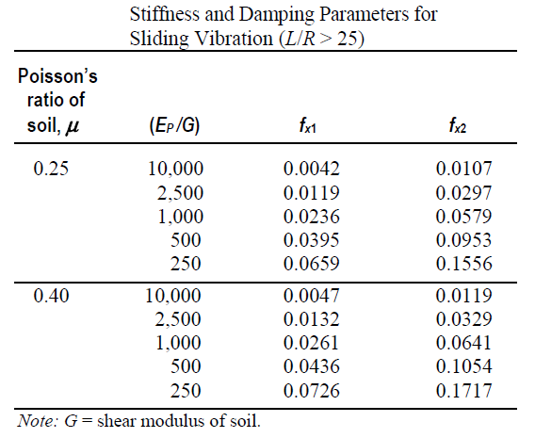
Piles Response- Sliding Vibration

Slide 17
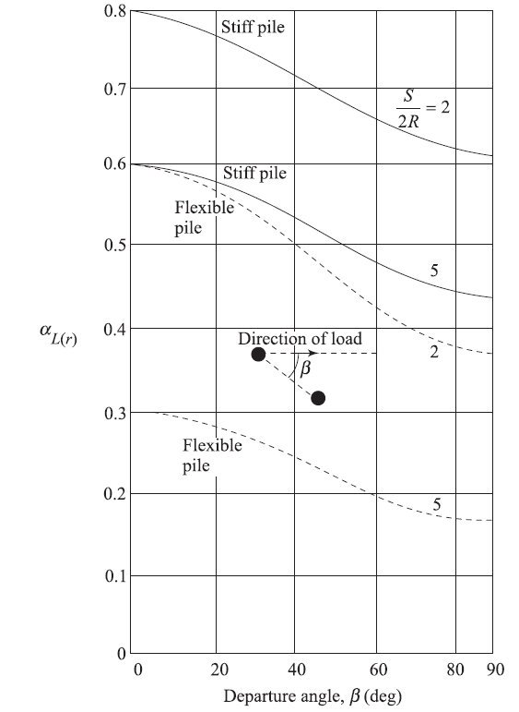
Piles Response- Sliding Vibration
For Group Piles;

Slide 18
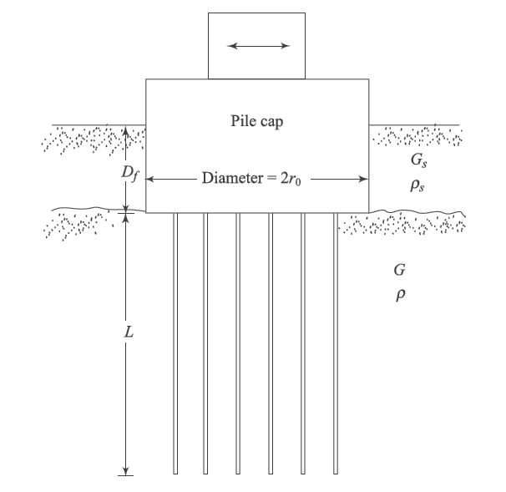
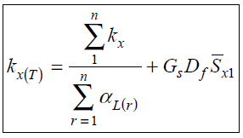
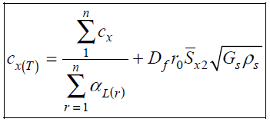
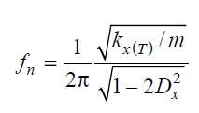
Piles Response- Sliding Vibration
Effect of the pile cap;

Slide 19
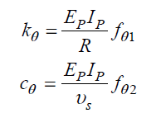
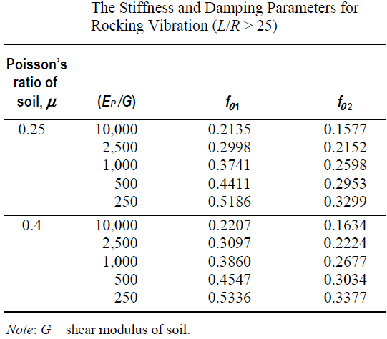
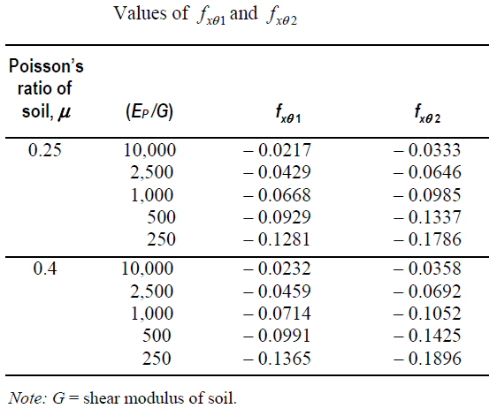
Piles Response- Rocking Vibration

Slide 20
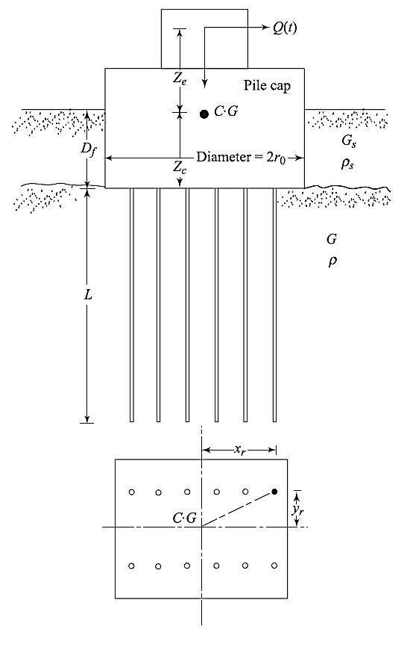
Piles Response- Rocking Vibration
For Group Piles;

Slide 21
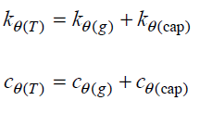
Piles Response- Rocking Vibration
Effect of the pile cap;

Slide 22
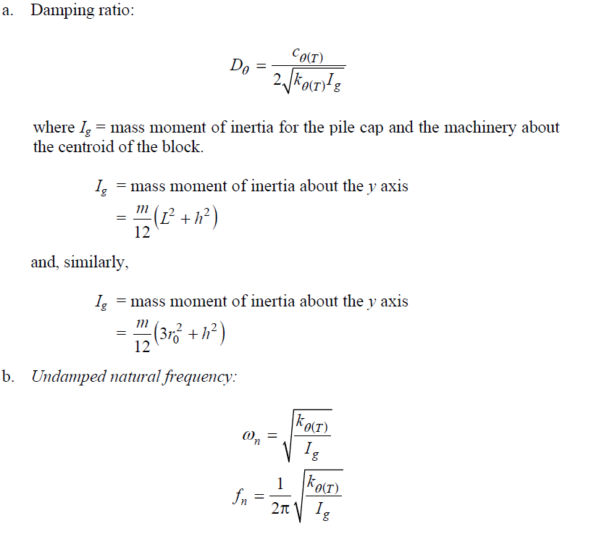
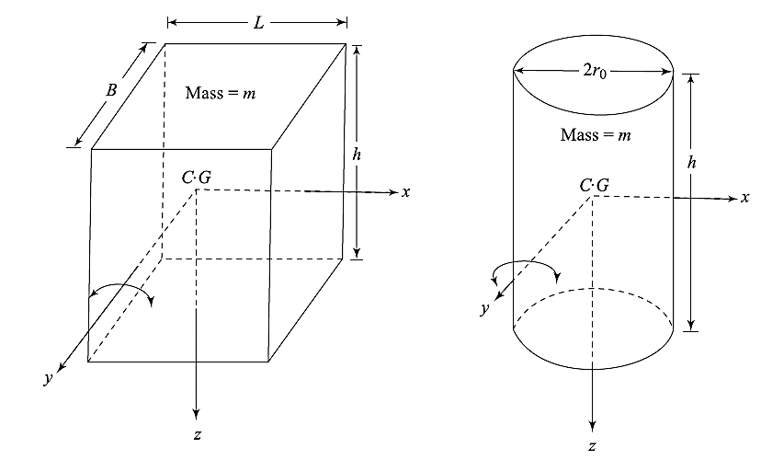
Piles Response- Rocking Vibration

Slide 23
Piles Response- Rocking Vibration
Exercise-1: Derive equation of motion for torsional vibration of a pile, group piles (with & without cap effects) And calculate the its response.

Slide 24
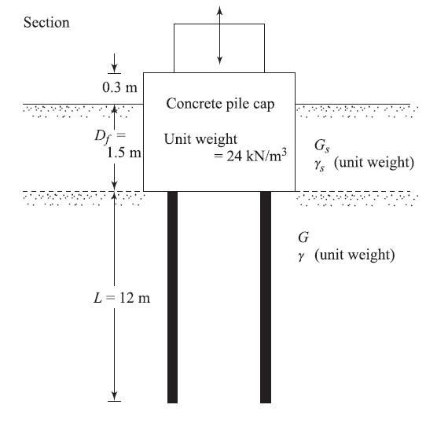
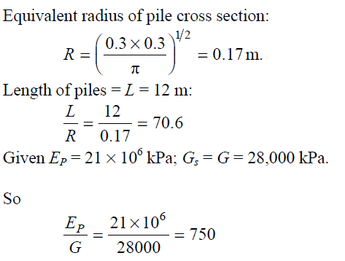
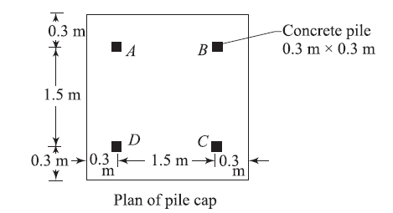
Piles Response- Example 1

Slide 25
Piles Response- Example 1

Slide 26
Piles Response- Example 1

Slide 27
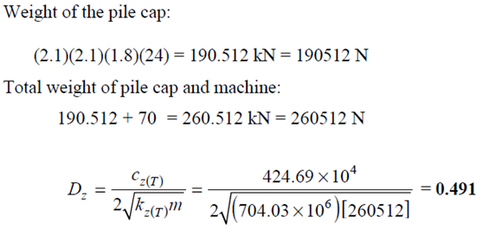
Piles Response- Example 2
Refer to previous example, If the weight of the machine being supported is 70 kN, determine the damping ratio.

Slide 28
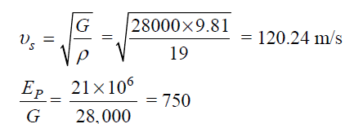
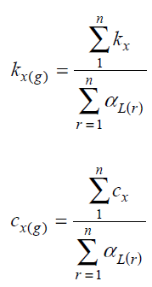
Piles Response- Example 3
Refer to the first example, Determine kx and cx for the sliding mode of vibration.

Slide 29
Piles Response- Example 3

Slide 30
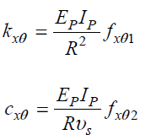
Piles Response- Example 4
Refer to the first example, Determine kθ and cθ for the rocking mode of vibration. Assume Poisson’s ratio of soil to be 0.25.

Slide 31
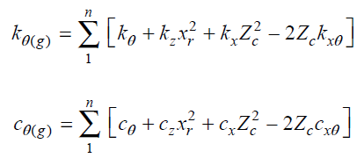
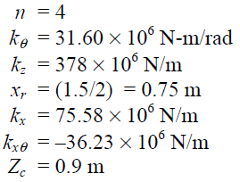
Piles Response- Example 4

Slide 32
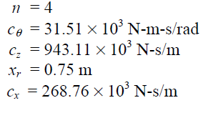
Piles Response- Example 4

Slide 33
Exercise-2
Evaluate the below parameters on the spring and damping ratio of the soil-pile-interaction, dynamic response and dominant frequency of vertical, sliding, rocking vibration:
Pile length,
pile diameter,
cap diameter (LXB),
soil condition,
weight of cap (or foundation),
distance between piles in group,
pile configuration in a group,
Number of piles in a group.

