Slide 1
Soil Dynamics
By: M. Iman Khodakarami (Associate Prof. of Earthquake Eng.)
Email: Khodakarami@semnan.ac.ir ; I.Khodakarami@gmail.com
Phone: (+98) 23- 31535243
Civil Eng. Faculty,
Semnan University

Slide 2
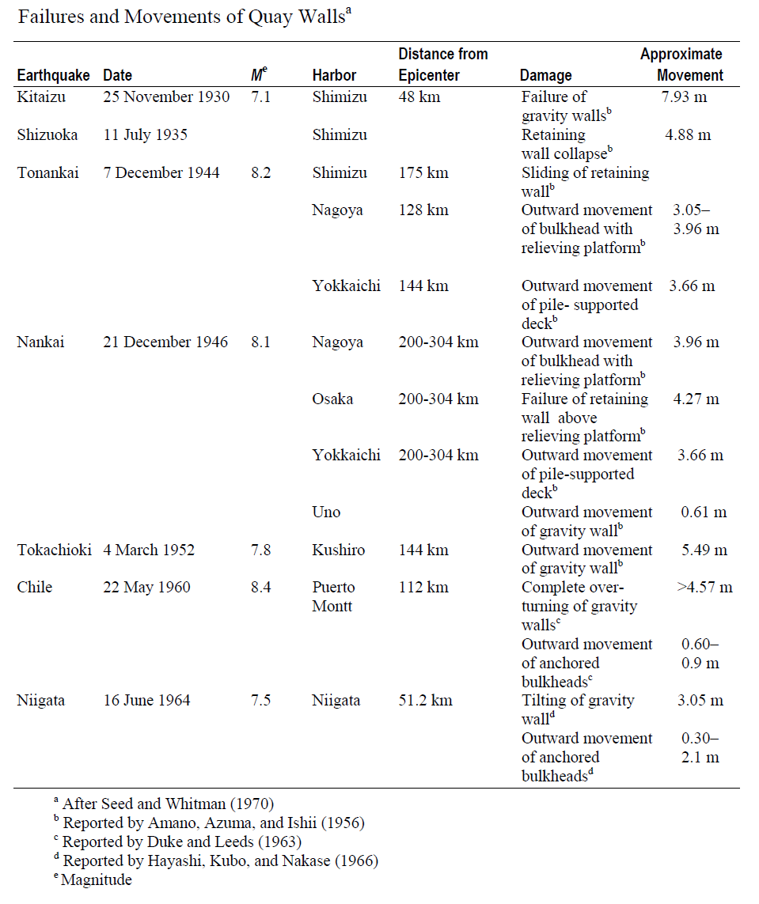
Retaining Walls
Seed and Whitman (1970) have suggested that some of these failures may have been due to several reasons, such as
Increase of lateral earth pressure behind the wall,
Reduction of water pressure at the front of the wall,
Liquefaction of the backfill material.
Nazarian and Hadjan (1979) have suggested; the theories for studying dynamic lateral earth pressure can be divided into three broad categories, such as
Fully plastic (static or pseudo-static) solution,
Solutions based on elastic wave theory,
Solutions based on elasto-plastic and nonlinear theory.

Slide 3
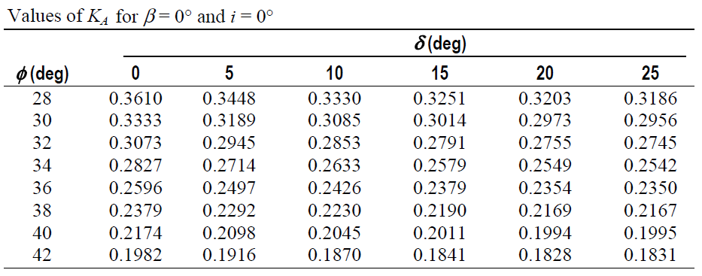
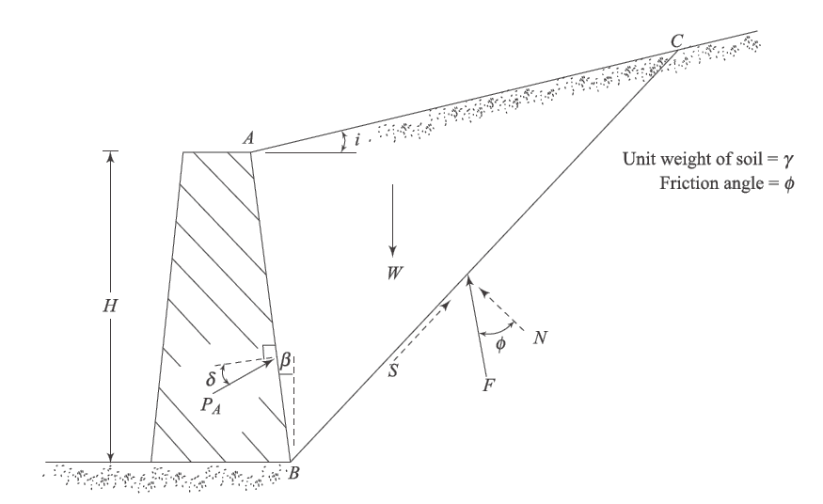
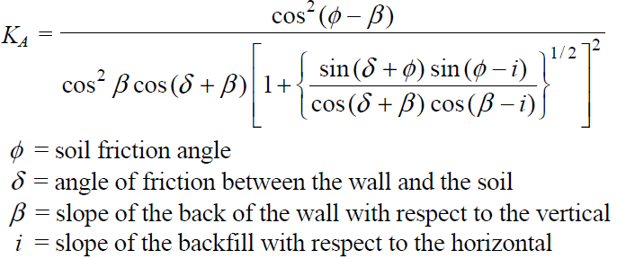
Coulomb’s active earth pressure

Slide 4
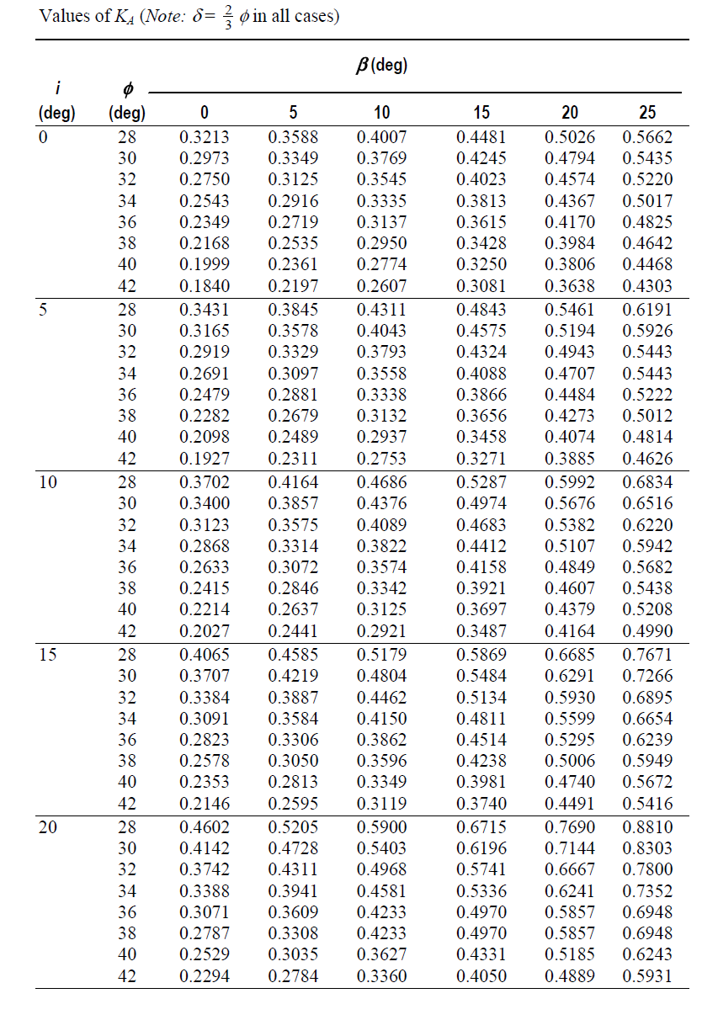
Coulomb’s active earth pressure
In the actual design of retaining walls, the value of the wall friction δ is assumed to be between φ/2 and 2/3φ. This is a very useful table for design considerations.

Slide 5
Mononobe-Okabe Active Earth Pressure Theory
Coulomb’s active earth pressure equation can be modified to take into account the vertical and horizontal coefficients of acceleration induced by an earthquake. This is generally referred to as the Mononobe-Okabe nalysis (Mononobe, 1929; Okabe, 1926):
The failure in soil takes place along a plane such as BC,
The movement of the wall is sufficient to produce minimum active pressure,
The shear strength of the dry cohesion-less soil can be given by the equation;
At failure, full shear strength along the failure plane BC,is mobilized.
The soil behind the retaining wall behaves as a rigid body.

Slide 6
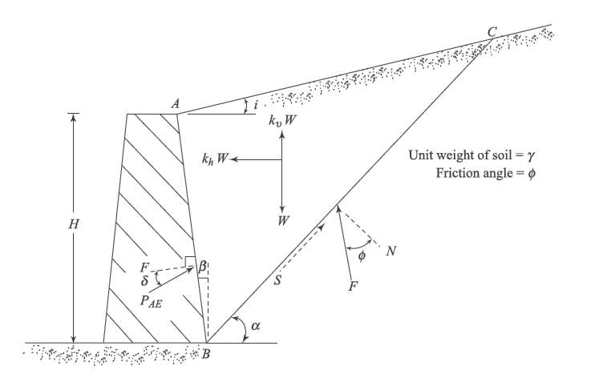
Mononobe-Okabe Active Earth Pressure Theory
The forces on the failure wedge per unit length of the wall are;
weight of wedge W,
active force PAE,
resultant of shear and normal forces along the failure plane F,
Kh.W and Ku.W, the inertia forces in the horizontal and vertical directions.

Slide 7
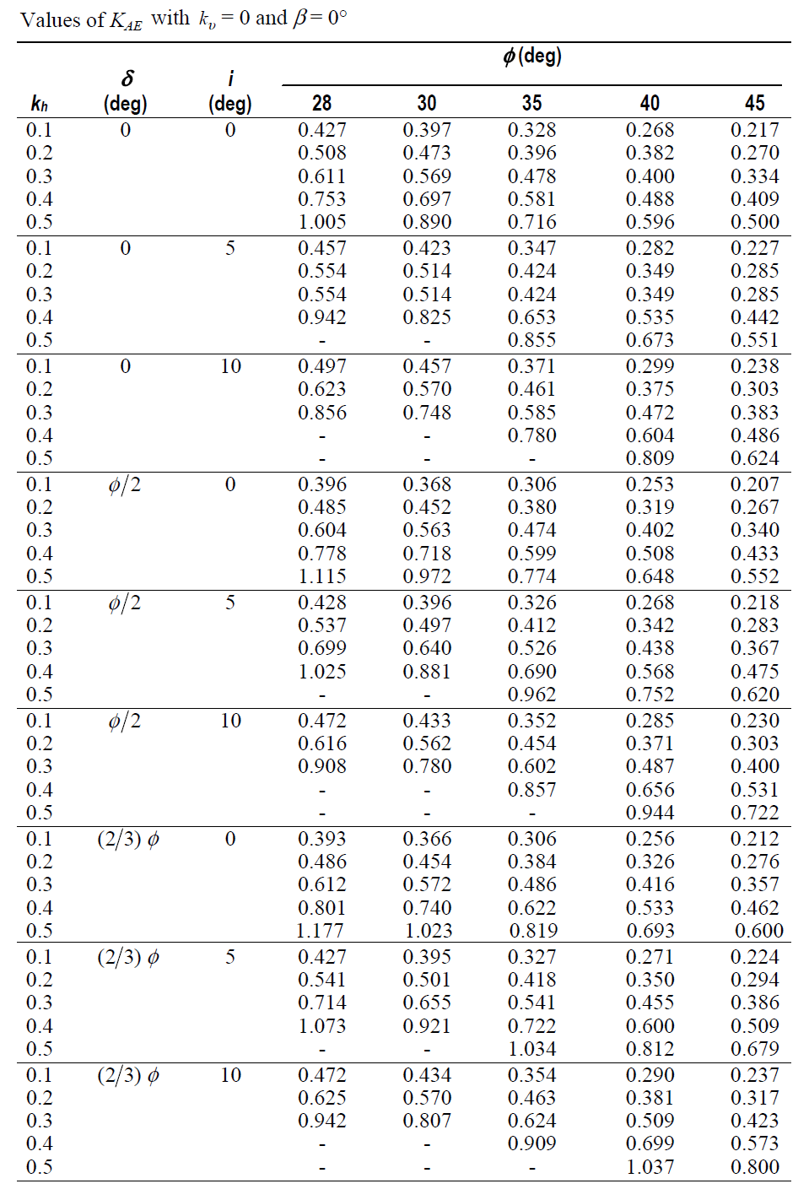
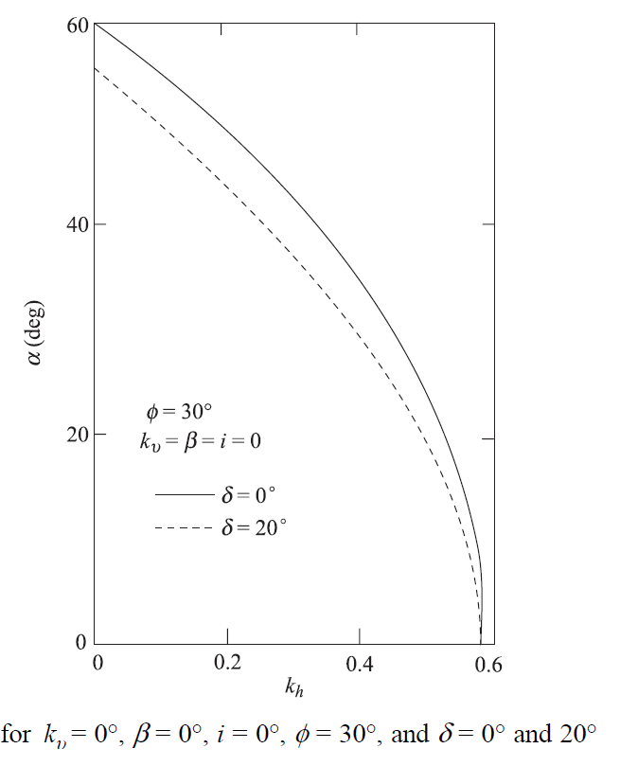
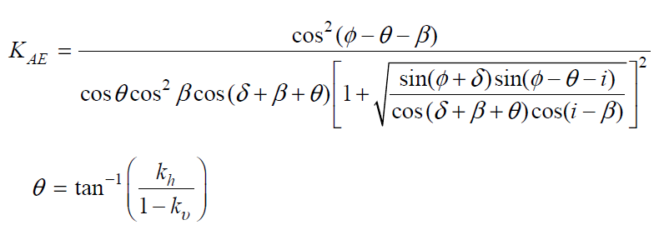
Mononobe-Okabe Active Earth Pressure Theory
The active force determined by the wedge analysis described here may be expressed as;

Slide 8
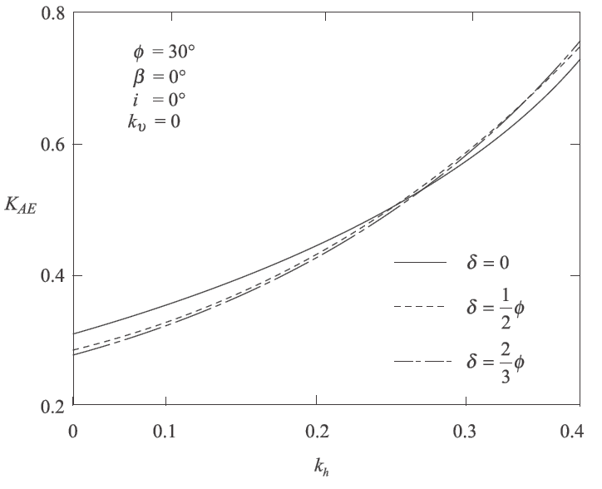
Effect of Various Parameters on the Value of the Active Earth Pressure Coefficient
Effect of Wall Friction Angle δ ;

Slide 9
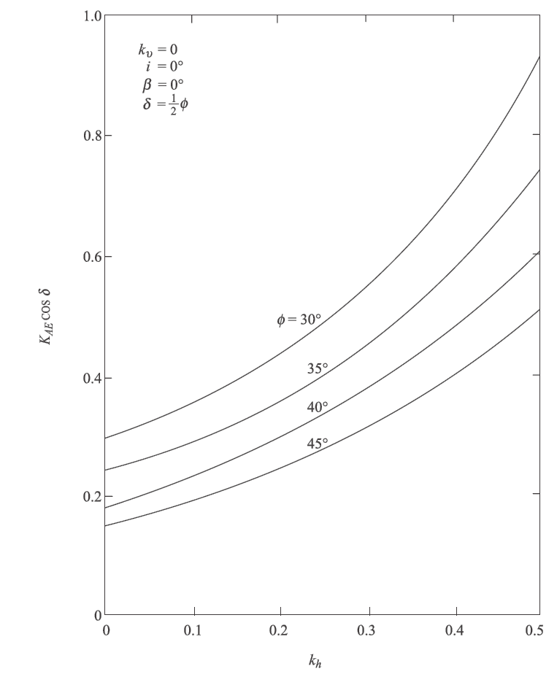
Effect of Various Parameters on the Value of the Active Earth Pressure Coefficient
Effect of Soil Friction Angle φ;

Slide 10
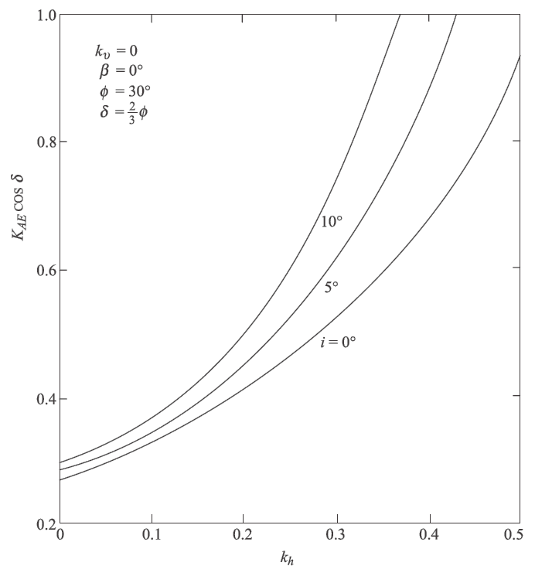
Effect of Various Parameters on the Value of the Active Earth Pressure Coefficient
Effect of Slope of the Backfill I;

Slide 11
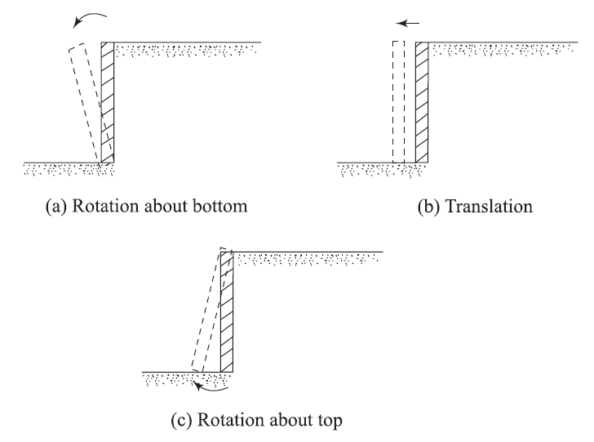
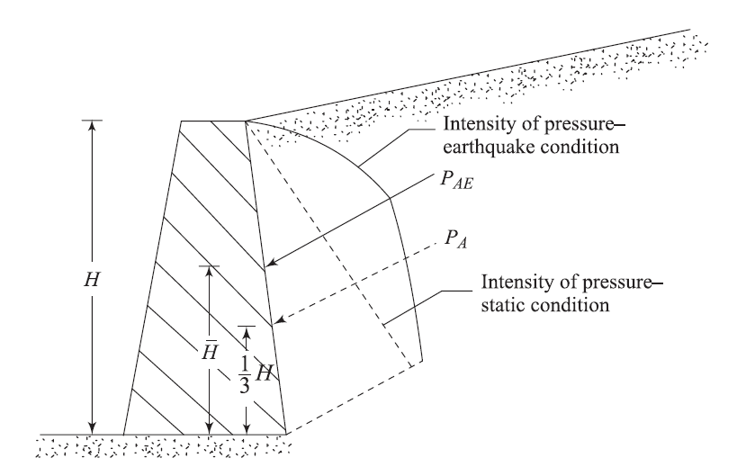
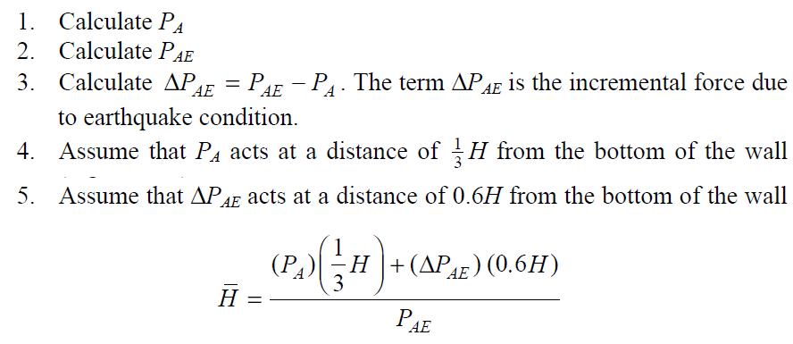
Point of Application of the Resultant Active Force
Rotation about the Bottom of the Wall;

Slide 12
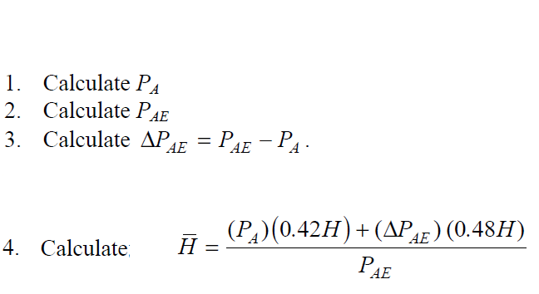
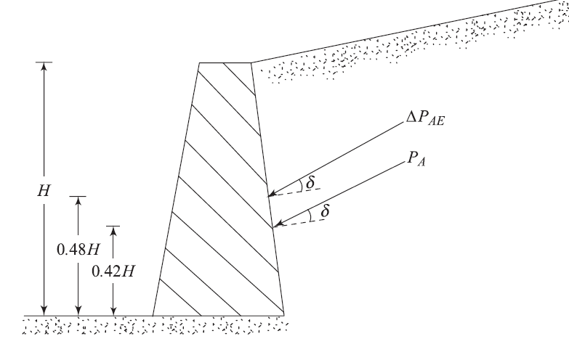
Point of Application of the Resultant Active Force
Translation of the Wall;

Slide 13
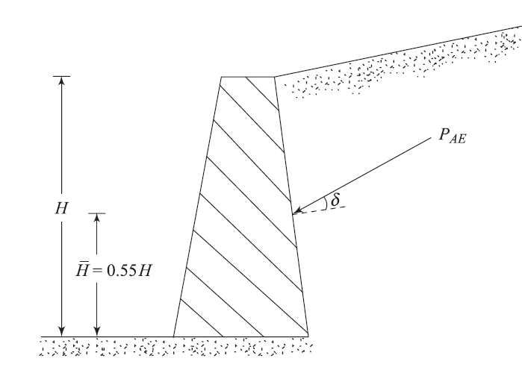
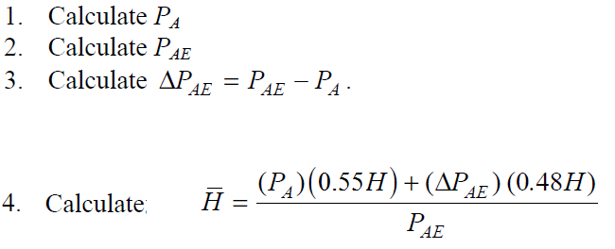
Point of Application of the Resultant Active Force
Rotation about the Top of the Wall;

Slide 14
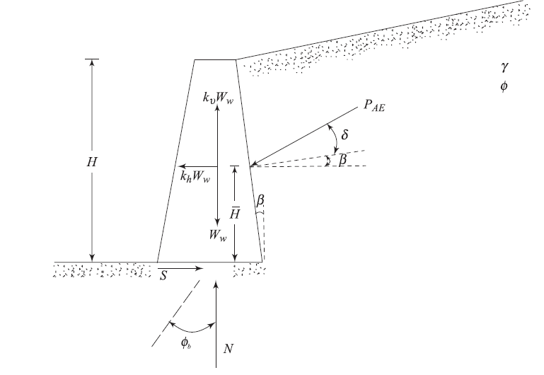
Design of Gravity Retaining Walls
For stability, summing the forces in the vertical direction,
Summing the forces in the horizontal direction
where N is the vertical component of the reaction at the base of the wall and Ww is the weight of the wall and S is the horizontal component of the reaction at the base of the wall

Slide 15
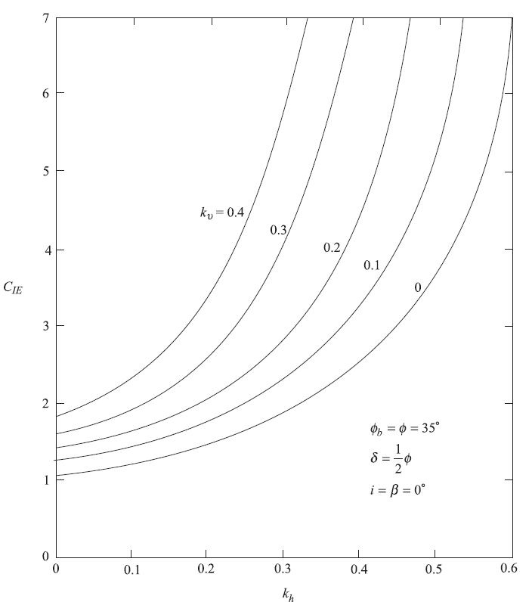
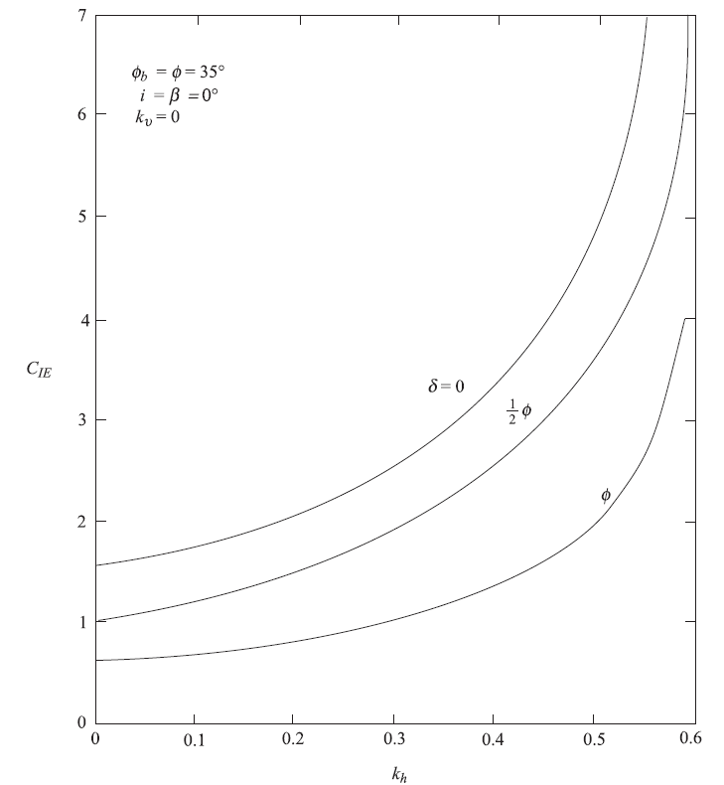
Design of Gravity Retaining Walls
At sliding condition;

Slide 16
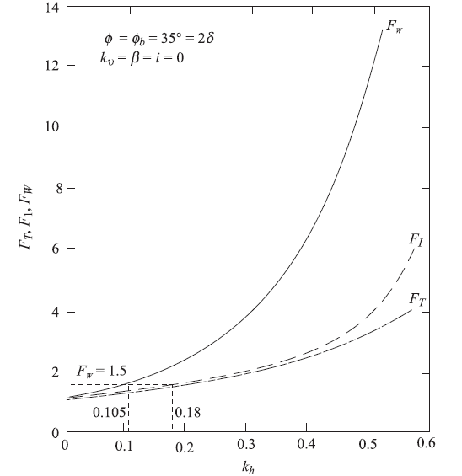
Design of Gravity Retaining Walls
For the static condition (i.e., kh = ku = 0 ),
FW is a factor of safety applied to the weight of the wall to take into account the effect of soil pressure and wall inertia.

Slide 17
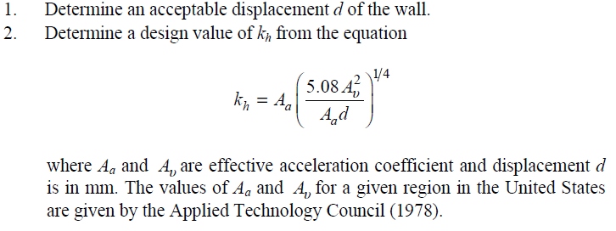
Design of Gravity Retaining Walls
These considerations show that, for no lateral movement, the weight of the wall has to be increased by a considerable amount over the static condition, which may prove to be very expensive. Thus, for actual design with reasonable cost, one has to assume some lateral displacement of the wall will take place during an earthquake; the procedure for determination of the wall weight (Ww) is then as follows:

Slide 18
Design of Gravity Retaining Walls

Slide 19
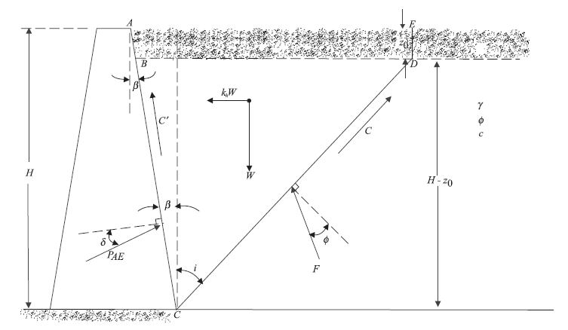
Mononobe –Okabe Active Earth Pressure Theory for c - φ Backfill
The depth of tensile crack that may develop in a c -φ soil is given as;
The forces acting on the soil wedge (per unit length of the wall) are as follows:

Slide 20
Mononobe –Okabe Active Earth Pressure Theory for c - φ Backfill
It is important to realize that the following two assumptions have been made:
The vertical inertia force ( ku.W ) has been taken to be zero.
The unit adhesion along the soil-wall interface (BC) has been taken to be equal to the cohesion ( c ) of the soil.

Slide 21
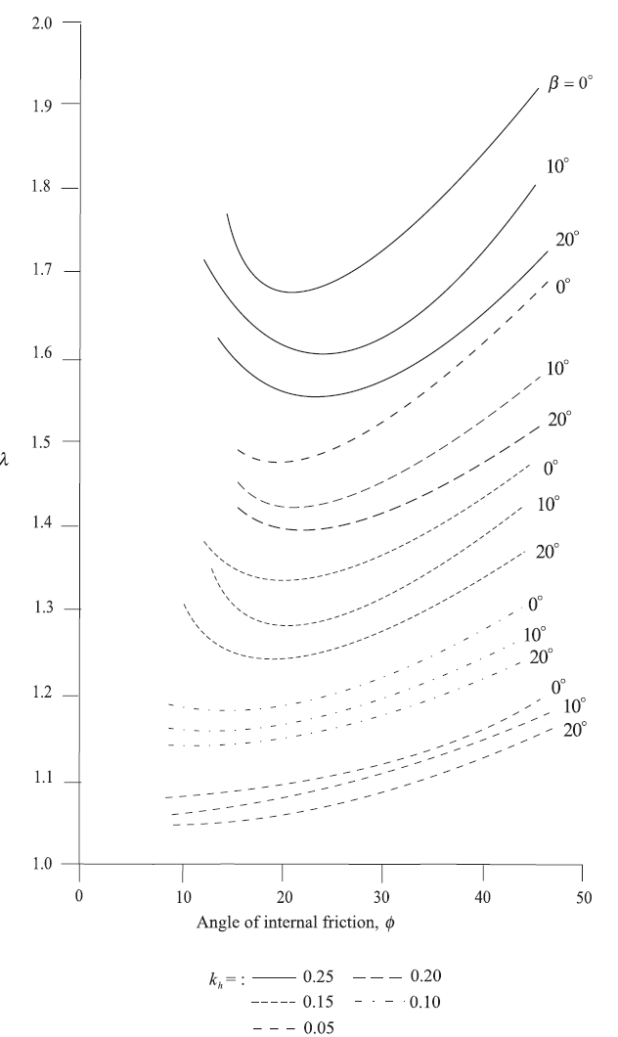
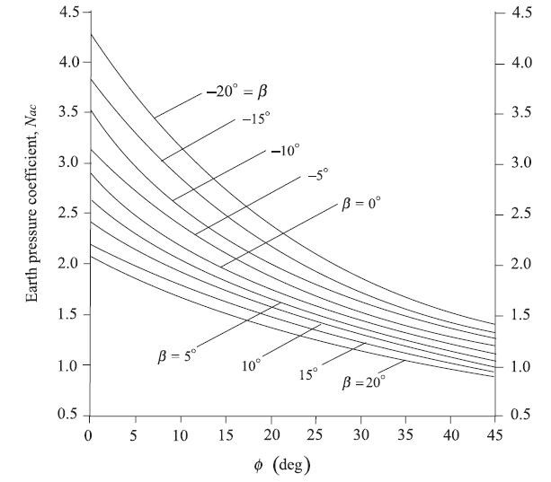
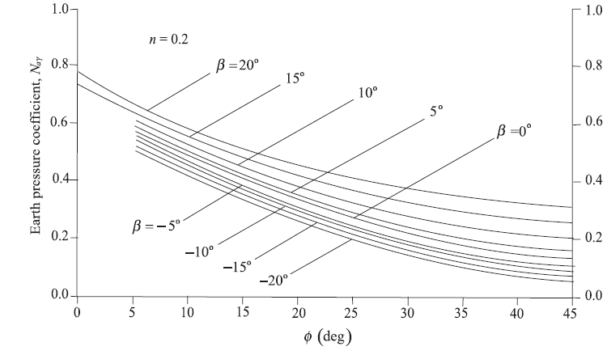
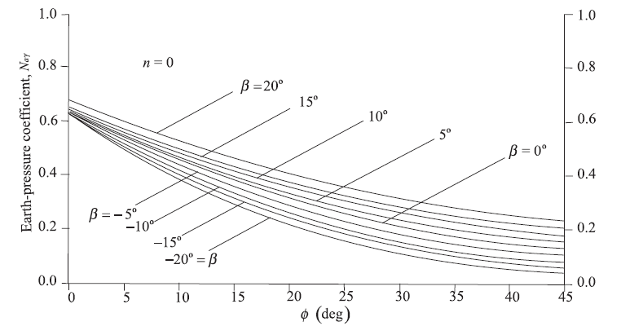
Mononobe –Okabe Active Earth Pressure Theory for c -φ Backfill
For the static condition, kh = 0 . Thus,

Slide 22
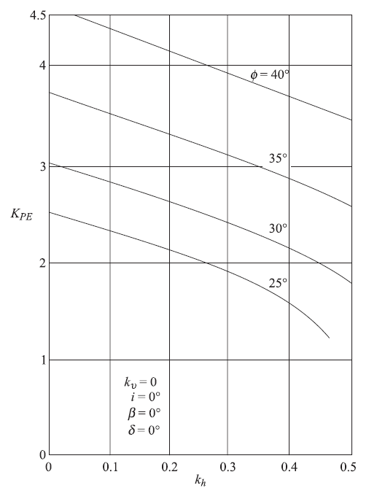
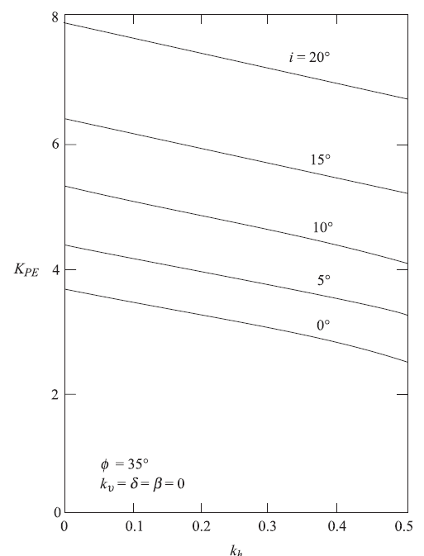
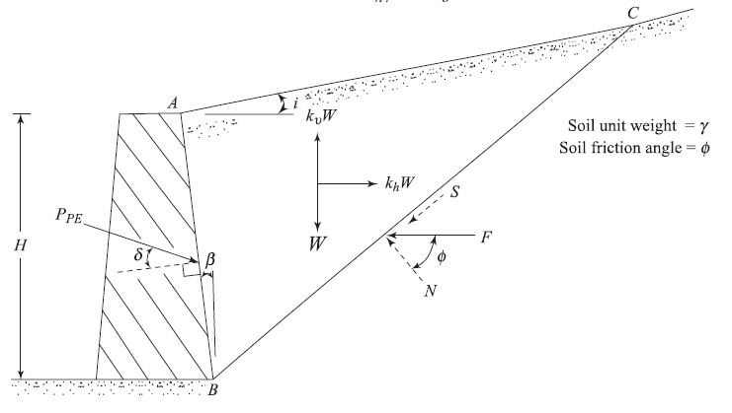
Dynamic Passive Force on Retaining Wall

Slide 23
Example
F.S.

Slide 24
Example
F.S.

Slide 25
Example

