Slide 1
Soil Dynamics
By: M. Iman Khodakarami (Associate Prof. of Earthquake Eng.)
Email: Khodakarami@semnan.ac.ir ; I.Khodakarami@gmail.com
Phone: (+98) 23- 31535243
Civil Eng. Faculty,
Semnan University

Slide 2
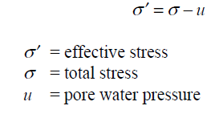
Soil Liquefaction (General concepts)

Slide 3
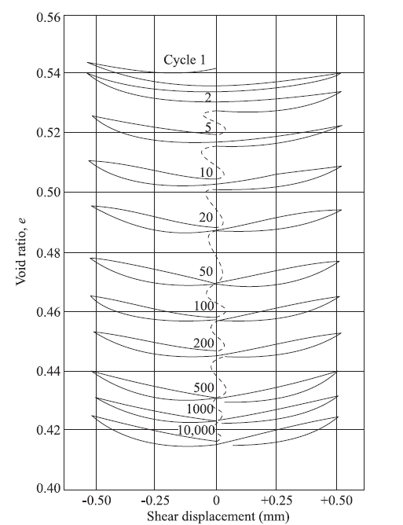
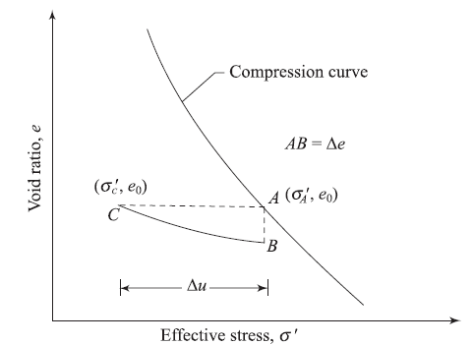
Soil Liquefaction (General concepts)

Slide 4
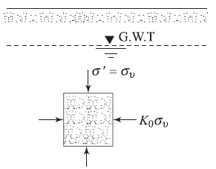
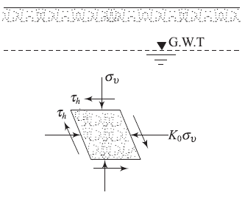
Soil Liquefaction (General concepts)
Before shaking During an earthquake

Slide 5
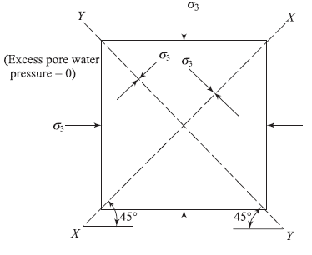
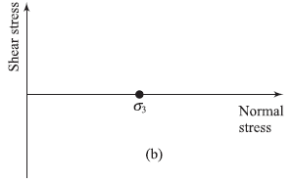
Soil Liquefaction-Dynamic Triaxial Test
A saturated soil specimen in a triaxial test, which is consolidated under an all-around pressure of σ 3 :
The corresponding Mohr’s circle:

Slide 6
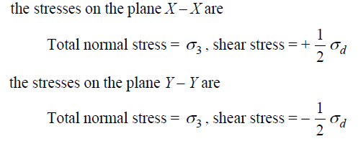
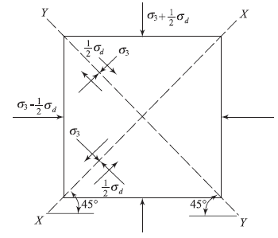
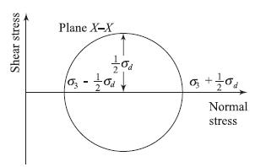
Soil Liquefaction-Dynamic Triaxial Test
If the stresses on the specimen are changed such that the axial stress is equal to σ3 + (1/2)σd and the radial stress is σ3 - (1/2)σd;
In the absence of drainage allowance, the corresponding total stress Mohr’s circle is;

Slide 7
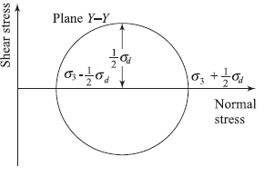
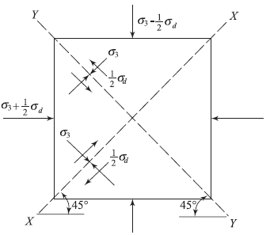
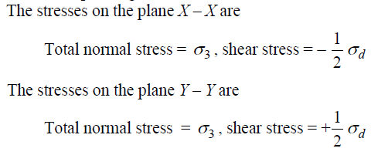
Soil Liquefaction-Dynamic Triaxial Test

Slide 8
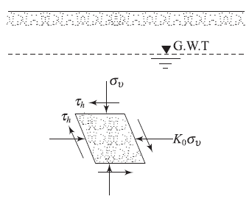
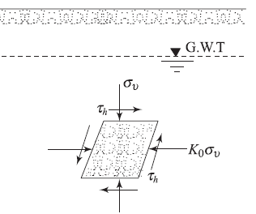
Soil Liquefaction-Dynamic Triaxial Test
If cyclic normal stresses of magnitude (1/2) σd are applied simultaneously in the horizontal and vertical directions, it is shown that;

Slide 9
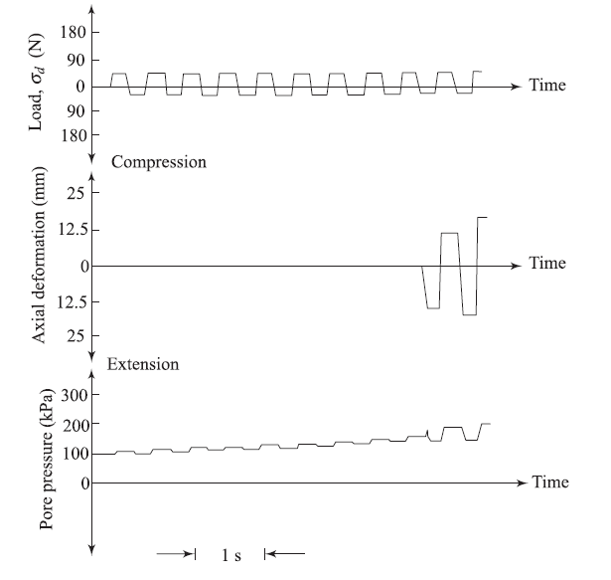
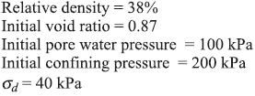
Typical Results from Cyclic Triaxial Test

Slide 10
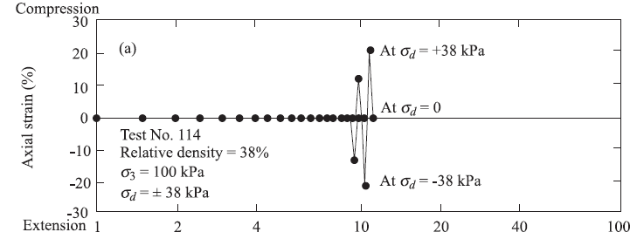
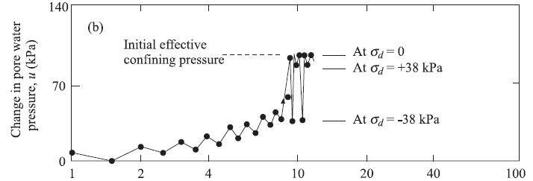
Typical Results from Cyclic Triaxial Test

Slide 11
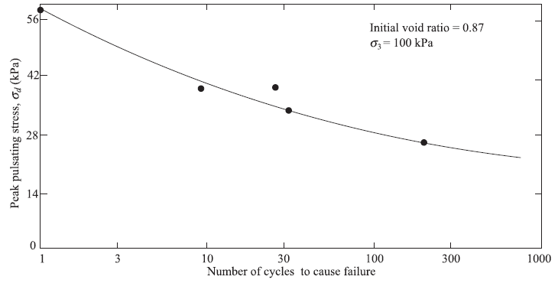
Typical Results from Cyclic Triaxial Test

Slide 12
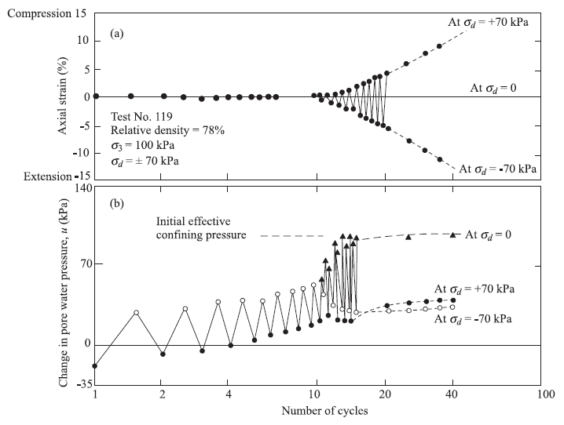
Typical Results from Cyclic Triaxial Test

Slide 13
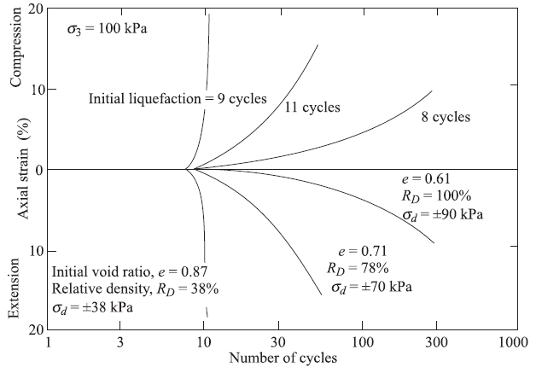
Typical Results from Cyclic Triaxial Test

Slide 14
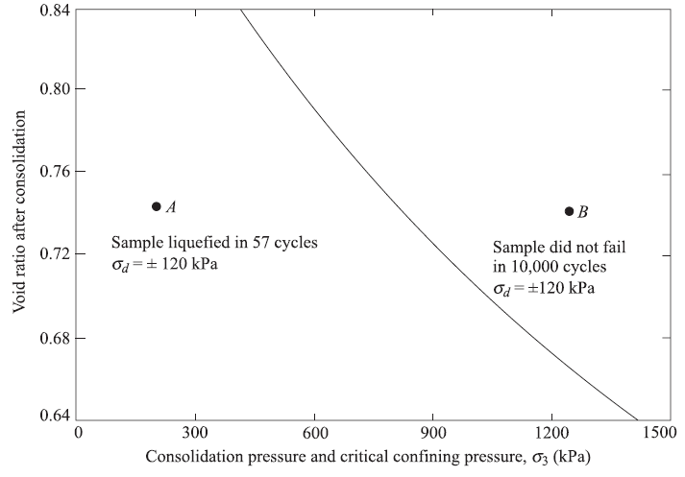
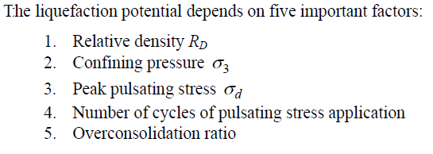
Typical Results from Cyclic Triaxial Test

Slide 15
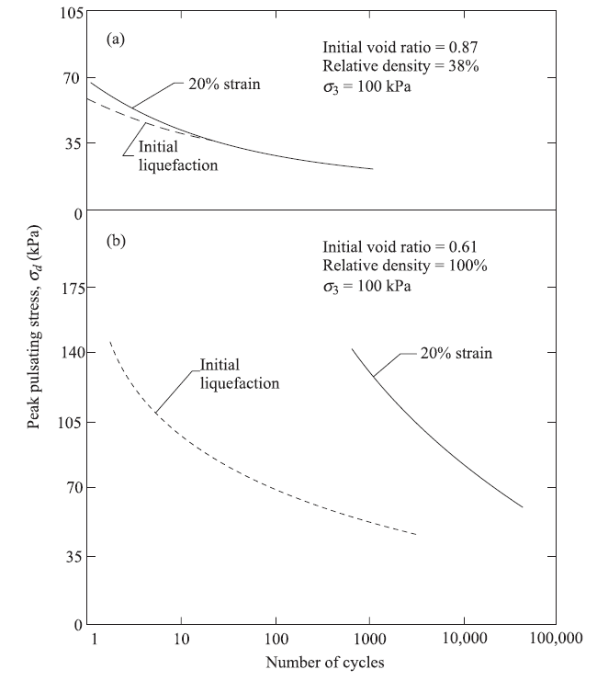
Influence of Various Parameters on Soil Liquefaction Potential
Initial Relative Density;

Slide 16
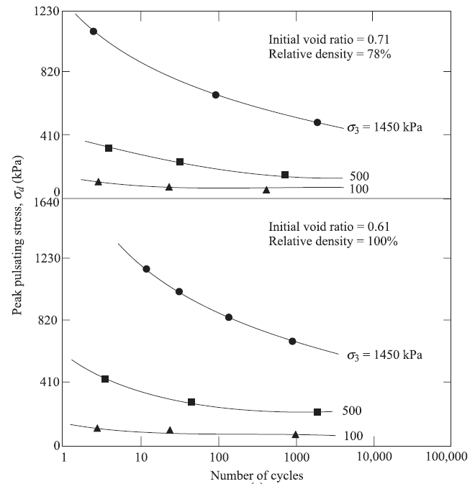
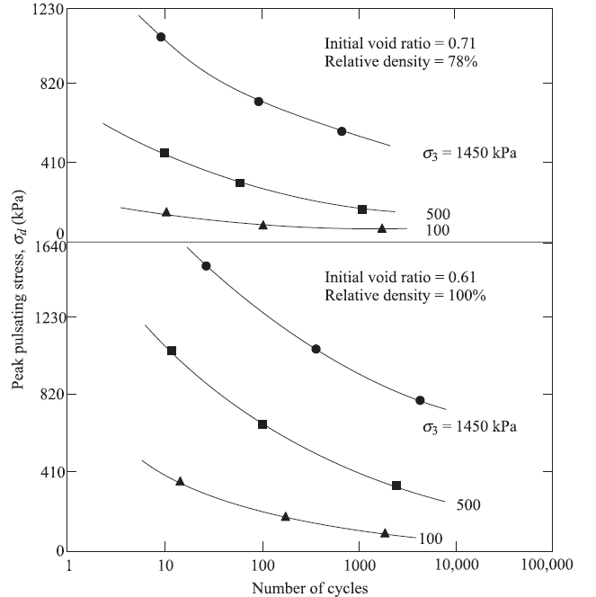
Influence of Various Parameters on Soil Liquefaction Potential
Confining Pressure;
Initial liquefaction
At failure condition

Slide 17
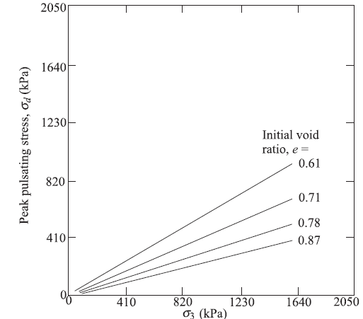
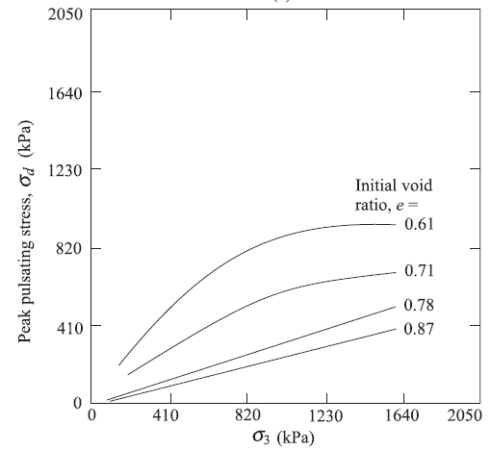
Influence of Various Parameters on Soil Liquefaction Potential
Peak Pulsating Stress;
Initial liquefaction
At failure condition

Slide 18
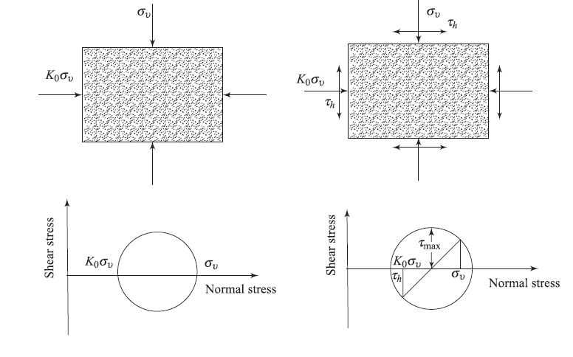
Soil Liquefaction-Cyclic Simple Shear Test
Before shaking During an earthquake

Slide 19
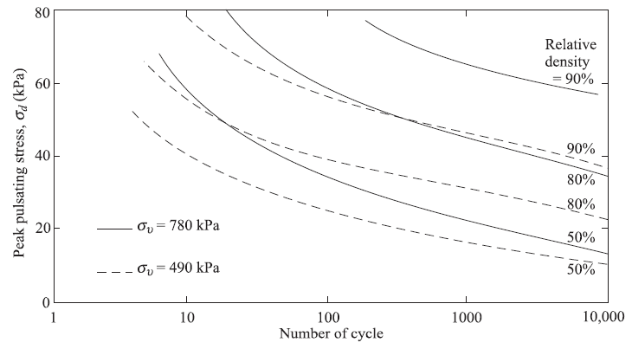
Typical Results from Cyclic Simple Shear Test

Slide 20
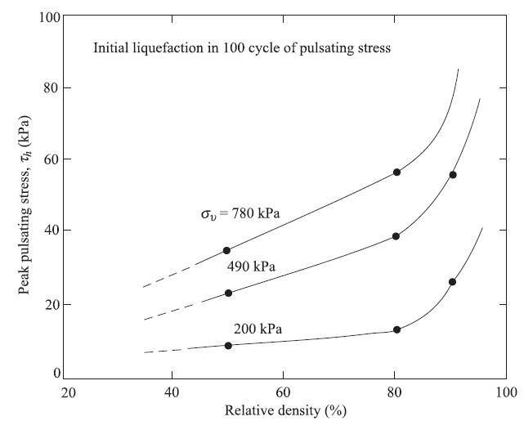
Typical Results from Cyclic Simple Shear Test

Slide 21
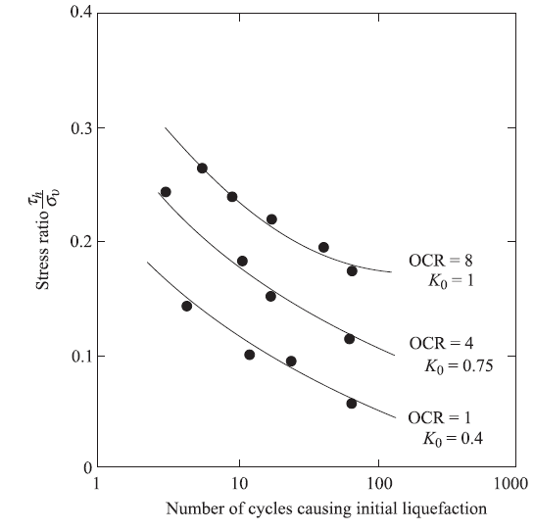
Typical Results from Cyclic Simple Shear Test
Influence of Over-consolidation Ratio on the Peak Value of τh;

Slide 22
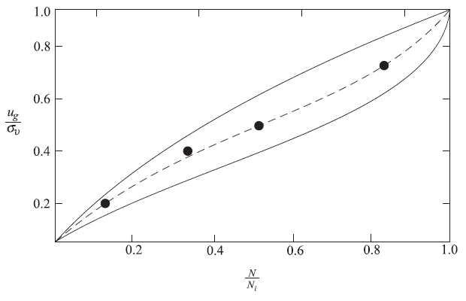
Rate of Excess Pore Water Pressure Increase
Usually for studying soil liquefaction a series of large-scale
simple shear tests will be conducted because:
Stress concentration in small-scale simple shear tests leads to some inaccuracy in the results’
Stress concentration at the base and cap of cyclic triaxial test specimens and the possibility of necking leads to non-uniformity of strain and redistribution of water content,
Attempts to study liquefaction by using shaking table tests have also raised some equations, since the results, in some cases,
have been influenced by the confining effects of the sides of the box.

Slide 23
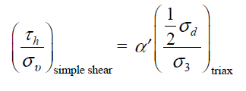
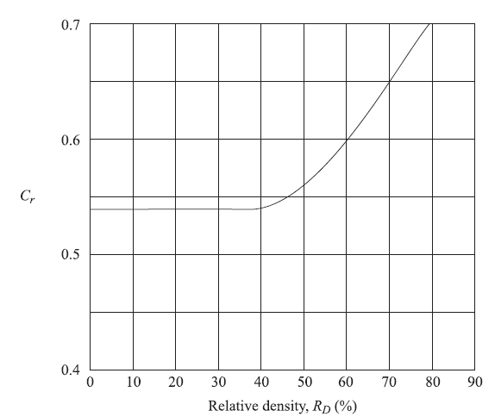
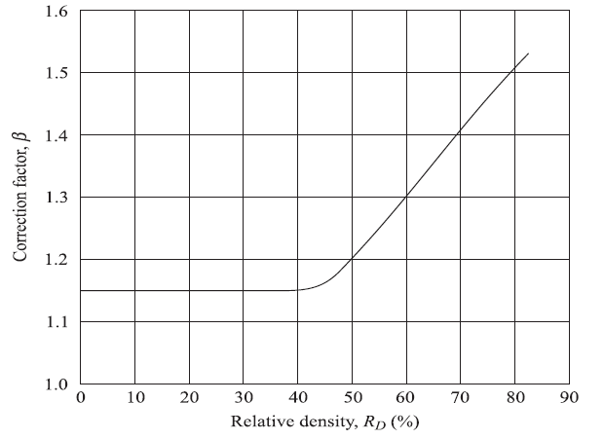
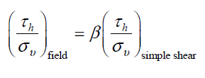
Determination of Field Liquefaction
Correlation of Liquefaction Results from Simple Shear and Triaxial Tests;
Field value of (τh/σu ) for initial liquefaction
is about 15% – 50% higher than that obtained
from simple shear tests;

Slide 24
Determination of Field Liquefaction
When laboratory tests are conducted at relative density, say, RD(1), whereas the fields conditions show the sand deposit to be a relative density of RD(2), one has to convert the laboratory test results to correspond to a relative density of RD(2).

Slide 25
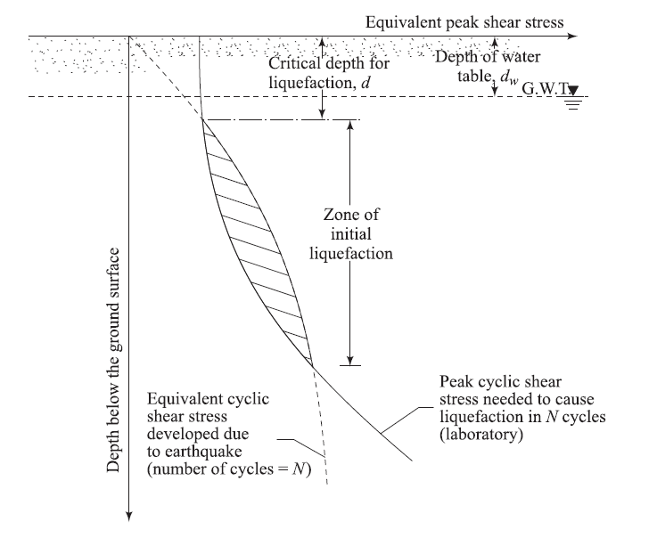
Zone of Initial Liquefaction in the Field
There are five general steps for determining the zone in the field where soil liquefaction due to an earthquake can be initiated:
Establish a design earthquake.
Determine the time history of shear stresses induced by the earthquake at various depths of sand layer.
Convert the shear stress–time histories into N number of equivalent stress cycles. These can be plotted against depth.
Using the laboratory test results, determine the magnitude of the cyclic stresses required to cause initial liquefaction in the field in N cycles at various depths. Note that the cyclic shear stress levels change with depth due to change of σu.
The zone in which the cyclic shear stress levels required to cause initial liquefaction are equal to or less than the equivalent cyclic shear stresses induced by an earthquake is the zone of possible liquefaction.

Slide 26
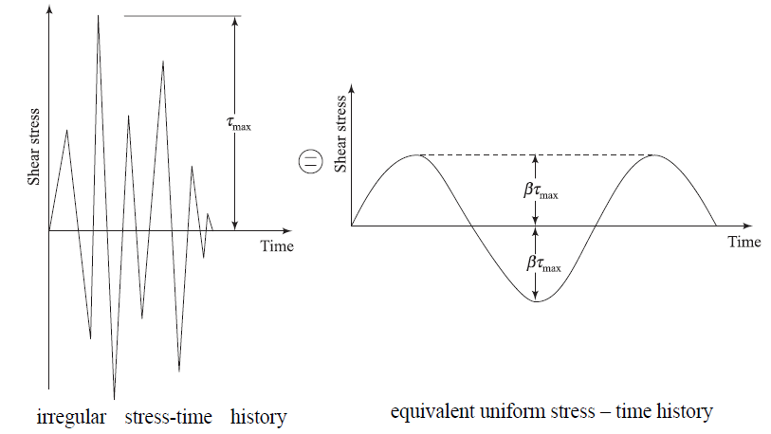
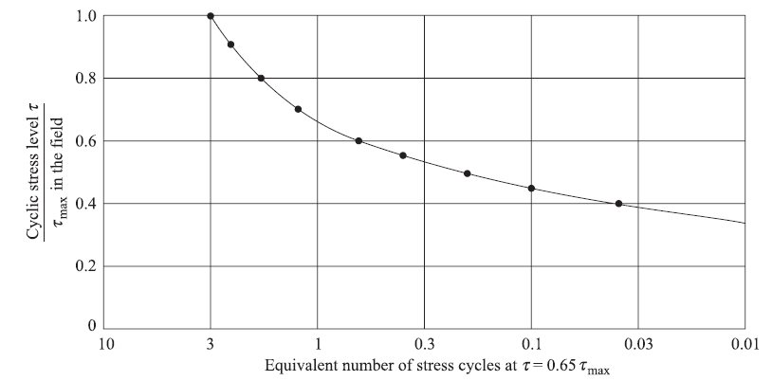
Equivalent Number of Significant Uniform Stress Cycles for Earthquakes
In the study of soil liquefaction of granular soils, it becomes necessary to determine the equivalent number of significant uniform stress cycles for an earthquake that has irregular stress-time history.

Slide 27
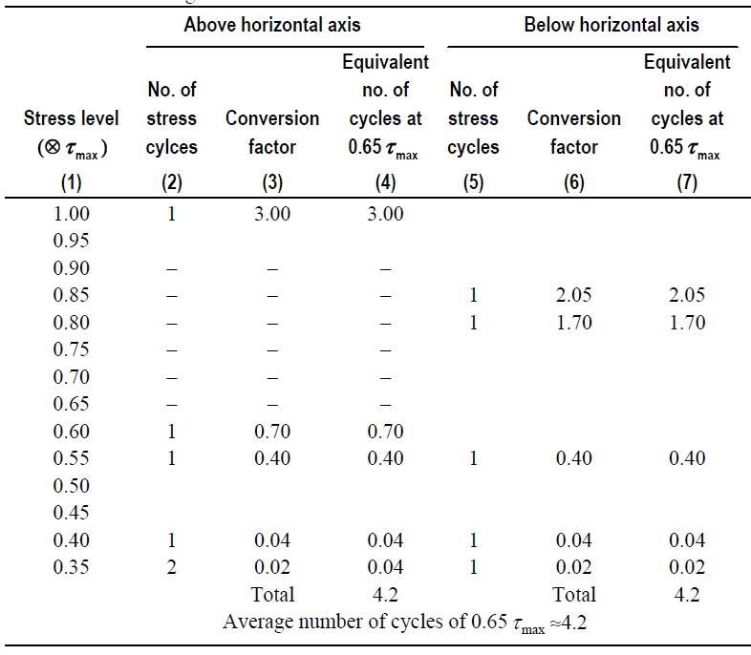
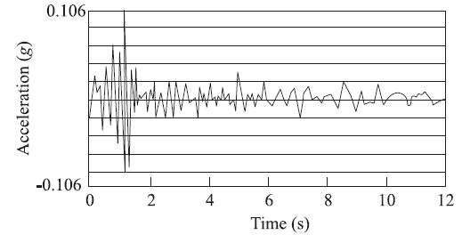
Equivalent Number of Significant Uniform Stress Cycles for Earthquakes
Determine the number of stress cycles at various stress levels such as τmax , 0.95τmax , 0.9τmax ,… above the horizontal axis (col. 2) and below the horizontal axis (col. 5).
Determine the conversion factors (cols. 3 and 6).
Determine the equivalent number of uniform cycles at a maximum stress level of 0.65τmax (cols. 4 and 7).
Determine the total number of equivalent stress cycles at 0.65τmax above and below the horizontal axis.

Slide 28
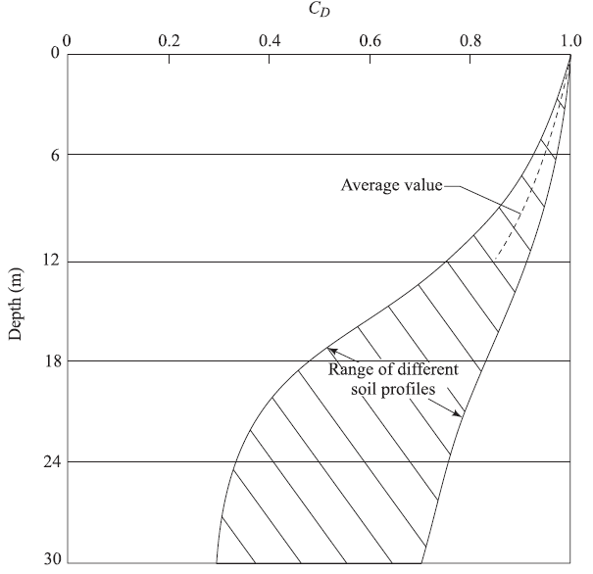
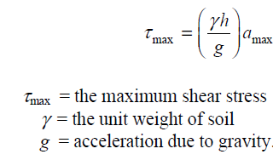
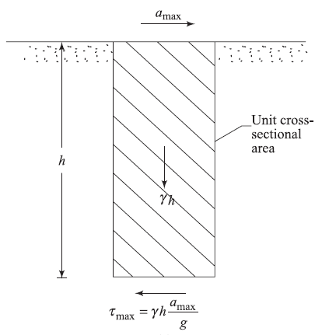
Relation between Maximum Ground Acceleration and the Relative Density of Sand for Soil Liquefaction
Consider a layer of sand deposit in which we assume a column of soil of height h and unit area of cross section. The soil column behaves as a rigid body, the maximum shear stress at a depth h due to a maximum ground surface acceleration of amax can be given by:
The soil column is not a rigid body; for the deformable
nature of the soil, the maximum shear stress at a depth h,
determined by:

Slide 29
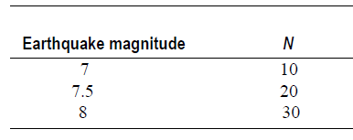
Relation between Maximum Ground Acceleration and the Relative Density of Sand for Soil Liquefaction
It has been shown that the maximum shear stress determined from the shear stress–time history during an earthquake can be converted into an equivalent number of significant stress cycles;
In general, the critical depth of liquefaction occurs at a depth of about 6.0 m) when the depth of water table dw is 0 – 3.0 m; similarly, the critical depth is about 9.0 m when the depth of water table is about 4.5 m.
Liquefaction occurs in sands having a mean size D50 of 0.075 – 0.2 mm.

Slide 30
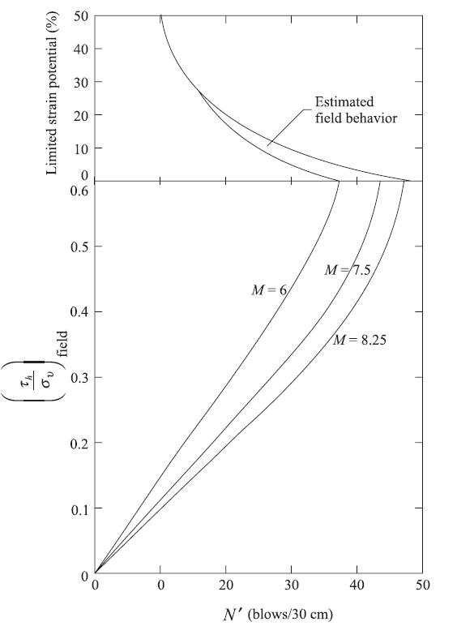
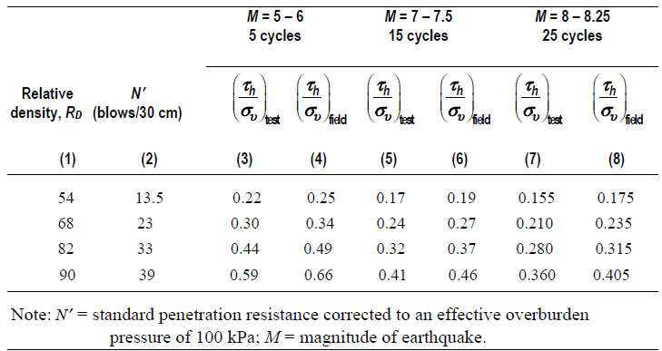
Liquefaction Analysis from Standard Penetration Resistance

Slide 31
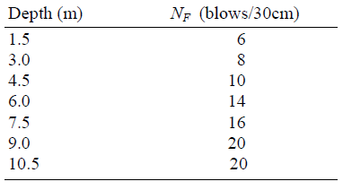
Liquefaction Analysis from Standard Penetration Resistance- Example
Geotechnical investigations carried out in a deposit of sand provided the field standard penetration numbers N as given in the table below. During the geotechnical investigations, it is also observed that groundwater table is encountered at a depth of 3.0 m measured from the ground surface.
Determine, for an earthquake magnitude of 7.5 Richter, if liquefaction will occur at the site. Assume that the maximum peak ground acceleration at the site is amax = 0.15 g.
Given for the sand:

Slide 32
Liquefaction Analysis from Standard Penetration Resistance- Example
The following table can now be prepared for calculating the shear resistance available in the sand deposit at different depths.

Slide 33
Liquefaction Analysis from Standard Penetration Resistance- Example
The following table can now be prepared for calculation of the shear stresses induced in the sand deposit at different depths:

Slide 34
Correlation with Overlying Liquefaction-Resistant Stratum

Slide 35
Remedial Action to Mitigate Liquefaction
Removal or replacement of undesirable soil. If liquefaction of a soil layer under a structure is a possibility, then it may be excavated and re-compacted with or without additives. Otherwise the potentially liquefiable soil may be replaced with non-liquefiable soil.
Densification of the in situ material. This can be achieved by using several techniques such as vibro-flotation, dynamic compaction, and compaction piles.
In situ soil improvement by grouting and chemical stabilization.
Use of relief wells such as gravel or rock drains for the control of undesirable pore water pressure. The purpose of the installation of gravel or rock drains is to dissipate the excess pore water pressure almost as fast as it is generated in the same deposit due to cyclic loading.
Exercise: Find how you can develop design principles of gravel and rock drains?

