Slide 1
اصول مهندسی زلزله
استاد درس: دکتر محمدایمان خداکرمی
نیمسال اول 01-00

Slide 2
اصول مهندسی زلزله – سرفصل مطالب

Slide 3
اصول مهندسی زلزله – مراجع

Slide 4
اصول مهندسی زلزله – مراجع

Slide 5
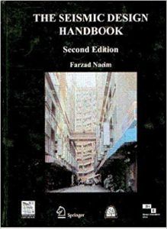
اصول مهندسی زلزله – مراجع

Slide 6
اصول مهندسی زلزله – ارزشیابی
مرحله 1: 00/7/25 3 نمره
مرحله 2: 00/8/23 3 نمره
مرحله3: 00/9/28 3 نمره
امتحان شفاهی 5 نمره
امتحان پایان ترم: طبق برنامه گلستان 4 نمره
حل تمرین: 2 نمره

Slide 7
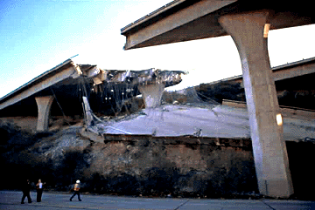
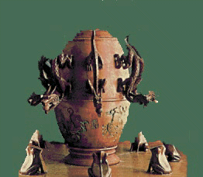
Seismology (a very short overview)

Slide 8
What is seismology?
Seismology is science dealing with all aspects of earthquakes:
OBSERVATIONAL SEISMOLOGY
Recording earthquakes (microseismology)
Cataloguing earthquakes
Observing earthquake effects (macroseismology)
ENGINEERING SEISMOLOGY
Estimation of seismic hazard and risk
Aseismic building
‘PHYSICAL’ SEISMOLOGY
Study of the properties of the Earth’s interior
Study of physical characteristics of seismic sources
EXPLORATIONAL SEISMOLOGY (Applied seismic methods)...

Slide 9
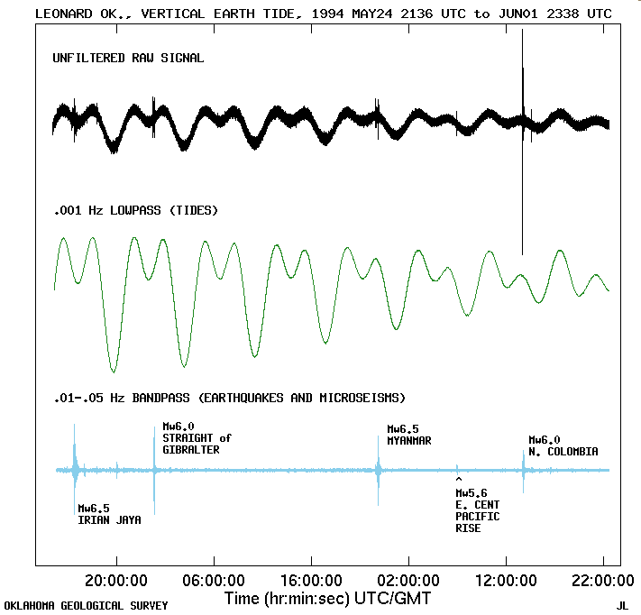
Seismology
Multidisciplinary science, links physics with other geosciences (geology, geography)
International science
Large span of amplitudes ( ~ 10⁻⁹ – 10¹ m)
Very large span of wave periods ( ~ 10⁻³ – 10⁴ s)
Very young science (second half of the 19th century)

Slide 10
Earthquake mythology – ancient beliefs
India: The earth is held up by 4 elephants that stand on the back of a turtle. The turtle is balanced on top of a cobra. When the animals move, the earth trembles and shakes
Siberia: The Earth rests on a sled driven by the god named Tuli. The dogs have fleas, When they stop to scratch, the Earth shakes
Japan: A great catfish, or namazu, lies curled up under the sea, with the islands of Japan resting on its back. A demigod, or daimyojin, holds a heavy stone over his head to keep him from moving. Once in a while, though, the daimyojin is distracted, the namzu moves and the earth trembles
New Zealand; Mother Earth has a child in its womb, the young god Ru. When he stretches and kicks as babies do, he causes earthquakes.
From: www.fema.gov

Slide 11
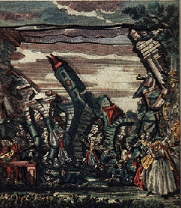
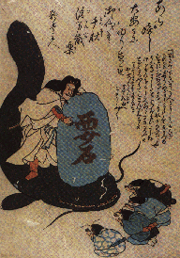
Myths and legends
Earthquakes occur:
When one of the eight elephants that carry the Earth gets tired (Hindu)
When a frog that carries the world moves (Mongolia)
When the giant on whose head we all live, sneezes or scratches (Africa)
When the attention of the god Kashima (who looks after the giant catfish Namazu that supports the Earth and prevents it to sink into the ocean) weakens and Namazu moves (Japan)
When the god Maimas decides to count the population in Peru his footsteps shake the Earth. Then natives run out of their huts and yell: “I’m here, I’m here!”

Slide 12
What is an earthquake?
An earthquake is the vibration of Earth produced by the rapid release of energy
Rock subjected to elastic deformation snaps back and/or breaks
Energy radiates in all directions from the break’s location, AKA source, the “focus”
Energy moves like waves as moving rocks push on their neighbors
Seismographs record the event

Slide 13
Anatomy of Earthquakes

Slide 14
The Three Major Chemical Radial Divisions
To see how earthquakes really occur, we first need to learn about constitution of the Earth!
Crust
Mantle
Core

Slide 15
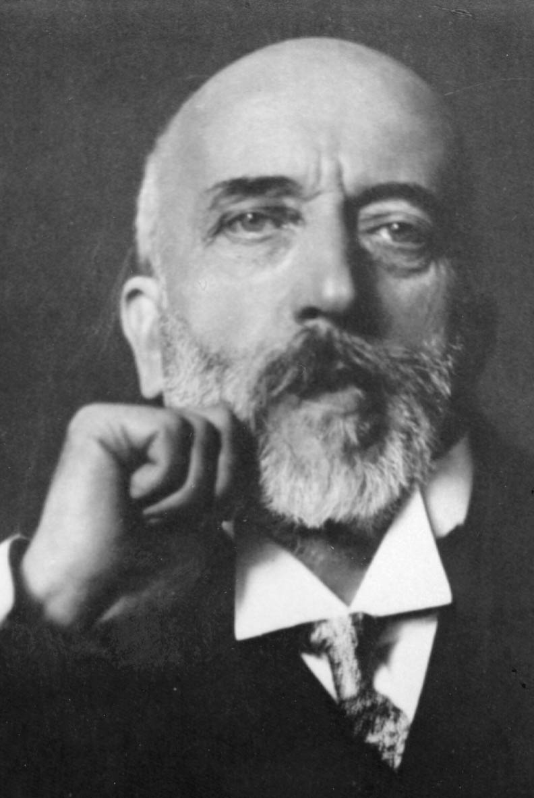
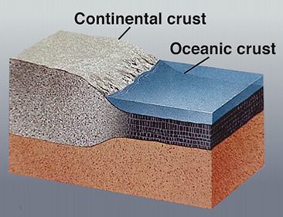
The Shallowest Layer of the Earth: the Crust
The crust is the most heterogeneous layer in the Earth
The crust is on average 33 km thick for continents and 10 km thick beneath oceans; however it varies from just a few km to over 70 km globally.
The boundary between the crust and the mantle is mostly chemical. The crust and mantle have different compositions.
This boundary is referred to as the Mohorovičić discontinuity or “Moho”.
It was discovered in 1910 by the Croatian seismologist Andrija Mohorovičić.

Slide 16
Crustal thickness
http://quake.wr.usgs.gov/research/structure/CrustalStructure/index.html

Slide 17
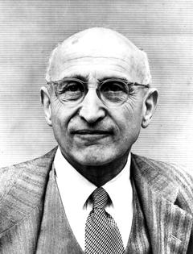
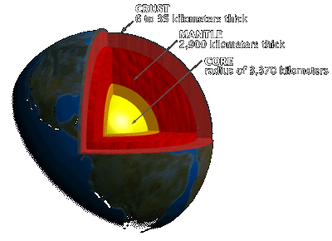
Middle Earth: The Mantle
Earth’s mantle exists from the bottom of the crust to a depth of 2891 km (radius of 3480 km) – Gutenberg discontinuity
It is further subdivided into:
The uppermost mantle (crust to 400 km depth)
The transition zone (400 – 700 km depth)
The mid-mantle (700 to ~2650 km depth)
The lowermost mantle (~2650 – 2891 km depth)
The uppermost mantle is composed dominantly of olivine; lesser components include pyroxene, enstatite, and garnet
Beno Gutenberg

Slide 18
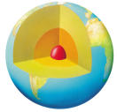
Earth’s Core
Owing to the great pressure inside the Earth the Earth’s core is actually freezing as the Earth gradually cools.
The boundary between the liquid outer core and the solid inner core occurs at a radius of about 1220 km – Lehman discontinuity, after Inge Lehman from Denmark.
The boundary between the mantle and outer core is sharp.
The change in density across the core-mantle boundary is greater than that at the Earth’s surface!
The viscosity of the outer core is similar to that of water, it flows kilometers per year and creates the Earth’s magnetic field.
The outer core is the most homogeneous part of the Earth
The outer core is mostly an alloy of iron and nickel in liquid form.
As the core freezes latent heat is released; this heat causes the outer core to convect and so generates a magnetic field.

Slide 19
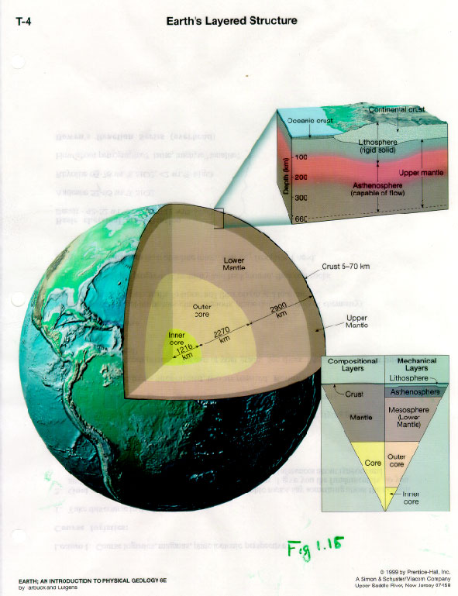
Mechanical Layers:
Lithosphere
Asthenosphere
Mesosphere

Slide 20
Litosphere
The lithosphere is the uppermost 50-100 km of the Earth.
There is not a strict boundary between the lithosphere and the asthenosphere as there is between the crust and mantle.
It consists of both crust and upper parts of mantle.
It behaves rigidly, like a solid, over very long time periods.

Slide 21
Astenosphere
The asthenosphere exists between depths of 100-200 km.
It is the weakest part of the mantle.
It is a solid over short time scales, but behaves like a fluid over millions of years.
The asthenosphere decouples the lithosphere (tectonic plates) from the rest of the mantle.

Slide 22
Tectonic forces
The interior of the Earth is dynamic – it cools down and thus provides energy for convective currents in the outer core and in the astenosphere.
Additional energy comes from radioactive decay...

Slide 23
Convection
Convection in the astenosphere enables tectonic processes – PLATE TECTONICS

Slide 24
Plate tectonics
PLATE TECTONICS theory is very young (1960-ies)
It provides answers to the most fundamental questions in seismology:
Why earthquakes occur?
Why are earthquake epicenters not uniformly distributed around the globe?
At what depths are their foci?

Slide 25
One year of seismicity

Slide 26
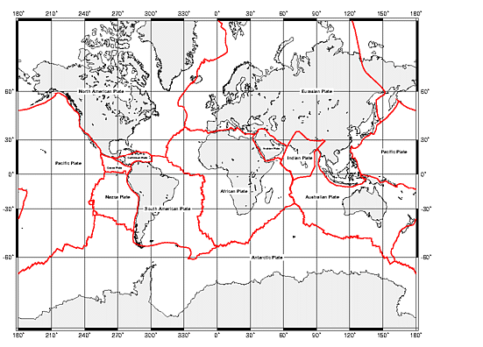
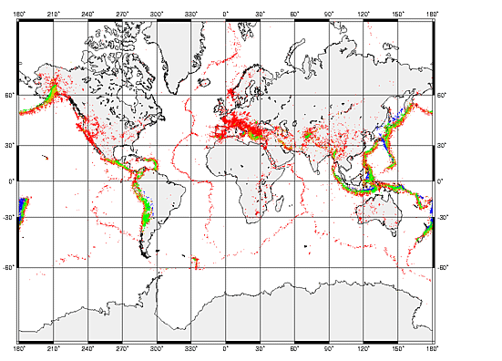
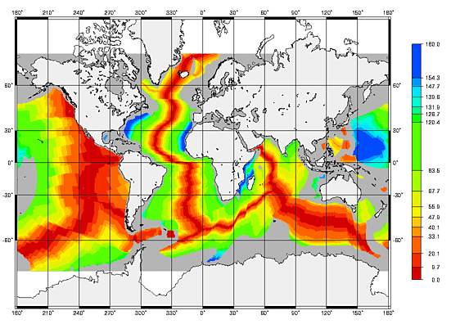
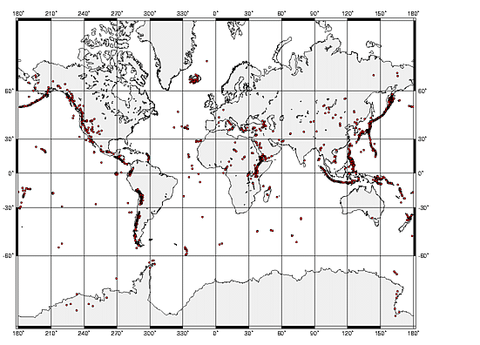
MAJOR TECTONIC PLATES EARTHQUAKE EPICENTRES
OCEAN-BOTTOM AGE VOLCANOES

Slide 27
Major tectonic plates

Slide 28
Tectonic plates
Tectonic plates are large parts of litosphere ‘floating’ on the astenosphere
Convective currents move them around with velocities of several cm/year.
The plates interact with one another in three basic ways:
They collide
They move away from each other
They slide one past another

Slide 29
Interacting plates
Collision leads to SUBDUCTION of one plate under another. Mountain ranges may also be formed (Himalayas, Alps...).
It produces strong and sometimes very deep earthquakes (up to 700 km).
Volcanoes also occur there.
EXAMPLES: Nazca – South America
Eurasia – Pacific

Slide 30
Interacting plates
Plates moving away from each other produce RIDGES between them (spreading centres).
The earthquakes are generally weaker than in the case of subduction.
EXAMPLES: Mid-Atlantic ridge (African – South American plates, Euroasian –North American plates)

Slide 31
Earthquake Depth and Plate Tectonic Setting
Weakest are the divergent zone earthquakes
Strongest Here
Strongest, with worst Tsunamis, at entrance to subduction zones
Subduction Zones discovered by Benioff

Slide 32
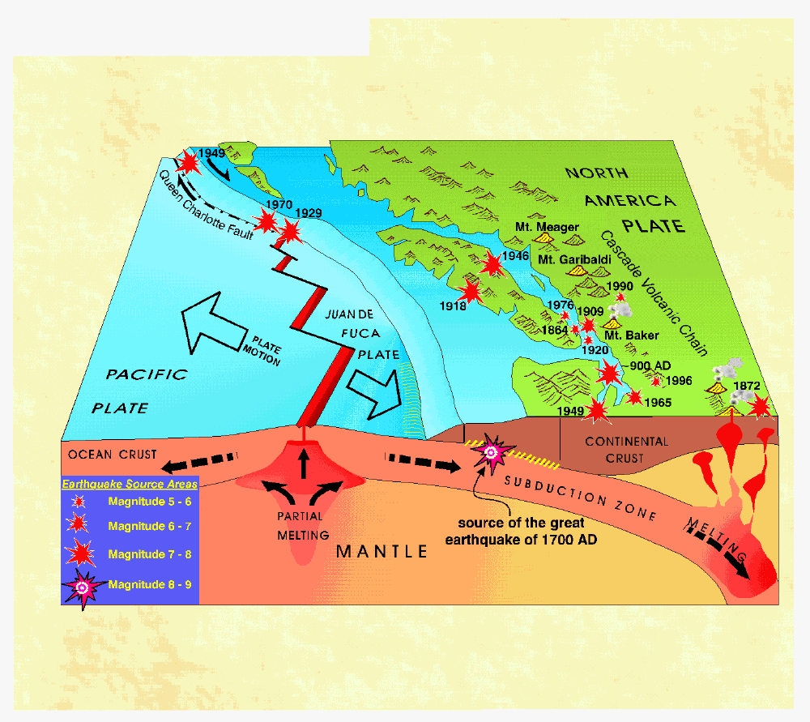
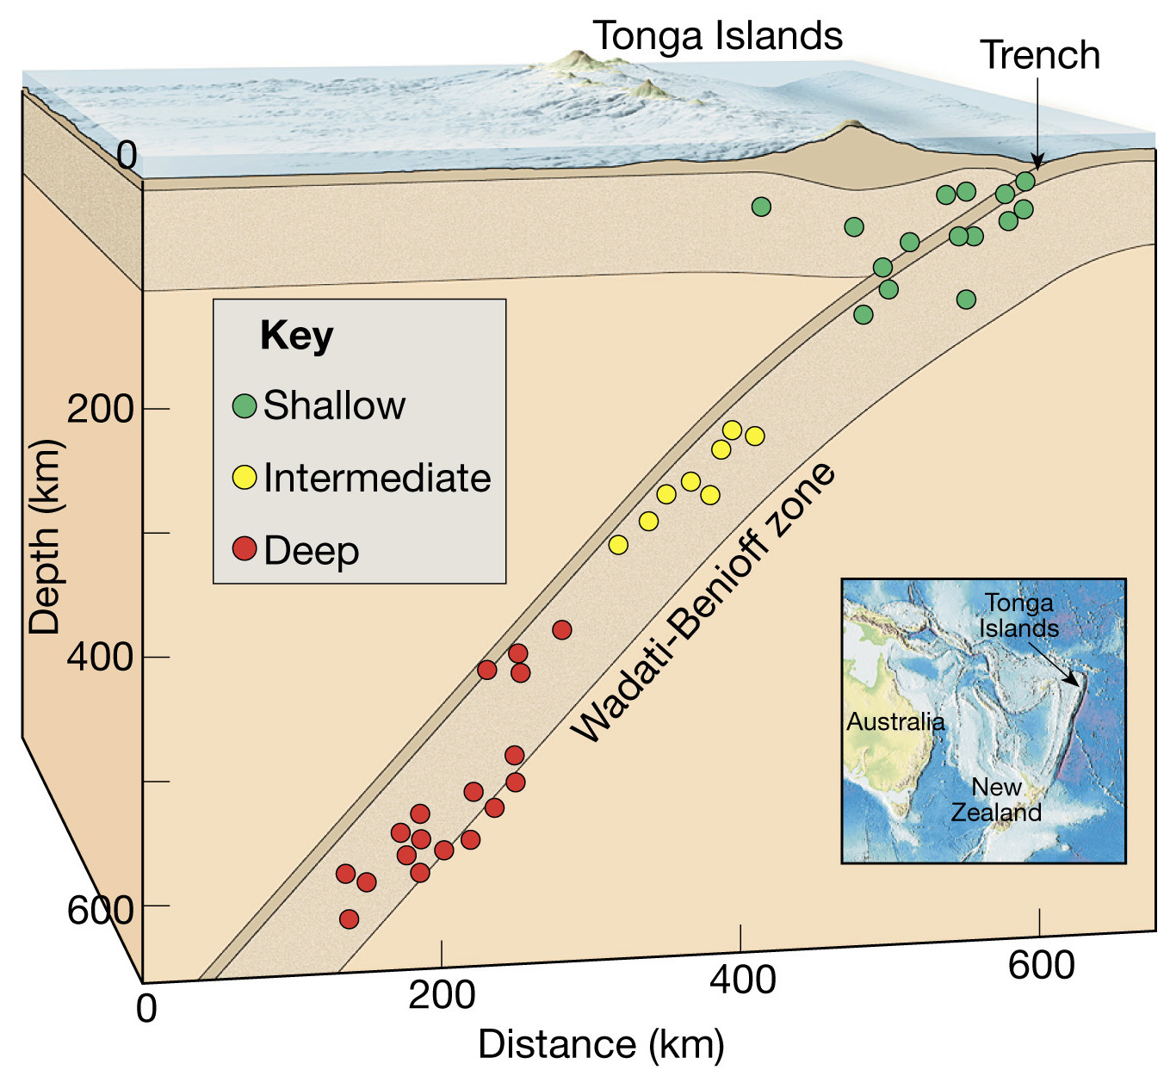
Earthquakes in subduction zones
Recent example, 9.0 Christmas 2004 Earthquake and Tsunami, Sumatra

Slide 33
Earthquakes at Divergent Boundaries - Iceland
A new graben, down dropped hanging wall block - Normal Fault – divergent zone MOR

Slide 34
Interacting plates
Plates moving past each other do so along the TRANSFORM FAULTS.
The earthquakes may be very strong.
EXAMPLES: San Andreas Fault (Pacific – North American plate)

Slide 35
How earthquakes occur?
Earthquakes occur at FAULTS.
Fault is a weak zone separating two geological blocks.
Tectonic forces cause the blocks to move relative one to another.

Slide 36
How earthquakes occur? Elastic rebound theory

Slide 37
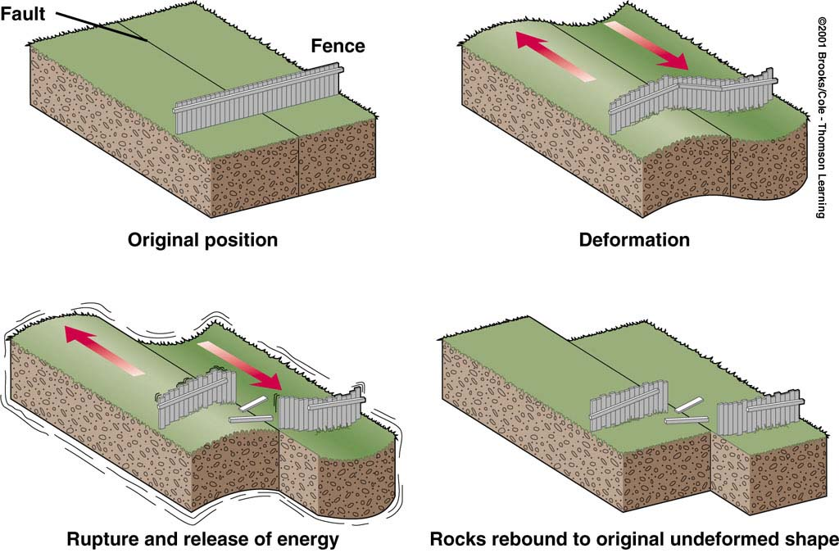
How earthquakes occur? Elastic rebound theory
Because of friction, the blocks do not slide, but are deformed.
When the stresses within rocks exceed friction, rupture occurs.
Elastic energy, stored in the system, is released after rupture in waves that radiate outward from the fault.

Slide 38
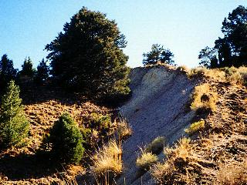
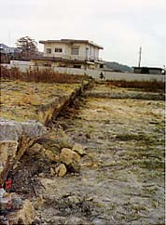
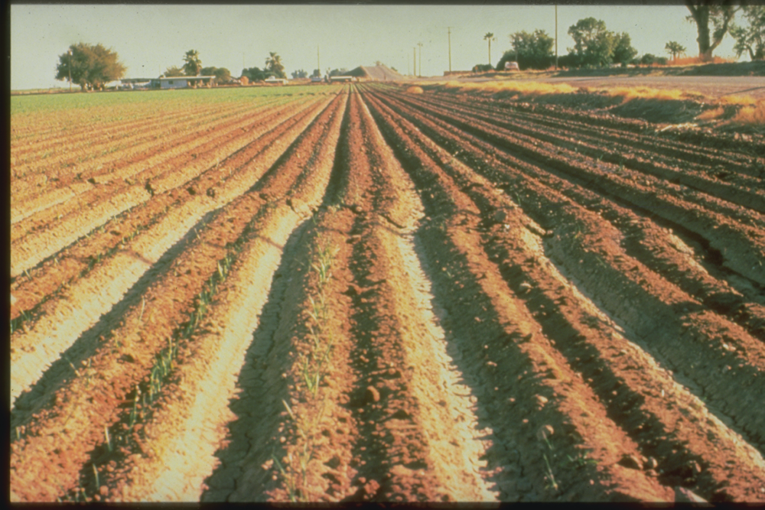
Normal Fault Quake - Nevada
Reverse Fault Quake - Japan
HW Down
Divergent
Convergent
HW Up
Transform
Strike Slip Fault Quake - California

Slide 39
San Andreas: An active earthquake zone
San Andreas is the most studied strike-slip (transform) fault system in the world
Displacement occurs along discrete segments 100 to 200 kilometers long
Most segments slip every 100-200 years producing large earthquakes
However, some portions exhibit slow, gradual displacement known as fault creep. The rocks have low strength minerals that cannot store strain, they just crumble and smear continuously as the plates move.

Slide 40
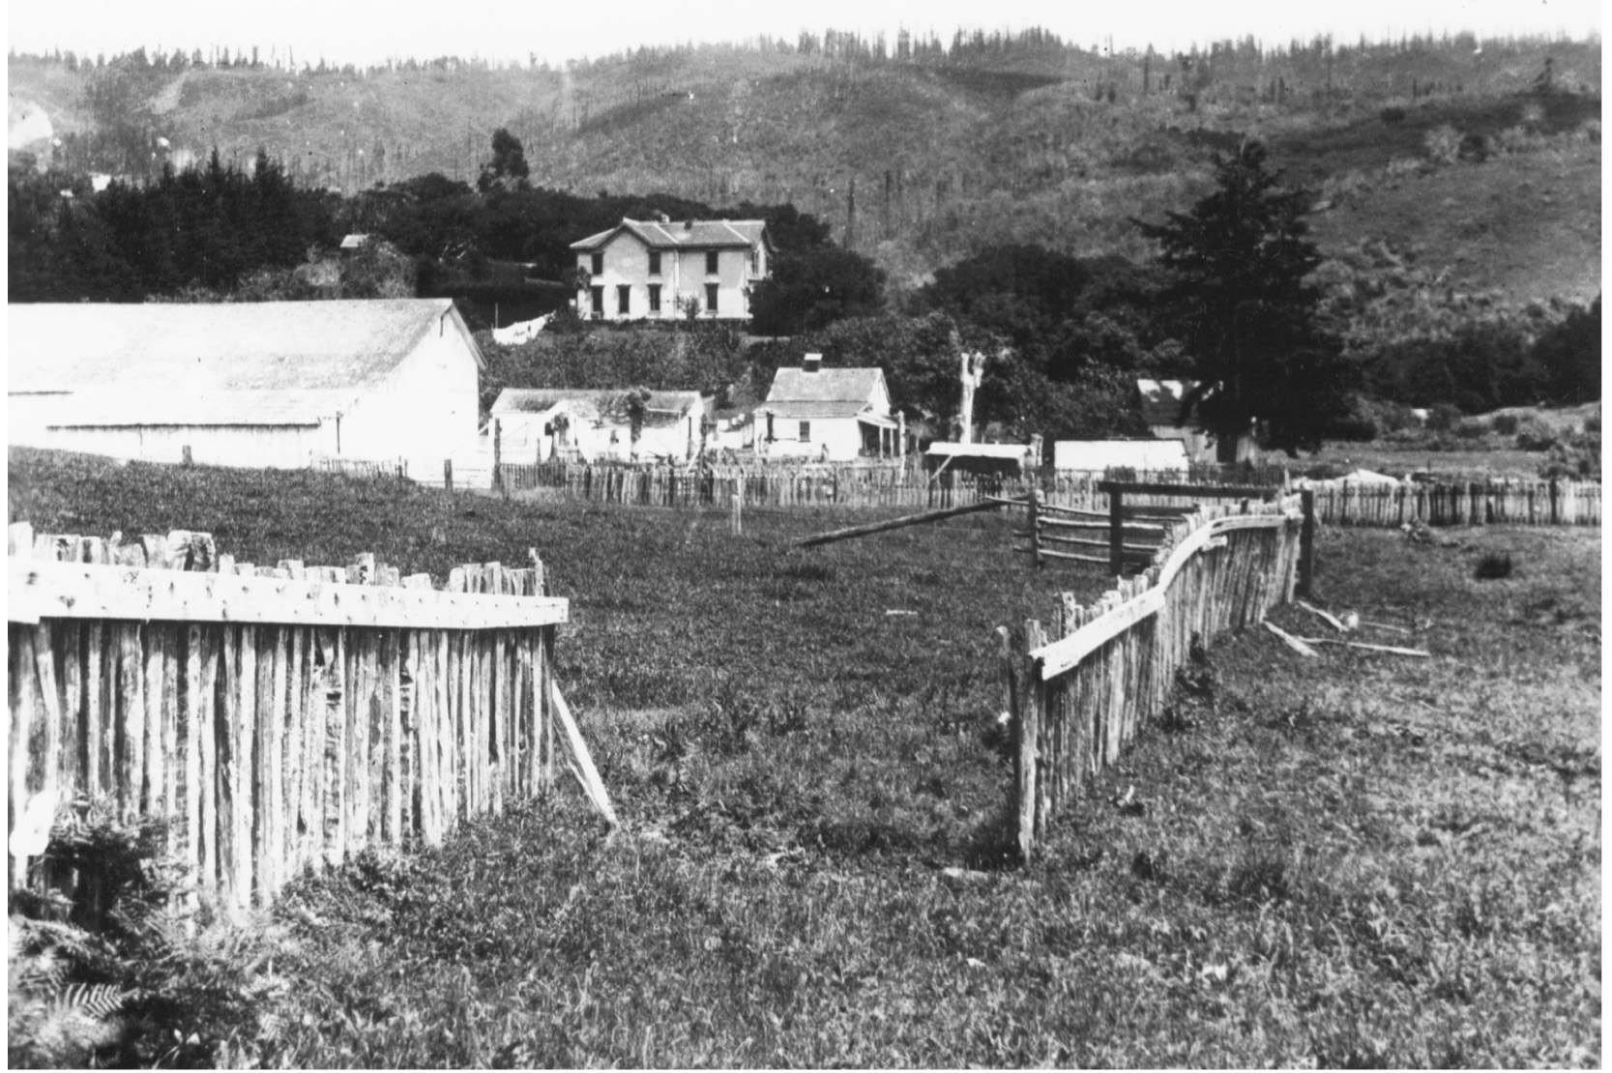
Fence offset by the 1906 San Francisco earthquake
San Andres Fault

Slide 41
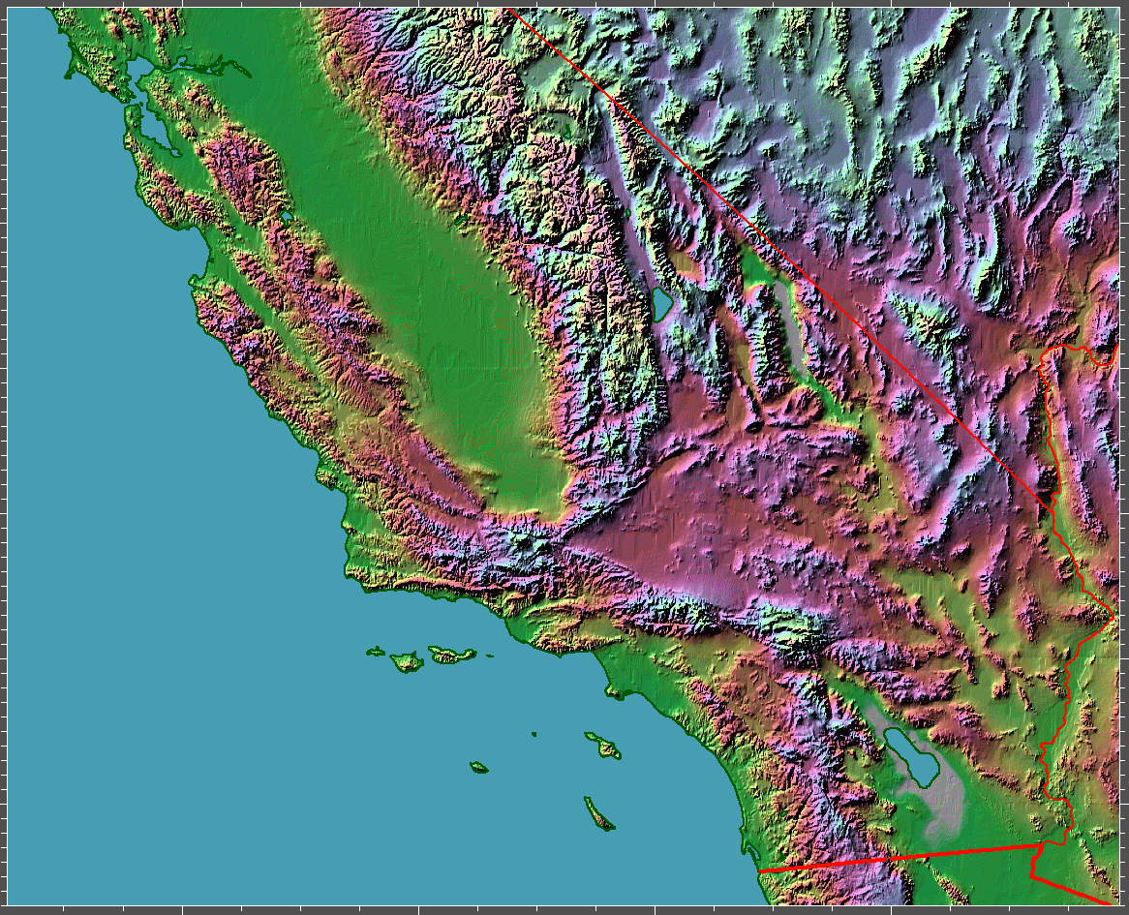
San Andreas Fault

Slide 42
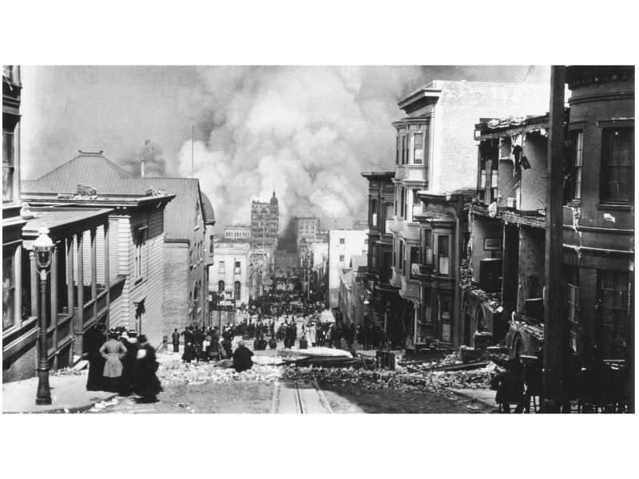
Fires caused by 1906 San Francisco Earthquake
Gas mains break, fires shaken out of furnaces and fireplaces. Water mains break.
Debris blocks streets. Fire Fighters cannot drive to the fire.

Slide 43
Landscape Shifting, Wallace Creek
San Andres Fault

Slide 44
Elastic waves – Body waves
Longitudinal waves:
They are faster than transversal waves and thus arrive first.
The particles oscillate in the direction of spreading of the wave.
Compressional waves
P-waves
Transversal waves:
The particles oscillate in the direction perpendicular to the spreading direction.
Shear waves – they do not propagate through solids (e.g. through the outer core).
S-waves

Slide 45
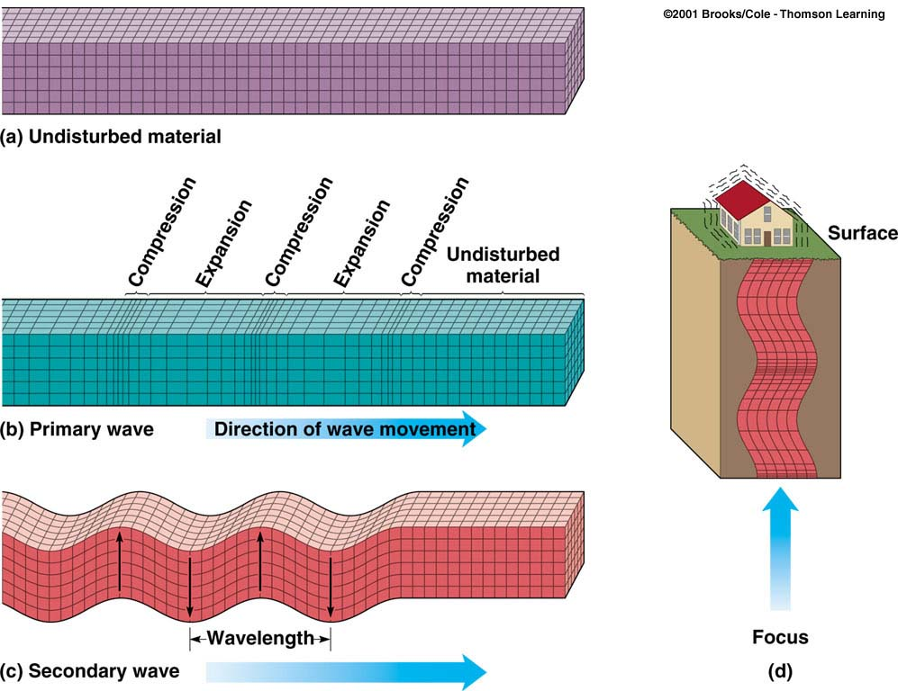
Elastic waves – Body waves
P-waves:
S-waves:

Slide 46
Elastic waves – Surface waves
Surface waves: Rayleigh and Love waves
Their amplitude diminishes with the depth.
They have large amplitudes and are slower than body waves.
These are dispersive waves (large periods are faster).

Slide 47
Two Types of Surface Waves
Most of the destruction
Larger amplitude than body waves

Slide 48
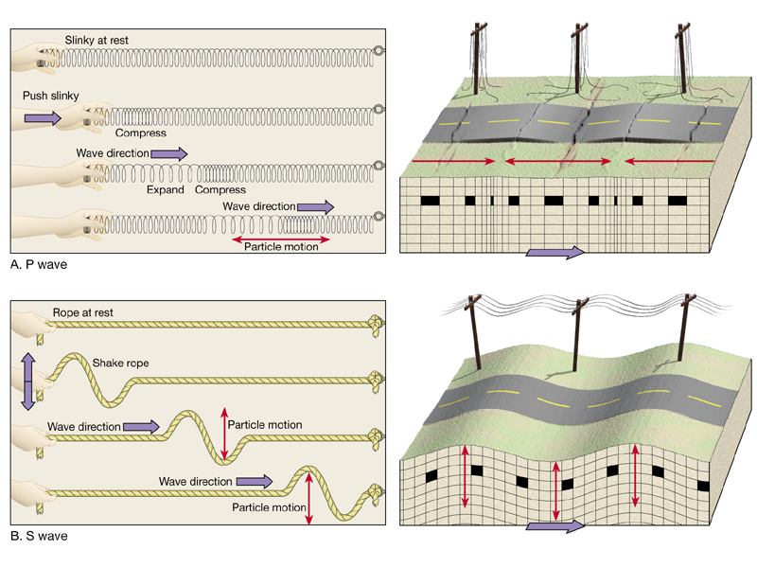
P and S waves
Smaller amplitude than surface (L) waves, but faster, P arrives first

Slide 49
Earthquake Records
Earthquake in Japan
Station in Germany
Magnitude 6.5
P S surface waves
Up-Down
N-S
E-W

Slide 50
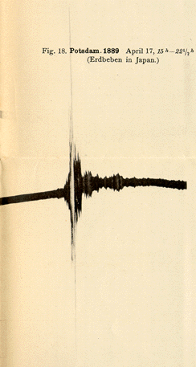
Seismometers
Seismometers are devices that record ground motion during earthquakes.
The first seismometers were constructed at the very end of the 19th century in Italy and Germany.

Slide 51
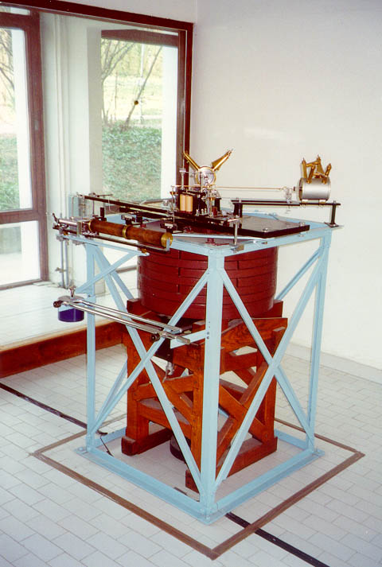
Seismometers
Horizontal 1000 kg Wiechert seismograph in Zagreb (built in 1909)

Slide 52
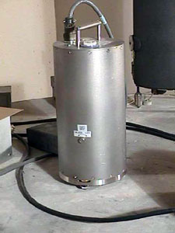
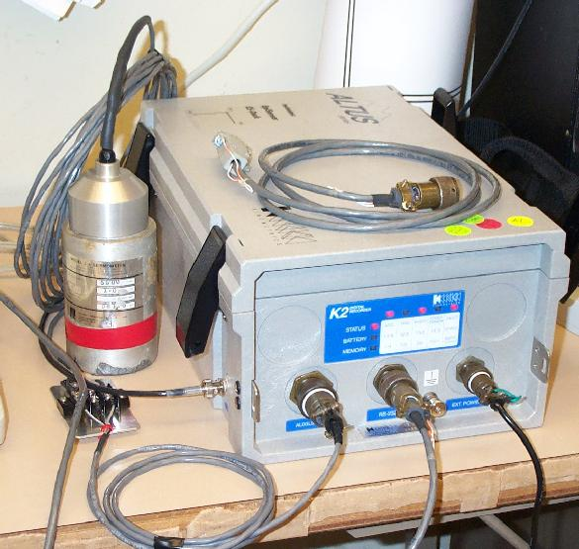
Seismometers
Modern digital broadband seismometers are capable of recording almost the whole seismological spectrum (50 Hz – 300 s).
Their resolution of 24 bits (high dynamic range) allows for precise recording of small quakes, as well as unsaturated registration of the largest ones.

Slide 53
Observational Seismology
We are now equipped to start recording and locating earthquakes. For that we need a seismic network of as many stations as possible.
Minimal number of stations needed to locate the position of an earthquake epicentre is three.
Broad-band seismological stations in Europe

Slide 54
Observational Seismology Locating Earthquakes
To locate an earthquake we need precise readings of the times when P- and S-waves arrive at a number of seismic stations.
Accurate absolute timing (with a precission of 0.01 s) is essential in seismology!

Slide 55
Observational Seismology Locating Earthquakes
Knowing the difference in arrival times of the two waves, and knowing their velocity, we may calculate the distance of the epicentre.
This is done using the travel-time curves which show how long does it take for P- and S-waves to reach some epicentral distance.

Slide 56
Observational Seismology Locating Earthquakes
Another example of picking arrival times

Slide 57
Observational Seismology Locating Earthquakes
After we know the distance of epicentre from at least three stations we may find the epicentre like this
There are more sofisticated methods of locating positions of earthquake foci. This is a classic example of an inverse problem.

Slide 58
Observational Seismology Magnitude determination
Besides the position of the epicentre and the depth of focus, the earthquake magnitude is another defining element of each earthquake.
Magnitude (defined by Charles Richter in 1935) is proportional to the amount of energy released from the focus.
Magnitude is calculated from the amplitudes of ground motion as measured from the seismograms. You also need to know the epicentral distance to take attenuation into account.

Slide 59
Observational Seismology Magnitude determination
Formula:
M = log(A) + c₁ log (D) + c₂
where A is amplitude of ground motion, D is epicentral distance, and c₁, c₂ are constants.
There are many types of magnitude in seismological practice, depending which waves are used to measure the amplitude: M_{L}, m_{b}, M_{c}, M_{s}, M_{w}, ...
Increase of 1 magnitude unit means ~32 times more released seismic energy!

Slide 60
Observational Seismology Some statistics
Magnitude Effects Number per year –––––––––––––––––––––––––––
less than 2 Not felt by humans. Recorded by instruments only. Numerous
2 Felt only by the most sensitive. Suspended objects swing >1 000 000
3 Felt by some people. Vibration like a passing heavy vehicle 100 000
4 Felt by most people. Hanging objects swing. Dishes and windows rattle and may break 12 000
5 Felt by all; people frightened. Chimneys topple; furniture moves 1 400
6 Panic. Buildings may suffer substantial damage 160
7-8 Widespread panic. Few buildings remain standing. Large landslides; fissures in ground 20
8-9 Complete devastation. Ground waves ~2

Slide 61
Observational Seismology Some statistics
Equivalent Magnitude Event Energy (tons TNT)
––––––––––––––––––––––––––––––––––––––––––––––––––––––––––––––––––
2.0 Large quary blast 1
2.5 Moderate lightning bolt 5
3.5 Large ligtning bolt 75
4.5 Average tornado 5 100
6.0 Hiroshima atomic bomb 20 000
7.0 Largest nuclear test 32 000 000
7.7 Mt. Saint Helens eruption 100 000 000
8.5 Krakatoa eruption 1 000 000 000
9.5 Chilean earthquake 1960 32 000 000 000

Slide 62
Observational Seismology Some statistics

Slide 63
Observational Seismology Some statistics

Slide 64
Observational Seismology Some statistics
Gutenberg-Richter frequency-magnitude relation:
log N = a – bM
b is approximately constant, b = 1 world-wide → there are ~10 more times M=5 than M=6 earthquakes
This shows selfsimilarity and fractal nature of earthquakes.

Slide 65
Observational Seismology Macroseismology
MACROSEISMOLOGY deals with effects of earthquakes on humans, animals, objects and surroundings.
The data are collected by field trips into the shaken area, and/or by questionaires sent there.
The effects are then expressed as earthquake INTENSITY at each of the studied places.
Intensity is graded according to macroseismic scales – Mercalli-Cancani-Sieberg (MCS), Medvedev-Sponheuer-Karnik (MSK), Modified Mercalli (MM), European Macroseismic Scale (EMS).
This is a subjective method.

Slide 66
Observational Seismology Macroseismology
European Macroseismic Scale (EMS 98)
EMS DEFINITION SHORT DESCRIPTION
––––––––––––––––––––––––––––––––––––––––––––––––––
I Not felt Not felt, even under the most favourable circumstances.
II Scarcely felt Vibration is felt only by individual people at rest in houses, especially on upper floors of buildings.
III Weak The vibration is weak and is felt indoors by a few people. People at rest feel a swaying or light trembling.
IV Largely The earthquake is felt indoors by many people, outdoors by very observed few. A few people are awakened. The level of vibration is not fright- ening. Windows, doors and dishes rattle. Hanging objects swing.
V Strong The earthquake is felt indoors by most, outdoors by few. Many sleeping people awake. A few run outdoors. Buildings tremble throughout. Hanging objects swing considerably. China and glasses clatter together. The vibration is strong. Top heavy objects topple over. Doors and windows swing open or shut.

Slide 67
EMS DEFINITION SHORT DESCRIPTION ––––––––––––––––––––––––––––––––––––––––––––––––––
VI Slightly Felt by most indoors and by many outdoors. Many people in damaging buildings are frightened and run outdoors. Small objects fall. Slight damage to many ordinary buildings e.g. fine cracks in plaster and small pieces of plaster fall.
VII Damaging Most people are frightened and run outdoors. Furniture is shifted and objects fall from shelves in large numbers. Many ordinary buildings suffer moderate damage: small cracks in walls; partial collapse of chimneys.
VIII Heavily Furniture may be overturned. Many ordinary buildings suffer damaging damage: chimneys fall; large cracks appear in walls and a few buildings may partially collapse.
IX Destructive Monuments and columns fall or are twisted. Many ordinary buildings partially collapse and a few collapse completely.
X Very Many ordinary buildings collapse. destructive
XI Devastating Most ordinary buildings collapse.
XII Completely Practically all structures above and below ground are devastating heavily damaged or destroyed.

Slide 68
Observational Seismology Macroseismology
Results of macroseismic surveys are presented on isoseismal maps.
Isoseismals are curves connecting the places with same intensities.
DO NOT CONFUSE INTENSITY AND MAGNITUDE!
Just approximately, epicentral intensity is: I_{o} = M + 2
One earthquake has just one magnitude, but many intensities!

Slide 69
Engineering Seismology
Earthquakes are the only natural disasters that are mostly harmless to humans! The only danger comes from buildings designed not to withstand the largest possible earthquakes in the area.
Engineering seismology provides civil engineers parameters they need in order to construct seismically safe and sound structures.
Engineering seismology is a bridge between seismology and earthquake engineering.
Izmit, Turkey, 1999

Slide 70
Engineering Seismology
Most common input parameters are: - maximal expected horizontal ground acceleration (PGA) - maximal expected horizontal ground velocity (PGV) - maximal expected horizontal ground displacement (PGD) - response spectra (SA) - maximal expected intensity (Imax) - duration of significant shaking - dominant period of shaking.
Engineering seismologists mostly use records of ground acceleration obtained by strong-motion accelerographs.
Accelerogram of the Ston-Slano (Croatia, M = 6.0, 1996) event

Slide 71
Engineering Seismology
In order to estimate the parameters, seismologists need:
Complete earthquake catalogues that extend well into the past,
Information on the soil structure and properties at the construction site, as well as on the path between epicentre and the site,
Records of strong earthquakes and small events from near-by epicentral regions,
Results of geological surveys ...

Slide 72
Engineering Seismology
Complete and homogeneous earthquake catalogues are of paramount importance in seismic hazard studies.
Seismicity of Croatia after the Croatian Earthquake Catalogue that lists over 15.000 events

Slide 73
Engineering Seismology
In estimating the parameters you may use:
PROBABILISTIC APPROACH –use statistical methods to assess probability of exceeding a predefined level of ground motion in some time period (earthquake return period), based on earthquake history and geological data.
DETERMINISTIC APPROACH – use a predefined earthquake and calculate its effects and parameters of seismic forces on the construction site. This is very difficult to do because the site is in the near-field (close to the fault) and most of the approximations you normally use are not valid.
A combination of the two

Slide 74
Engineering Seismology
Examples of probabilistic hazard assessment in Croatia
Probability of exceeding intensity VII °MSK in any 50 years (Zagreb area)
Earthquake hazard in Southern Croatia (Dalmatia) in terms of PGA for 4 return periods

Slide 75
Engineering Seismology Soil amplification
Amplification of seismic waves in shallow soil deposits may cause extensive damage even far away from the epicentre. It depends on:
Thickness of soil above the base rock,
Density and elastic properties of soil,
Frequency of shaking,
The strength of earthquake...
Spectral amplification along a profile in Thessaloniki , Greece

Slide 76
‘Physical’ Seismology
Our knowledge about the structure of the Earth deeper than several km was gained almost exclusively using seismological methods.
Seismologists use seismic rays to look into the interior of the Earth in the same way doctors use X-rays.

Slide 77
‘Physical’ Seismology
Seismic waves get reflected, refracted and converted on many discontinuities within the earth thus forming numerous seismic phases. The rays also bend because the velocity of elsastic waves changes with depth.

Slide 78
‘Physical’ Seismology Forward problem:
Given the distribution of velocity, density and attenuation coefficient with depth, and positions of all discontinuities, calculate travel times and amplitudes of some seismic phase (e.g. pP or SKS).
This is relatively easy and always gives unique solution.

Slide 79
‘Physical’ Seismology Inverse problem:
Given the arrival times and amplitudes of several seismic phases on a number of stations, compute distribution of velocity, density and attenuation coefficient with depth, and positions of all discontinuities.
This is very difficult and often does not give a unique solution. Instead, a range of solutions is offered, each with its own probability of being correct. The solution is better the more data we have.

Slide 80
Inverse problems: Tomography
Seismic tomography gives us 3-D or 2-D images of shallow and deep structures in the Earth. They may be obtanied using earthquake data, or explosions (controlled source seismology). These methods are also widely used in explorational geophysics in prospecting for oil and ore deposits.

Slide 81
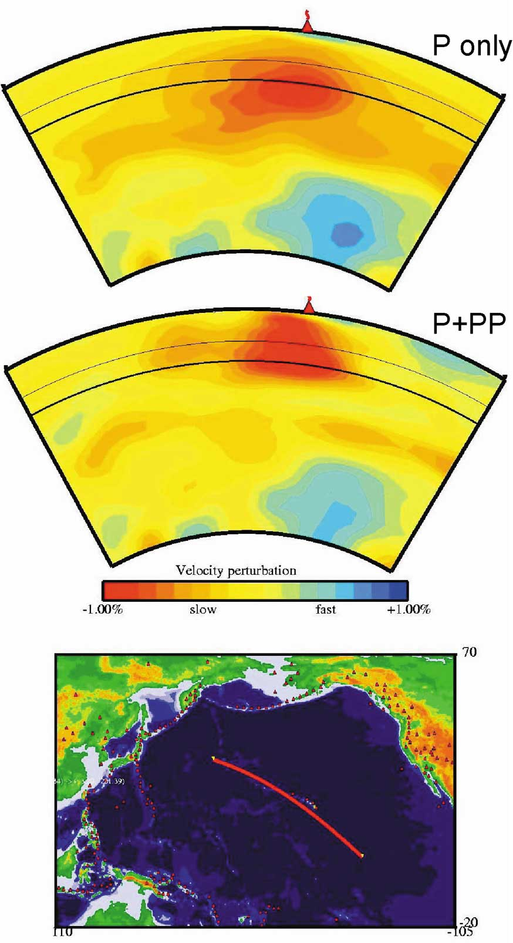
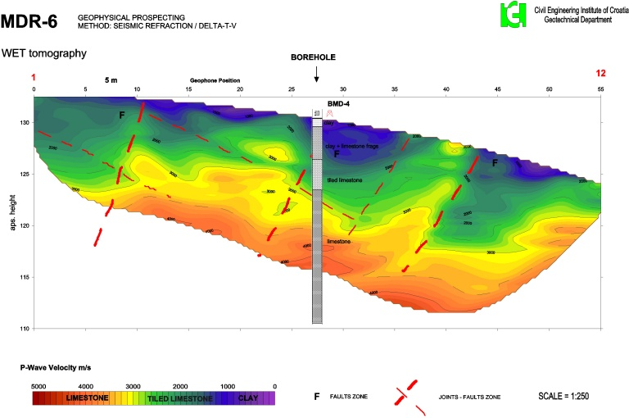
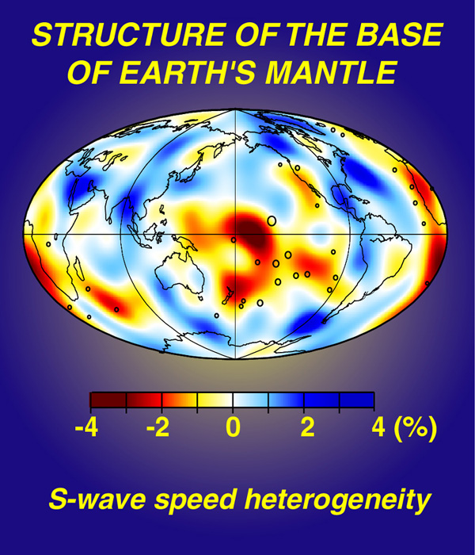
Tomography

Slide 82
Some basic theoretical background
Theoretical seismology starts with elements of theory of elasticity:
Infinitesimal strain tensor has elements (e) that are linear functions of spatial derivatives of displacement components (u):
Stress tensor has 9 elements (τ₁₁ ... τ₃₃), and consists of normal (τ₁₁, τ₂₂, τ₃₃) and shear stress components. τ_{ij} is stress that acts on the small surface with the normal along i-th coordinate, and the force component is directed in the j-th direction:
Stress and strain are related by Hooke’s law: (c_{ijkl} are elastic constants)

Slide 83
Some basic theoretical background
Considering that all internal and external forces must be in equilibrium, Newton’s law gives us equations of motion:
Combining the Hookes law, equations of motion, and the equation that links strains and displacement components, we obtain the Navier equation of motion in the form:
This is one of the basic equations of theoretical seismology which links forces (body-forces and forces originating from stresses within the body) with measurable displacements.
Here we assumed the anisotropic body, so that of all elastic constants c_{ijkl} only two remain and are denoted as λ and μ. They are called Lamé’s constants.
This is rather complicated 3-D partial differential equation describing displacements within the elastic body.

Slide 84
Some basic theoretical background
The Navier equation is usually solved using the Helmholtz’s theorem, which expresses any vector field (in our case displacement, u) as:
In these expressions α and β are velocities of longitudinal and transversal waves. We see that they only depend on the properties of material through which they propagate.
The few equations presented are the most basic ones. Combined with the general principles (like conservation of energy), laws of physics (e.g. Snell’s law) and with boundary conditions that nature imposes (e.g. vanishing of stresses on free surface) they are fundamental building stones for all problems in theoretical seismology.
where φ and ψ are called scalar and vector potentials. They may be shown to be directly linked with longitudinal and transversal waves, respectively, obeying wave equations:

Slide 85
Highly recomended reading
Aki, K. & Richards, P. G. (2002): Quantitative Seismology – 2nd Edition, University Science Books, Sausalito, CA.
Lay, T. and Wallace, T. C. (1995): Modern Global Seismology, Academic press, San Diego.
Udias, A. (1999): Principles of Seismology, Cambridge Univesity Press, Cambridge.
Shearer, P. M. (1999): Introduction to Seismology, Cambridge Univesity Press, Cambridge.
Ben Menahem, A. and Singh, S. J. (1980): Seismic Waves and Sources, Springer-Verlag, New York.
Cox, A. and Hart, R.B. (1986): Plate Tectonics - How it Works, Palo Alto, California, Blackwell Scientific Publications, 392 p.

Slide 86
Used sources
billharlan.com/pub/ tomo/tomoin.gif
www.earth.ox.ac.uk/research/ seismology.htm
rayfract.com
www.exploratorium.edu/ls/ pathfinders/earthquakes/
www.okgeosurvey1.gov/level2/ok.grams/tide.1994MAY24.JUN01/tide.1994MAY24.JUN01.html
www.fcs-net.com/biddled/myths_legend.htm
www.eas.slu.edu/People/KKoper/EASA-193/ 2002/Lecture_01/lecture_01.ppt
www.uic.edu/classes/geol/eaes102/Lecture%2021-22.ppt
earthquake.usgs.gov/image_glossary/ crust.html
www.geneseo.edu/~brennan/ gsci345/crustalT.jpg
www.nap.edu/readingroom/books/ biomems/bgutenberg.html
paos.colorado.edu/~toohey/fig_70.jpg
www.geo.uni-bremen.de/FB5/Ozeankruste/ subduction.jpg
www.exploratorium.edu/faultline/earthquakescience/fault_types.html
www.geophysik.uni-muenchen.de/Institute/Geophysik/obs_seis.htm
www.earthquakes.bgs.ac.uk/
www-geology.ucdavis.edu/~gel161/sp98_burgmann/earthquake1.html
seismo.unr.edu/ftp/pub/louie/class/100/seismic-waves.html
geology.asu.edu/research/ deep_earth/de3a.jpg
www.seismo.com/msop/msop79/rec/fig_1.1.2a.gif
earthquake.usgs.gov/
www.iris.washington.edu/pub/userdata/default_maps/yearly.gif
www.ictp.trieste.it/sand/ Thessaloniki/Fig-8b.jpg

Slide 87
Attenuation Relationship
Donovan: $a=\frac{1080e^{(0.5M)}}{{(R+25)}^{1.32}}$
Esteva: $a=\frac{1230e^{(0.8M)}}{{(R+25)}^{2}}$
Esteva (Cal.):$a=\frac{5600e^{(0.8M)}}{{(R+40)}^{2}}$
Campbell: $Ln\left(a\right)=3.99+1.28M−1.75(R+0.147e^{\left(0.732M\right)})$

Slide 88
Return Period: T=$\frac{1}{P}=⇒P=\frac{1}{T}$
$P^{′}=1−P=\left(1−\frac{1}{T}\right)$
$P^{′}={(1−\frac{1}{T})}^{n}$
$P=1−{\left(1−\frac{1}{T}\right)}^{n}$
$P\left(t\right)=1−e^{(−N.t)}$

Slide 89
$$P=1−{\left(1−\frac{1}{T}\right)}^{n}$$
Earthquake Frequency | Return period (year) | Probability of exceedance
Frequent | 43 | 50% in 30 years
Frequent | 43 | 69% in 50 years
Occasional | 72 | 50% in 50 years
Rare | 475 | 10% in 50 years
Very Rare | 970 | 10% in 100 years
Very Rare | 970 | 5% in 50 years
Extremely Rare | 2475 | 2% in 50 years

Slide 90
تحلیل خطرپذیری سازها در مقابل زلزله
خطر (Hazard) – ریسک(Risk)=خطرپذیری
خطرات مرتبط زلزله:
بریدگی سطح زمین
سونامی
لرزش های قوی زمین
زمین لغزه
روانگرایی
تشدید

Slide 91
کاربرد مطالعات خطر/خطرپذیری سازه ها در برابر زلزله
تدوین آیین نامه های طراحی ساختمانها در برابر زلزله
سیاست گذاری ها و برنامه ریزی های شهری
مدیریت های قبل و بعد از زلزله (ریسک – بحران)
تصمیم گیری های کلان جامعه
مسایل بیمه و بانک ها
هدف: عددی کردن احتمال وقوع زلزله، خطرات و پیامدهای آن در یک منطقه خاص

Slide 92
روش تحلیل خطرپذیری زلزله
روش دقیق (Deterministic Seismic Hazard Analysis)
DSHA
برای سازه ها مهم کاربرد دارد
بزرگترین زلزله محتمل
تعیین خصوصیات منبع زلزله
روش احتمالاتی(Probabilistic Seismic Hazard Analysis)
PSHA
احتمال رخداد یک زلزله با بزرگای خاص
میناری کار تمام ایین نامه های طراحی

Slide 93
مراحل تحلیل خطرپذیری در مقابل زلزله
تعیین منطقه مورد بررسی (ناحیه ای به شعاع 200 کیلومتر)
تعیین گسل های منطقه مورد بررسی و وضعیت لرزه خیزی آنها
تهیه کاتالوگ زلزله برای منطقه مورد بررسی (زلزله های دستگاهی/ زلزله های تاریخی / زلزله های زمین شناسی)
استخراج رابطه گوتنبرگ –ریشتر
روابط کاهندگی
روابط احتمالاتی وقوع زلزله
P(t)=10% MCE
P(t)=64% DBE

Slide 94
انواع گسل از نظر لرزه خیزی
گسل های فعال (حداقل یک حرکت در 35 هزار سال گذشته و یا حداقل 2 حرکت در 500 هزار سال گذشته)
کسل های با قابلیت فعال شدن
گسل های با فعالیت خیلی کم
گسل های غیرفعال

Slide 95
چگونگی تشخیص فعالیت گسل
الف- عوامل زمین شناسی (اندازه گیری حرکات صفحات، بریده شدن رسوبات جوان، علایم ژئومورفولوژیکی سطح گسل، تغییر مسیر رودخانه ها)
ب- عوامل تاریخی (زلزله های تاریخی)
ج- عوامل لرزه شناسی (پراکندگی وقوع زلزله ها در حوالی یک گسل، تهیه مکانیزم گسل، بالاآمدگی یا پایین رفتگی ناهگهانی سطح آب دریا)

Slide 96
رابطه بزرگای زلزله و طول بریده شده گسل
Tocher: M=5.7+log(Lf)
Housner: M=5.34+1.3log(Lf)
اشجعی و نوروزی: M=5.4+log(Lf)
Lf=0.5L

Slide 97
سازه: کارخانه هواپیماسازی محل: ایران رابطه کاهندگی: Donovan عمر مفید: 80 سال شتاب سطح طراحی: 0.4g

Slide 98
سازه: کارخانه هواپیماسازی محل: ایران رابطه کاهندگی: Donovan عمر مفید: 80 سال شتاب سطح طراحی؟ فاصله سازه از گسل: 25 کیلومتر

Slide 99
سازه: نیروگاه هسته ای محل: غرب کانادا (a=5.05, b=1.09) عمر مفید: 70 سال شتاب سطح طراحی؟
F3: L=130 km
R2= 20
F2: Esteva
R1=25 km
F1: Donovan

