Slide 1
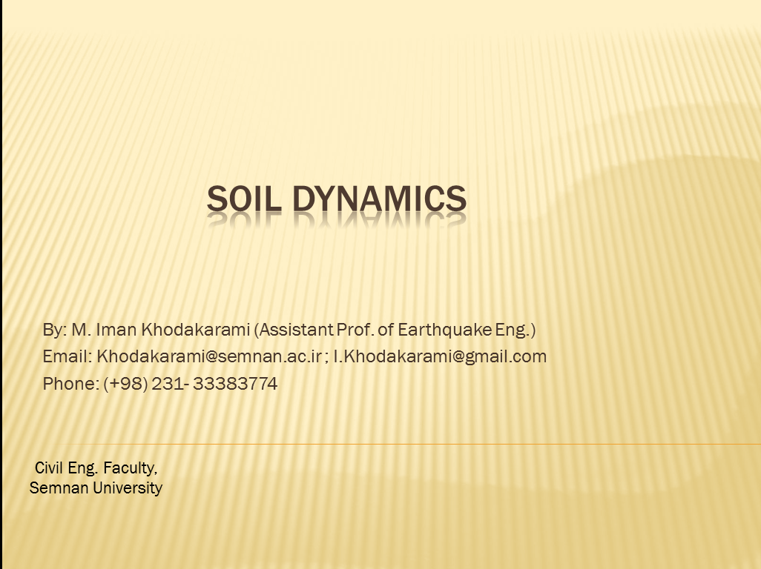

Slide 2
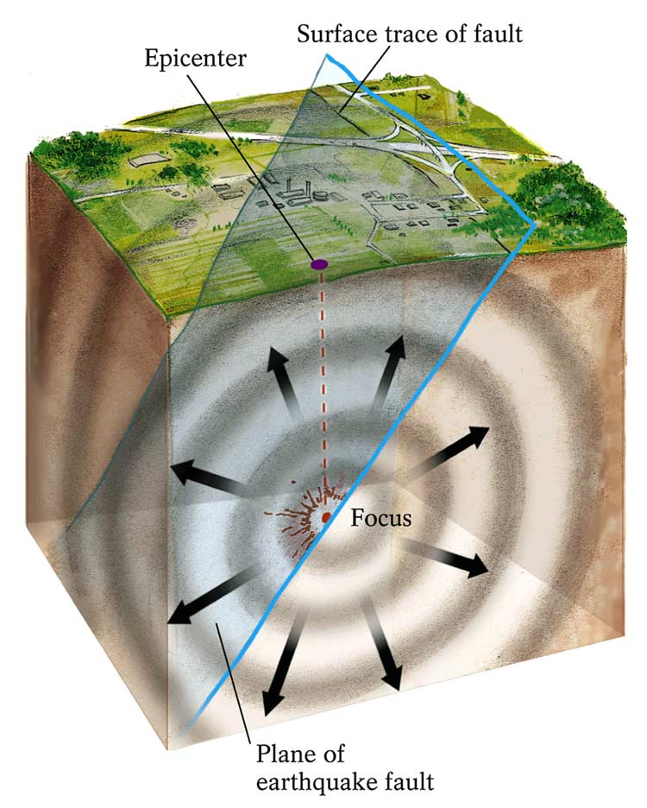
A Review on Earthquake Engineering
Anatomy of Earthquakes
An earthquake is the vibration of Earth produced by the rapid release of energy

Slide 3
A Review on Earthquake Engineering
Elastic waves – Body waves
Longitudinal waves:
They are faster than transversal waves and thus arrive first.
The particles oscillate in the direction of spreading of the wave.
Compressional waves
P-waves
Transversal waves:
The particles oscillate in the direction perpendicular to the spreading direction.
Shear waves – they do not propagate through solids (e.g. through the outer core).
S-waves

Slide 4
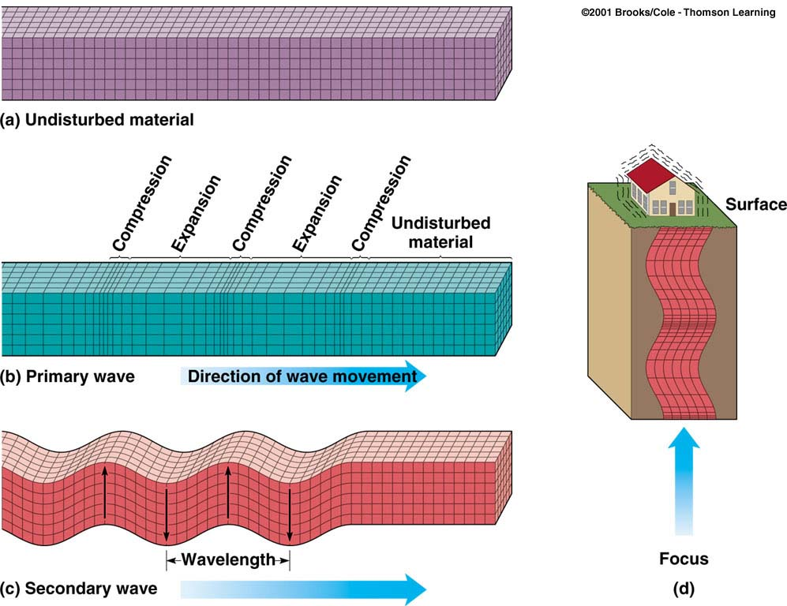
A Review on Earthquake Engineering
P-waves:
S-waves:
Elastic waves – Body waves

Slide 5
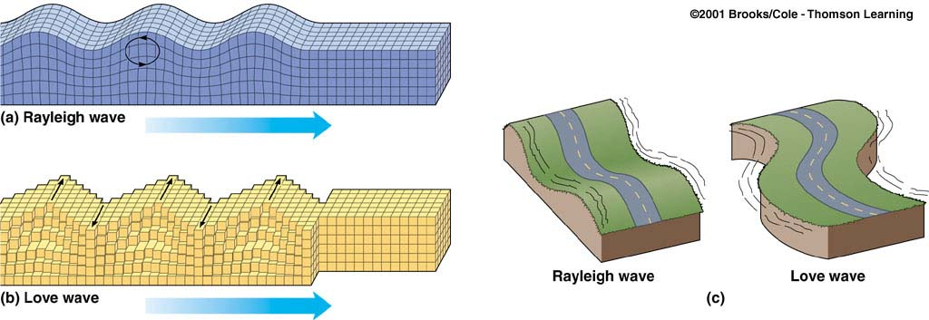
A Review on Earthquake Engineering
Elastic waves – Body waves
Surface waves: Rayleigh and Love waves
Their amplitude diminishes with the depth.
They have large amplitudes and are slower than body waves.
These are dispersive waves (large periods are faster).

Slide 6
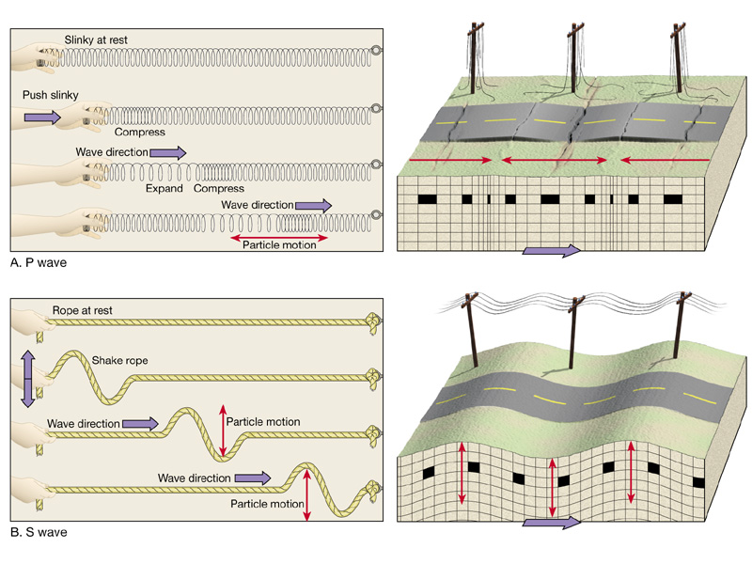
A Review on Earthquake Engineering
Seismic surface waves
Smaller amplitude than surface (L) waves, but faster, P arrives first

Slide 7
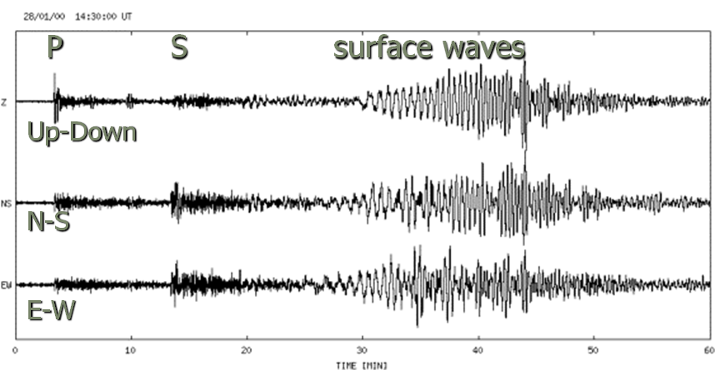
A Review on Earthquake Engineering
Seismogram

Slide 8
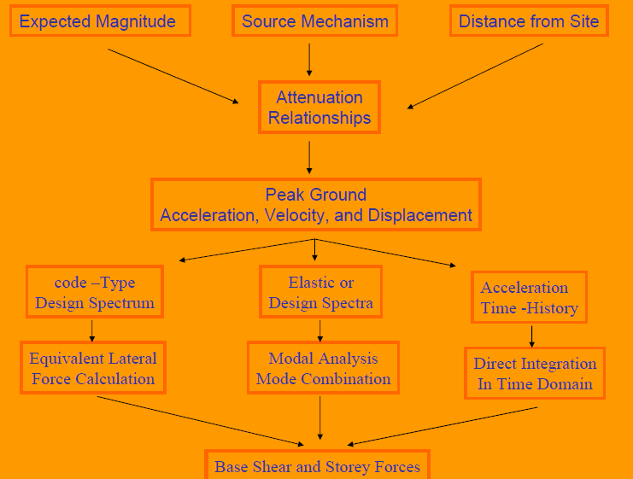

Slide 9
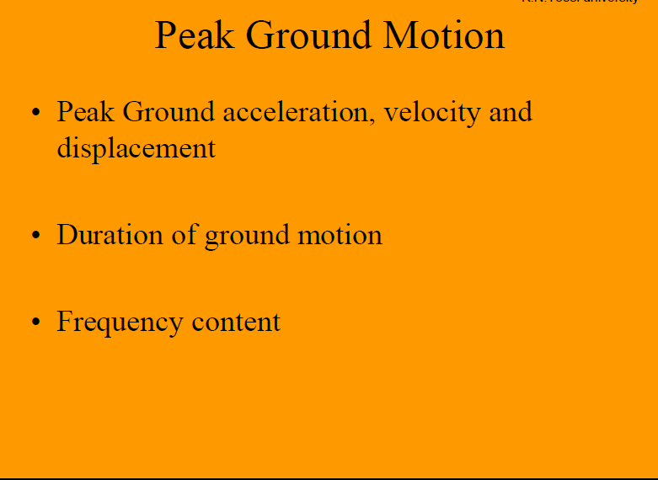

Slide 10
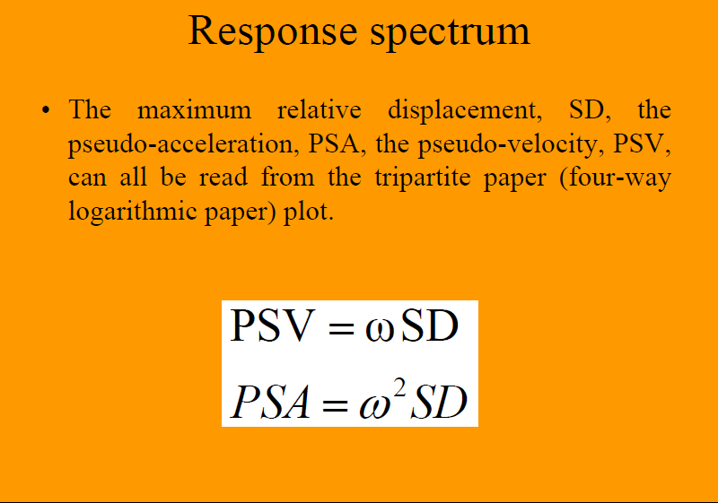

Slide 11
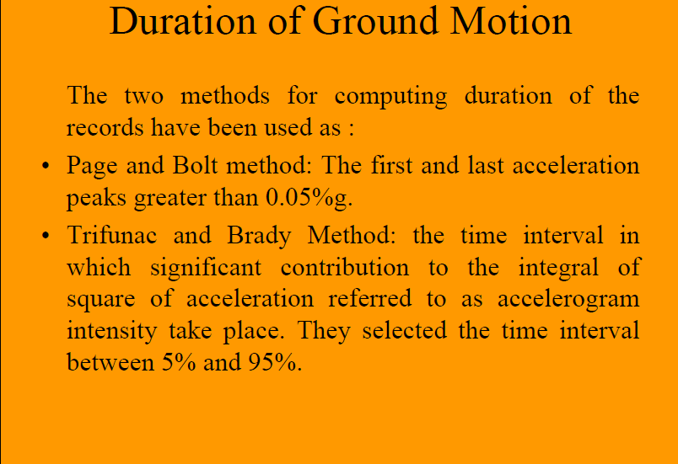

Slide 12
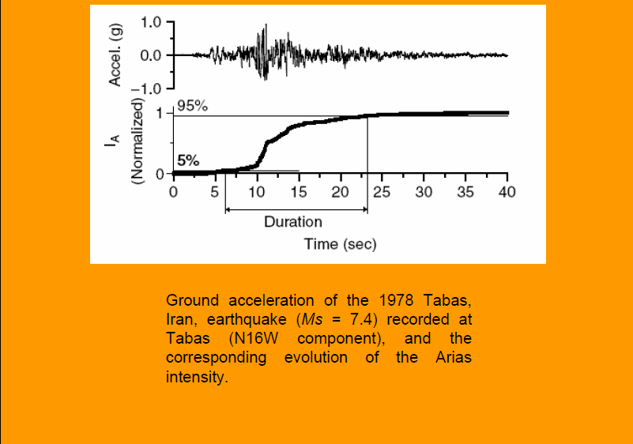

Slide 13
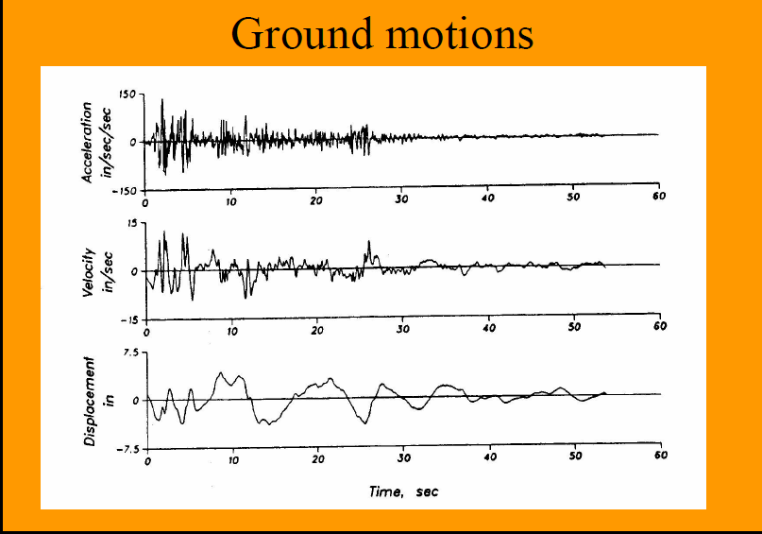

Slide 14
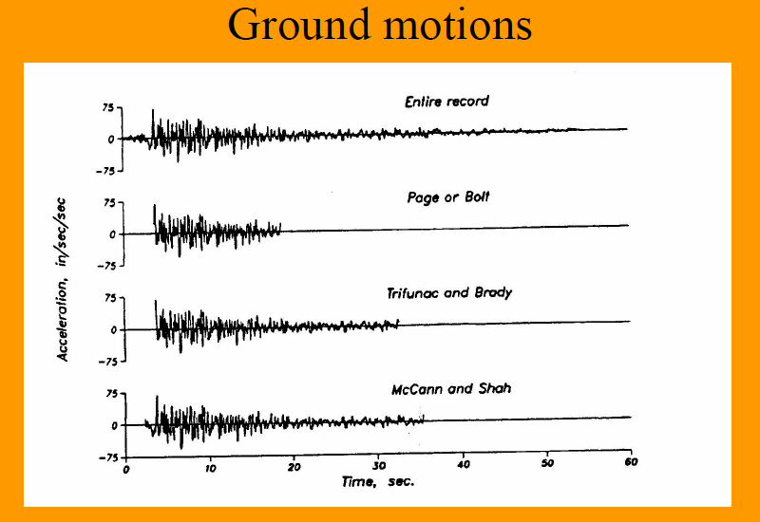

Slide 15
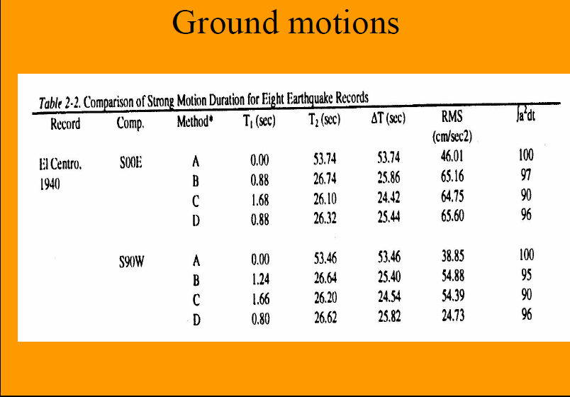

Slide 16
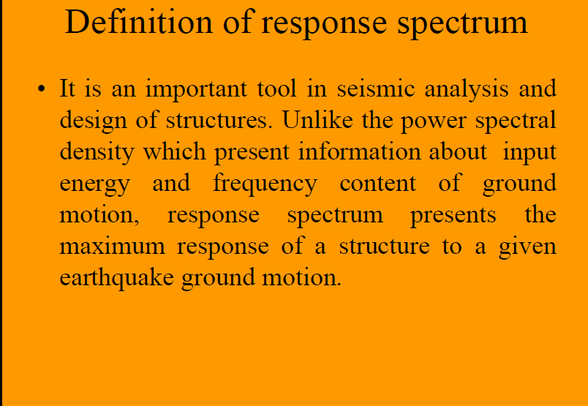

Slide 17
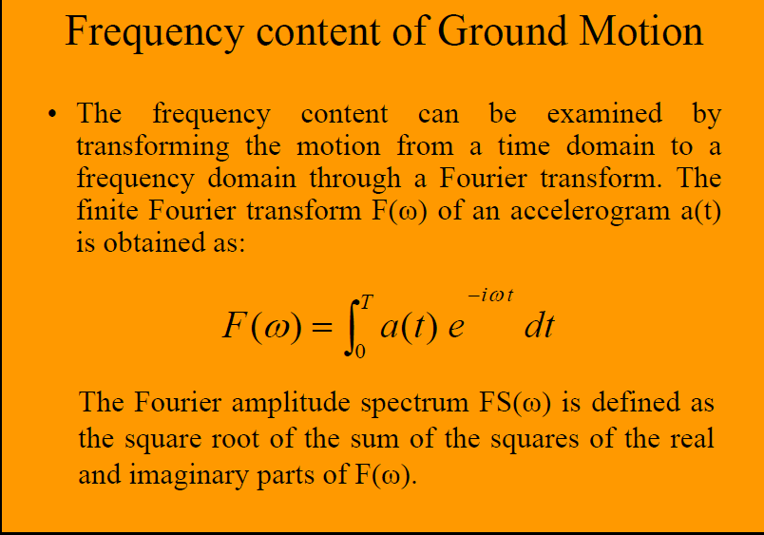

Slide 18
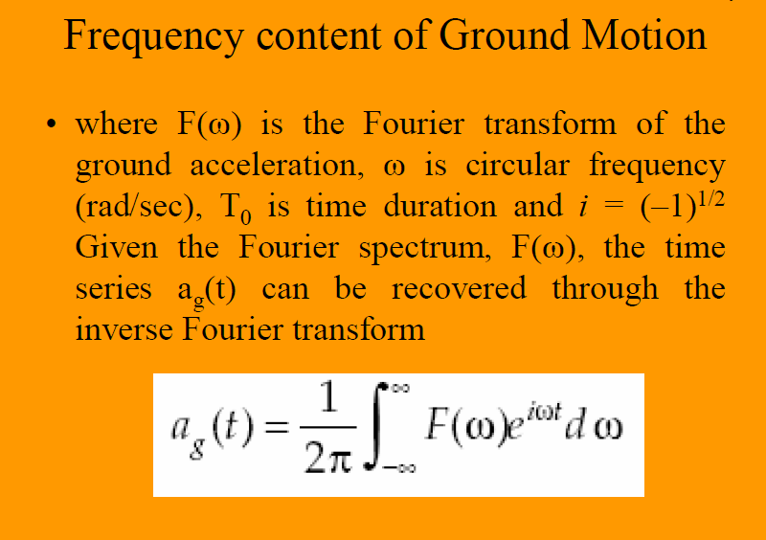

Slide 19
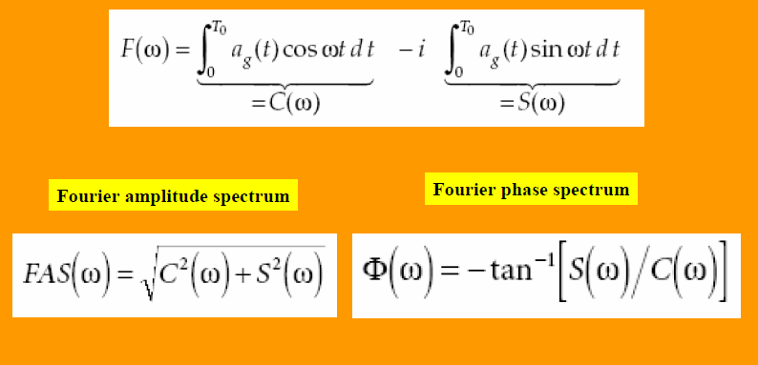

Slide 20
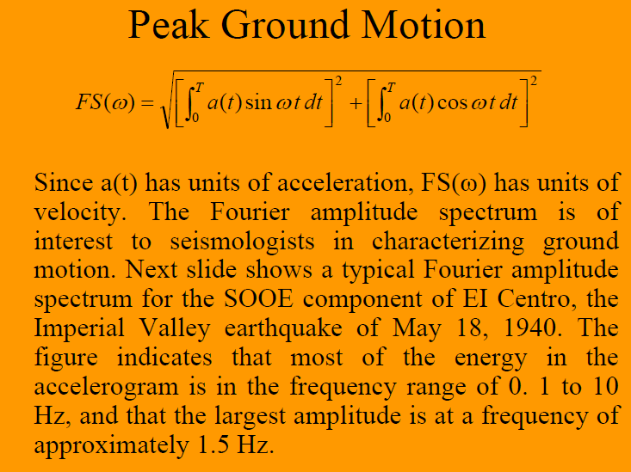

Slide 21
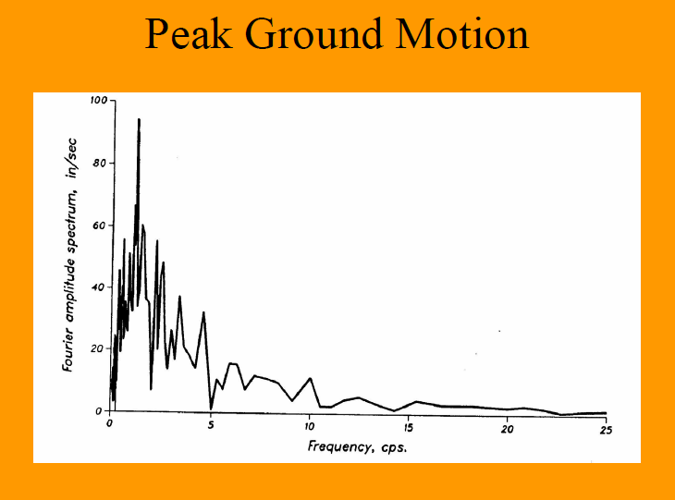

Slide 22
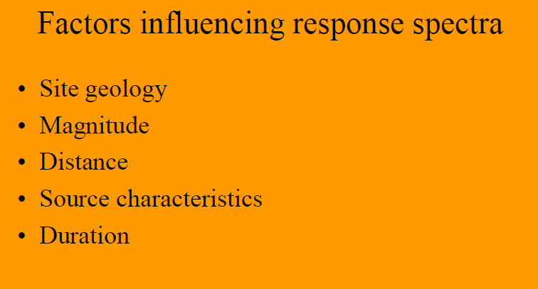
`

Slide 23
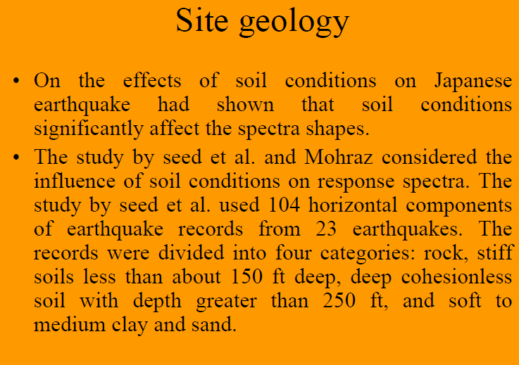

Slide 24
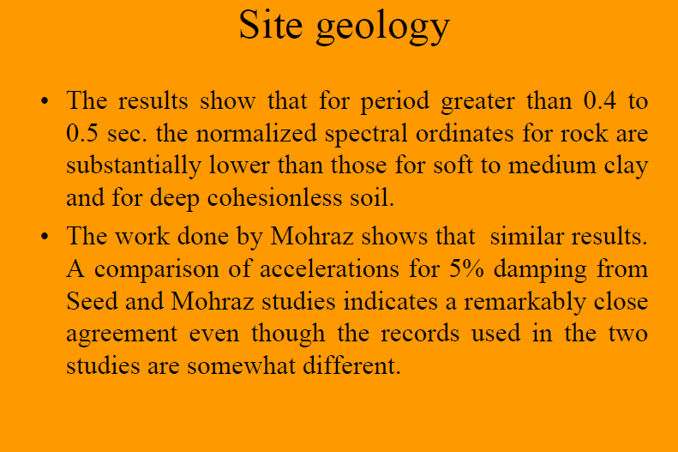

Slide 25
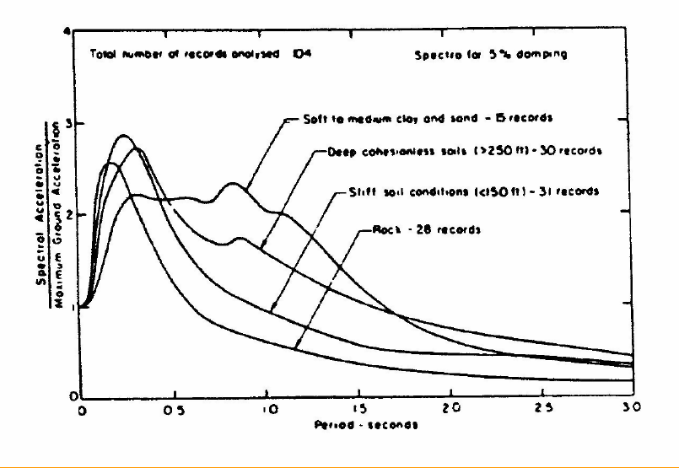

Slide 26
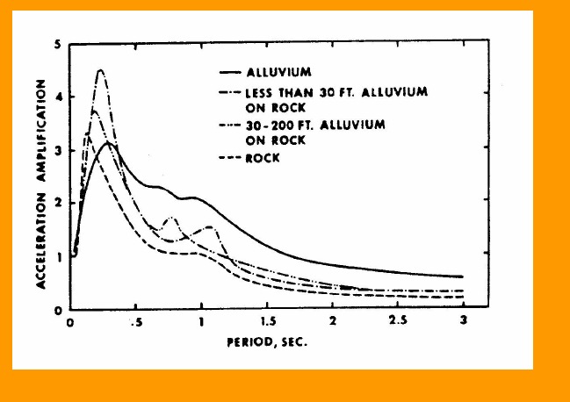

Slide 27
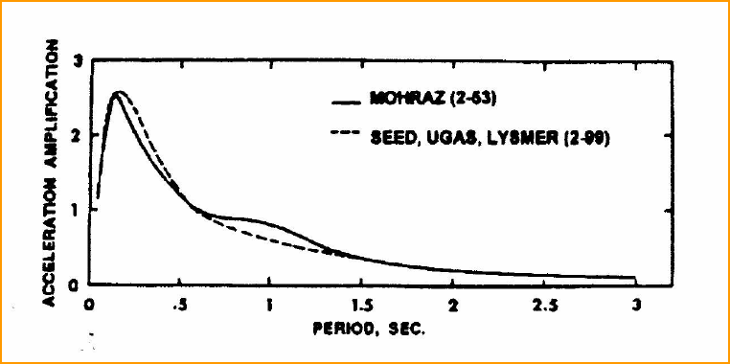

Slide 28
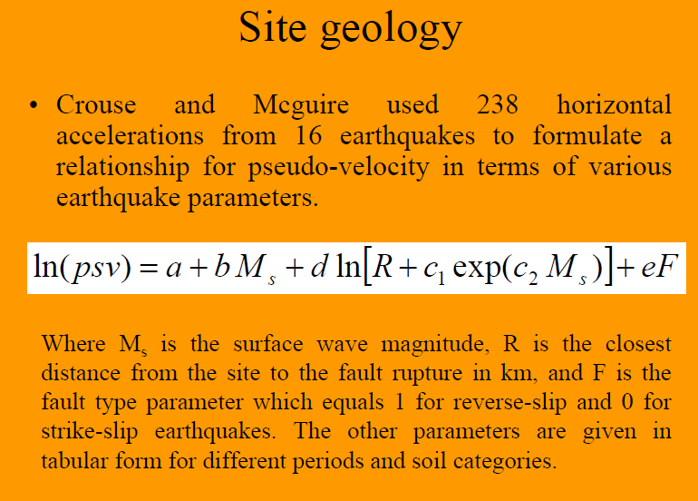

Slide 29
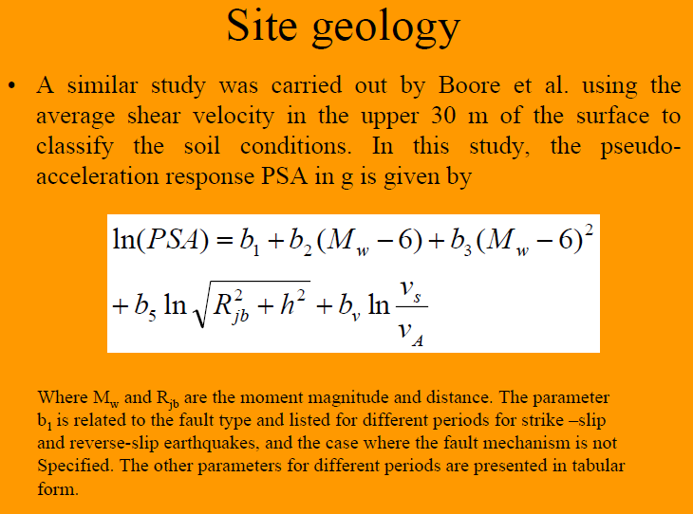

Slide 30
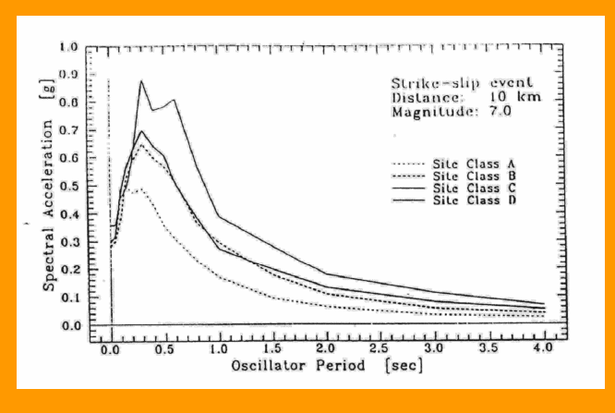

Slide 31
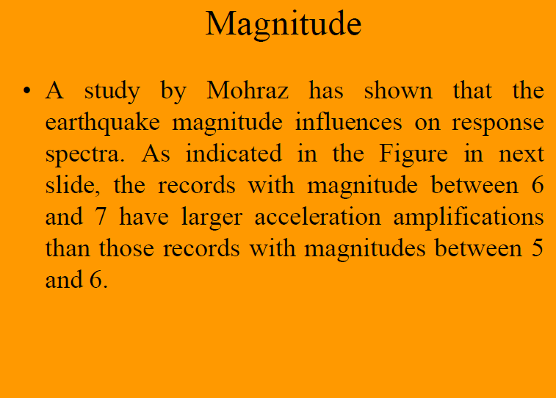

Slide 32
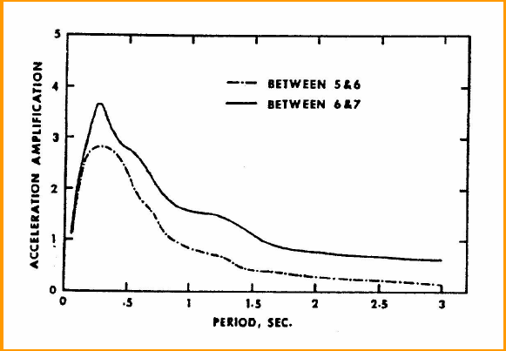

Slide 33
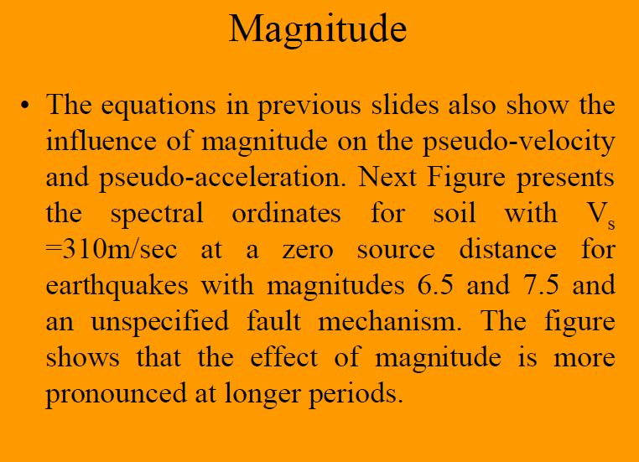

Slide 34
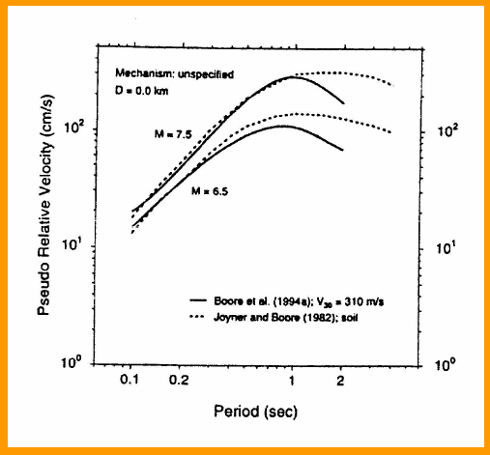

Slide 35
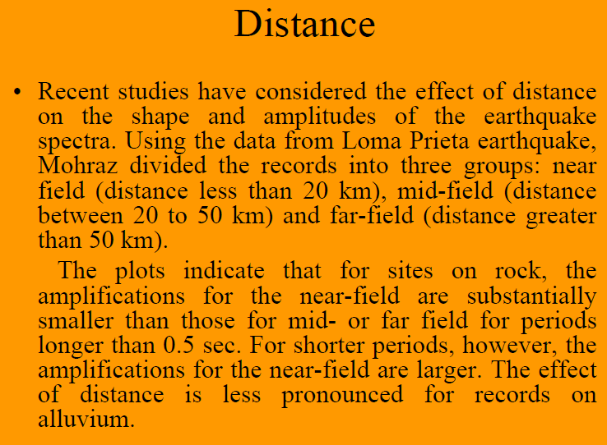

Slide 36
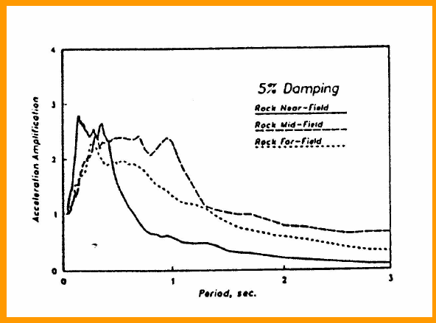

Slide 37
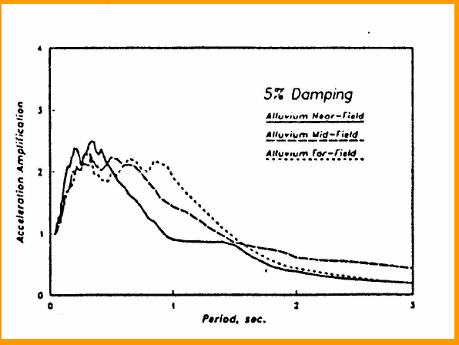

Slide 38
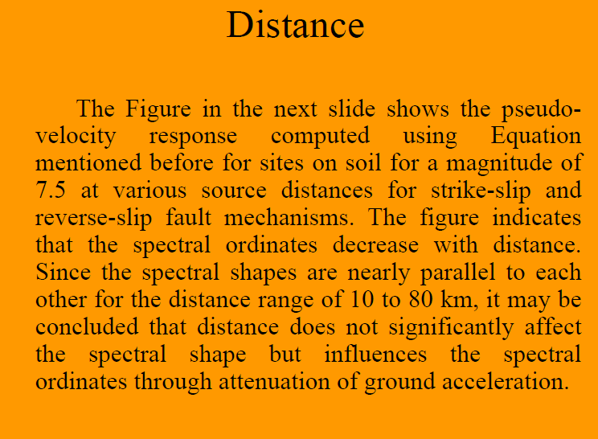

Slide 39
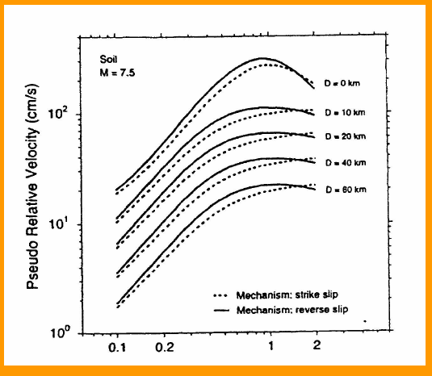

Slide 40
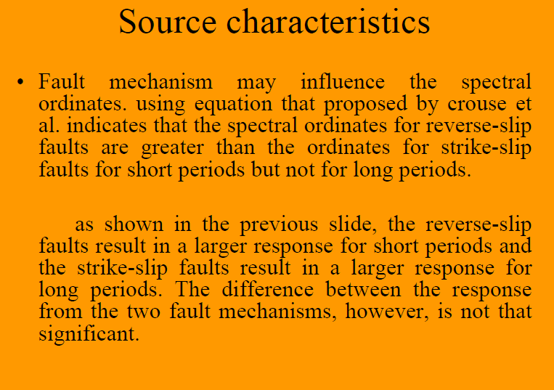

Slide 41
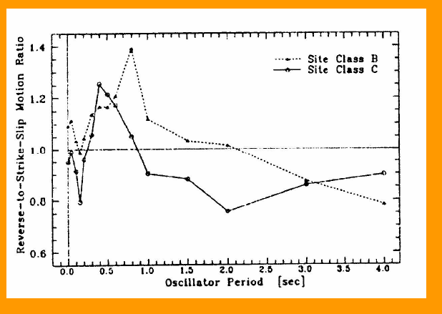

Slide 42
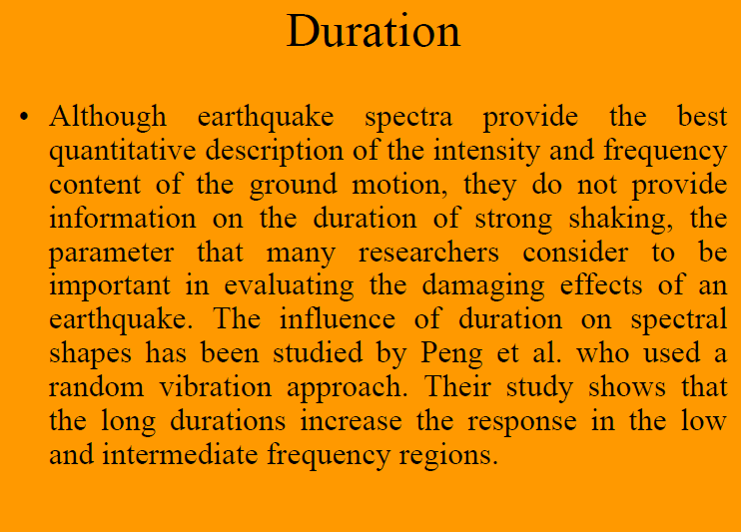

Slide 43
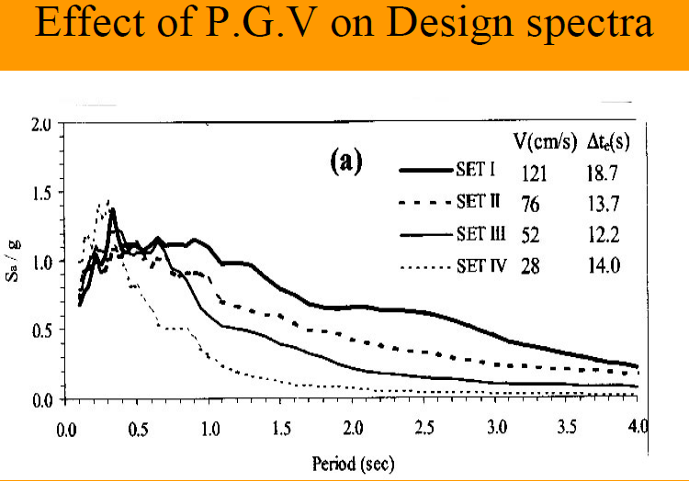

Slide 44
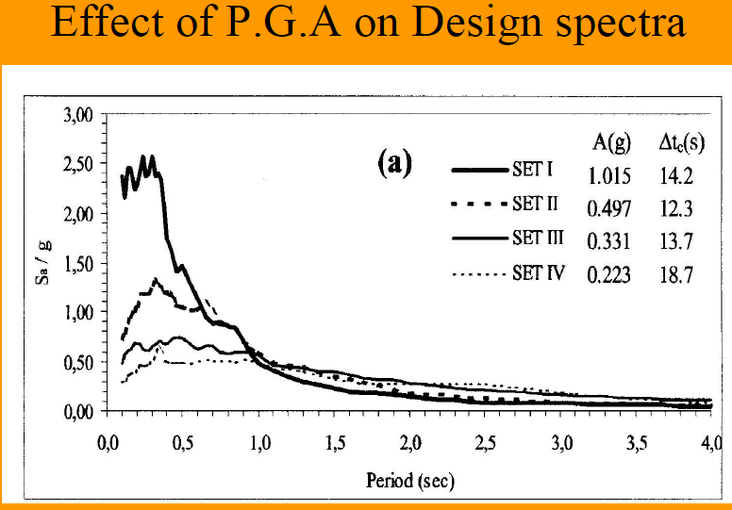

Slide 45
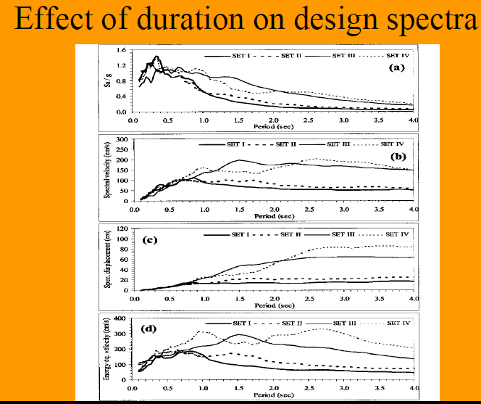

Slide 46
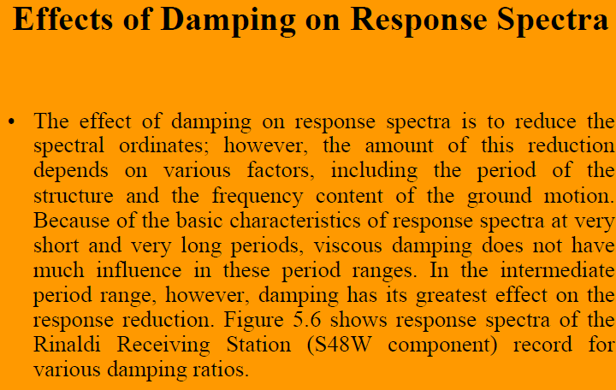

Slide 47
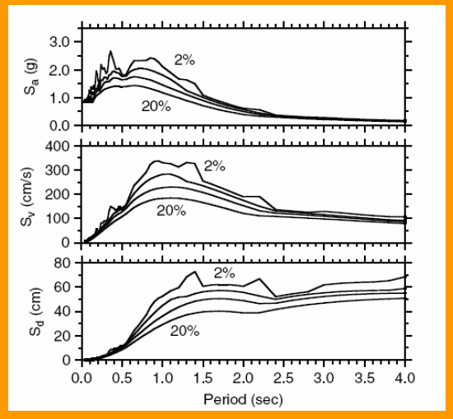

Slide 48
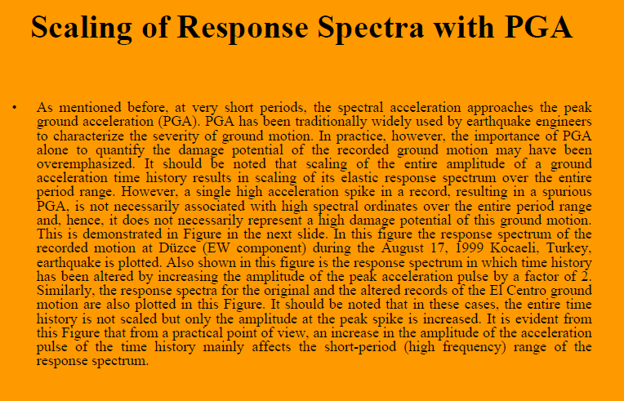

Slide 49
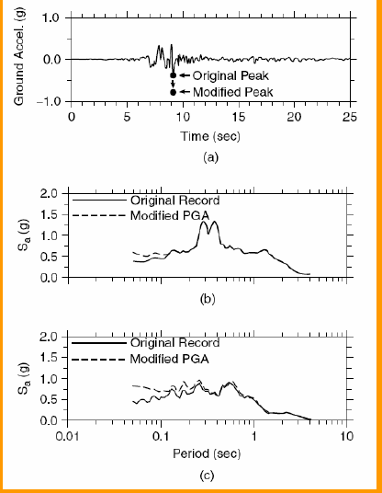

Slide 50
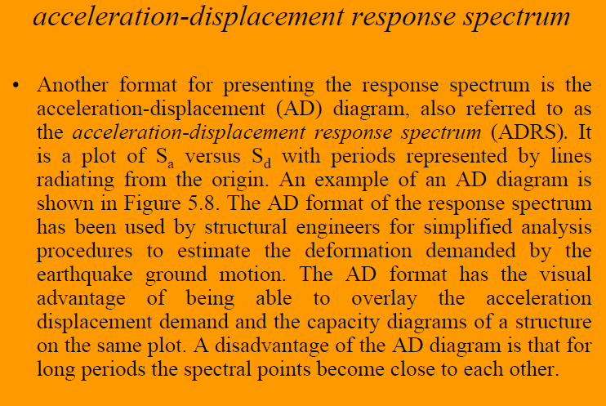

Slide 51
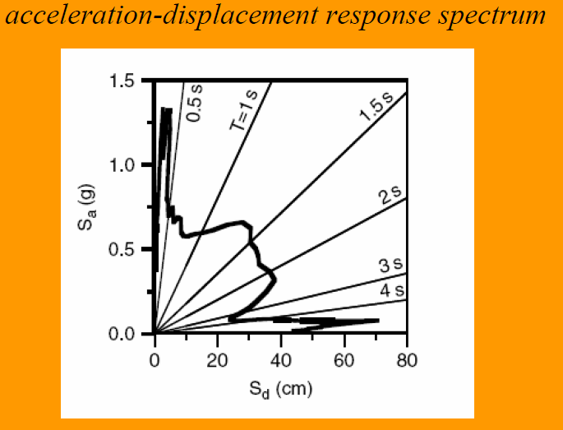

Slide 52


Slide 53


Slide 54

Elastic Design Spectra

Slide 55


Slide 56


Slide 58


Slide 59


Slide 60


Slide 61


Slide 62


Slide 63


Slide 64


Slide 65


Slide 66


Slide 67


Slide 68


Slide 69


Slide 70


Slide 71


Slide 72


Slide 73


Slide 74


Slide 75


Slide 76


Slide 77


Slide 78


Slide 79


Slide 80

Comparison of design spectra with spectra records of different soil types

Slide 81

Comparison of design spectra with spectra records of different soil types

Slide 82

The influence of duration on acceleration spectra

Slide 83

Comparison of design spectra with spectra records of different soil types

Slide 84

Comparison of design spectra with spectra records of different soil types

