Slide 1
Dynamic
Soil-Structure-Interaction
By: M. Iman Khodakarami (Assistant Prof. of Earthquake Eng.)
Email: Khodakarami@semnan.ac.ir ; I.Khodakarami@gmail.com
Phone: (+98) 23- 33383774
Civil Eng. Faculty,
Semnan University

Slide 2
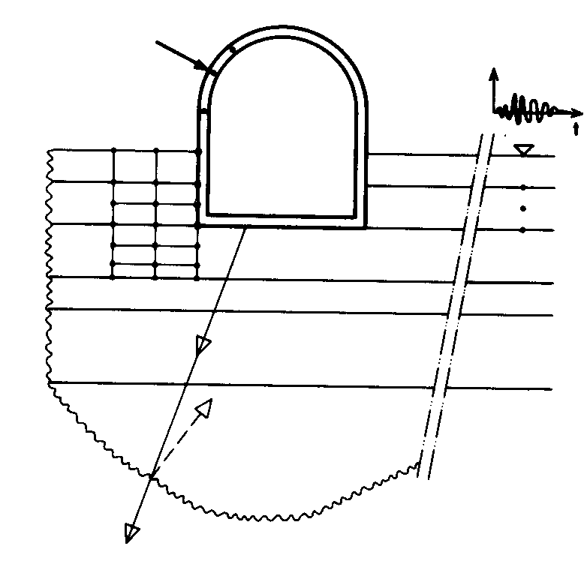
Soil-Structure-Interaction
For static loading, a fictitious boundary at a sufficient distance from the structure. Where the response is expected to have died from a practical point of view, can be introduced ➔ Modeling soil as a finite domain.
For dynamic loading, above fictitious boundaries would reflect waves originating from the vibrating structure back into the finite domain instead of letting them pass through and propagate toward infinity.

Slide 3
Soil-Structure-Interaction
The response of a structure to earthquake shaking is affected by interactions between three linked systems: the structure, the foundation, and the soil underlying and surrounding the foundation.
Considering soil-structure interaction makes a structure more flexible and thus, increasing the natural period of the structure compared to the corresponding rigidly supported structure. Also, it increases the effective damping ratio of the system.
The smooth idealization of design spectrum suggests smaller seismic response with the increased natural periods and effective damping ratio due to SSI.
With this assumption, it was traditionally been considered that SSI can conveniently be neglected for conservative design. In addition, neglecting SSI tremendously reduces the complication in the analysis of the structures which has tempted designers to neglect the effect of SSI in the analysis.
This conservative simplification is valid for certain class of structures and soil conditions, such as light structures in relatively stiff soil. Unfortunately, the assumption does not always hold true. In fact, the SSI can have a detrimental effect on the structural response, and neglecting SSI in the analysis may lead to unsafe design for both the superstructure and the foundation.

Slide 4
Soil-Structure-Interaction- In Codes
Practical application of SSI gained momentum following publication of FEMA 440, Improvement of Inelastic Seismic Analysis Procedures (FEMA, 2005), which provided the design community with procedures for incorporating the effects of soil-structure interaction in nonlinear static pushover type analyses.
These procedures were eventually adopted into ASCE/SEI 41-06, Seismic Rehabilitation of Existing Buildings (ASCE, 2007). Because they were developed for nonlinear static analysis, however, they were not directly applicable to response history analysis, which requires more careful consideration of specific components of soil-foundation interaction and the manner by which input ground motions should be applied to structural models.

Slide 5
Detrimental effects of SSI
Increase in natural period of structure due to SSI is not always beneficial as suggested by the simplified design spectrums. Soft soil sediments can significantly elongate the period of seismic waves and the increase in natural period of structure may lead to the resonance with the long period ground vibration. Additionally, the study showed that ductility demand can significantly increase with the increase in the natural period of the structure due to SSI effect. The permanent deformation and failure of soil may further aggravate the seismic response of the structure.
When a structure is subjected to an earthquake excitation, it interacts with the foundation and the soil, and thus changes the motion of the ground. Soil-structure interaction broadly can be divided into two phenomena: a) kinematic interaction and b) inertial interaction. Earthquake ground motion causes soil displacement known as free-field motion. However, the foundation embedded into the soil will not follow the free field motion. This inability of the foundation to match the free field motion causes the kinematic interaction. On the other hand, the mass of the super-structure transmits the inertial force to the soil causing further deformation in the soil, which is termed as inertial interaction
The term free-field refers to motions that are not affected by structural vibrations or the scattering of waves at, and around, the foundation.

Slide 6
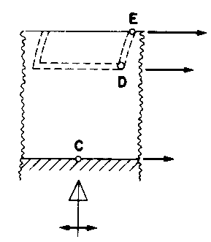
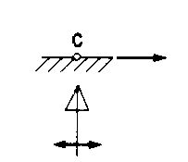
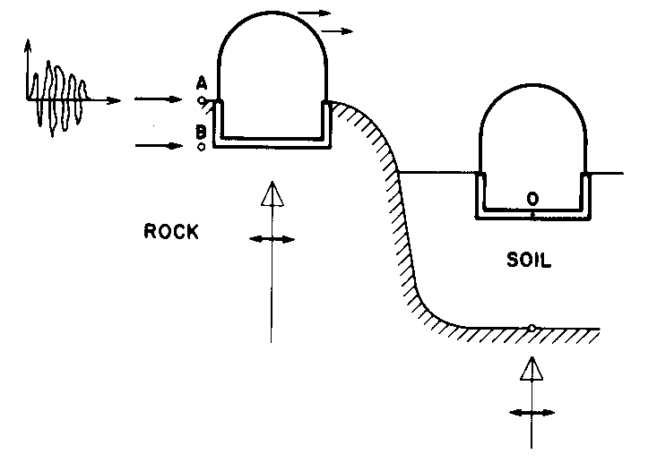
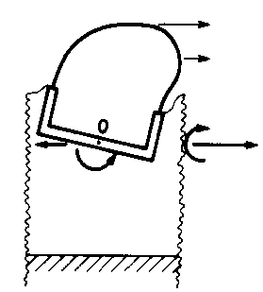
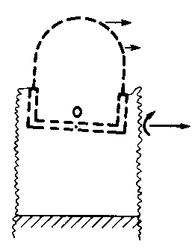
Detrimental effects of SSI
Outcropping rock
Free field
Site
Kinematic interaction
Inertial interaction

Slide 7
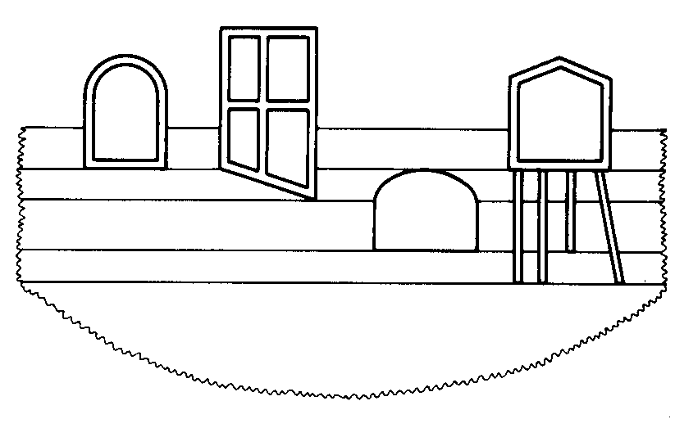
Types of problems
The number and the location of the battered and vertical piles;
Rigidity and flexibility of the basement and the wall;
Types of the buried structures;
Layering of the soil;
Slope of the soil layers;
Shallow structures and buried one;
Behavior of the soil, structure and the interaction.

Slide 8
SSI effects in In the context of engineering analysis and design
Foundation stiffness and damping:
These effects are rooted in structural inertia, they are referred to as inertial interaction effects.
Inertia in a vibrating structure
Increasing in base shear, moment, and torsion
Displacements and rotations at the soil-foundation interface (are only possible because of flexibility in the soil-foundation system)
1- Overall structural flexibility (and increases the building period);
2- Give rise to energy dissipation via radiation damping and hysteretic soil damping, which can significantly affect overall system damping.

Slide 9
SSI effects in In the context of engineering analysis and design
Variations between foundation input motions and free-field ground motions:
Kinematic interaction, in which stiff foundation elements placed at or below the ground surface cause foundation motions to deviate from free-field motions due to base slab averaging, wave scattering, and embedment effects in the absence of structure and foundation inertia;
Relative displacements and rotations between the foundation and the free-field associated with structure and foundation inertia.
Foundation Deformations:
Flexural, axial, and shear deformations of structural foundation elements occur as a result of forces and displacements applied by the superstructure and the soil medium. These represent the seismic demands for which foundation components should be designed, and they could be significant, especially for flexible foundations such as rafts and piles.
Methods that can be used to evaluate the explained effects can be categorized as direct and substructure approaches.
In a direct analysis, the soil and structure are included within the same model and analyzed as a complete system.
In a substructure approach, the SSI problem is partitioned into distinct parts that are combined to formulate the complete solution.

Slide 10
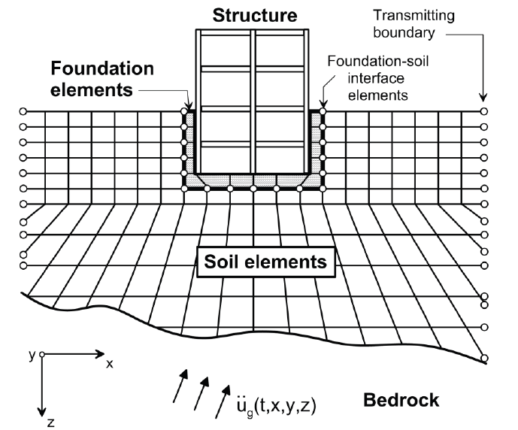
Methods of SSI analysis
Direct Analysis:
In this approach, the soil is often represented as a continuum (e.g., FEM, BEM, SBFEM ➔ DSBFEM or other numerical methods) along with foundation and structural elements, transmitting boundaries at the limits of the soil mesh, and interface elements at the edges of the foundation.
Evaluation of site response using wave propagation analysis through the soil is important to this approach. Such analyses are most often performed using an equivalent linear representation of soil properties in finite element, finite difference, or boundary element numerical formulations.
Direct analysis can address all of the SSI effects described above, but incorporation of kinematic interaction is challenging because it requires specification of spatially variable input motions in three dimensions.
Because direct solution of the SSI problem is difficult from a computational standpoint, especially when the system is geometrically complex or contains significant nonlinearities in the soil or structural materials, it is rarely used in practice.

Slide 11
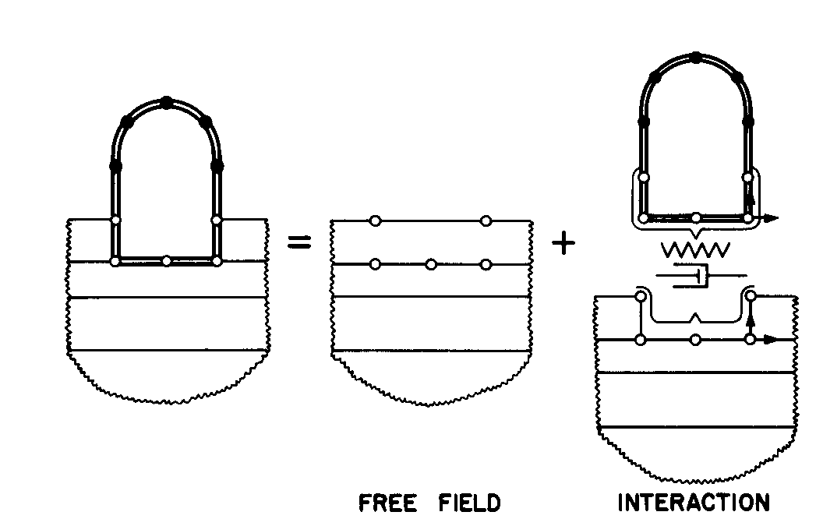
Methods of SSI analysis
Substructure Approach:
Proper consideration of SSI effects in a substructure approach requires:
An evaluation of free-field soil motions and corresponding soil material properties;
An evaluation of transfer functions to convert free-field motions to foundation input motions;
Incorporation of springs and dashpots (or more complex nonlinear elements) to represent the stiffness and damping at the soil-foundation interface;
A response analysis of the combined structure-spring/dashpot system with the foundation input motion applied.

Slide 12
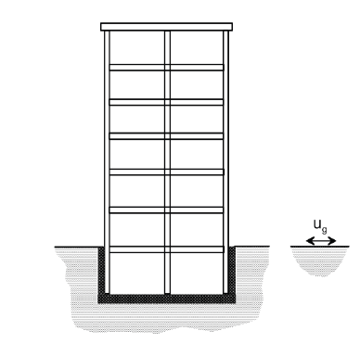
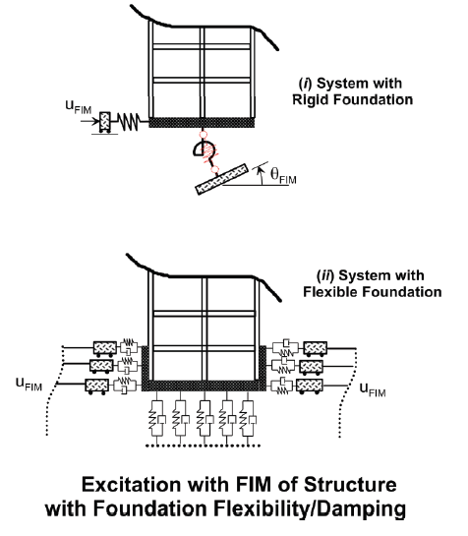
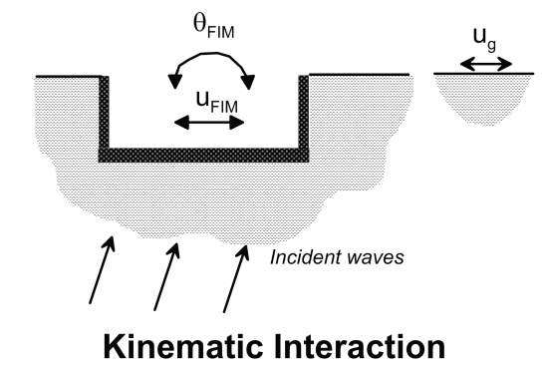
Methods of SSI analysis
Substructure Approach:
Specification of a foundation input motion (FIM), which is the motion of the base-slab that accounts for the stiffness and geometry of the foundation. Because inertia is dealt with separately, the FIM applies for the theoretical condition of the base-slab and structure having no mass.
This motion generally differs from the free-field motion, involves both translational and rotational components, and represents the seismic demand applied to the foundation and structural system. The variation between free-field and foundation input motions is expressed by a transfer function that represents the ratio of foundation/freefield motion in the frequency domain. Since inertial effects are neglected, the transfer function represents the effects of kinematic interaction only.
An essential first step in defining the FIM is to evaluate the free-field response of the site, which is the spatial and temporal variation of ground motion in the absence of the structure and foundation. This task requires that the earthquake input motion in the free field is known, either at a specific point (e.g., ground surface, rock-outcrop) or in the form of incident waves (e.g., oblique shear waves) propagating up from a reference depth.
Having established the free-field motion, wave-propagation analyses are performed to estimate the foundation input motion along the planned soil-foundation interface. Equivalent linear properties for the soil (e.g., shear modulus, material damping) can be evaluated as part of this analysis.
Impedance functions represent the frequency-dependent stiffness and damping characteristics of soil-foundation interaction

Slide 13
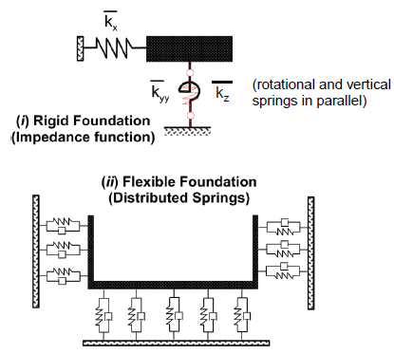
Methods of SSI analysis
Substructure Approach:
The stiffness and damping characteristics of the soil-foundation interaction are characterized using relatively simple impedance function models or a series of distributed springs and dashpots. Impedance functions represent the frequency-dependent stiffness and damping characteristics of soil-foundation interaction.
Use of a series of distributed springs and dashpots acting around the foundation is needed when foundation elements are non-rigid, or when internal demands (e.g., moments, shears, deformations) are required outcomes of the analysis.
The superstructure is modeled above the foundation and the system is excited through the foundation by displacing the ends of the springs and dashpots using the rocking and translational components of the FIM. It should be noted that FIM varies with depth. In the case of the distributed spring and dashpot model, differential ground displacements should be applied over the depth of embedment. This application of spatially variable displacements introduces a rotational component to the FIM, which is why a rotational component does not specifically appear in modeling of flexible foundation.

Slide 14
Inertial Interaction
Inertial interaction refers to displacements and rotations at the foundation level of a structure that result from inertia-driven forces such as base shear and moment. Inertial displacements and rotations can be a significant source of flexibility and energy dissipation in the soil-structure system.
A rigid base refers to soil supports with infinite stiffness (i.e., without soil springs).
A rigid foundation refers to foundation elements with infinite stiffness (i.e., not deformable).
A fixed base refers to a combination of a rigid foundation elements on a rigid base.
A flexible base analysis considers the compliance (i.e., deformability) of both the foundation elements and the soil.

Slide 15
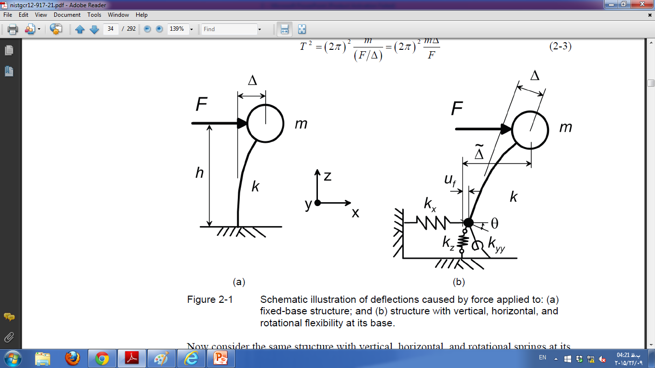



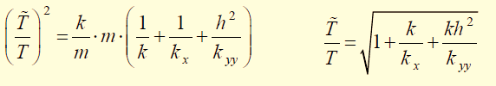
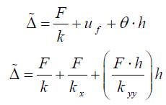

Inertial Interaction
A SDOF structure resting on a fixed base;
A SDOF structure resting on a flexible base;

Slide 16

Inertial Interaction
A MDOF structure resting on a flexible base;
The previous equation, can be applied to multi-degree-of-freedom structures by taking the height, h, as the height of the center of mass for the first-mode shape. This is commonly referred to as the effective modal height, which is approximately two-thirds of the overall structure height, and taken as 0.7 times the height in (ASCE, 2010).
Researches in this area have shown that the dimensionless parameters controlling period lengthening are:
h; the structure height (or height to the center of mass of the first mode shape),
B and L; the half-width and half-length of the foundation,
M; mass (or effective modal mass),
ρs; the soil mass density,
ν is the Poisson’s ratio of the soil.

Slide 17

Inertial Interaction
A MDOF structure resting on a flexible base;
To the extent that h/T quantifies the stiffness of the superstructure, the term h/(VsT) represents the structure-to-soil stiffness ratio. The term h/T has units of velocity, and will be larger for stiff lateral force resisting systems, such as shear walls, and smaller for flexible systems, such as moment frames. The shear wave velocity, Vs, is closely related to soil shear modulus, G.
For typical building structures on soil and weathered rock sites, h/(VsT) is less than 0.1 for moment frame structures, and between approximately 0.1~0.5 for shear wall and braced frame structures (Stewart et al., 1999). Period lengthening increases markedly with structure-to-soil stiffness ratio, which is the most important parameter controlling inertial SSI effects.

Slide 18

Inertial Interaction
A MDOF structure resting on a flexible base;
Usually, works have done for circular foundations, and then have been adapted here for rectangular shapes considering the ratio, B/L.
The structure-height-to-foundation-width ratio, h/B, and foundation-width-to-length ratio, B/L are aspect ratios describing the geometry of the soil-structure system.
The mass ratio, m/ ρs4BLh, is the ratio of structure mass to the mass of soil in a volume extending to a depth equal to the structure height, h, below the foundation; and it can be seen that period lengthening has no fundamental dependence on mass.
The mass ratio term was introduced so that period lengthening could be related to easily recognizable characteristics such as structural first mode period, T, and soil shear wave velocity, Vs, rather than structural stiffness, k, and soil shear modulus, G.
The effect of mass ratio is modest, and it is commonly taken as 0.15 (Veletsos and Meek, 1974).
The Poisson’s ratio of the soil, ν, affects the stiffness and damping characteristics of the foundation.

Slide 19
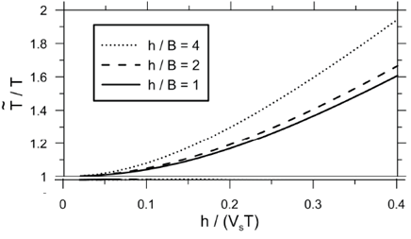
Inertial Interaction
Plot of period lengthening ratio;
L = B (B/L = 1.0)
= 0.33
Period lengthening increases with the structure-height-to- foundation-width ratio, h/B, due to increased overturning moment and foundation rotation, θ ⎝ Ιnertial SSI effects would be more significant in tall buildings, but tall buildings typically have low h/(VsT) ratios, which is more important for controlling inertial SSI effects ➔ period lengthening in tall buildings is near unity.
For a fixed ratio of h/B, period lengthening is observed to decrease modestly with foundation-width-to-length ratio, B/L, due to increased foundation size (and therefore stiffness) normal to the direction of loading.

Slide 20

Inertial Interaction
Foundation damping;
In addition to period lengthening, system behavior is also affected by damping associated with soil-foundation interaction, referred to as foundation damping, βf.
This damping is composed of two parts:
Hysteretic damping: contributions from soil hysteresis,
Radiation damping: radiation of energy away, in the form of stress waves, from the foundation.
Foundation damping is a direct contributor to the flexible-base system damping, β0:
βi is the structural damping in the superstructure assuming a fixed base, which is generally taken as 5% for typical structural systems.
Observations from case studies (Stewart et al., 1999) have shown that βf ranges from approximately 0% to 25%.
The exponent, n, on the period lengthening term is taken as 3 for linearly viscous structural damping, and 2 otherwise (e.g., for hysteretic damping) (Givens, 2013).

Slide 21


Inertial Interaction
Foundation damping;
The procedure given by Wolf (1985) neglects the frequency dependence of foundation stiffness terms, and assumes foundation radiation damping to be linearly viscous (i.e., constant dashpot coefficients for translation and rotation, cx and cyy), and applies for a circular foundation resting on a half-space. Considering frequency dependence, the form of Wolf’s damping expression (similar to Roesset, 1980) can be re-written as:
βs is soil hysteretic damping; is strain-dependent, and can typically be evaluated from information in the literature.
βx and βyy are damping ratios related to radiation damping from translational and rotational,
Exponents ns, nx, and nyy depend on the specific form of damping associated with the respective components of the foundation damping.

Slide 22
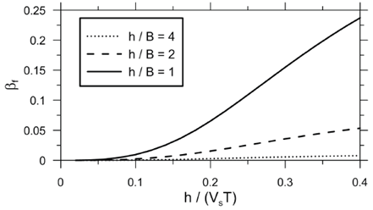
Inertial Interaction
Plot of foundation damping;
L = B (B/L = 1.0)
= 0.33
Hysteretic soil damping βs = 0
Mass ratio= 0.15
n=2
It is clear that, the single most important parameter controlling the significance of inertial interaction is h/(VsT), and that inertial SSI effects are generally negligible for h/(VsT) < 0.1, which occurs in flexible structures (e.g., moment frame buildings) located on competent soil or rock.
Conversely, inertial SSI effects tend to be significant for stiff structures, such as shear
wall or braced frame buildings, located on softer soils.
foundation damping βf increases strongly with structure-to-soil-stiffness ratio, h/(VsT).
Damping βf decreases with increasing values of h/B, indicating that lateral movements of the foundation (which dominate at low h/B ratios) dissipate energy into soil more efficiently than foundation rocking (which dominates at high h/B ratios).
Radiation damping terms (βx and βyy) are reduced significantly when a stiff bedrock layer is encountered at moderate or shallow depths ➔ Will be described later.

Slide 23
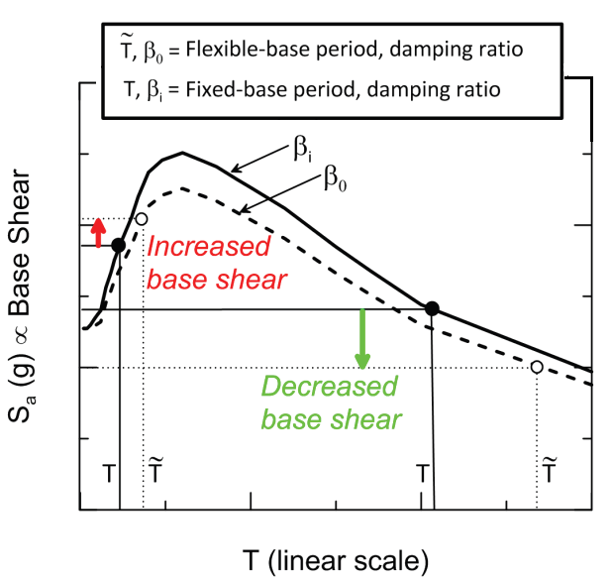
Inertial Interaction
The effect of SSI on base shear is related to the slope of the spectrum. Base shear tends to increase when the slope is positive and decrease when the slope is negative.
For the common case of buildings with relatively long periods on the descending portion of the spectrum, use of base shear from flexible base in lieu of base shear from fixed base, typically, results in reduced base shear demand.
Conversely, inertial SSI can increase the base shear in relatively short-period structures.
The period at which the spectral peak occurs, referred to as the predominant period of ground motion, Tp, is generally controlled by the tectonic regime, earthquake magnitude, and site-source distance and the period of the structure or system of SSI must be selected as resonance don’t occur.

Slide 24




Equations for Shallow Foundation Stiffness and Damping
Models for Rigid Foundations and Uniform Soils
Classical solutions for the complex valued impedance function for mode j can be written as:
The imaginary part of the complex impedance represents a phase difference between harmonic excitation and response at a given frequency

Slide 25
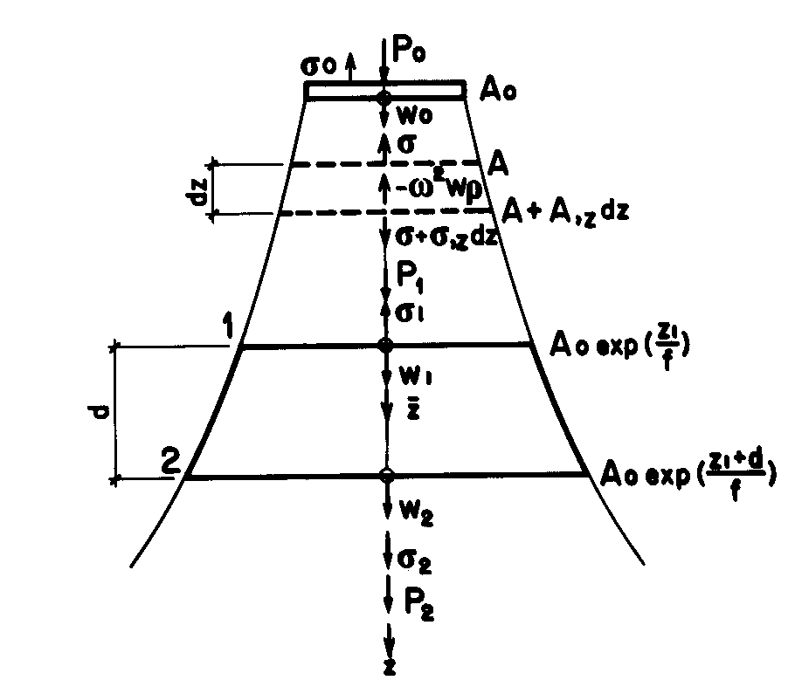

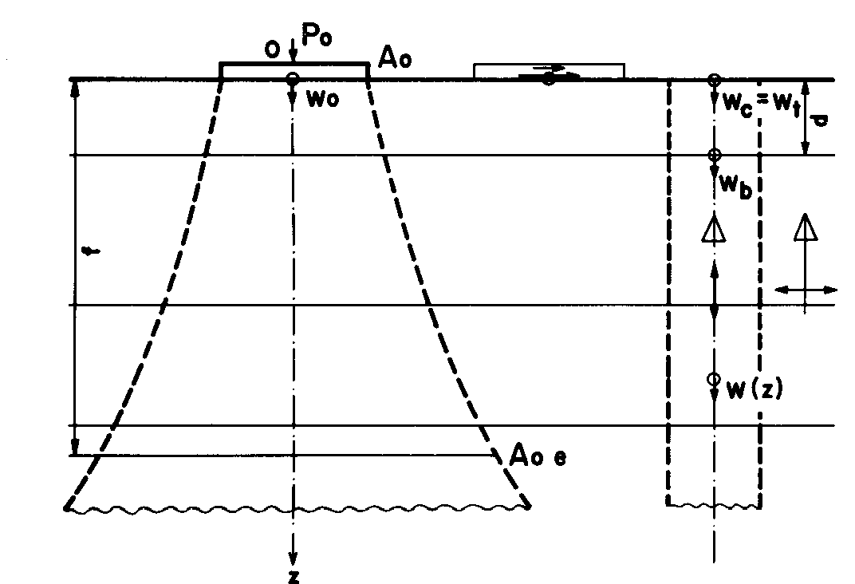




Equations for Shallow Foundation Stiffness and Damping
1-D wave equation

Slide 26


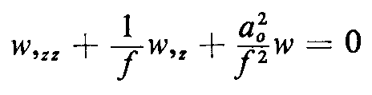

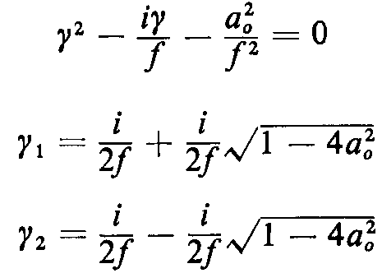
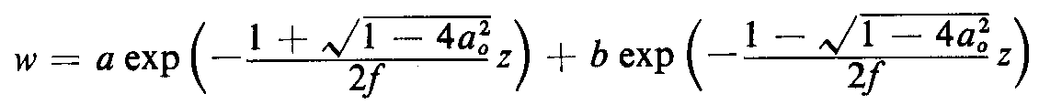
Equations for Shallow Foundation Stiffness and Damping
1-D wave equation
If f→∞;

Slide 27

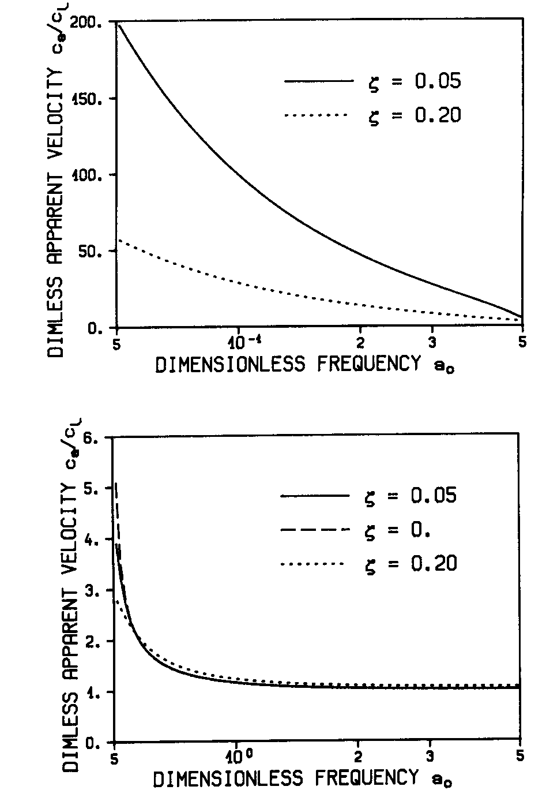

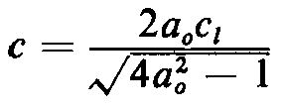
Equations for Shallow Foundation Stiffness and Damping
➔ No wave propagation along z direction
For
a0 is cutoff frequency
is phase velocity
A given harmonic wave with frequency ω will only propagate at a specific apparent velocity

Slide 28
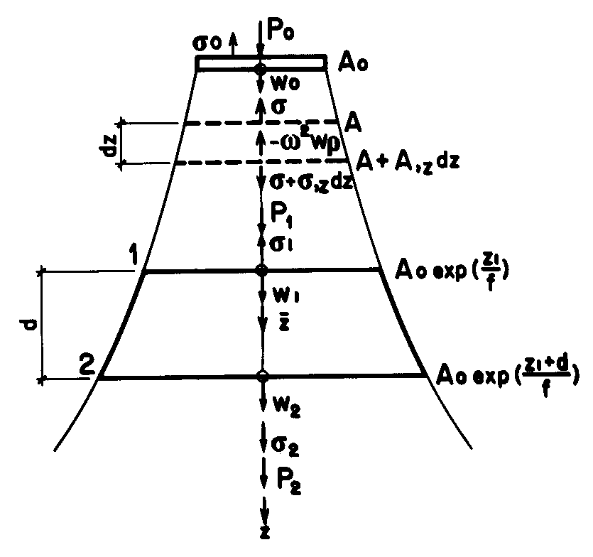
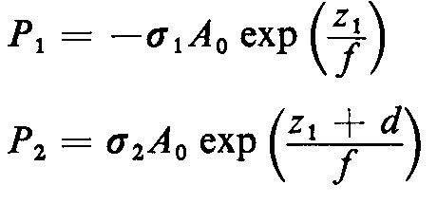
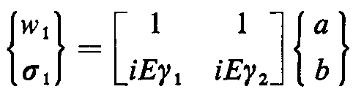

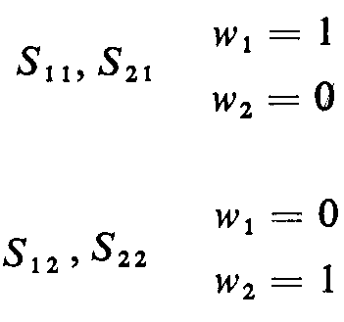
Equations for Shallow Foundation Stiffness and Damping
Dynamic stiffness of finite rod;

Slide 29
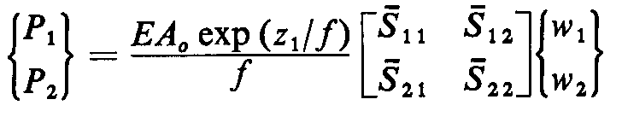
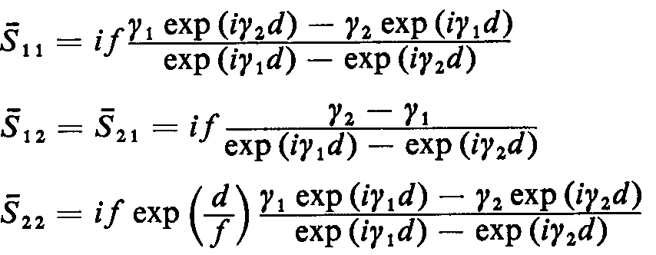
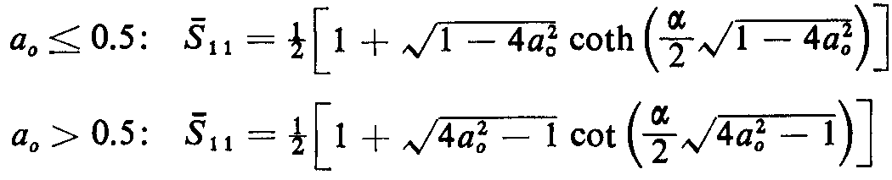

Equations for Shallow Foundation Stiffness and Damping
Dynamic stiffness of finite rod;

Slide 30
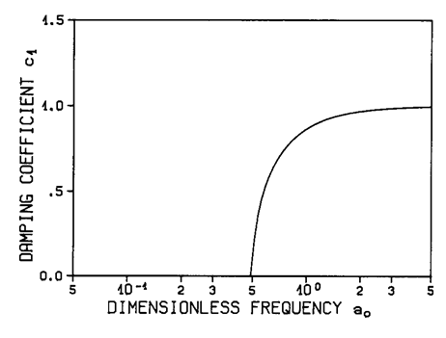
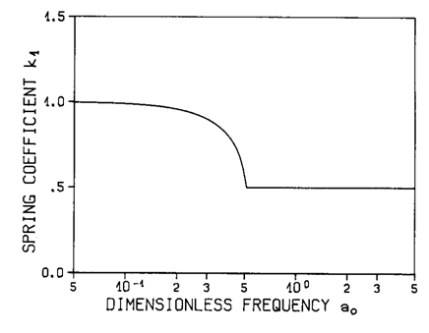
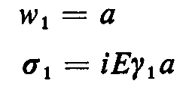

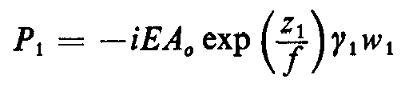



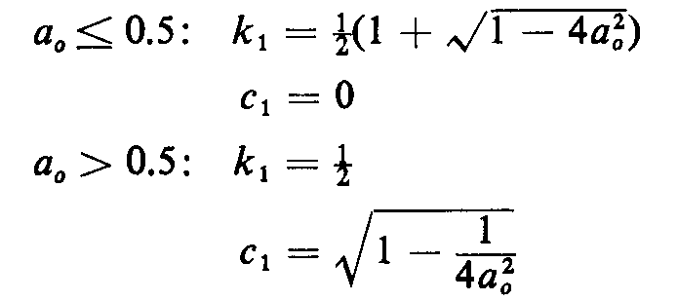

Equations for Shallow Foundation Stiffness and Damping
Dynamic stiffness of infinite rod;
Radiation boundary condition;

Slide 31
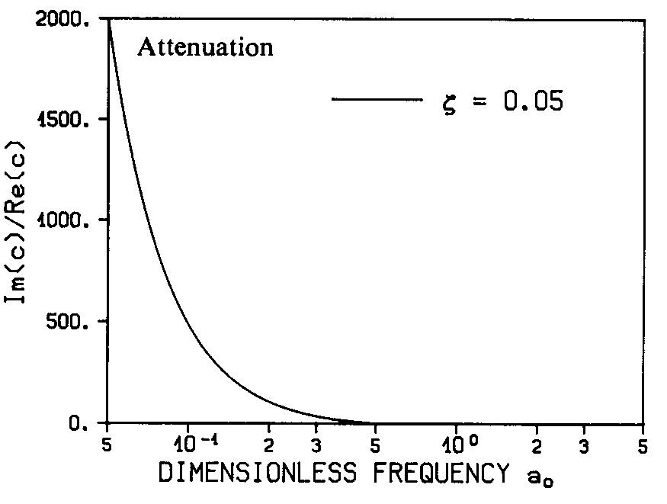
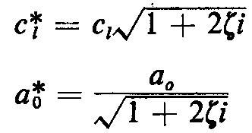


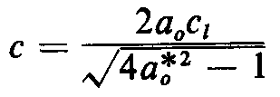
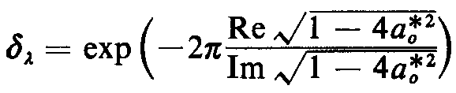

Equations for Shallow Foundation Stiffness and Damping
Material damping;
Apparent velocity
Phase velocity

Slide 32
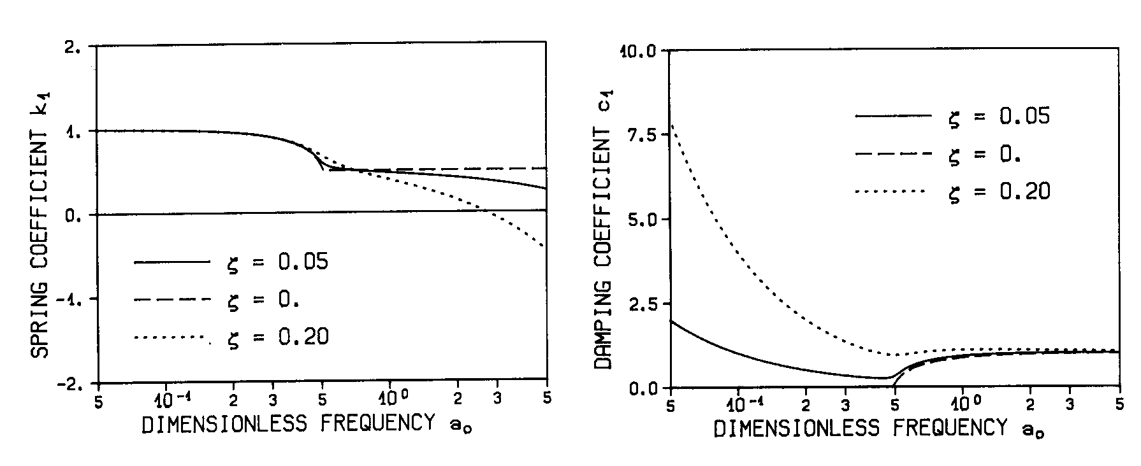

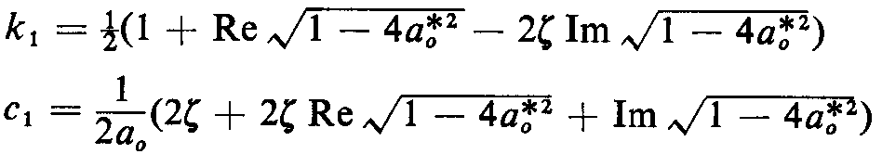
Equations for Shallow Foundation Stiffness and Damping
Material damping;

Slide 33
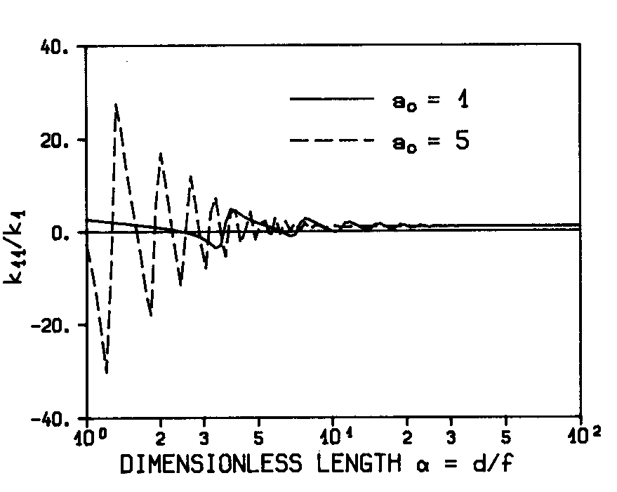
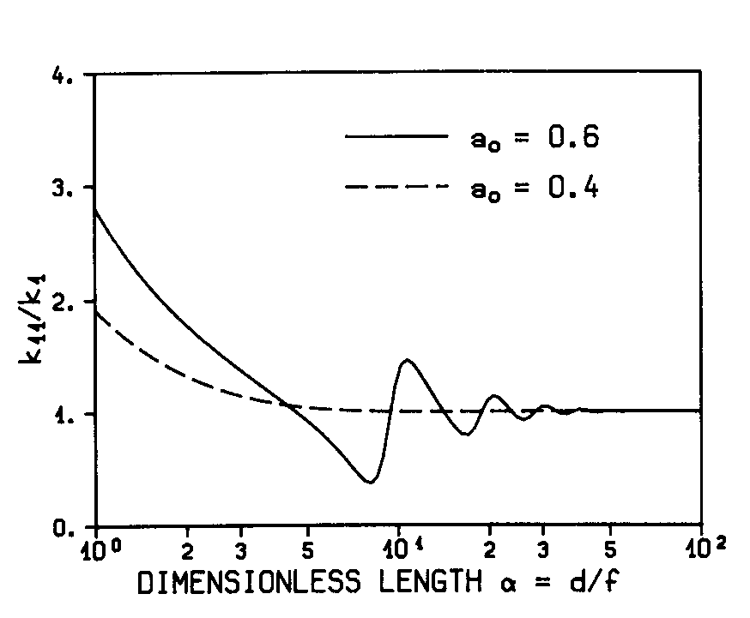
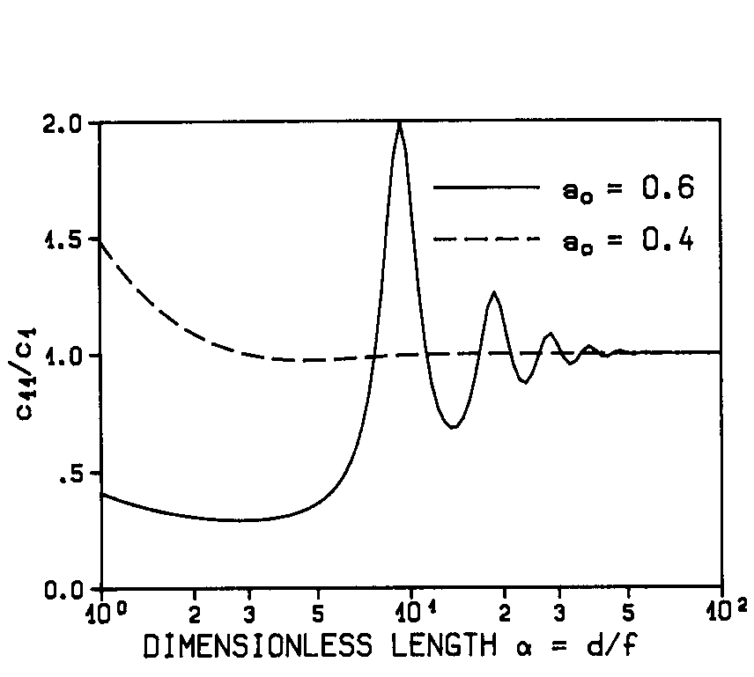
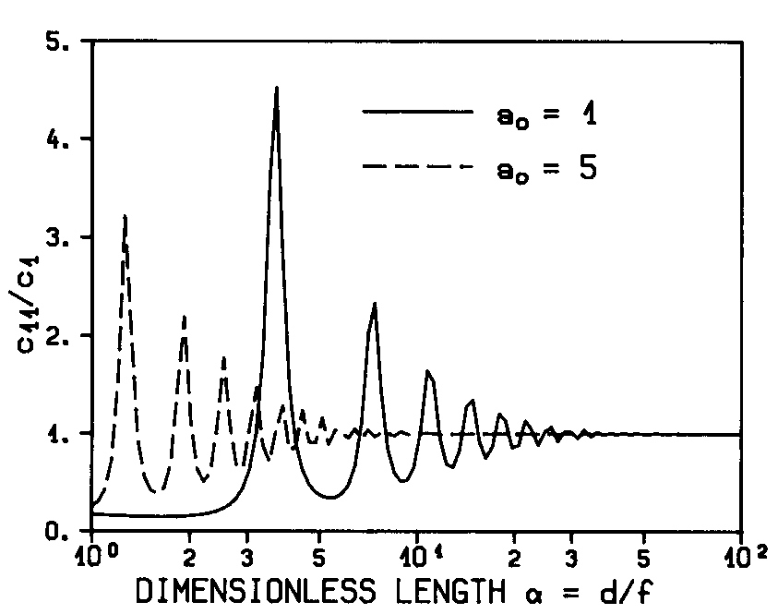
Equations for Shallow Foundation Stiffness and Damping
Convergence of dynamic-stiffness of finite rod to infinite rod (ζ=0.05)

Slide 34
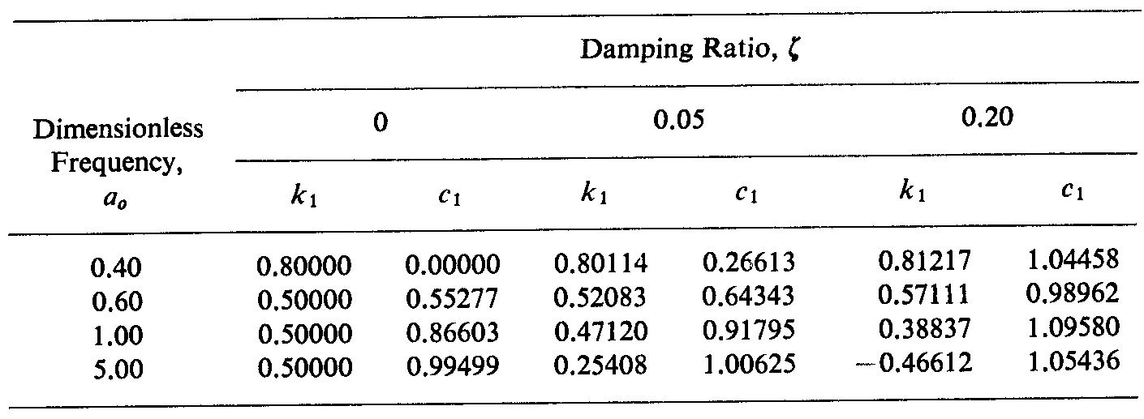
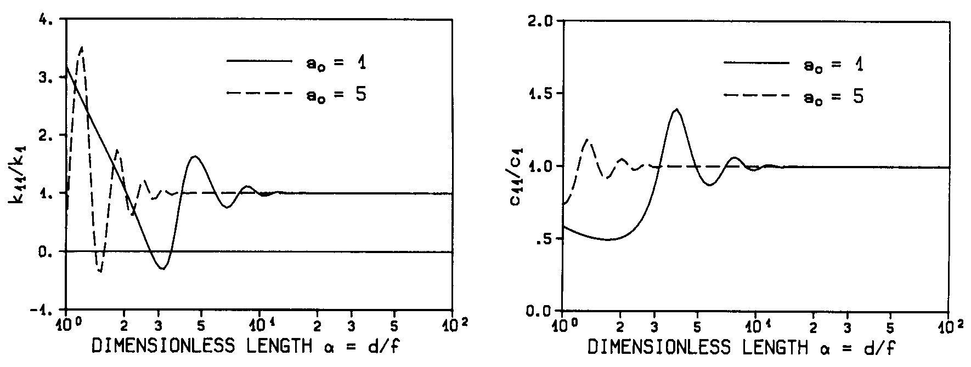
Equations for Shallow Foundation Stiffness and Damping
Convergence of dynamic-stiffness of finite rod to infinite rod (ζ=0.20)

Slide 35





Free-Field Response

Slide 36



Equations for Shallow Foundation Stiffness and Damping
Models for Rigid Foundations and Uniform Soils
Many impedance function solutions are available for rigid circular or rectangular foundations located on the surface of, or embedded within, a uniform, elastic, or visco-elastic half-space. In the case of a rigid rectangular foundation resting on the surface of a half-space with shear wave velocity Vs, Pais and Kausel (1988), Gazetas (1991), and Mylonakis et al. (2006) review impedance solutions in the literature.
Kj is the static foundation stiffness at zero frequency for mode j, and m = 1 for translation, and m = 3 for rotation.

Slide 37


Equations for Shallow Foundation Stiffness and Damping
Models for Rigid Foundations and Uniform Soils
sur== surface
emb== embedded

Slide 38

Equations for Shallow Foundation Stiffness and Damping
Models for Rigid Foundations and Uniform Soils

Slide 39

Equations for Shallow Foundation Stiffness and Damping
Models for Rigid Foundations and Uniform Soils

Slide 40

Equations for Shallow Foundation Stiffness and Damping
Models for Rigid Foundations and Uniform Soils
As aspect ratio increases, the ends of the foundation are located further apart, and energy radiating into the soil from each end of the foundation experiences less destructive interference, thus increasing damping.
Rectangular footings resting on the surface
Zero hysteretic damping
ν=0.33

Slide 41

Equations for Shallow Foundation Stiffness and Damping
Models for Rigid Foundations and Uniform Soils
Rectangular footings embedded in a half-space
Zero hysteretic damping
ν=0.33

Slide 42


Equations for Shallow Foundation Stiffness and Damping
Effect of Non-Uniform Soil Profiles
The effect of variation in soil shear modulus with depth is most critical for static stiffness and radiation damping associated with foundation rocking. Because rocking is often an insignificant contributor to overall foundation damping, the practical impact of soil non-homogeneity is primarily related to its effect on static stiffness.

Slide 43


Equations for Shallow Foundation Stiffness and Damping
Effect of Flexible Foundation Elements
The flexibility of the foundation is represented by a relative soil-to-foundation stiffness ratio, as:
Rf; the foundation radius
tf; the foundation thickness
Ef ;the Young’s modulus
νf ; Poisson’s ratio

Slide 44



Equations for Shallow Foundation Stiffness and Damping
Effect of Flexible Foundation Elements
Distributed springs allow the foundation to deform in a natural manner given the loads imposed by the superstructure and the spring reactions. For vertical springs, this can be accomplished by calculating the vertical translational impedance, as described before, and normalizing it by the foundation area to compute stiffness intensity, and known as coefficient of subgrade reaction and dashpot intensity, with dimensions of force per cubic length:
If this approach were used across the entire length, the vertical stiffness of the foundation would be reproduced, but the rotational stiffness would generally be underestimated. This occurs because the vertical soil reaction is not uniform, and tends to increase near the edges of the foundation.
Using a similar process with dashpot intensity would overestimate radiation damping from rocking. This occurs because translational vibration modes (including vertical translation) are much more effective radiation damping sources than rocking modes.

Slide 45



Equations for Shallow Foundation Stiffness and Damping
Effect of Flexible Foundation Elements
Re= 0.3 ~ 0.5
⬅ To correct for underestimation of rotational stiffness
To correct for overestimation of rotational damping ➔

Slide 46
Equations for Shallow Foundation Stiffness and Damping
Effect of Flexible Foundation Elements
In the horizontal direction, the use of a vertical distribution of horizontal springs depends largely on whether the analysis is two-dimensional or three-dimensional, and whether or not the foundation is embedded. Current recommendations are as follows:
For two-dimensional analysis of a foundation on the ground surface, the horizontal spring from the impedance function is directly applied to the foundation, no distributed springs.
For two-dimensional analysis of an embedded foundation, the component of the embedded stiffness attributable to the base slab (i.e., the stiffness without the embedment modifier, kx/ ηx) can be applied to the spring at the base slab level. Distributed springs are then positioned along the height of the basement walls with a cumulative stiffness equal to kx (1–1/ηx).
For three-dimensional analysis, springs are distributed in both horizontal directions uniformly around the perimeter of the foundation. The sum of the spring stiffnesses in a given direction should match the total stiffness from the impedance function.

Slide 47
Nonlinear Soil-Structure Interaction Models for Response History Analysis
Nonlinear soil-structure interaction phenomena can involve geometric and material nonlinearities in the superstructure, foundation, and soil. Specific sources of nonlinearity may include:
Yielding of seismic-force-resisting elements in the superstructure;
Yielding of soil, potentially exacerbated by strength loss induced by pore-pressure (e.g., liquefaction, cyclic softening);
Gapping between the foundation and the soil, such as base uplift or separation of foundation sidewalls from the surrounding material;
Yielding of foundation structural elements.
These nonlinear effects must be computed with response history analyses (RHA) performed in the time domain. Addressing all these issues in RHA is a formidable task, even with modern computational capabilities. Despite recent progress, knowledge in the area is incomplete and the subject is evolving.

Slide 48
Nonlinear Soil-Structure Interaction Models for Response History Analysis
Nonlinear Structure and Equivalent-Linear Soil
Generally, nonlinear SSI reduces ductility demand in the superstructure.
When the period is lengthened on the descending branch of the spectrum (i.e., T/Tp > 1), the seismic demand is reduced, regardless of whether the structure yields or not.
In the case of long-period input motions that potentially place the structure on the ascending branch of the spectrum (i.e., T/Tp < 1), SSI-induced period lengthening may lead to an increase in ductility demand. This can be viewed as progressive resonance, when the effective fundamental period of the yielding structure, T, approaches the predominant period of the foundation input motion, Tp. Evaluation of the damping effects is more complex as nonlinearity tends to reduce radiation damping and increase material damping in both the soil and the structure.

Slide 49
Nonlinear Soil-Structure Interaction Models for Response History Analysis
Nonlinearity in the Foundation and Soil
There is mounting analytical and experimental evidence that material and geometric nonlinearities in the soil may be beneficial to the seismic response of a structure.
This has led some authors (e.g., Gazetas, 2006; Gajan and Kutter, 2008) to propose revising the foundation design philosophy by allowing significant yielding in the soil close to the foundation, or the foundation itself, to dissipate energy and protect the superstructure.
This requires control of settlement and tilting of the structure. Hence, the analysis and design process considering soil nonlinearity involves optimization of the trade-offs between the potentially beneficial effects of soil yielding (especially with regard to energy dissipation) and the detrimental effects of settlement or residual tilt.
Soil-structure interaction studies with nonlinear soil and foundation behavior can be classified into three approaches: (1) continuum models, (2) beam-on-nonlinear winkler foundation (BNWF) models, and (3) plasticity-based macro-models.

Slide 50


Beam-on-Nonlinear Winkler Foundation (BNWF) Models
Key advantages of these models over continuum formulations lies in their ability to describe soil-structure interaction phenomena by one-dimensional nonlinear springs distributed along the soil-foundation interface.
The modulus of the springs depends on foundation stiffness, geometry, frequency, response mode, and level of strain.
A limitation of the approach relates to its one-dimensional nature. A spring responds only to loads acting parallel to its axis, so loads acting in a perpendicular direction have no effect on the response of the spring.
Accordingly, the concept of plastic potential and flow rule cannot be explicitly incorporated.
The BNWF approach is popular because of its simplicity and predictive abilities on a variety of problems.
The BNWF model implemented into OpenSees by Raychowdhury and Hutchinson (2009) consists of elastic beam-column elements that capture the structural footing behavior with independent zero-length soil elements that model the soil-footing behavior.
The spring spacing is input by the user as a fraction of the footing half-length L (S = le/L), where le is the non-normalized spring spacing. A maximum element length equal to 8% of the footing half-length (i.e., a minimum number of 25 springs along the full length of the footing) is recommended to provide numerical stability and reasonable accuracy.
ATC-40, Seismic Evaluation and Retrofit of Concrete Buildings (ATC, 1996) suggests the use of Lend = B/6 from each end of the footing.

Slide 51




Beam-on-Nonlinear Winkler Foundation (BNWF) Models
Qzsimple2 material model Txsimple1 material model
s50 is the displacement at which 50% of the ultimate load is mobilized,
s0 is the displacement at load q0,
c and n are constitutive parameters controlling the shape of the post-yield portion of the backbone curve.
Pxsimple1 material model

Slide 52
Plasticity Based Macro-Element (PBM) Models
This family of models combines elements from both continuum and BNWF formulations. Hence, it aims at bridging the gap between the two approaches. The models are based on the following main assumptions:
The foundation is considered sufficiently rigid, so its response can be described by three or six degrees of free domin two and three dimensions, respectively;
An ultimate surface, corresponding to a general bearing capacity failure in vertical force–shear force–moment (Q-V-M) space, exists corresponding to the state of stress beyond which plastic flow occurs;
A mechanism for describing plastic flow is incorporated in the form of a hypoplastic approach or a simple G-γ and βs-γ correction based on a characteristic shear strain;
Uplift behavior can be modeled by means of a nonlinear model allowing for separation between the footing and soil.
While PBM models are rational and can capture plastic effects, available formulations possess a number of drawbacks, notably an inability to incorporate flexible foundation behavior, the effects of stress-induced inhomogeneity on radiation damping, and failure modes other than general shear failure.

Slide 53

Plasticity Based Macro-Element (PBM) Models
Macro-element contact interface model (CIM)
the CIM provides nonlinear relations between cyclic loads and displacements of the soil- foundation system during combined cyclic loading (i.e., vertical, shear, and moment).

Slide 54

Plasticity Based Macro-Element (PBM) Models
Soil-foundation contact is tracked in the CIM using a parameter called the critical contact area ratio, A/Ac, where A is the area of the footing, and Ac is the area of the footing required to have contact with the soil to support the vertical and shear loads.
The ratio A/Ac can be considered to be an alternate definition of the factor of safety with respect to bearing capacity.
For a two-dimensional shear wall structure loaded in the plane of the wall, the ratio A/Ac equals the footing length ratio 2L/Lc.
The foundation position is tracked relative to the underlying soil surface, which is pushed as far as the “soil_max” surface, but which rebounds to the “soil_min” surface when unloaded. Zero stress transfer between the soil and foundation occurs in the gap region.

Slide 55
Plasticity Based Macro-Element (PBM) Models
The CIM is intended to capture the essential features (load capacities, stiffness degradation, energy dissipation, and permanent deformations) of the cyclic load-deformation behavior of shallow foundations.
One advantage of the CIM relative to the BNWF model is that the moment, shear, and vertical load capacities are coupled. Coupling between the vertical and moment capacities is caused by gap formation (i.e., the moment capacity typically occurs after a gap has formed, causing the vertical capacity to drop). The coupling between shear and moment capacity is accounted for using an interaction diagram.
Input parameters for the CIM are the ultimate vertical load, QULT, the length of footing, 2L, the initial vertical stiffness, Kv, the initial horizontal stiffness, Kh, the elastic rotation limit, θelastic, the rebound ratio, Rv, and the internal node spacing, DL.
The initial rotation stiffness is calculated by the CIM based on the specified vertical stiffness and footing geometry.

Slide 56
Plasticity Based Macro-Element (PBM) Models
Elastic rotation limit (θelastic), is defined as the maximum amplitude of rotation for which no settlement occurs. A value of 0.001 radians is recommended based on comparisons with centrifuge experiments.
Rebound ratio (Rv), is an empirical factor that accounts for the elastic rebound and bulging of soil into the gap below an uplifted footing. It is the ratio of the soil uplift displacement (from rebound) to the total soil settlement, and significantly affects the length of the transition zone between the gap and the full foundation pressure zone. The default value is 0.1, which reasonably fits data from available centrifuge model tests. Increasing Rv reduces cyclic foundation settlement, and improves numerical convergence in most cases.
Footing node spacing (DL), specifies the distance between footing nodes internally created within the model. This user-defined parameter affects numerical stability and accuracy as well as computation time. Node spacing should be selected based on the vertical factor of safety, FSv; foundations with large FSv require small node spacing, DL. The suggested range for DL varies from 1.0% of the half-length, L, of the footing (for FSv≈2) to 0.1% (for FSv≈ 40).

Slide 57


Comparisons of the performance of the BNWF and CIM
If the simulations are to be used for structural design of footing elements, or the footing flexibility is anticipated to contribute to the foundation response, the BNWF model should be chosen. This model can be used to more directly evaluate internal moments and shears used for section design.
M / (V ∗ L) <3.0,
and sliding is not restrained by slabs and grade beams,
the moment capacity of the footing will be sensitive to shear load,
For cases with M / (V ∗ L) greater than 3.0, rocking will tend to dominate, and both models should produce similar results if the parameter selection protocols herein are followed.
In other analytical platforms (other than OpenSees), implementation of the BNWF model will be more easily accomplished if bilinear spring, gap, and damping elements are available. Although feasible, implementation of the CIM in another platform would require implementation of a new element, and access to the source code for the host platform.
CIM model is preferred
The ability of this method to account for coupling between the moment, shear, and axial responses.

Slide 58
Kinematic Interaction
Kinematic interaction results from the presence of stiff foundation elements on or in soil, which causes motions at the foundation to deviate from free-field motions.
One cause of these deviations is base-slab averaging, in which spatially variable ground motions within the building envelope are averaged within the foundation footprint due to the stiffness and strength of the foundation system.
Another cause of deviation is embedment effects, in which foundation-level motions are reduced as a result of ground motion reduction with depth below the free surface. If the foundation is pile-supported, the piles interact with wave propagation below the base slab, which can further modify foundation-level motions at the base of a structure.
Models for kinematic interaction effects are expressed as frequency dependent ratios of the Fourier amplitudes (i.e., transfer functions) of foundation input motion (FIM) to free-field motion.
The FIM is the theoretical motion of the base slab if the near-surface foundation elements (i.e., base slabs, basement walls) and the structure had no mass, and is used for seismic response analysis in the substructure approach.

Slide 59



Shallow Foundations at the Ground Surface
Motions of surface foundations are modified relative to the free-field when seismic waves are incoherent.
Incoherence of the incident waves at two different points means that they have variations in their phase angle.
Wave passage effect causes waves to arrive at different points along the foundation of a building at different times.
In the presence of incoherent wave fields, translational base-slab motions are reduced relative to the free-field, and torsional and rotational motions are introduced.

Slide 60





Shallow Foundations at the Ground Surface
Relationship between foundation input and free field ground motions:
The results are essentially independent of foundation shape, but is strongly dependent upon a parameter, κa, related to lagged coherency and wave inclination that scales the frequency axis of the theoretical transfer function.

Slide 61


Embedded Shallow Foundations
The reduction of translation is substantial at high frequencies, saturating at about 70% of fE, which is the fundamental frequency of the soil column between the surface and depth, D. With a high-frequency de-amplification level of 0.45, the embedment effect is often more important than the base-slab averaging effect for building structures.
Conversely, foundation rotation increases with frequency and saturates at fE.

Slide 62



Shallow Foundations
Vs = 390 m/sec,
B = 16.8 m,
L = 63.1 m,
D = 5.9 m.
Ground motion reductions with depth
Incoherent ground motions → base slab averaging

Slide 63
Pile Foundations
When building foundations are pile-supported, the kinematic interaction problem is complicated by the influence of the piles on wave propagation below the foundation, and also by the potential for the soil to settle away from the pile-supported base of the structure, forming a gap. This is a complex kinematic soil-structure interaction problem for which there are no well-calibrated engineering models.
Development of analytical solutions for the kinematic interaction problem for pile-supported foundations of varying flexural rigidity subjected to realistic (incoherent) input motion remains an important research need.

Slide 64



Application of Transfer Functions
The response spectrum for uFIM (Sa-FIM) differs from the spectrum for ug (Sa) because of a reduction in high frequency ground motion components due to kinematic interaction.
For moderate to low frequencies, the ratio of spectral ordinates can be estimated as:
At high frequencies, a conservative approximation of spectral ordinates can generally be obtained from:
The limiting frequency, fL, depends on the frequency content of ug.
For typical stiff soil or rock ground motions having mean periods in the range of 0.2 sec to 0.5 sec, fL has been found to be approximately 5 Hz, (FEMA, 2005).
Long-period ground motions resulting from near-fault directivity pulses or soft soil effects, however, can have much lower limiting frequencies, fL, such that no significant spectral ordinate reductions from kinematic interaction are realizable.
Further research is needed to identify factors controlling fL, and to develop more reliable recommendations for engineering application.

Slide 65
From free-field motion to FIM
Acceleration histories representing the FIM can be modified from free-field motions using the following procedure:
Calculate the Fourier transforms of ug.
Multiply the amplitude of ug by Hu.
Perform a reverse Fourier transform to estimate uFIM(t).

