Slide 1
Dynamic
Soil-Structure-Interaction
By: M. Iman Khodakarami (Assistant Prof. of Earthquake Eng.)
Email: Khodakarami@semnan.ac.ir ; I.Khodakarami@gmail.com
Phone: (+98) 23- 3153 3774
Civil Eng. Faculty,
Semnan University

Slide 2
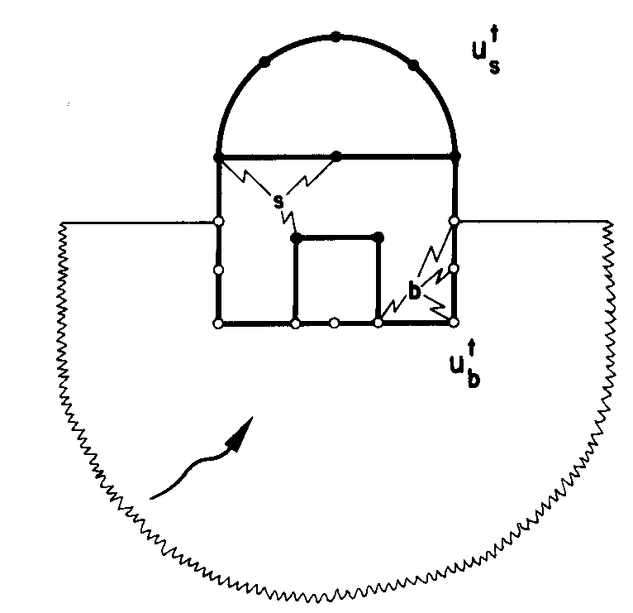




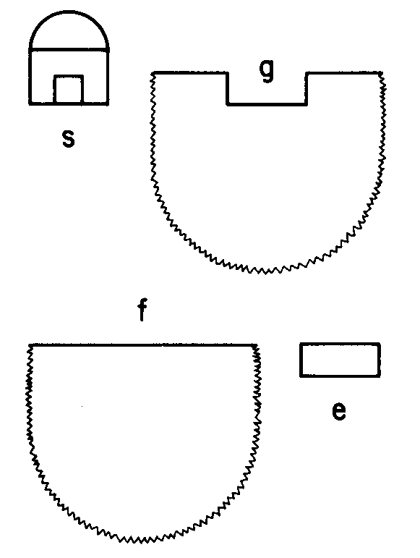
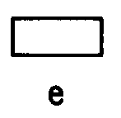
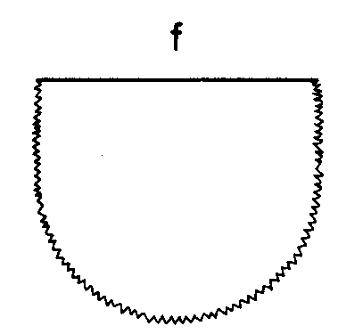
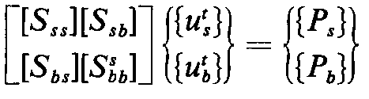
Basic equation of motion
Flexible base;

Slide 3

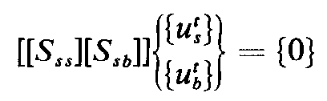
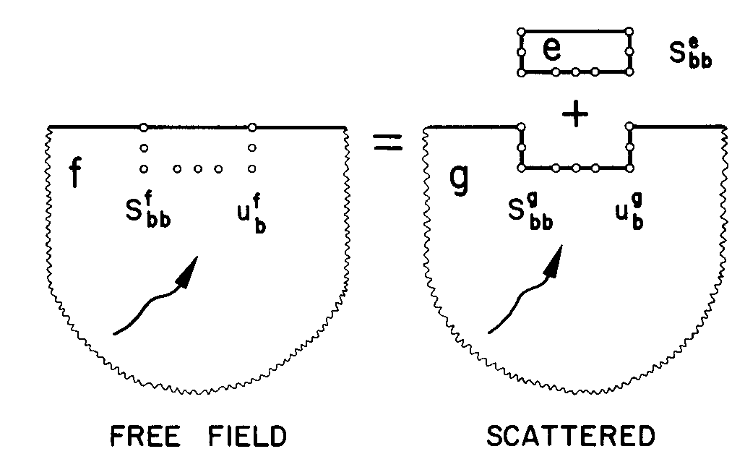

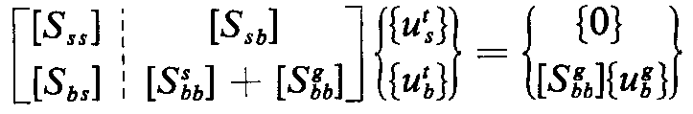

Basic equation of motion
Flexible base;
For earthquake excitation:
The interaction force:

Slide 4




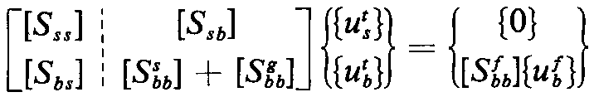

Basic equation of motion
Flexible base;
The Structure consist of the excavated part of the soil, only
The amount of interaction of the embedded part

Slide 5
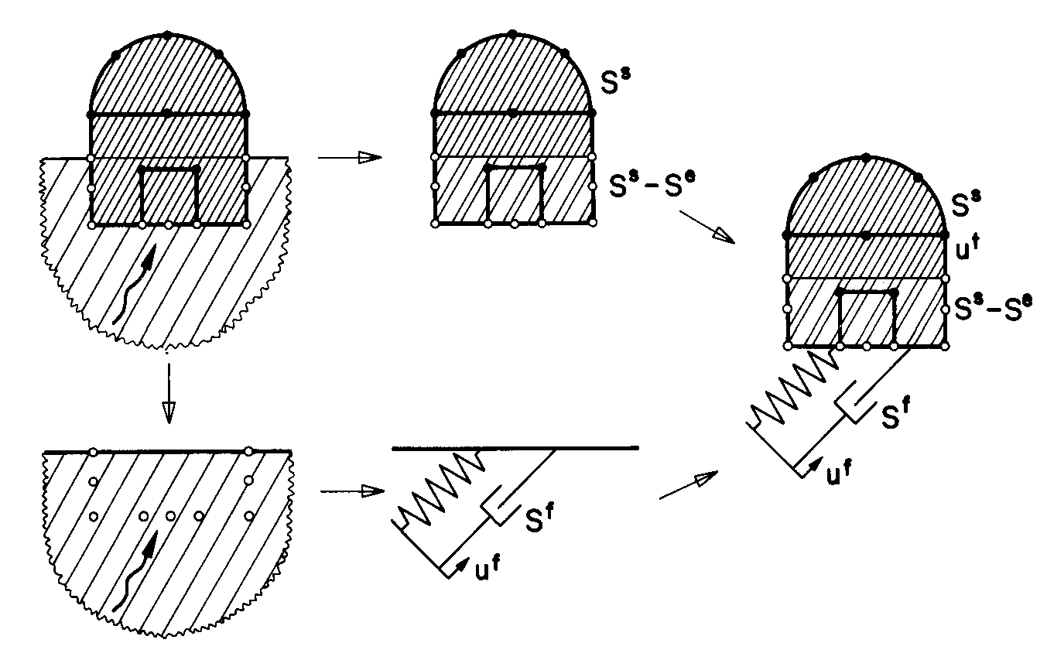
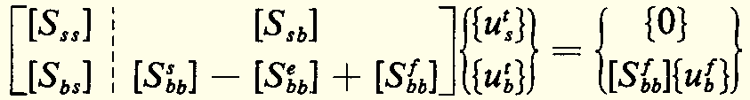


Basic equation of motion
Flexible base;

Slide 6
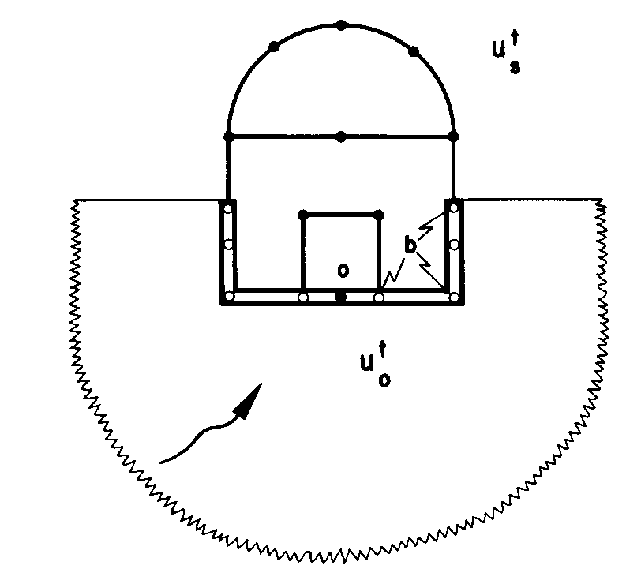

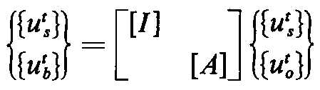
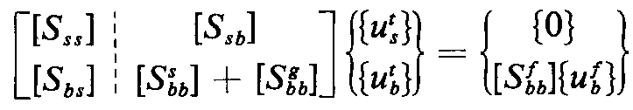
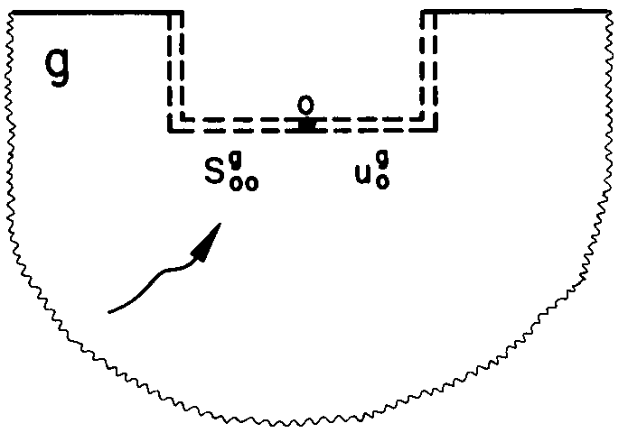
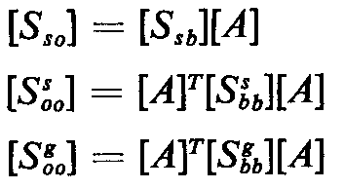
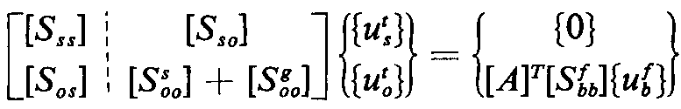
Basic equation of motion
Rigid base;
[A] is a kinematic transformation matrix

Slide 7



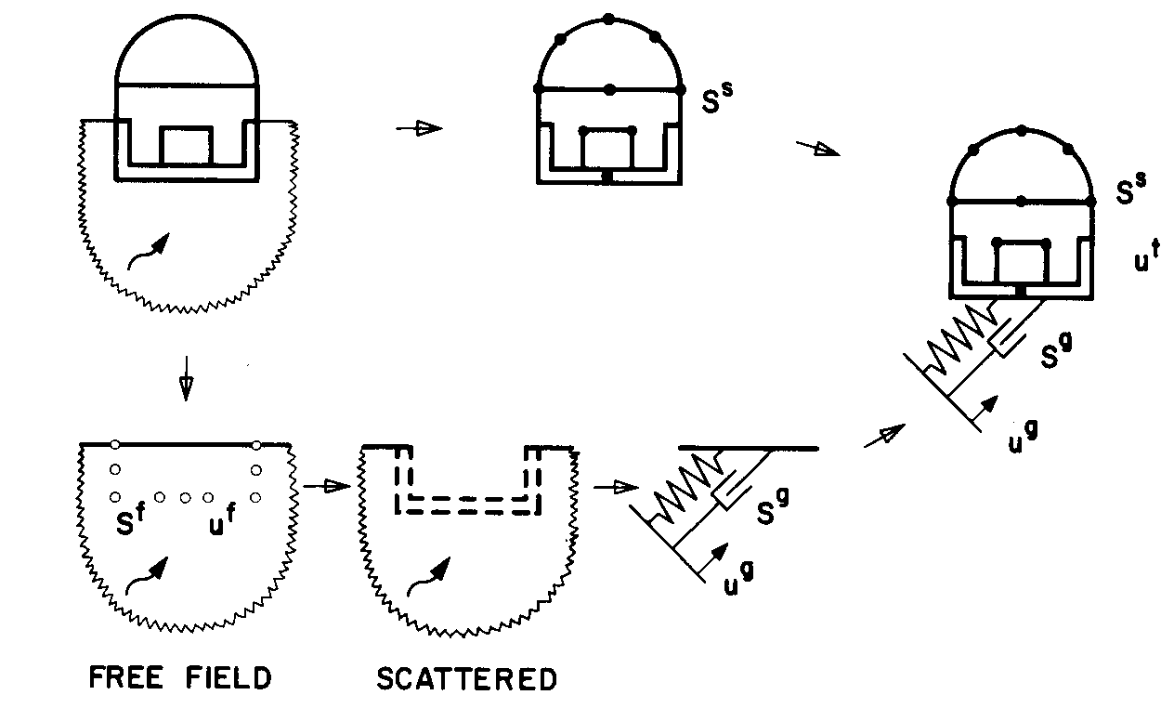

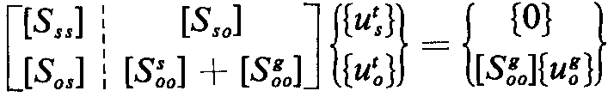
Basic equation of motion
Rigid base;

Slide 8
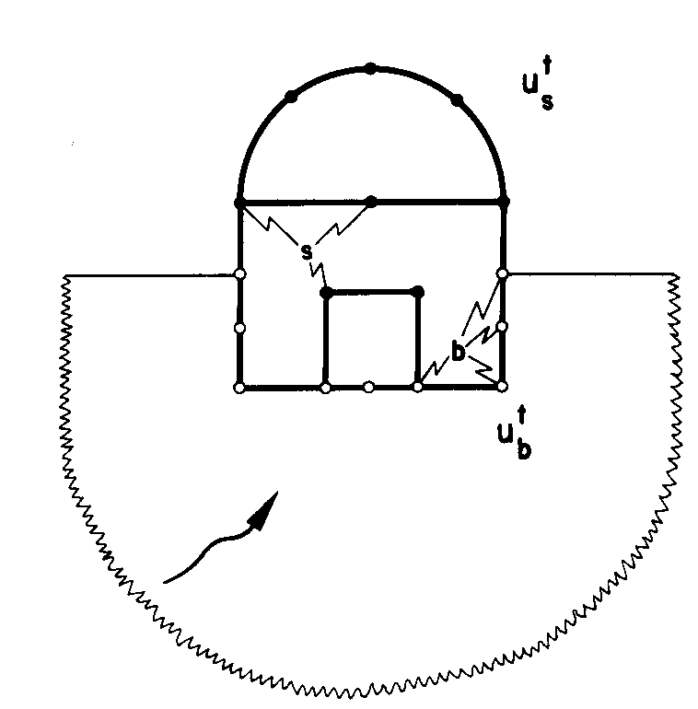
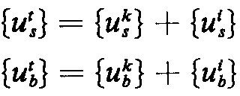
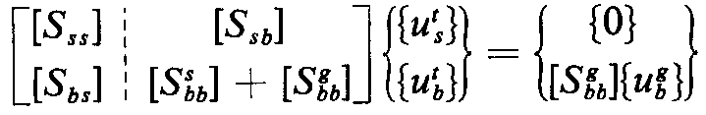


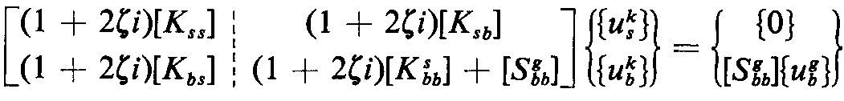
Kinematic and Inertial Interaction
Flexible base;
In Kinematic Interaction part, M=0
Quasi-static transformation function;
Depends on the geometry and relative stiffness

Slide 9
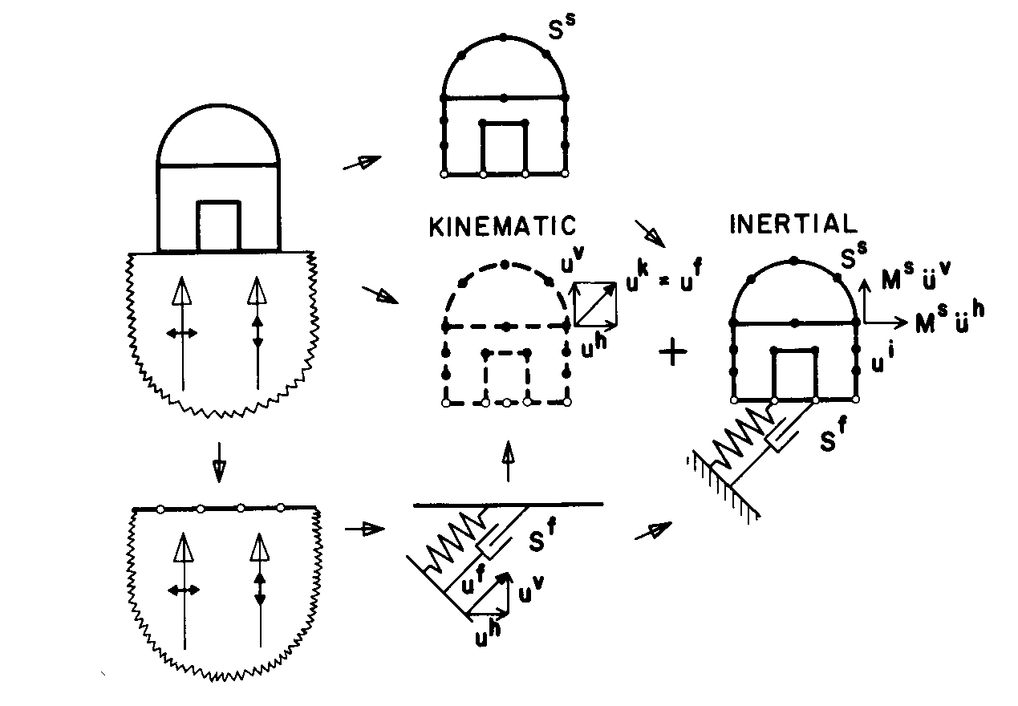
Kinematic and Inertial Interaction
Flexible base;
≠
≠

Slide 10
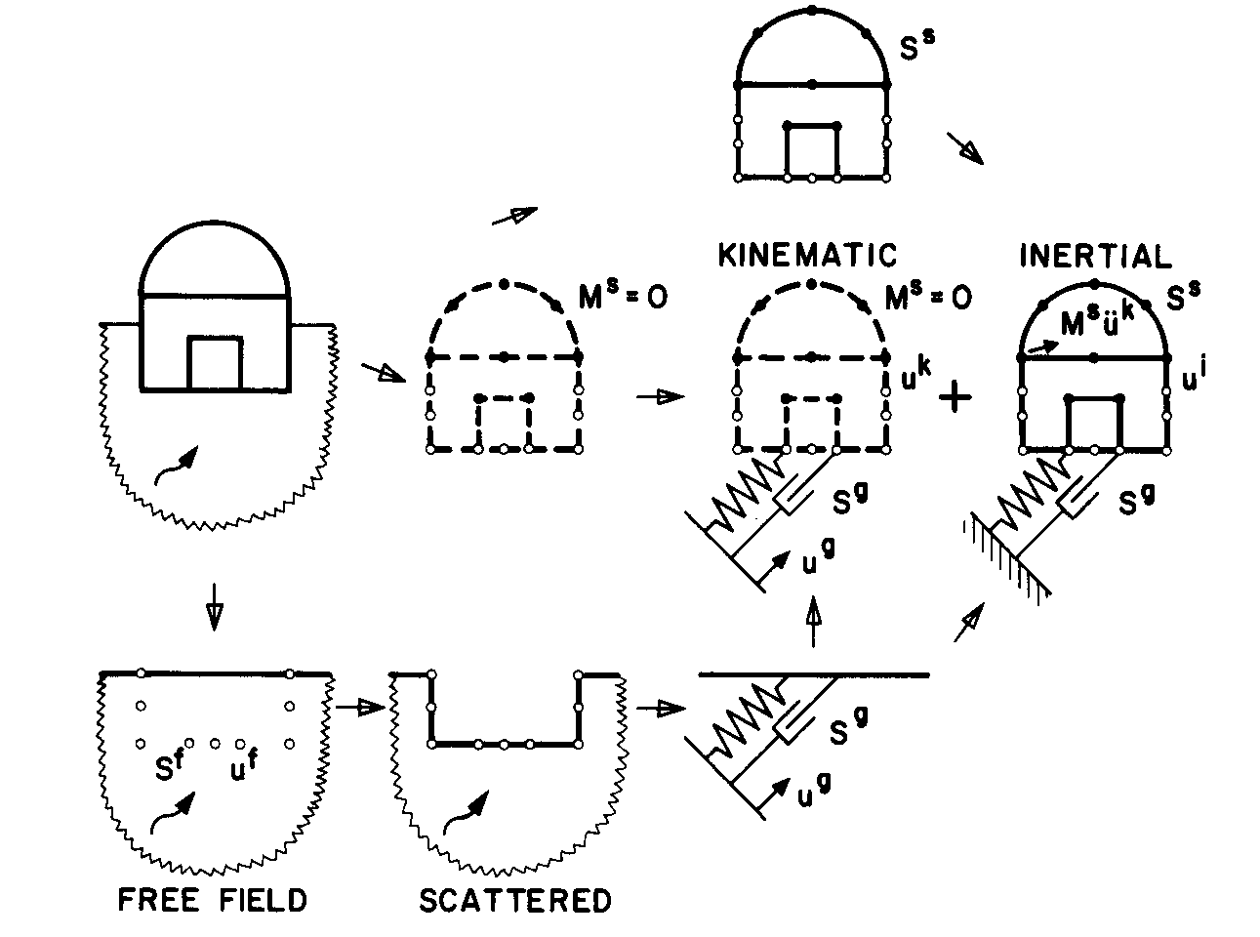
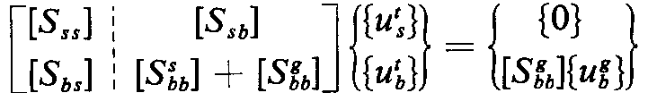
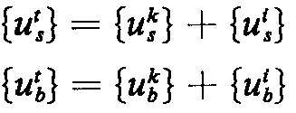
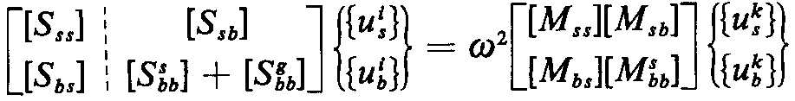
Kinematic and Inertial Interaction
Flexible base;

Slide 11
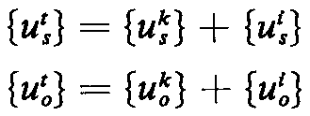
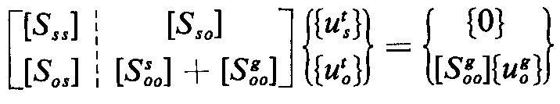
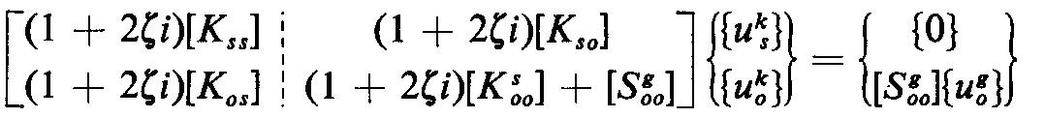
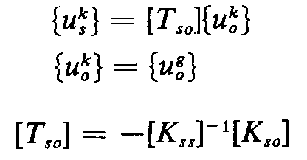
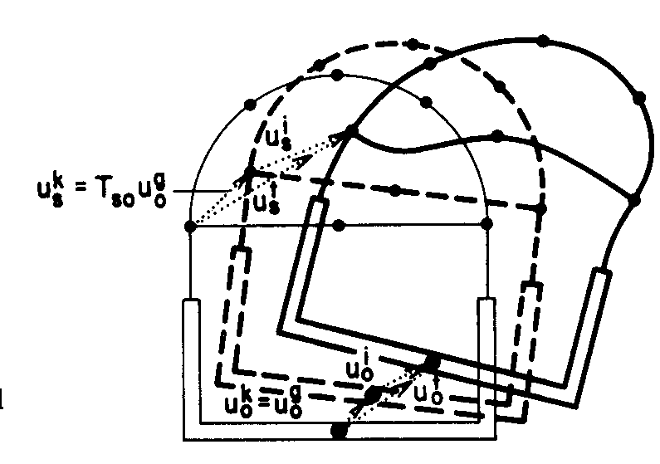
Kinematic and Inertial Interaction
Rigid base;
Quasi-static transformation function;
Depends on only the geometry properties

Slide 12
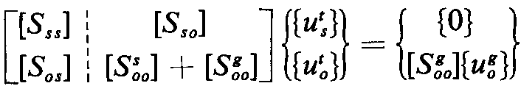
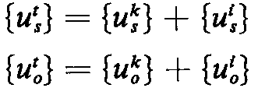
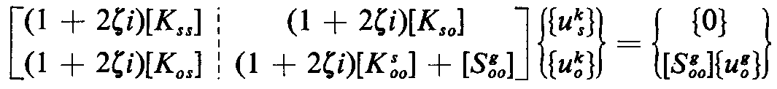
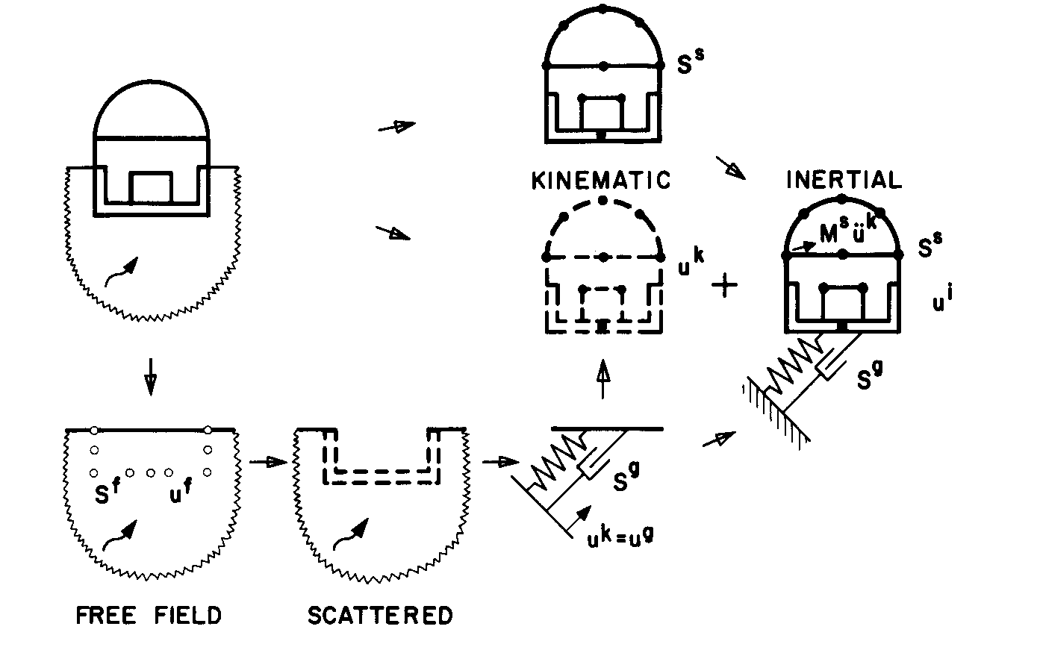
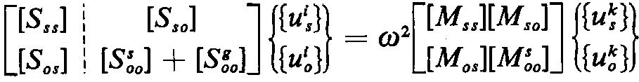
Kinematic and Inertial Interaction
Rigid base;

Slide 13
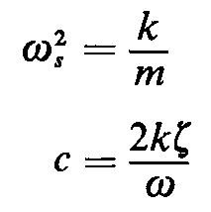
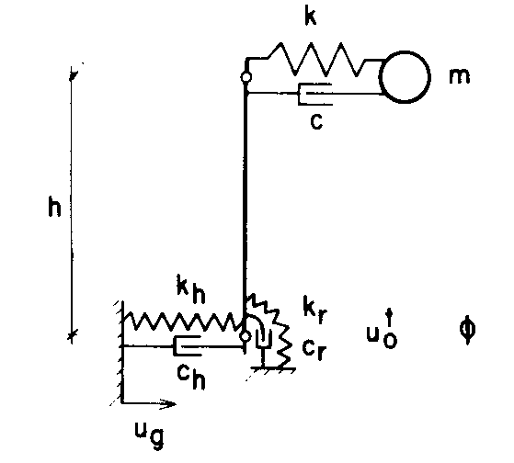
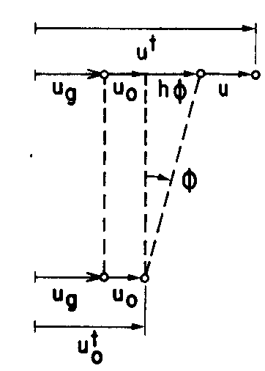
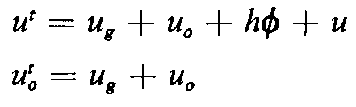
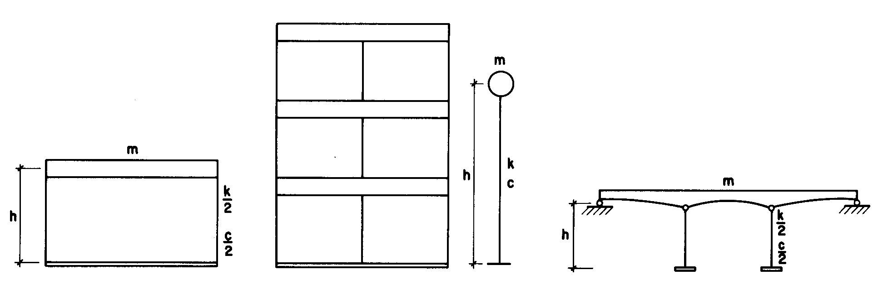
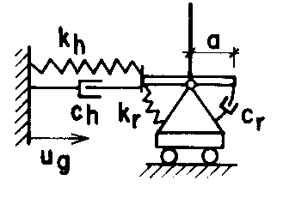
Statement of Problem
For a fixed-base structure:
Rigid bar

Slide 14

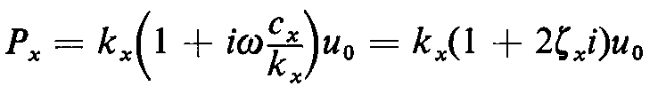



Statement of Problem
The horizontal force amplitude of the soil:
The moment amplitude of the soil:

Slide 15
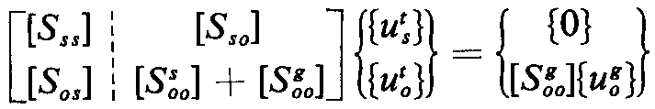
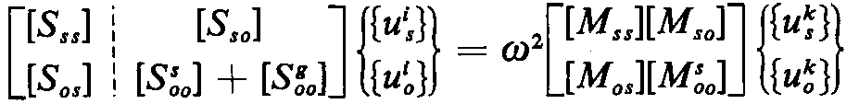
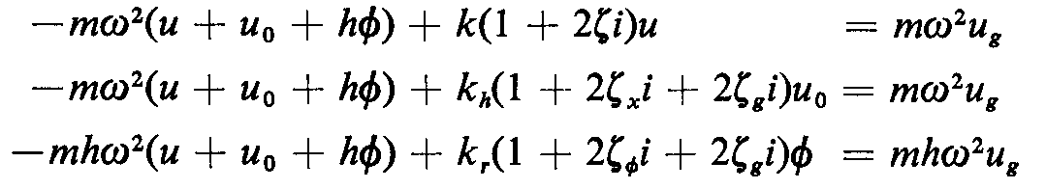
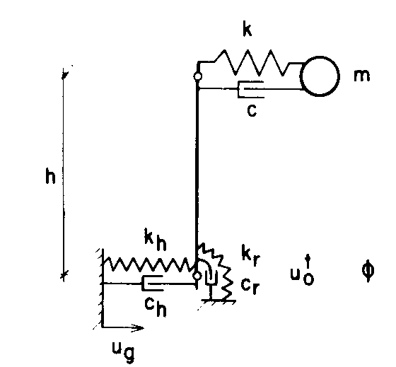
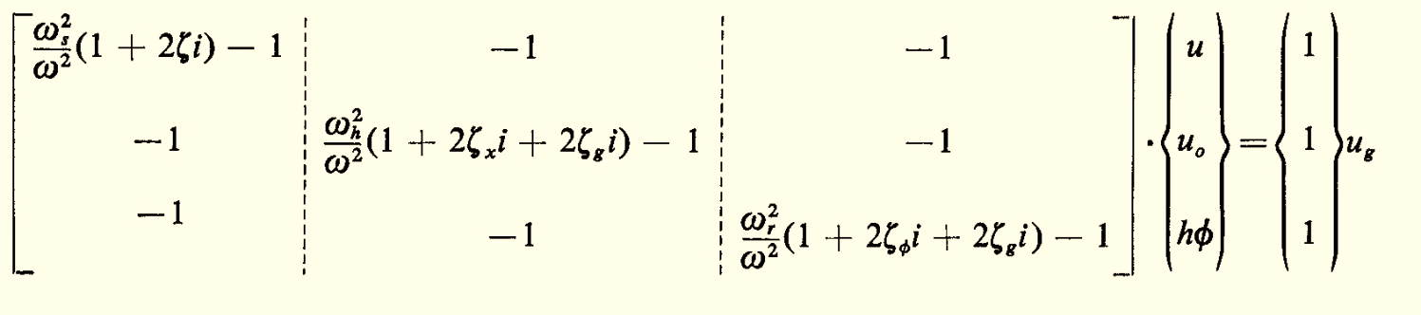
Equation of Motion
Rigid base;
(Dividing by mω^2)
(Dividing by mω^2)
(Dividing by h.mω^2)

Slide 16


Equation of Motion
Rigid base;

Slide 17











Equivalent SDOF system ( )
At natural frequency:
≤ωs

Slide 18



Effective parameters
Ratio of the stiffness of the structure to the soil;
The slenderness ratio;
The mass ratio;
Poisson’s ratio of the soil,
Hysteretic damping ratios of the structure and the soil.

Slide 19

Parametric study

Slide 20

Parametric study

Slide 21



Parametric study

Slide 22



Parametric study

